Slide 1
Unconfirmed Retirements
Forced Outage NSOs
Gap Analysis for CDR DG Reporting
GINR Projects with an Inactive Status
Supply Analysis Working Group
Pete Warnken
Manager, Resource Adequacy
September 27, 2019
Notes:
Welcome to

Slide 2
CDR Reporting of Unconfirmed Retirements

Slide 3
Updated Supplemental Tab Layout and Capacity Reporting Criteria
Changes:
  Edit to the note regarding ERCOT follow-up inquires
  List both Unconfirmed Retirements and associated replacement capacity (if identified) in the line item section
  Deleted Note 3 pertaining to replacement capacity

Slide 4
Treatment of Forced Outage NSOs

Slide 5
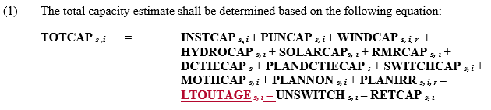

NPRR Options
ERCOT Legal Department recommends an NPRR to clarify how Forced Outages reported in NSOs should be handled if such information is to be included in the CDR
At least three possible options
  Option 1: Define a new capacity variable in Section 3.2.6.2.2

Slide 6

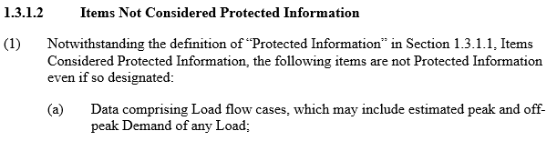

NPRR Options
  Option 2: Make Forced Outage NSOs an exception to Section 1.3.1.1, Items Considered Protected Information
  Option 3: Add NSOs to Section 1.3.1.2, Items Not Considered Protected Information
…

Slide 7
Gap Analysis for Reporting of DG in the CDR

Slide 8
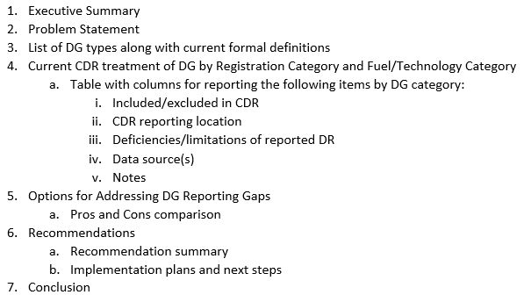
Gap Analysis Paper Outline

Slide 9
GINR Projects with an Inactive Status

Slide 10
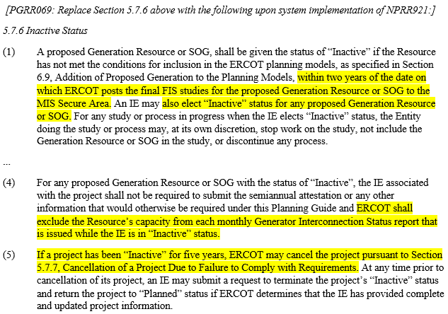
Planning Guide Section 5.7.6, Inactive Status (Gray boxed)

Slide 11
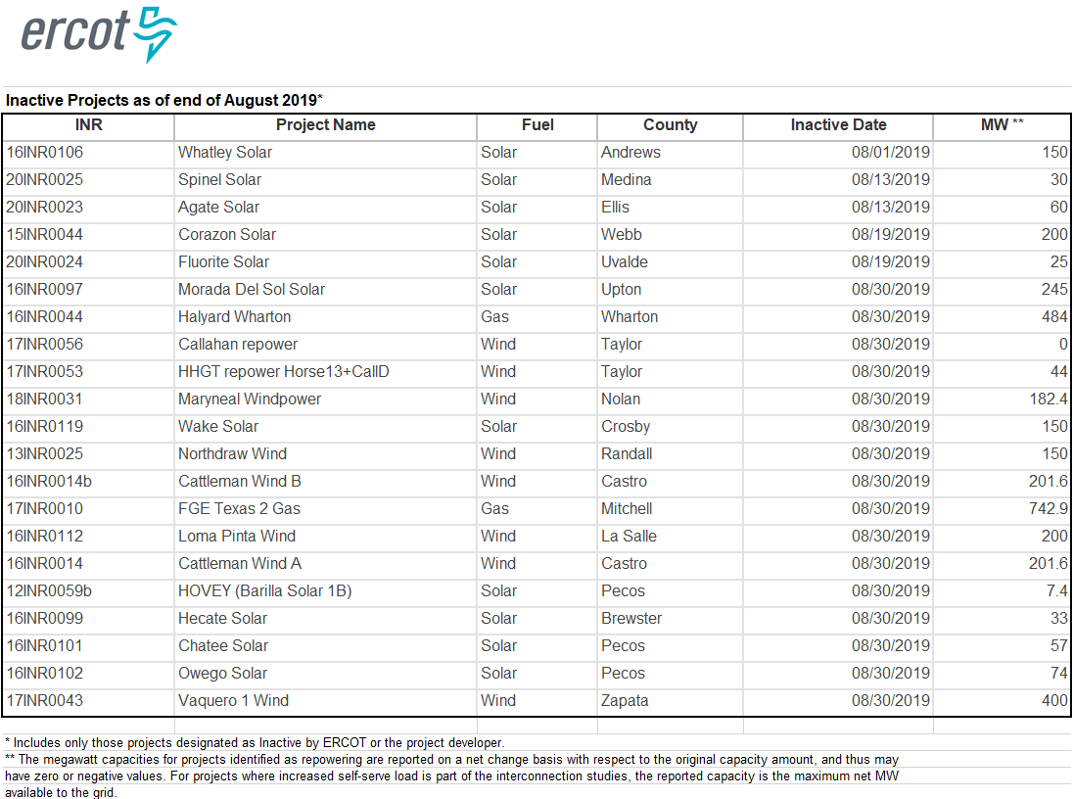
GIS Report “Inactive Status” Project List

Slide 12
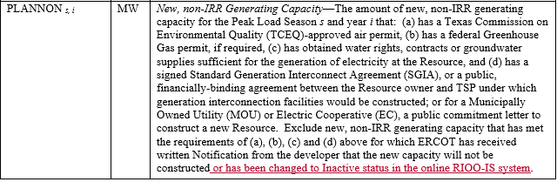
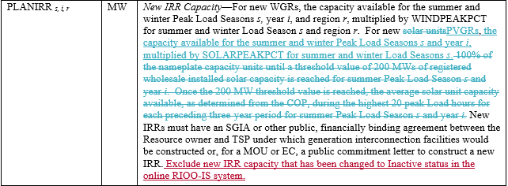
Treatment of Inactive Projects in the CDR
ERCOT will exclude inactive projects from Planning Reserve Margin calculations in the December CDR
Protocol Section 3.2.6.2.2 NPRR to update the PLANNON and PLANIRR variables?
Pending NPRR958 Language

