Slide 1
Pipeline Outage Questions
Craig Wolf
Planning Engineer
9/20/19

Slide 2
Purpose:
Who: The ERCOT Regional Transmission Planning team
What: Annual assessment of grid conditions over a 6 year horizon
Why: To evaluate the impact of gas pipeline outages on the grid
End Goal: Convert fuel supply contingencies to generator contingencies

Slide 3
Going Forward
ERCOT will use guidelines from the NERC EGWG to gather the necessary information
Generation Owners
Pipeline Operators
Fuel Suppliers
Possible Questions:
Gather appropriate fuel supply contingencies
Fuel supply response plans for disruptions

Slide 4
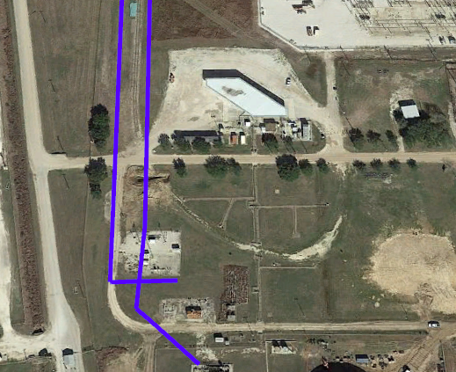
Q1: Redundancy
When generation substations are supplied by multiple pipelines/pipeline companies – does that mean:
They are fully redundant
The loss of one would result in deration of the unit
Case by case basis
Other

Slide 5
Q2: Existing Studies
Do pipeline companies perform studies to evaluate the effect of losing any single pipeline on the ability to supply their customers?

