Slide 1
Gas Electric Working Group
September 20, 2019
Alan H. Allgower
Operations Analyst, Senior
alan.allgower@ercot.com
512-248-4613 (o)

Slide 2
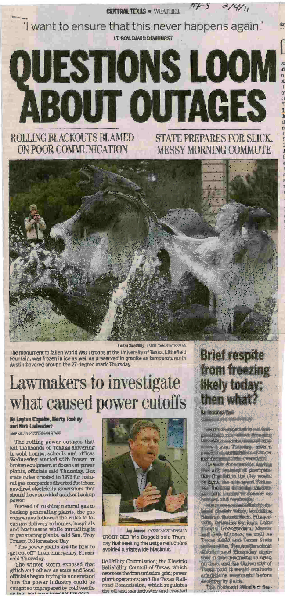
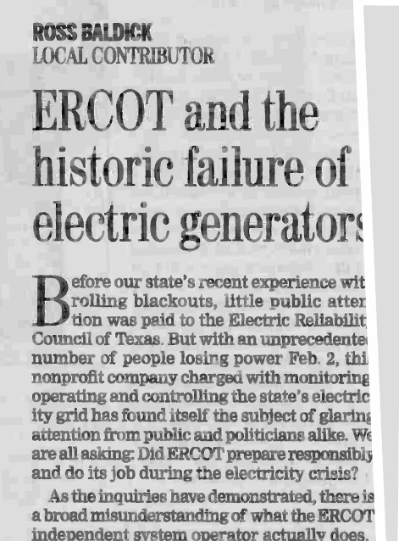
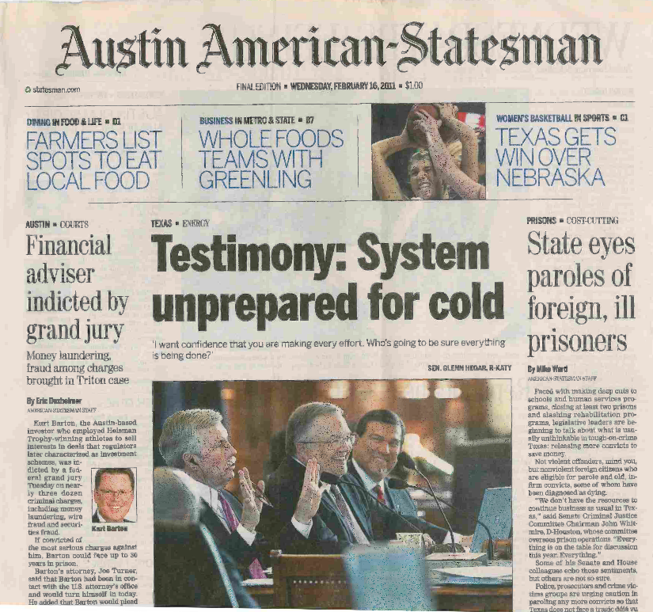
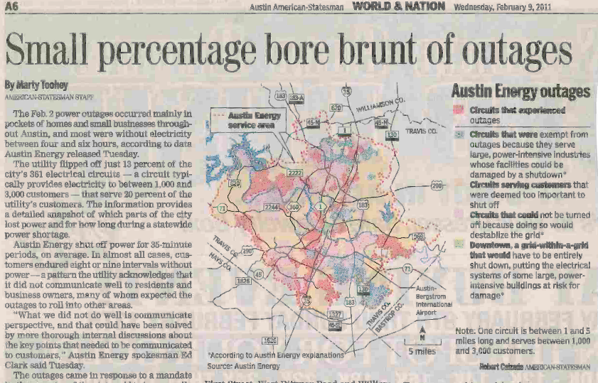
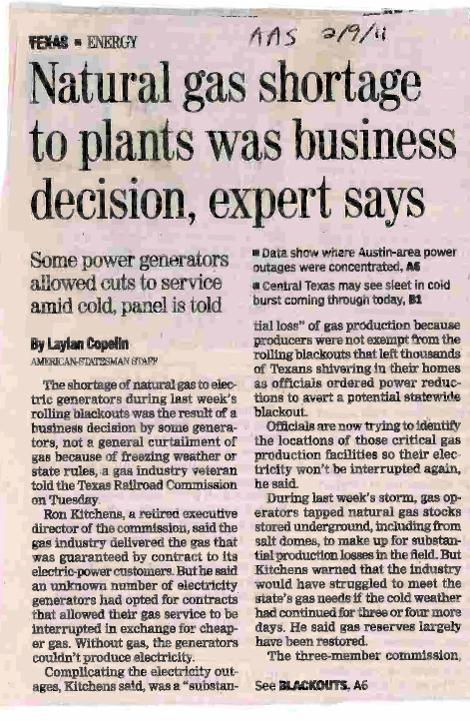
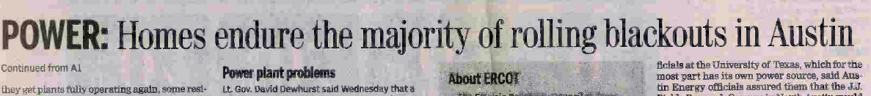
February 2011 Headlines….

Slide 3
PUCT Regulatory Requirements for Generator Preparedness
§25.53. Electric Service Emergency Operations Plans.
    (c)(1)(H) A plan for the inventory of pre-arranged supplies for emergencies.
    (c)(1)(I) A plan that addresses staffing during severe weather events.
    (c)(2)(A) A plan that addresses severely cold and severely hot weather.
    (c)(2)(B) A plan that addresses any known critical failure points, including any effects of weather design limits.
    (c)(2)(G) Checklists for generating facility personnel to address emergency events.
    (c)(2)(H) A summary of alternate fuel and storage capacity.
    (c)(2)(I) A plan for alternative fuel testing if the facility has the ability to utilize alternative fuels.
    (c)(2)(d) A Market entity shall conduct or participate in one or more drills annually to test its emergency procedures if its emergency procedures have not been implemented in response to an actual event within the last 12 months.

Slide 4
ERCOT Nodal Requirements
Nodal Protocol 3.20 (3)
  No earlier than November 1 and no later than December 1 of each year, each Resource Entity shall submit the declaration Section 22, Attachment K, Declaration of Completion of Generation Resource Weatherization Preparations, to ERCOT stating that, at the time of submission, each Generation Resource under the Resource Entity’s control has completed or will complete all weather preparations required by the weatherization plan for equipment critical to the reliable operation of the Generation Resource during the winter time period (December through February).
  If the work on the equipment that is critical to the reliable operation of the Generation Resource is not complete at the time of filing the declaration, the Resource Entity shall provide a list and schedule of remaining work to be completed.
Section 22, Attachment K, Declaration of Completion of Generation Resource Weatherization Preparations
“I hereby attest that all weatherization preparations for equipment critical to the reliable operation of each of the above-listed Generation Resources during the time period stated above are complete or will be completed, as required by the weatherization plan applicable to each Generation Resource.”

Slide 5
ERCOT’s role in preparing for winter
  Units spot checked (conventional gas, coal and lignite)
    The purpose of spot checks is to verify plant personnel are following their weatherization plan.
      PUCT requirements, lessons learned as far back to 2011 and best practices.
    As necessary, plant personnel are left with a recommendation(s) based on PUCT requirements, lessons learned or best practices.
    80 units on average are spot checked each winter.
    Company senior management is emailed results.
    ERCOT conducts an annual winter weatherization workshop.
      Lessons learned from generators.
      Best practices from generators.
      ERCOT Meteorologist preliminary winter outlook.
      ERCOT’s review of previous winter.
      Texas RE regulatory review/update.

Slide 6
Natural gas portion of ERCOT spot checks
  Preparations needed in gas yard prior to winter.
  Alternate gas supplies that can be used during curtailments.
  Communicating curtailments to ERCOT.
  Sensing lines for main gas supply regulators.
      Recently, we have had an instance of frozen instrument air to main gas supply regulator.

Slide 7
Common causes of transmitter manifolds and/or sensing lines freezing
  Tripped heat trace circuit breaker.
  Blown fuse in heat trace panel.
  Contractor error when terminating heat trace after testing.
  Insulating contractor damage to heat trace.
  Section of heat trace not functioning.
  Incorrect heat trace for application.
  Heat trace open ended and not grounded.
  Transmitter cabinet heater not functioning.
  Poor or lack of wind break measures.
  Transmitter(s) exposed to the elements.
  Gaps in insulation.

Slide 8
What have we learned since February 2011?
Identify critical components if frozen, will derate, trip or fail to start the unit and incorporate the measures to prevent from freezing into weatherization plan.
Heat trace failure rates in Texas on average are 10-15% from previous season.
Detailed testing of heat trace is necessary, identifying critical circuits. Repair at minimum, critical circuits.
Verify critical heat trace circuits are functioning prior to every extreme cold weather event.
Insulation inspections, focusing on critical components.
As an additional measure, install wind breaks and/or space heaters protecting critical components, focusing on the N and NE sides of unit. Avoid off the shelf tarps.

Slide 9
What have we learned since February 2011? (continued)
Review scope of contractor work and verify acceptable completion.
Verify instrument air dryers, dew point monitoring, blow downs are all operating correctly.
Conduct a refresher training drill in the fall with operators on extreme cold weather procedures.
Ensure critical transmitters are in a heated enclosure and inspect integrity of transmitter enclosures in the fall as part of weatherization plans.
Test critical components transmitter cabinet thermostat and heater as part of heat trace testing.
Weatherization plan portion of EOP should be updated annually as lessons are learned and sent to ERCOT at EOP@ercot.com.

Slide 10
EEA3
Normal
Operations
Normal
Operations
*2/2/2011 1/6/2014 1/8/2015 12/19/2016 1/7/2017 1/1/2018 *1/17/2018 3/3/2019 3/5/2019
Salmon colored reflects four coldest days in ERCOT in last eight years
*2/2/2011 and 1/17/2108 were the two coldest days this decade

Slide 11
Two coldest days and hours below 32DegF this decade
 | 2/2/2011 | Hours below 32DegF | 1/17/2018 | Hours below 32DegF
Dallas | 13°/20MPH | 24 | 13°/5MPH | 19
Houston | 21°/16MPH | 14 | 19°/13 MPH | 18
San Antonio | 19°/25MPH | 24 | 23°/10 MPH | 12
Austin | 18°/26 MPH | 24 | 18°/10 MPH | 20
Brownsville | 32°/26 MPH | 0 | 30°/14 MPH | 10
Abilene | 7°/16 MPH | 24 | 8°/5 MPH | 19
Midland | 6°/16 MPH | 24 | 28°/7 MPH | 10
Source: Chris Coleman, ERCOT

Slide 12
Closing comments……
Recent history has shown us that for every extreme cold weather event, a small amount of generation will experience freeze related derates or trips.
Overall, ERCOT was pleased with the performance of generators during this past winter.
For winter 2019/2020, spot checks will begin November 15, 2019 and will conclude February 28, 2020.

