Slide 1
SPP Operating Reserve Market Overview
Gary Cate
Manager, Market Design

Slide 2
Section header slide optional
Use this if you need to divide your presentation into sections

Slide 3
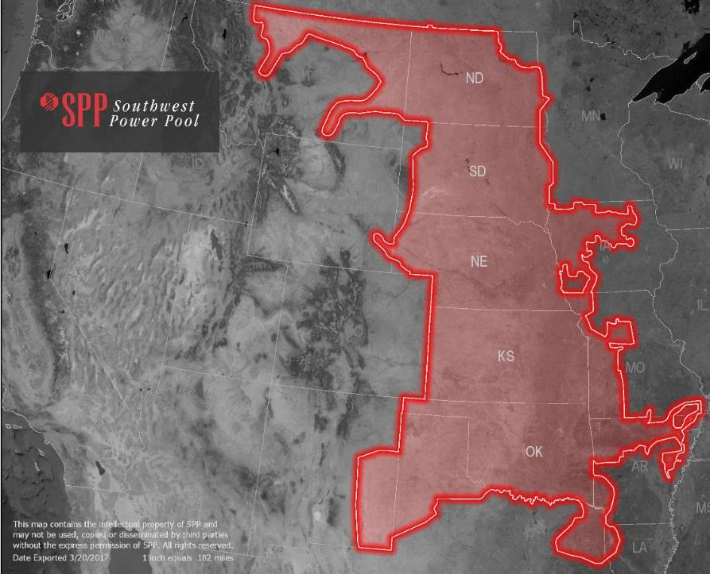
OPERATING REGION
Service territory: 546,000 square miles
Population served: 17.5 million
Generating plants: 818*
Substations: 5,054*
* In SPP’s reliability coordination footprint

Slide 4
2018 Energy Production by Fuel Type: 275,887 GWh total
Notes:
The energy consumption number represents the summed hourly average of the amount of energy used by retail customers in the market footprint.

Slide 5
MIN AND MAX PERCENT OF GENERATION MIX BY FUEL TYPE
Max
Min
June 2018 – June 2019

Slide 6
Market Facts
225 market participants
757 generating resources
2018 marketplace settlements = $20.5 billion
50,662 MW coincident peak load (8/19/19)
Winter peak: 43,584 MW (1/17/18)
16,972 MW Wind Peak (9/11/2019)
67.3% Wind Penetration Peak (4/27/2019)

Slide 7
SPP Integrated Marketplace overview
“Day-2” Market Implemented March 1, 2014
Replaced Energy Imbalance Service (EIS) Market launched in 2007
SPP consolidated all EIS member Balancing Authorities (BA) into one SPP BA
• Day-Ahead Market, Reliability Unit Commitment, Real-Time Balancing, and Transmission Congestion Rights (CRR’s in ERCOT)
Products: Energy, Regulation UP, Regulation DN, Spinning, Supplemental

Slide 8
SPP Integrated Marketplace Overview (Key Differences from ERCOT)
Day Ahead Must Offer
Must offer enough generation to cover Load and Operating Reserve (Regulation, Spinning and Supplemental) obligations
High Participation in Day Ahead Market
Average of 99% of Real Time Load bid into Day Ahead
Day Ahead Market Commitments are binding
Over 95% of all commitments come from Day Ahead
Non-instructed deviation from Day Ahead Commitment Plan allocated portions of Make Whole Payment
Less aggressive shortage pricing

Slide 9
SPP Operating Reserve Products
Regulation UP
Procured in both DA and RT
Resources cleared in DA may be different than resources in Real Time
Regulation Selection process occurs 30 minutes prior to top of hour
No virtual offers. Physical supply offers only.

Slide 10
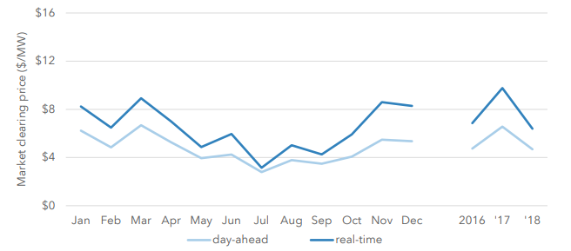
SPP Operating Reserve Products
Regulation DN
Procured in both DA and RT
Resources cleared in DA may be different than resources in Real Time
Regulation Selection process occurs 30 minutes prior to top of hour
No virtual offers. Physical supply offers only.

Slide 11
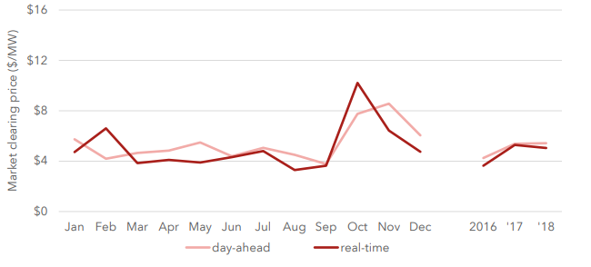
SPP Operating Reserve Products
Spinning Reserve
Procured in both DA and RT
Resources cleared in DA may be different than resources in Real Time
Covers trip of largest unit plus ½ of second largest unit
SPP typically employs a 50/50 split between Spinning and Supplemental
No virtual offers. Physical supply offers only.

Slide 12
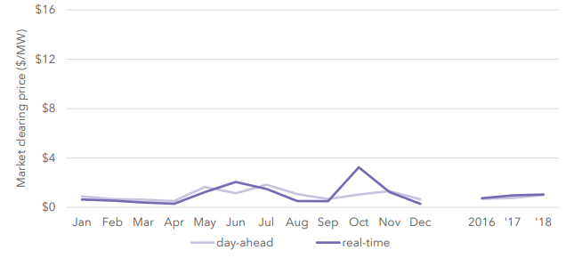
SPP Operating Reserve Products
Supplemental Reserve
Procured in both DA and RT
Resources cleared in DA may be different than resources in Real Time
Covers trip of largest unit plus ½ of second largest unit
SPP typically employs a 50/50 split between Spinning and Supplemental
Can be offline or online
No virtual offers. Physical supply offers only.

Slide 13
SPP Product Offer Caps (FERC Mandated)
SPP Operating reserve and product offer caps
SPP Scarcity Price Caps
(FERC Approved, not Mandated)
Regulation- $500
Contingency Reserves- $100
Energy- $1000 (absent FERC Order 831)
Regulation
$600
Contingency Reserve Cap + Regulation Offer Cap ($100+$500)
Operating Reserves
$1100
Energy Offer Cap + Contingency Reserve Offer Cap ($1000+$100)

Slide 14
Regulating Reserve Demand Curves
Regulation Base Demand Curve
C$ost to Commit =Cold Start Up Cost+$
$[ No Load + \int_{0}^{Eco Min}{Energy Offer \$}∗ Economic Minimum (MW)$ ] * Min Run Time
$Demand Curve Base=\frac{\text{C}ost to Commit}{Economic Min}$
Notes:
Base Curve calculated monthly. Regions are based on historical results.

Slide 15
Contingency Reserve Demand Curves
The regions specified for Contingency Reserve scarcity are based on the excess CR SPP carries relative to the largest resource contingency, as required by NERC
Currently SPP carries Contingency Reserves protecting the largest resource contingency and half of the second largest in SPP
The regions may be adjusted as system conditions change
Whenever the largest or next largest contingencies change
0.5 * Second Largest Gen Online (881MW)

Slide 16
Biggest Lesson Learned
Regulation Deliverability
SPP employs Reserve Zones to ensure deliverability of Reserves
SPP clearing engine does not account for the deployment of cleared reserves on Operating Constraints
Study is not granular enough to account for some real time system conditions
When system is congested, resources that have an adverse effect on a constraint are pushed downwards
This makes those resources prime candidates for clearing up Regulation UP
Deployment of that regulation then acerbates the loading on the Operating Constraints
SPP had to make system changes to address inequities associated with this process
Removed the buy back obligation for Resources that were manually removed from regulation by the SPP Operators

Slide 17
Integrated Marketplace Implementation
Official Start in 2011
Consolidated Balancing Authority, Congestion Rights Market, Day Ahead and Real Time Market, 5 minutes Settlements
Budget was approximately $100 Million
Approximately 2/3 of cost were Software and Systems
Additional costs for program management and support
Go-Live March 2014
Reached $1 billion in savings in late 2016

Slide 18
Integrated Marketplace Implementation
Official Start in 2011
Consolidated Balancing Authority, Congestion Rights Market, Day Ahead and Real Time Market, 5 minutes Settlements
Budget was approximately $100 Million
Approximately 2/3 of cost were Software and Systems
Additional costs for program management and support
Go-Live March 2014
Reached $1 billion in savings in late 2016
Reduced overall regulation requirement for SPP by 20%

Slide 19
Integrated Marketplace Implementation
Significant Stakeholder involvement
Bi-weekly meetings to design and write tariff and protocols
Co-optimization was one of primary goals
Most efficient way to clear
Provides opportunities for participants and savings for ratepayers

Slide 20
Integrated Marketplace Scope/Readiness/Go-lIVE Issues
Scope
Clearing Regulation Up and Regulation Dn as separate products initially created issues
Mainly from commitment perspective
Real Time market had less performance issues
Readiness
Understanding economics of clearing particular product becomes more difficult. Significant learning opportunities for participants and staff.
Go-Live
Previously discussed deliverability issues
Majority of our issues were from a commitment perspective and not really related to co-optimization

Slide 21
Tips/Tricks
Managing deliverability
Constraint impacts
Ramp Rate interaction
Ensuring appropriate ramp is available for all products
Ramp Sharing
Product Substitution
Ramping Capability Product

Slide 22
Questions?

Slide 23
Gary Cate
Manager, Market Design
Please feel free to contact me at gcate@spp.org

