Slide 1
Defaults/Uplifts – Summer 2019

Slide 2
ERCOT Default/Uplift
Axon Power
On August 30, 2019, Axon Power (Axon), a competitive Retail Electric Provider (REP) failed to make payment on a Settlement Invoice (which was issued on August 28, 2019). ERCOT had insufficient Financial Security for Axon to pay the invoice. This resulted in a short payment to the marketplace in an amount of $54,002.29. On September 3, 2019, ERCOT initiated the process to draw from available Financial Security provided by Axon to pay the invoice.
On September 4, 2019, ERCOT received funds for the outstanding Settlement invoice and issued refunds to QSEs and CRRAHs that were impacted by the short payment on September 3, 2019.
Sparcnet LLC
On September 6, 2019, Sparcnet LLC (Sparcnet), a Trader defaulted under its Standard Form Agreement (SFA) with ERCOT due to non-payment of collateral (which was due on September 5). In addition, ERCOT had insufficient Financial Security to pay Sparcnet’s outstanding Settlement Invoice which was due on September 11. As a result, the marketplace was short paid on September 12, 2019, in an amount of $104,850.68.
In accordance with Section 9.19, ERCOT will uplift $104,850.68 to the market no earlier than 180 days after the Sparcnet short payment.

Slide 3
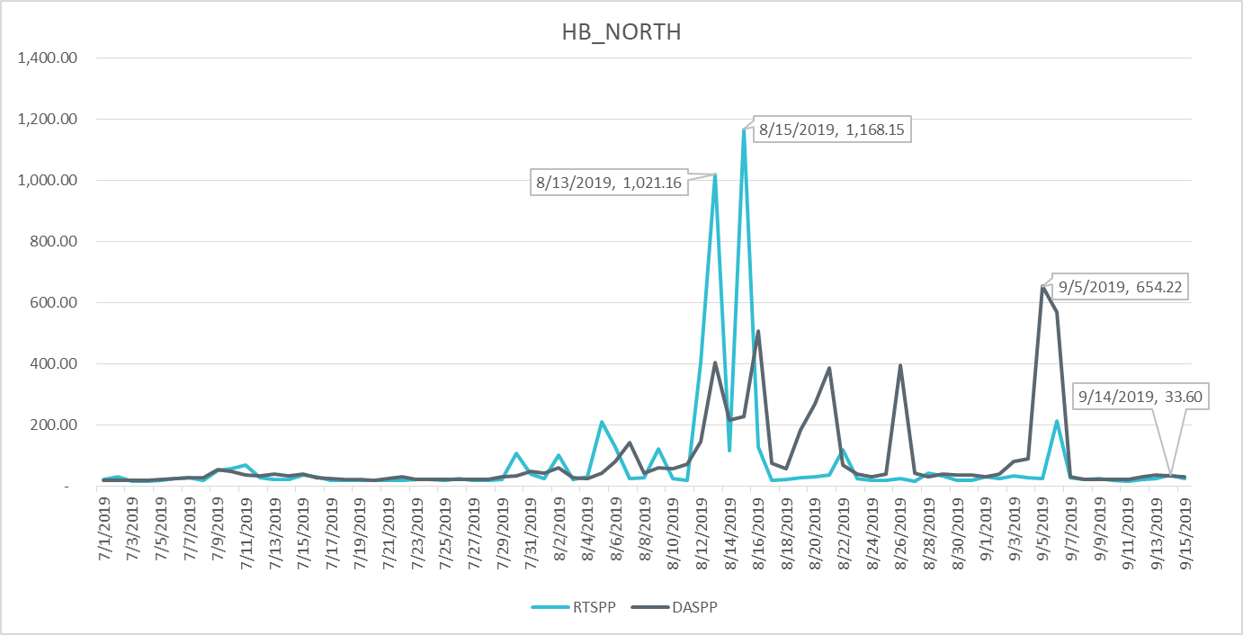
Real-Time and Day-Ahead Settlement Point Prices July 2019- September 2019

Slide 4
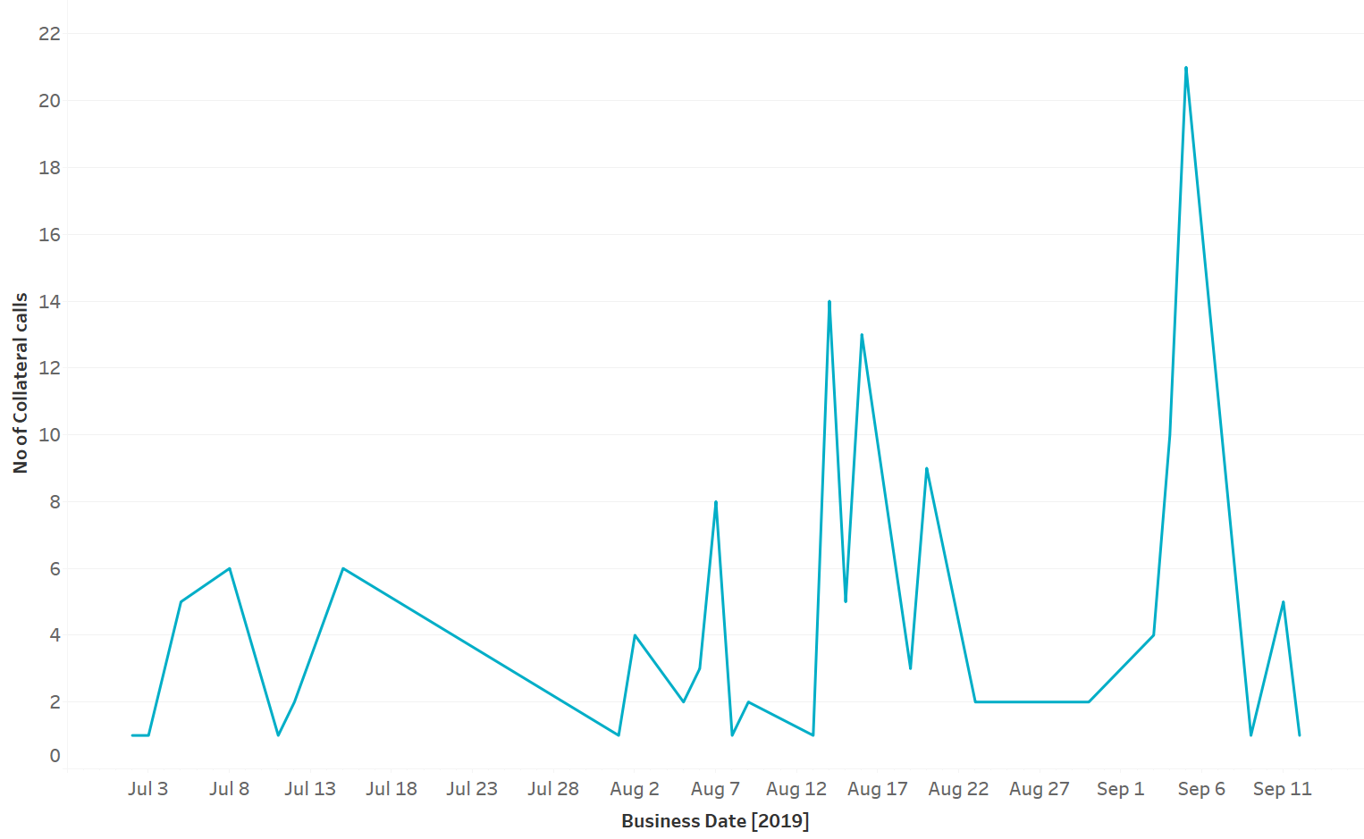
Collateral Calls July 2019- September 2019
Notes:
Collateral Calls
Relatively high collateral call activity in August 2019 compared to July 2019 due to an increase in ERCOT Real-Time settlement prices. However, the number of collateral calls in September increased significantly due to an increase in Forward Adjustment Factors.

