Slide 1
Credit Exposure Update
Spoorthy Papudesi
Credit Work Group
ERCOT Public
September 18, 2019

Slide 2
Monthly Highlights Jul 2019- Aug 2019
Market-wide average TPE increased from $495.01 million to $ 1,020.1 million
  The increase in TPE is due to relatively high ERCOT Real Time and Day Ahead prices during August 2019
Discretionary Collateral is defined as Secured Collateral in excess of TPE,CRR Locked ACL and DAM Exposure.
  Average Discretionary Collateral increased from $ 1,219.8 million to $1,730.5 million
  The increase in Discretionary Collateral is largely due to increase in Secured Collateral
  The increase in Secured Collateral more than offsets the increase in TPE and CRR Locked ACL
Number of active Counter-Parties increased from 238 to 241
Relatively high collateral call activity in August 2019 compared to July 2019

Slide 3
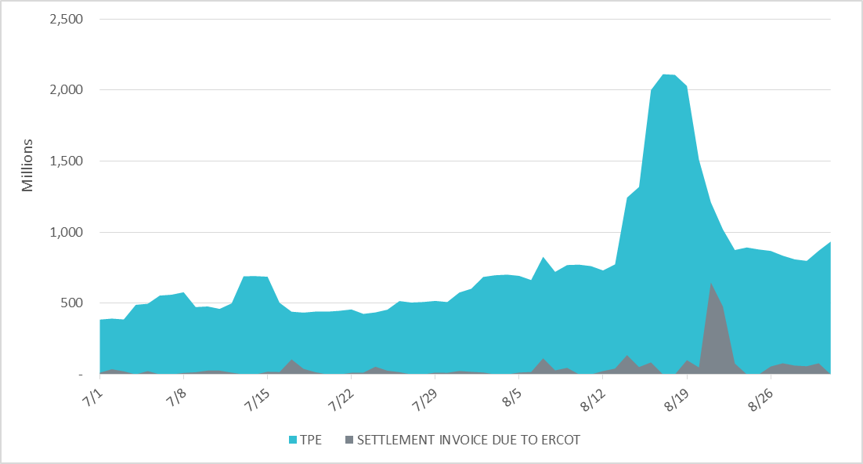
Settlement Invoice Charges/TPE Jul 2019- Aug 2019

Slide 4
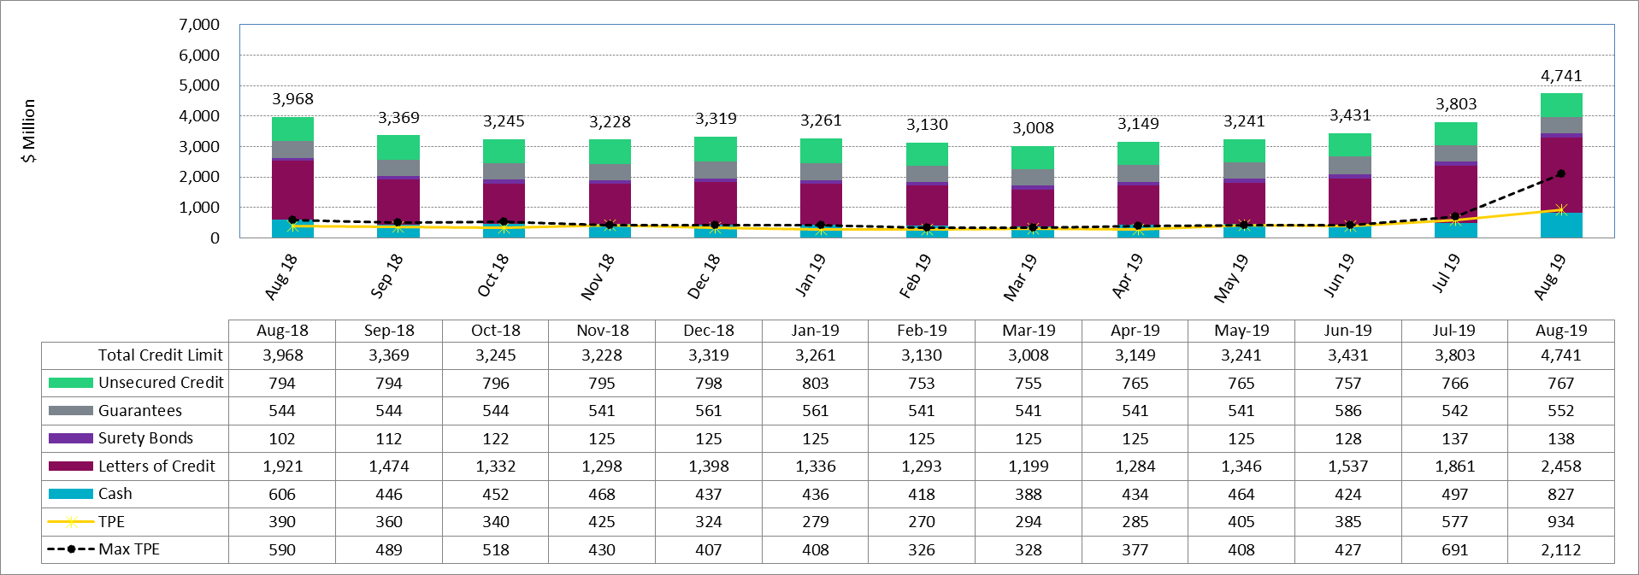
Available Credit by Type Compared to Total Potential Exposure (TPE)
*Numbers are as of month end except for Max TPE

Slide 5
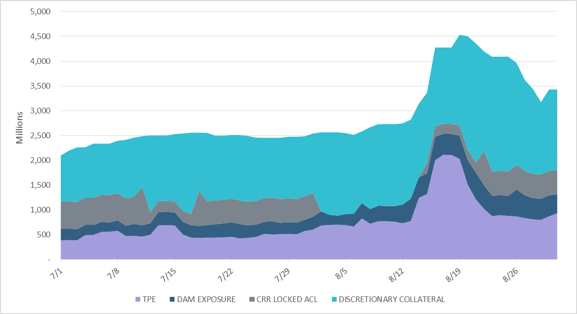
Discretionary Collateral Jul 2019- Aug 2019
At a Counter-Party level, no unusual changes were noted
Note: Discretionary collateral doesn’t include Unsecured Credit Limit or parent guarantees

Slide 6
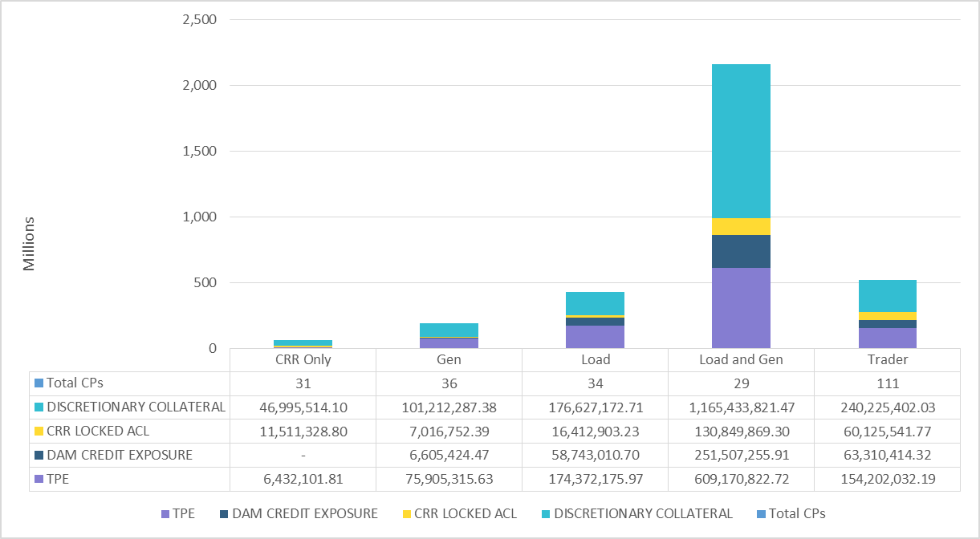
TPE and Discretionary Collateral by Market Segment- Aug 2019
Load and Generation entities accounted for the largest portion of discretionary collateral

Slide 7
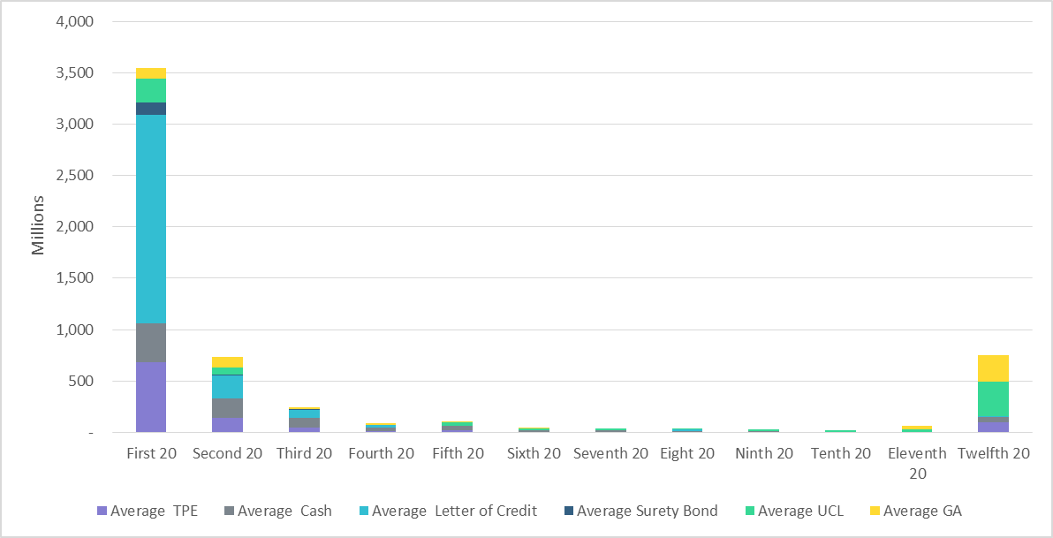
Secured Collateral and Unsecured Credit Limit (UCL) distribution/ TPE- Aug 2019
TPE in the last bucket is mostly covered by Guarantees and UCL

Slide 8
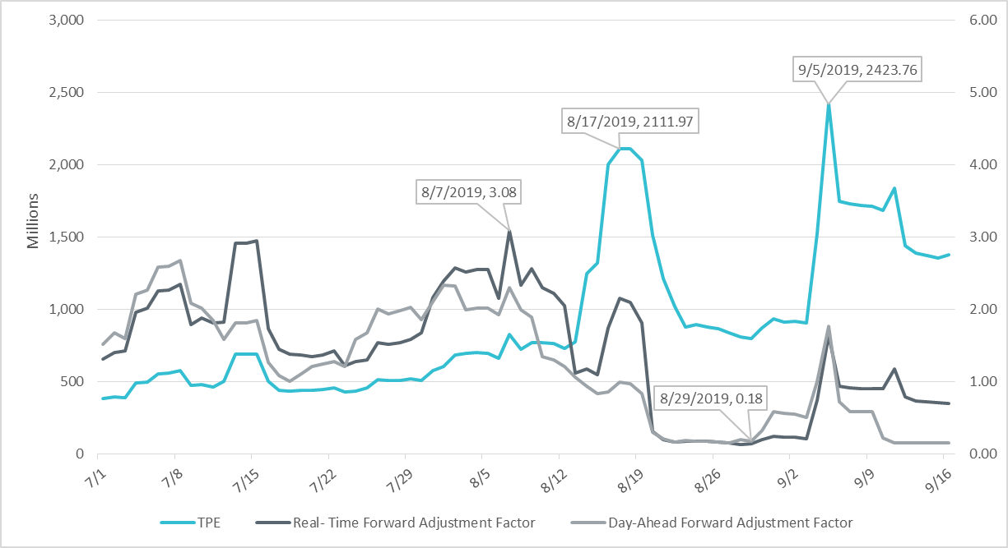
TPE and Forward Adjustment Factors Jul 2019- Sep 2019
TPE moved in conjunction with forward adjustment factors
The Real-Time (RFAF) and Day-Ahead (DFAF) forward adjustment factors capture the ratio of forward ERCOT North prices to actual prices.

Slide 9
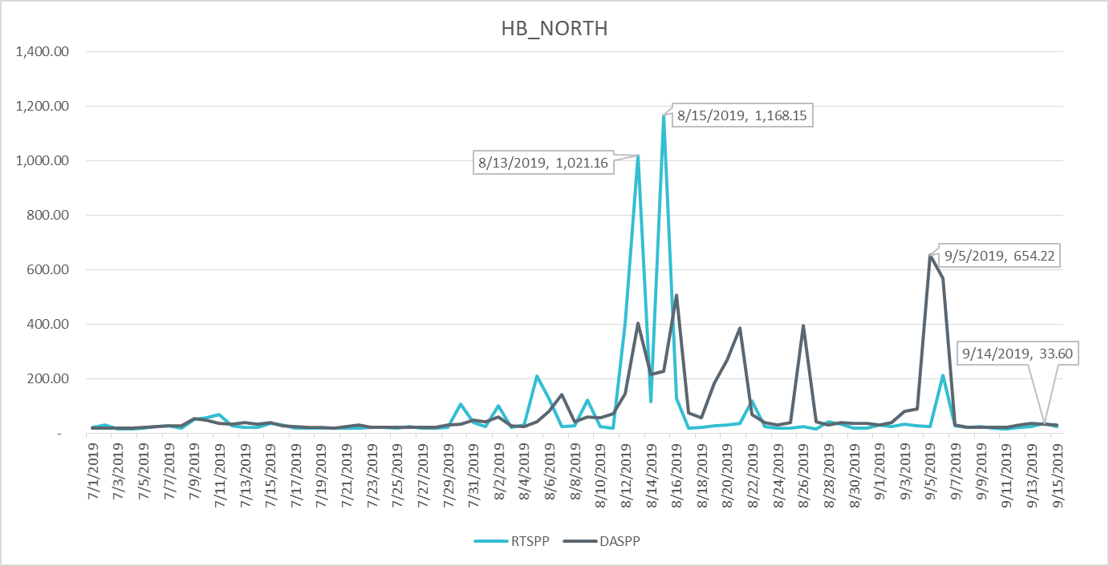
Real-Time and Day-Ahead Settlement Point Prices Jul 2019- Sep 2019

Slide 10
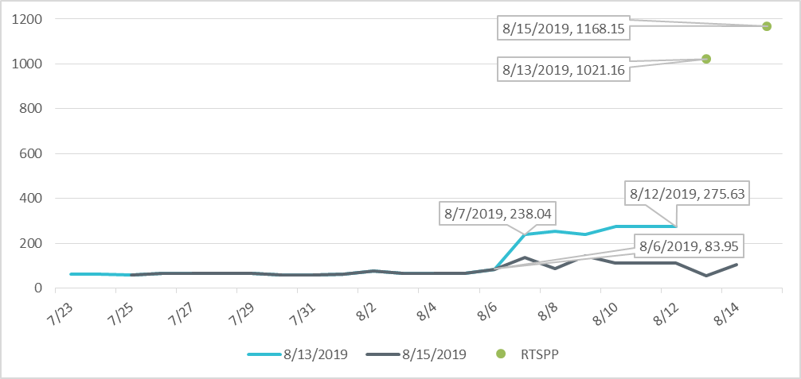
ICE vs ERCOT Real Time Prices for HB_NORTH

Slide 11
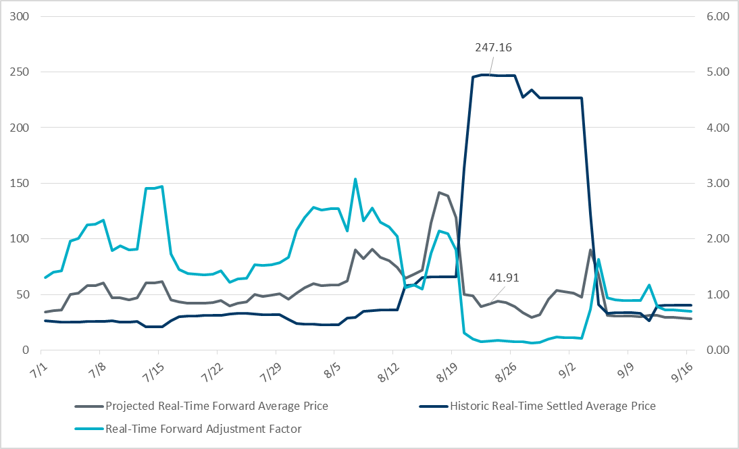
Real-Time Forward Adjustment Factor Jul 2019- Sep 2019

Slide 12
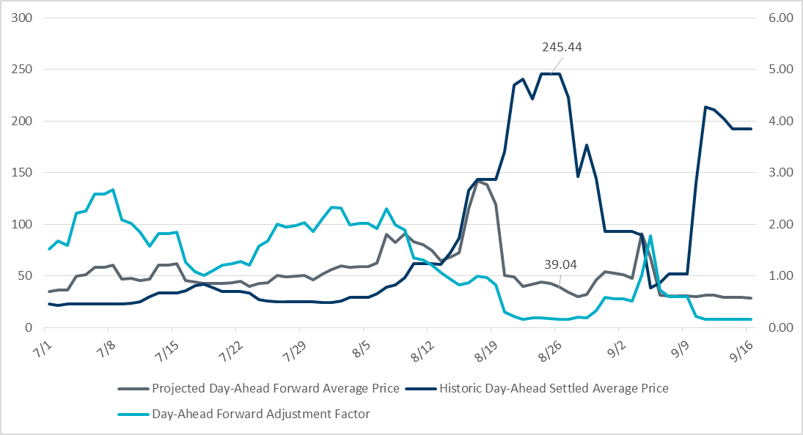
Day-Ahead Forward Adjustment Factor Jul 2019- Sep 2019

Slide 13
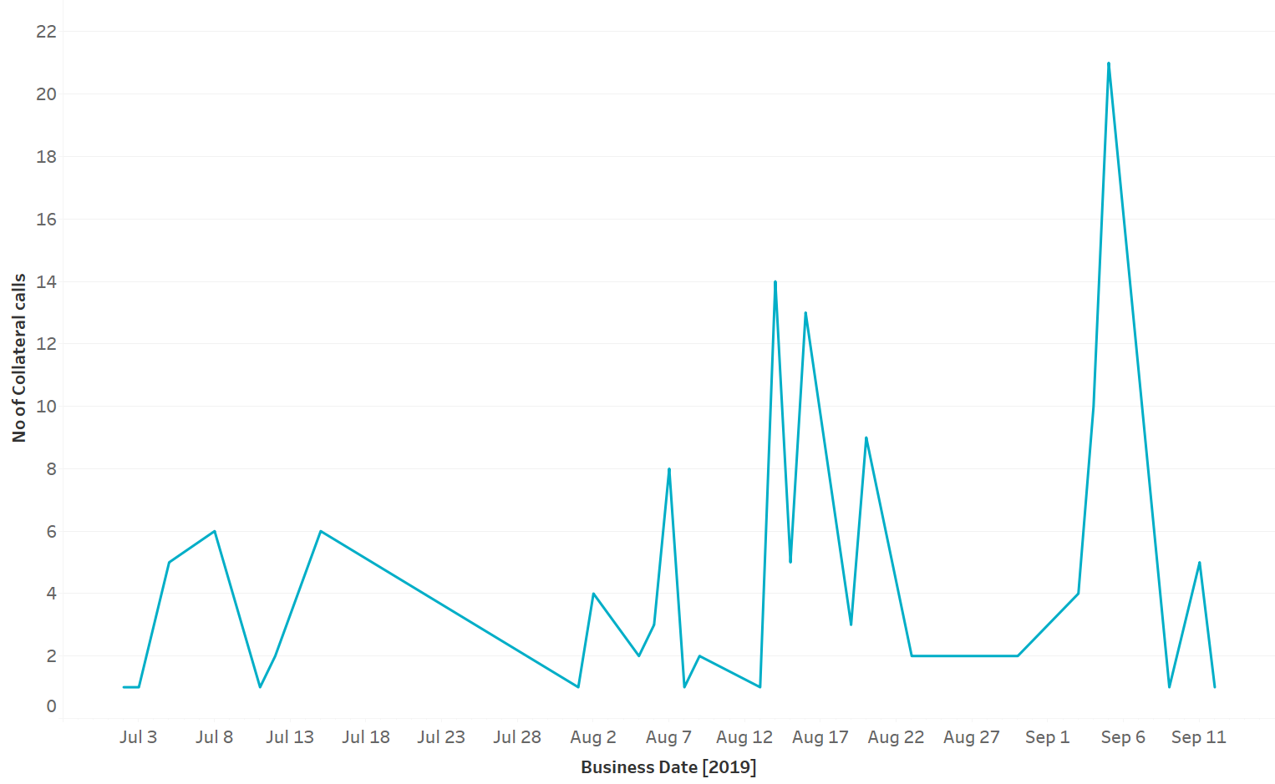
Collateral Calls Jul 2019- Sep 2019

Slide 14
Appendix

Slide 15
Summary of Distribution by Market Segment

Slide 16
Summary of Distribution by Rating Group

Slide 17
Distribution of TPE by Rating and Category

Slide 18
Distribution of Excess Collateral by Rating and Category
Note: Excess collateral doesn’t include Unsecured Credit Limit

Slide 19
Bottom Quintile Distribution of Excess Collateral by Rating and Category

Slide 20
Bottom Quintile Distribution of Average TPE by Rating and Category

Slide 21
Questions

