Slide 1
NPRR947 Issue and Solution
9/16/2019

Slide 2
NPRR947 issue
At the 7/22 WMWG meeting, ERCOT requested to table NPRR947 to solve an issue with how failed quantities are settled with the current language.
The current language provides an opportunity for a QSE to go “short” on its Ancillary Service Responsibility to capture the positive difference between the online ORDC+ Reliability price adders and DAM/SASM prices via the Ancillary Service Imbalance Payment.

Slide 3
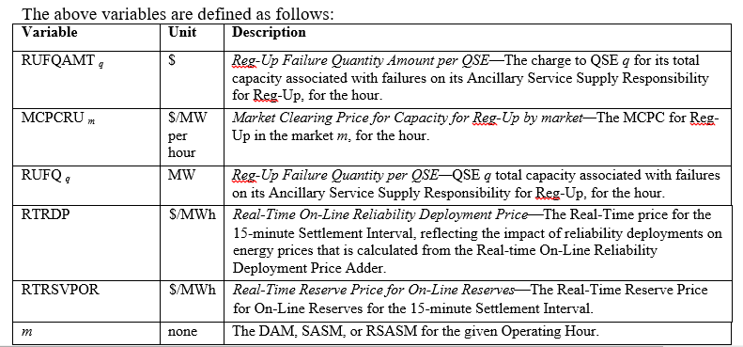
NPRR947 solution
To remedy this issue, ERCOT recommends that the Failed Quantity formulas be adjusted as below:

Slide 4
Appendix

Slide 5
Ancillary Service Supply Responsibility
4.4.7.4 Ancillary Service Supply Responsibility
Self Arranged +
Trades (QSE is seller) – Trades (QSE is buyer) +
RUC Award + DAM Award + SASM Award –
SASM Failed Quantity – Failed Quantity

Slide 6
Ancillary Service Failed Quantity
4.4.7.4 Ancillary Service Supply Responsibility
Self Arranged +
Trades (QSE is seller) – Trades (QSE is buyer) +
RUC Award + DAM Award + SASM Award –
SASM Failed Quantity – Failed Quantity
For a single AS type, when the hourly sum of AS for a QSE is less than the amount calculated above (per submitted COP), the QSE is considered “short” on their AS, and is evaluated for a failed quantity.

Slide 7
Ancillary Service Failed Quantity
6.4.9.1.3 Replacement of Ancillary Service Due to Failure to Provide
(1) ERCOT may procure Ancillary Services to replace those of a QSE that has failed on its Ancillary Services Supply Responsibility through a Supplemental Ancillary Services Market, as described below in Section 6.4.9.2, Supplemental Ancillary Services Market. A QSE is considered to have failed on its Ancillary Services Supply Responsibility when ERCOT determines, in its sole discretion, that some or all of the QSE’s Resource-specific Ancillary Service capacity will not be available in Real-Time. This Section does not apply to a failure to provide caused by events described in Section 6.4.9.1.2, Replacement of Infeasible Ancillary Service Due to Transmission Constraints.

Slide 8
Ancillary Service Failed Quantity
Per the Reliability Risk and Resource Desk Operating Procedures, the operator monitors future hours and determines if any QSEs show Ancillary Service shortage (compared to their obligation per 4.4.7.4) in their COPs
The operator will contact the QSE about the shortage
If the QSE cannot provide the AS, the operator will then discuss with the Shift Supervisor to determine if the AS shortage amount needs to be procured through a SASM (failed quantity logged and sent to Settlements)
Additionally, if the QSE cannot provide the AS, and it is determined that the failure amount is not significant enough to replace with a SASM, the operator can send the failed amount to Settlements to initiate claw-back of the AS payment

