Slide 1
RTC Task Force General Information
Matt Mereness
September 19, 2019

Slide 2
Antitrust Admonition
Antitrust Admonition
To avoid raising concerns about antitrust liability, participants in ERCOT activities should refrain from proposing any action or measure that would exceed ERCOT’s authority under federal or state law. For additional information, stakeholders should consult the Statement of Position on Antitrust Issues for Members of ERCOT Committees, Subcommittees, and Working Groups, which is posted on the ERCOT website.1
Disclaimer
All presentations and materials submitted by Market Participants or any other Entity to ERCOT staff for this meeting are received and posted with the acknowledgement that the information will be considered public in accordance with the ERCOT Websites Content Management Operating Procedure.
1 The document is available at http://www.ercot.com/about/governance/index.html .

Slide 3
Outline of RTCTF Update
RTCTF Meeting Schedule
TAC Update
Reminder of RTCTF Posting Locations
Today’s Plan for Discussion
Appendix
Stakeholder Process Summary
PUCT Direction on RTC Items

Slide 4
RTCTF Meeting Schedule
Schedule of future meetings for principles/scope of RTC:
Tuesday, April 30
Monday, May 13
Friday, June 7
Friday, June 21
Friday, July 12 (Taylor site)
Friday, Aug. 9
Tuesday, Aug. 27
Thursday, Sept. 19
Tuesday, Sept. 24 (special meeting for ISO Lessons Learned)
Wednesday, Oct. 9 (moved from Oct. 11 due to PUCT Summer Mtg)
Wednesday, Oct. 30
Tuesday, Nov. 19
Tuesday, Dec. 3 (half day after RMS)
Thursday, Dec. 19

Slide 5
TAC Update
TAC email vote on Friday August 30, 2019 was unanimously in favor:
TAC vote to endorse the RTC Key Principles below for purposes of informing the Board.
Key Principle 1.4 Subsection 2(a)-(d) System Inputs into RTC
Key Principle 1.5 Subsections 7-13: Deploying AS
Key Principle 3 Subsections 10-12: Reliability Unit Commitment

Slide 6
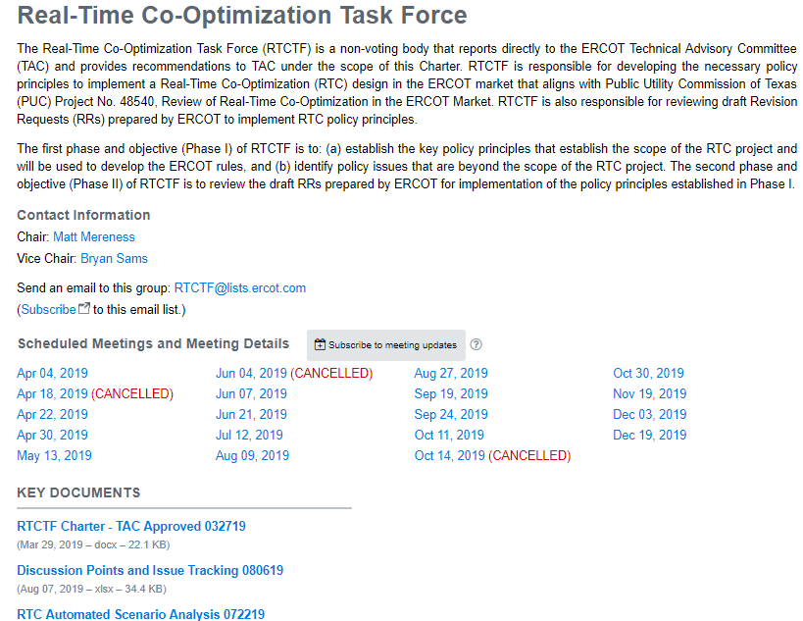
Reminder of RTCTF Posting Locations
RTCTF Home Page
RTCTF Charter
Meeting Calendar
Principle Tracking Schedule
RTC Scenario/Clearing Tool
http://www.ercot.com/committee/rtctf
RTCTF Calendar Pages
Current/new materials posted on RTCTF meeting pages
ERCOT.com/ MarketRules, PUCT Directive/RTC Page All historical materials posted
http://www.ercot.com/mktrules/puctDirectives/rtCoOptimization

Slide 7
Today’s Plan for Key Principles (KP)
KP1.1 - Curve Disaggregation into Individual ASDC (3rd/final iteration)
Input from NRG, Luminant, Siddiqi
KP1.2 - KP1.2 - Capping of MCPCs (2nd iteration)
Input from Luminant and Siddiqi
KP 1.3 - RTC Constraints (2nd iteration or later, depending on topic)
Multiple topics within discussion; including AS Re-procurement, Combined Cycle expectations, STEC Hydro issue, Infeasible AS, AS Offer structure and proxies.
Input from TCPA/LCRA, Siddiqi, Trefny
KP 5 - Day-Ahead Market (2nd iteration)
Input from Morgan Stanley
KP 2- Definition of AS Products to align RTC Framework (1st iteration)
ERCOT proposal
Any questions or concerns?

Slide 8
Appendix
Stakeholder Process Summary
PUCT Direction on RTC Items

Slide 9
RTCTF Review Process
Internal ERCOT Draft Principles and Principle Concepts (elements)
ERCOT presents concepts for meeting in presentation format
ERCOT takes feedback and posts in 2 days as initial document for MP edits
ERCOT posts all MP feedback and responds to MP redlines, concerns, alternatives
ERCOT provides responses to finalize supporting principle concept
Meeting #1 Meeting #2 Meeting #3
MPs share initial feedback, concern, request for additional information
MPs submit feedback as edits to document and any
- Concerns
Alternatives
MPs must document concerns and alternative approach prior to meeting and be prepared to discuss
Take consensus and non-consensus items to TAC for vote

Slide 10
TAC Review Process
TAC is the stakeholder body to vote on Design Principles.
RTC Key Principles are non-binding and will not go directly to the Board after TAC consideration.
Procedures set forth in Protocol Section 21 do not apply to discussions, opinions or approvals by TAC with respect to RTC Key Principles.
Section VIII of the ERCOT Board Policies and Procedures does not apply to discussions, opinions or unofficial approvals by TAC with respect to RTC Key Principles.
After TAC endorsement of all RTC Key Principles, ERCOT will compile the RTC Key Principles into a single package, and submit it to TAC for a courtesy review prior to Board review. The package will contain a full record of TAC votes.
Following TAC review of the complete RTC Key Principles package, ERCOT will submit it to the Board for discussion and consideration.
Any stakeholder opposed to an RTC Key Principle may, at this time, request Board consideration in accordance with Section VIII of the ERCOT Board Policies and Procedures.

Slide 11
PUCT Direction on RTC Design Items
Key updates PUCT Project No. 48540
June 26, 2019 Chair Memo: http://interchange.puc.texas.gov/Search/Documents?controlNumber=48540&itemNumber=60
June 27, 2019 PUCT Open Meeting: http://www.adminmonitor.com/tx/puct/open_meeting/20190627/
July 17, 2019 ERCOT Letter on RTC Timeline: http://interchange.puc.texas.gov/Search/Documents?controlNumber=48540&itemNumber=62
July 18, 2010 PUCT Open Meeting: http://www.adminmonitor.com/tx/puct/open_meeting/20190718/
Ancillary Services Demand Curves – Curves should follow current Operating Reserve Demand Curve (ORDC) parameters.
System-wide Offer Cap (SWCAP) and Power Balance Penalty Curve (PBPC) – Set SWCAP $2,000 per MWh, Max ASDC $9,000 per MWh, VOLL $9,000 per MWh. Prices capped at $9,000 per MWh exclusive of congestion costs. LCAP will apply if necessary.
Ancillary Service Offers – Creation of Proxy AS Offers if qualified and available but not offered.
Suite of Ancillary Service Products – All Ancillary Service products finalized with the approval of NPRR863.
Day-Ahead Market – The Commission did not want to add DAM enhancements to the RTC Project that would jeopardize the RTC delivery timeline.

