Slide 1
Analysis of MOCs from Proposed Method
WMWG
September 16, 2019
Market Analysis

Slide 2
Introduction
This study is based on the recently-presented draft NPRR for RUC EOC to Reflect Commitment Cost
The draft NPRR is posted at http://www.ercot.com/calendar/2019/8/19/169169-WMWG
The stated intent of the draft NPRR is to update the Mitigated offer cap (MOC) used in SCED for RUC committed resources to
include the commitment cost amortized over the commitment duration
ensure that, when the RUC resources are mitigated for resolving congestion, the locational prices reflect the real cost of resolving constraint

Slide 3
Draft Method for MOC Calculation
Draft NPRR 4.4.9.4.1 (d)
For each RUC-committed Resource which is not a QSGR, ERCOT shall change the MOC of the of RUC-committed Resource to be used in SCED to greater of (i) and (ii) below for all hour which are not RUC Buy-Back Hours. For (ii) below, Resource Category Generic Cold Startup Cost and Minimum-Energy Cost will be used for resources with no available RUC cost.
(i) 25 multiplied by FIP
(ii) MOC per paragraph (1) above plus
(a) Startup Cost used in RUC for the RUC commitment block divided by the product of LSL and number of hours in the RUC commitment block and
(b) Maximum of zero and the difference between Minimum- Energy Cost used in RUC and MOC per paragraph (1) at the Midpoint of the curve divided by Capacity Factor Multiplier

Slide 4
New MOC Calculation
$${\text{MOC}}_{\text{New}} =\max\left(i, ii\right)$$
$$i=25∗FIP$$
$$ii={\text{MOC}}_{\text{Origin}}+ a+b$$
$$a=\frac{Startup Cost}{LSL∗ {\text{Hour}}_{\text{RUC}\text{_}\text{Block}}}$$
$$b=max⁡(0, \frac{Minimum Energy Cost−{\text{MOC}}_{\text{Midpoint}}}{Capacity Factor Multiplier} )$$

Slide 5
Study
Analyzed 138 RUC-committed blocks from 06/01/2017 to 08/31/2019
Calculated a new midpoint MOC value using the proposed methodology and compared it with the maximum price in the MOC used in the original RUC commitment
The study included RUC instructions that were subsequently opted out of as well as those that were not

Slide 6
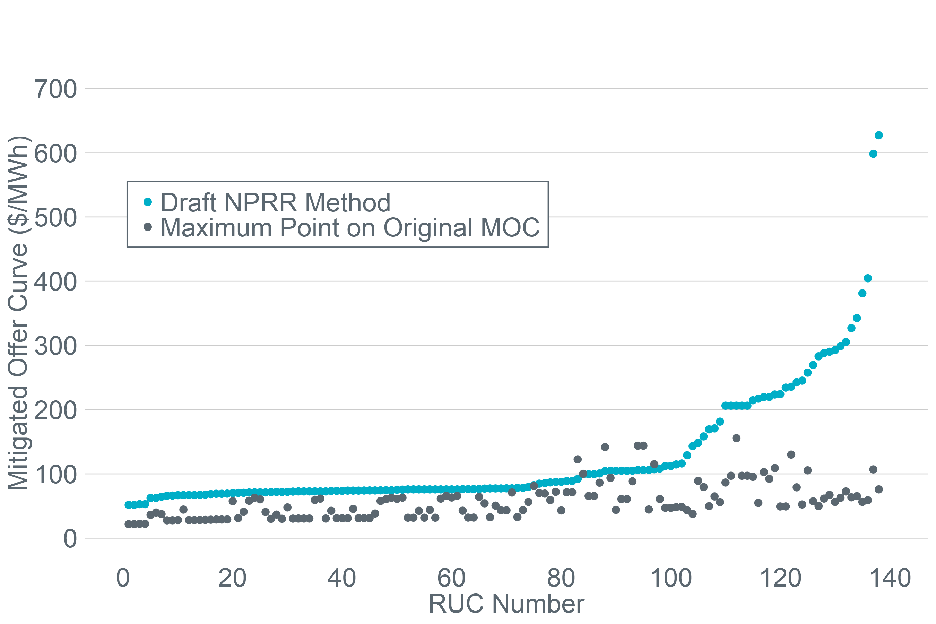
Study Results

Slide 7
Conclusion
Some of the MOCs from the proposed method would create offers that could not be dispatched on active constraints and could affect the ability of the Resource to get dispatched to help manage the constraint for which the Resource was committed through a RUC.
We propose two options for ceiling offers to address this limitation:
Establish a static ceiling value based on a shift factor * maximum shadow price criterion. This method would need to be more conservative but would be easier to implement.
Calculate a ceiling between step 1 and step 2 of each SCED run based on the active constraints (similar to NPRR826). This method could be less conservative and but would be more complex to implement.

