Slide 1
Alternative Proposals for AS Proxy Offers
TCPA & LCRA

Slide 2
Alternative Proposals for AS Proxy Offers
Proxy AS Price Floor Proposals
“L Factor” Proposal
Goal: To allow AS capacity to be available to ERCOT without distorting market prices. A resource that is not actively participating in the AS market should not be assigned an offer that undercuts a competitive offer.

Slide 3
Proxy AS Price Floor Proposals

Slide 4
Proposed Floor Prices:
SWOC
Use DAM Clearing price for corresponding hour
Determine Cost differential between HSL and LSL (Average HR decreases at lower MW output)
Use the highest offer of the resource that submitted and cleared for that service in DAM as the proxy
Base on highest observed real-time AS offers just prior to SCED run to place at the “back of the line”
Evaluate and determine fixed values periodically based on observed historical AS offers (and/or other factors)
For LDRs: Proxy opportunity cost based on RTD Indicative LMPs

Slide 5
“L Factor” Concept

Slide 6
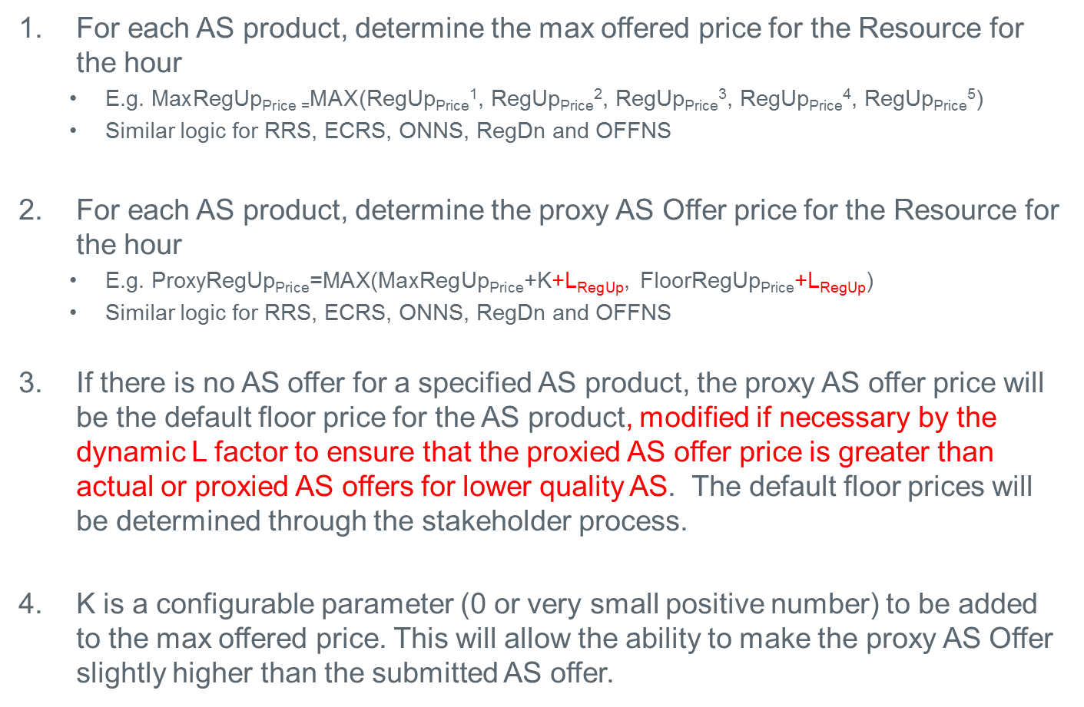
Determine Proxy AS Offer Prices
For each AS product, determine the max offered price for the Resource for the hour
E.g. $\text{Max}\text{RegUp}\text{Price}\text{ =}\text{MAX}$(RegUp_{Price}¹, RegUp_{Price}², RegUp_{Price}³, RegUp_{Price}⁴, RegUp_{Price}⁵)
Similar logic for RRS, ECRS, ONNS, RegDn and OFFNS
For each AS product, determine the proxy AS Offer price for the Resource for the hour
E.g. Proxy$\text{RegUp}\text{Price}$=MAX($\text{Max}\text{RegUp}\text{Price}$+K+L_{RegUp}, $\text{Floor}\text{RegUp}\text{Price}$+L_{RegUp})
Similar logic for RRS, ECRS, ONNS, RegDn and OFFNS
If there is no AS offer for a specified AS product, the proxy AS offer price will be the default floor price for the AS product, modified if necessary by the dynamic L factor to ensure that the proxied AS offer price is greater than actual or proxied AS offers for lower quality AS. The default floor prices will be determined through the stakeholder process.
K is a configurable parameter (0 or very small positive number) to be added to the max offered price. This will allow the ability to make the proxy AS Offer slightly higher than the submitted AS offer.

Slide 7
Example 1: Online Upward AS Offers for All AS Products
Example illustrates extension of On-Line upward AS Offers for a Resource with 100 MW HSL and only 20 MW of AS Offers submitted
In this example, L for each AS would be $0 because AS offer prices already increase monotonically with AS quality
AS Offer MW | RegUp Price ($/MW/h) | RRS Price ($/MW/h) | ECRS Price ($/MW/h) | Non-Spin Price ($/MW/h)
20 | 15 | 10 | 5 | 1
100 | 15 + K + L_{RegUp} | 10 + K + L_{RRS} | 5 + K + L_{ECRS} | 1 + K + L_{NSRS}

Slide 8
Example 2: Online Upward AS Offers for Some AS Products
Example illustrates creation of proxy On-Line upward AS Offers for a Resource with 100 MW HSL and only 20 MW of offer for RegUp submitted
In this example, L_{RegUp} would presumably be $0, unless one of the other AS floor prices were equal to $15 + K; L_{RRS} and L_{ECRS} would be >$0, however, to ensure that the proxy offer for RRS is greater than the proxy offer for ECRS, which is in turn greater than the proxy offer for NSRS.
L_{NSRS} would presumably be $0 unless there was some lesser AS quality in the offer matrix behind it.
AS Offer MW | RegUp Price ($/MW/h) | RRS Price ($/MW/h) | ECRS Price ($/MW/h) | Non-Spin Price ($/MW/h)
20 | 15
100 | 15 + K + L_{RegUp} | FloorRRS_{price} + L_{RRS} | FloorECRS_{price} + L_{ECRS} | FloorONNS_{price} + L_{NSRS}

Slide 9
Example 3: Multi-Segment Online Upward AS Offers
Example illustrates creation of proxy On-Line upward AS Offers for a Resource with 100 MW HSL and 3 segments submitted
In this example, L_{RegUp} would again presumably be $0; L_{RRS} would be >$0, however, to ensure that the proxy offer for RRS is greater than the proxy offer for ECRS. L_{ECRS} would presumably be $0, unless FloorONNS_{price} = $16 + K.
L_{NSRS} would again presumably be $0 unless there was some lesser AS quality in the offer matrix behind it.
AS Offer MW (up to 5 per Resource) | RegUp Price ($/MW/h) | RRS Price ($/MW/h) | ECRS Price ($/MW/h) | On-Line Non-Spin Price ($/MW/h)
20 | 22 | 16 | 15
30 | 23
10 | 21 |  | 16
100 | 23 + K + L_{RegUp} | 16 + K + L_{RRS} | 16 + K + L_{ECRS} | FloorONNS_{price} + L_{NSRS}

Slide 10
Example 4: No Online Upward AS Offers
Example illustrates creation of proxy On-Line upward AS Offers for a Resource with 100 MW HSL and no AS Offers submitted
In this example, L_{RegUp}, L_{RRS}, and L_{ECRS} would be >$0 to ensure that the proxy offer for RegUp is greater than the proxy offer for RRS, which in turn is greater than the proxy offer for ECRS, which again in turn is greater than the proxy offer for NSRS. → RegUp_{proxy} > RRS_{proxy} > ECRS_{proxy} > NSRS_{proxy}
L_{NSRS} would again presumably be $0 unless there was some lesser AS quality in the offer matrix behind it.
AS Offer MW | RegUp Price ($/MW/h) | RRS Price ($/MW/h) | ECRS Price ($/MW/h) | Non-Spin Price ($/MW/h)
100 | FloorRegUp_{price} + L_{RegUp} | FloorRRS_{price} + L_{RRS} | FloorECRS_{price} + L_{ECRS} | FloorONNS_{price} + L_{NSRS}

