Slide 1
2020 LTSA Update
September, 2019
RPG Meeting
Notes:
Welcome to

Slide 2
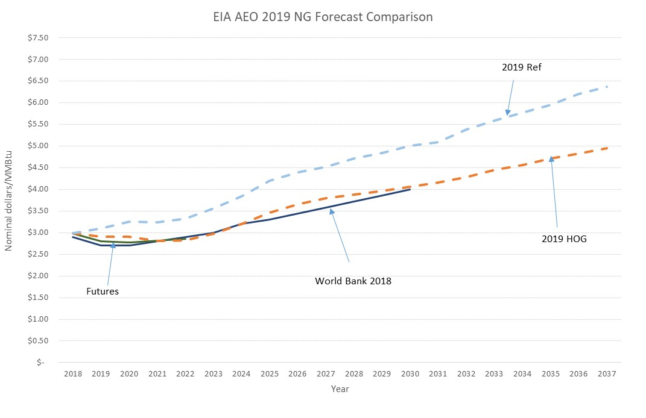
Natural Gas Price Assumptions Change
Based on stakeholder feedback, the natural gas price from 2019 EIA AEO Reference case is used in Current Trends scenario

Slide 3
Other Changes Based on Stakeholder Feedback
Lowered current wind capital cost from $1,350/kW to $1,200/kW
Updated PRD to be 1,969 MW based on 2019 analysis
Input hourly AS prices for every month based on average market AS prices of 2016-2018
Added the following fixed-aged retirement assumptions:
Natural gas unit: 60 years old (~11 GW by 2035)
Coal unit: 45 years old (~10 GW by 2035)
Took Oklaunion and two Decker units offline

Slide 4
Updated Results for Current Trends
Reserve margin in final year: 9%
Built 27,250 MW gas generation
Built 21,300 MW solar
Built 32,500 MW wind
Unserved energy in years 2030 through 2035. Shortages concentrated in 3-8 PM in 2030 and in 7-9 PM in 2035 in summer months with maximum magnitude over 9,000 MW

Slide 5
2020 LTSA Process
Current Trends Preliminary Capacity Expansion
Gather Stakeholder Feedback
Finalize Current Trends Capacity Expansion
Develop Current Trends Transmission Expansion
Develop Load Forecast for Other Scenarios
Develop Capacity Expansion for Other Scenarios
Develop Transmission Expansion for Other Scenarios
Report
Develop ~4 Other Scenarios

Slide 6
Questions
Julie Jin
Julie.Jin@ercot.com
512.248.3982
John Bernecker
John.Bernecker@ercot.com
512.248.4274
?

Slide 7
Appendix

Slide 8
LTSA Methodology Improvement
Co-optimize capacity expansion and transmission planning through iterative process
Long-term Capacity Expansion
Yes
New interface limits recommended?
Long-term Transmission Analysis
No
End

