Slide 1
MarkeTrak Training
IAG / IAL Reporting

Slide 2
Monthly IAG/IAL Reporting
What information is reported?
Monthly IAG/IAL Statistics
Top 10 Monthly – IAG/IAL
Top 10 – 12 Month Average IAG/IAL
% of the aggregated totals for the last 12 months
Explanation of the IAG/IAL Stats
Top REPs – 12 Month Average Rescission
% of the aggregated totals for the last 12 months
Explanation of Rescission Stats
18 Month Running Market Totals

Slide 3
Monthly IAG / IAL Statistics
Total IAG+IAL % of Total Enrollments: 1.40%
IAG/IAL % Greater Than 1% of Enrollments
Total IAG+IAL Count: 3,547
IAG/IAL % Less Than 1% of Enrollments
Total IAG+IAL Count: 1,806
Retail Electric Provider Counts
 | Percent of Enrollments Resulting in IAG/IAL
Enrollment Total | .00% to .25% | .26% to .50% | .51% to .75% | .76% to 1.00%
<= 500 | 1 | 1 | 3 | 2
> 500 and <= 2500 | 4 | 4 | 6 | 3
> 2500 | 2 | 3 | 4 | 8
The above chart shows a count of REPs whose IAG/IAL percentage of their total enrollments is below 1%.
Blue row shows counts of REPs that have less than 500 total enrollments by their % ranges
Orange row shows counts of REPs that have between 500 and 2500 total enrollments by their % ranges
Purple row shows counts of REPs that have greater than 2500 total enrollments by their % ranges

Slide 4
Monthly Top 10 – IAG / IAL Statistics
Top 10 – Monthly– IAG / IAL % Greater Than 1% of Enrollments With Number of Months Greater Than 1%
2
Retail Market Subcommittee

Slide 5
12 Month Average – IAG / IAL Statistics
Top 10 - 12 Month Average IAG / IAL % Greater Than 1% of Enrollments With Number of Months Greater Than 1%

Slide 6
Explanation of IAG / IAL Slides Data
Slide XX charts show the top 10 REPs whose IAG/IAL percentage of their total enrollments is above 1%.
The blue chart shows enrollment totals of less than 500 for the month being reported
The orange chart shows enrollment totals between 500 and 2500 for the month being reported
The purple charts show enrollment totals of over 2500 for the month being reported
REPs with the lowest AG/IAL totals start on the left, and move to the highest counts on the right
Slide XX charts show the top 10 REPs whose 12 month average IAG/IAL percentage of their total enrollments is above 1%.
The blue chart shows enrollment total averages of less than 500 for the month being reported
The orange chart shows enrollment total averages between 500 and 2500 for the month being reported
The purple charts show enrollment total averages of over 2500 for the month being reported
REPs with the lowest IAG/IAL averages start on the left, and move to the highest counts on the right
Number labels represent the number of months the REP has been over 1% during the 12 month period

Slide 7
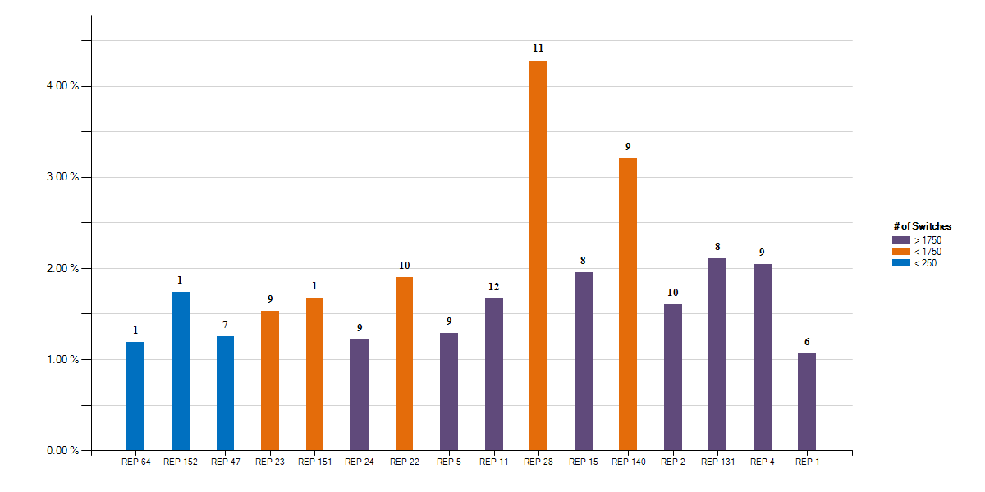
12 Month Average – Rescission Statistics
Top - 12 Month Average Rescission % Greater Than 1% of Switches With number of months Greater Than 1%

Slide 8
Explanation of Rescission Slide Data
NOTE:
A 10% chart range limit has been set. REPs data points that exceed 10% will be bordered in yellow. Please see the spreadsheet for actual percentages of these REPs.
Slide XX charts show the top REPs whose 12 month average Rescission percentage of their total Switches is above 1%.
The blue shades show switch totals of less than 250 for the month being reported
The orange shades show switch totals between 250 and 1750 for the month being reported
The purple shades show switch totals of over 1750 for the month being reported
The REPs with the lowest count of rescission totals start on the left, and move to the highest counts on the right
Number labels represent the number of months the REP has been over 1% during the 12 month period

Slide 9
18 Month Running Market Totals
 | Enrollments |  |  | IAG, IAL, Rescission |  |  |  |  | Days to Resolution
Month | SWI | MVI | Total | IAG | IAL | Rescission | IAG,IAL,Res Total | Overall % | IAG | IAL | Rescission
2018-01 | 88,933 | 230,409 | 319,342 | 1,879 | 1,779 | 778 | 4,436 | 1.39% | 12 | 22 | 9
2018-02 | 76,119 | 215,292 | 291,411 | 1,811 | 1,681 | 687 | 4,179 | 1.43% | 12 | 15 | 10
2018-03 | 95,159 | 224,289 | 319,448 | 2,078 | 1,738 | 719 | 4,535 | 1.42% | 11 | 16 | 12
2018-04 | 81,291 | 225,380 | 306,671 | 1,773 | 1,774 | 703 | 4,250 | 1.39% | 11 | 15 | 9
2018-05 | 96,828 | 244,431 | 341,259 | 1,850 | 1,715 | 1,106 | 4,671 | 1.37% | 12 | 15 | 11
2018-06 | 109,653 | 257,125 | 366,778 | 2,039 | 2,133 | 964 | 5,136 | 1.40% | 12 | 17 | 11
2018-07 | 121,926 | 270,122 | 392,048 | 2,197 | 2,449 | 942 | 5,588 | 1.43% | 13 | 16 | 11
2018-08 | 120,867 | 287,935 | 408,802 | 2,208 | 2,436 | 1,054 | 5,698 | 1.39% | 12 | 15 | 11
2018-09 | 89,078 | 230,635 | 319,713 | 1,936 | 1,731 | 760 | 4,427 | 1.38% | 12 | 15 | 10
2018-10 | 84,425 | 245,672 | 330,097 | 2,221 | 1,914 | 716 | 4,851 | 1.47% | 12 | 16 | 10
2018-11 | 185,003 | 213,210 | 398,213 | 1,647 | 1,831 | 697 | 4,175 | 1.05% | 12 | 16 | 11
2018-12 | 65,380 | 192,182 | 257,562 | 1,609 | 1,789 | 570 | 3,968 | 1.54% | 12 | 16 | 12
2019-01 | 108,941 | 236,129 | 345,070 | 2,519 | 2,549 | 935 | 6,003 | 1.74% | 11 | 14 | 10
2019-02 | 87,973 | 218,467 | 306,440 | 2,215 | 2,284 | 898 | 5,397 | 1.76% | 12 | 15 | 11
2019-03 | 97,148 | 238,133 | 335,281 | 1,997 | 2,731 | 726 | 5,454 | 1.63% | 11 | 14 | 9
2019-04 | 121,897 | 237,124 | 359,021 | 2,249 | 2,968 | 622 | 5,839 | 1.63% | 12 | 14 | 10
2019-05 | 145,059 | 253,622 | 398,681 | 2,330 | 3,224 | 621 | 6,175 | 1.55% | 13 | 16 | 10
2019-06 | 126,031 | 255,608 | 381,639 | 2,558 | 2,795 | 564 | 5,917 | 1.55% | 13 | 17 | 11

Slide 10
How can we drive efficiency? Reporting
Reporting to measure success … New format!!
Impact by REP
% of IAG/IALs to total enrollments by REP
Each REP is assigned a REP # - this # won’t change
Enrollments are MVIs+SWIs for IAG/IALs
For Rescissions, enrollments are SWIs only
IAG/IAL totals & % are calculated using the counts of the acknowledged Inadvertent Gaining REP only for both IAG & IAL issues.
If the Gaining REP in a submitted IAL issue does not agree to return the ESI to the Losing REP, that issue will not be counted
The Losing REP is not represented in any of the totals or % in any data
Two month lag in reporting to allow for IAG/IALs to be tied to enrollment transaction
MVI sent in November that resulted in an IAG MT submitted in December, will be reported on the % IAG/IAL total for November

Slide 11
Market Performance - Volumes
Overall % Change in IAS volume per enrollment:
2015 to 2016 = -6.62%
2016 to 2017 = -7.09%
2017 to 2018 = 5.38%
2018 to 2019 YTD = 19.71%

Slide 12
Market Performance - % of enrollments
 | Enrollments |  |  | IAG, IAL, Rescission
Year | SWI | MVI | Total | IAG | IAL | Rescission | IAG,IAL,Res Total | Overall %
2015 | 901,409 | 2,593,096 | 3,494,505 | 22,337 | 18,861 | 11,574 | 52,772 | 1.51%
2016 | 864,357 | 2,647,635 | 3,511,992 | 22,843 | 16,555 | 10,210 | 49,608 | 1.41%
2017 | 1,001,416 | 2,765,274 | 3,766,690 | 21,807 | 18,017 | 9,036 | 48,860 | 1.30%
2018 | 1,214,662 | 2,836,682 | 4,051,344 | 22,979 | 22,680 | 9,668 | 55,327 | 1.37%
2019YTD | 687,049 | 1,439,083 | 2,126,132 | 13,868 | 16,551 | 4,366 | 34,785 | 1.64%

Slide 13
Market Performance – Resolution Days

Slide 14
Market Challenge
Together we can make it a …

Slide 15
Checkpoint Question #1
An Inadvertent Loss MT submitted by the Losing REP will count toward which REP’s % total?
The Losing REP
The Gaining REP
ANSWER
The Gaining REP – valid IAG & IAL MTs will only count toward the Gaining REP’s total

Slide 16
Checkpoint Question #2
The assigned REP’s # on the IAG report will change each month.
True
False
ANSWER
FALSE – Assigned REP #s will remain consistent for the market reporting

Slide 17
Checkpoint Question #3
Driving down the number IAGs / IALs / Rescissions in the market will result in which of the following:
Fewer customer complaints
Improved customer experience
Addressing customer issues faster
Fewer back-off resources
All of the above
ANSWER
All of the above – If all REPs work to drive efficiencies in their processes, the market will benefit

