Slide 1
Undefrequency Load Shedding Event in Great Britain on August 9th, 2019
Julia Matevosyan
Planning Engineer
Resource Adequacy
9/11/2019

Slide 2
National Grid UK, Background
Facts
Scotland, Wales & England
Not synchronously interconnected with Ireland or the rest of Europe
HVDC links to Irelands (500 MW and 450 MW), France (2000 MW) and Netherlands (1000 MW)
Peak Demand 57 GW
>21 GW of wind and >13 GW solar (a lot of it at sub-transmission level)
Minimum inertia 135 GW·s
Resource Contingency Criteria =1000 MW (HVDC import)
Concerns
Loss-of-mains protection in the distribution networks uses vector shift relays or RoCoF relays (used to trigger at 0.125 Hz/s) to detect islanding.
All distribution connected renewables were set to trip at RoCoF=0.125 Hz/s, changed to 1Hz/s for the plants installed after Aug. 2014. These considerations set the criteria for determining RCC limit.

Slide 3
National Grid UK, Mitigation Measures
Monitors inertia online real time
RCC limited in real time by the operators to minimize the risk of high RoCoF 0.125 Hz/s (gradually changing settings towards 1 Hz/s)
Forecasts inertia < 12 hours ahead, derives largest loss that the system can withstand due to RoCoF considerations.
Post-fault inertia limit is set to 130 GW·s
Varies frequency containment reserve based on inertia and largest RCC size
Introduced Enhanced Frequency Response Service (EFR): deliver 100% Active Power output within 1 second, sustain for 15 minutes

Slide 4
August 9th Event, Background
Friday August 9th was windy, rainy warm day.
Before the event system load is around 29 GW,
32.13 GW of transmission connected generation capacity online: 30% from wind, 30% from gas, 20% from nuclear, 10% export over the interconnections. (No mentioning of where the remaining 10% were coming from, may be other distributed generation).
System inertia is around 210 GWs (moderate), import over French interconnector is limited at 1000 MW

Slide 5
Event Start
At 4:52 pm, lightning strike on transmission line caused single phase to ground fault
Cleared in 74 ms seconds (disconnect), an automatic re-closure after 20 seconds, brought the line back to normal operation (within normal time).
The protection on the transmission line operated correctly to clear the fault as expected and the associated voltage disturbance was as expected.

Slide 6
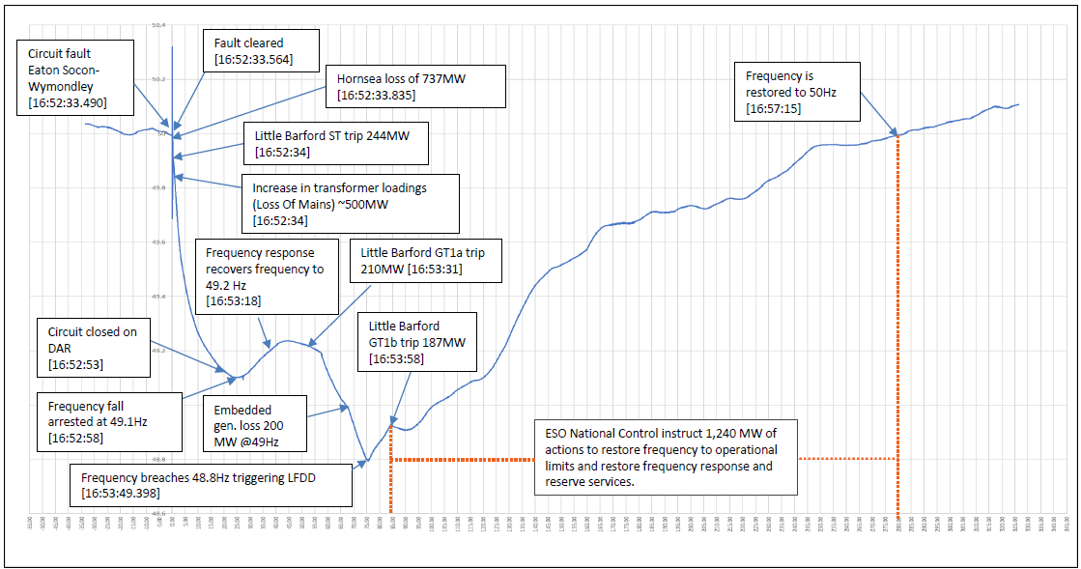
Sequence of the Events

Slide 7
Hornsea Wind Farm Improper VRT
About 164 ms after the fault was cleared, transmission connected 1.2 GW Hornsea offshore wind farm started de-loading (pre-disturbance production 799 MW)
About 270 ms after the fault was cleared, Hornsea production stabilized at 62 MW. Total loss was 737 MW
Two maintenance outages of the wind farm network created a weak internal network environment. The wind turbine controls were not set to operate in weak grid conditions and reacted incorrectly (due to SSR).
This was unexpected improper ride-through behavior. Following the initial review, adjustments were made to wind farm configuration and fine-tuning its controls for responding to the abnormal events robustly. Compliance testing was conduced by the system operator
Notes:
Equipment at Hornsea saw a system voltage fluctuation with unusual characteristics coincidental with the lightning. The initial reaction at the plant was as expected attempting to accommodate and address the system conditions, but very shortly afterwards as the reaction expanded through the plant the protective safety systems activated.

Slide 8
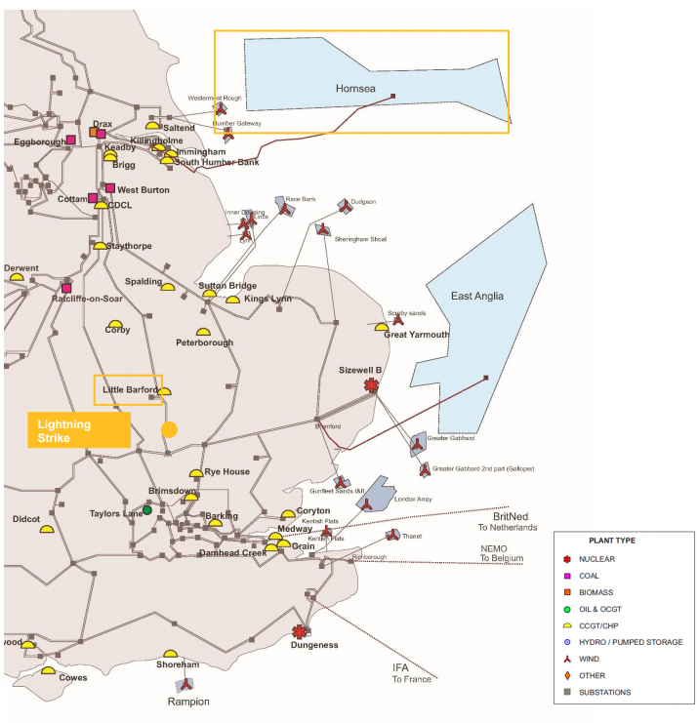
Hornsea Wind Farm Location

Slide 9
Voltage Profile at Various Locations

Slide 10
Voltage and Active Power at Hornsea

Slide 11
Stream Turbine Trip
About 0.5 second after the lightning strike, Steam Turbine (ST) at transmission connected Combined Cycle (CC) plant (close to the strike) trips 244 MW instantaneously, due to discrepancy between measurements of three speed signals. Review is still ongoing
This was unexpected behavior, since CCs are supposed to ride through such system conditions
Total generation loss 737+244=981 MW
Frequency at the time is around 49.85 Hz. Continuous operation range 49-51 Hz is required from the generators by the Grid Code.

Slide 12
Sequence of the Events

Slide 13
Embedded Generation (Distributed Generation)Trip
The operator experienced about 500 MW transformer loading increase, indicating loss of embedded generation (typically solar, some small gas and diesel fired generation):
150 MW of embedded generation tripped due to vector shift protection simultaneously with the lightning strike. This is expected for a lightning strike on transmission line
Additional 350 MW of embedded generation disconnected after de-loading of Hornsea wind farm and steam turbine trip due to local RoCoF in excess of 0.125 Hz/s
Total Generation loss at that moment 737+244+500=1481 MW

Slide 14
Sequence of the Events

Slide 15
Gas Turbine Trip
10 seconds after ST trip frequency response delivered at least 650 MW and frequency stabilized at 49.1 Hz.
As frequency response delivered reaches 900 MW, frequency recovers to 49.2 Hz
About 1 minute after ST trip, Gas Turbine (GT1A) at the same CC plant, outputting 210 MW, trips automatically due to excessive steam pressure in the steam bypass system. Reason presently unknown.
Frequency starts declining again.

Slide 16
Sequence of the Events

Slide 17
Underfrequency Load Shedding
At 48.8 Hz load shedding starts, 1GW of demand is disconnected (5% of load) including 1.1 million residential customers and Newcastle airport.
Some load (e.g. hospital and rail) lost supply due to their own protection.
This, together with use of reserves, rapid dispatch of additional generation, recovered the system security position within 5 minutes.
GT1B, 187 MW manually disconnected by plant operator, 30 seconds after GT1A trip again due to high steam pressure.
Notes:
There is total of 9 stages of load shedding starting with 5% at 48.8 Hz and moving down to 47.5 Hz (below which stable system operation is not possible.
Airport had back up emergency generation, which worked smoothly but since the event filed to be included in the list of critical customers, i.e. not part be part of load shedding schemes.

Slide 18
Sequence of the Events

Slide 19
Event Summary
Generation is normally not expected to trip or de-load in response to lightning strike. This was unexpected and extremely rare event.
Total loss of generation from the event was 1878 MW. This is much larger than GB’s current largest contingency, 1000 MW, therefore reserves (1000 MW) including 472 MW of battery storage were not sufficient to cover for this loss.
Everything was returned to normal and load restored within 31 minute. Rail services couldn’t be restored until the next day, since some trains needed an engineer to reset.

Slide 20
What Went Wrong?
734 MW of wind generation on Hornsea wind farm did not ride through fault as was required.
Almost simultaneously, ST tripped (due to speed measurements discrepancies), this was not in line with Grid Code, since frequency was well within continuous operating limits.
500 MW of embedded generation tripped by loss of mains protection. This event on its own is as expected after transmission fault, but not following the single largest contingency. The operator maintains adequate inertia or limits the single largest contingency for RoCoF to be >0.125 Hz/s. Vector Shift protection operation is not expected after a large unit trip, but is expected after transmission fault.

Slide 21
Frequency Responsive Reserve Held
Dynamic – refers to proportional response while Static – refers to step response

Slide 22
Validated Frequency Response Performance
To date, the system operator has worked with providers and used internal data to validate the performance of 91% of all primary and secondary reserves that was being held. Of the validated response holding 89% of primary (841MW) and 88% of secondary (1055MW) response performed as expected and in line with its contractual obligations.

Slide 23
Simulation of the Event
The Frequency Simulation Engine (FSE) is used by the system operator to calculate the frequency response holding required to keep frequency within limits for a given loss and set of system conditions. This tool has been used to simulate the 09 August incident.

Slide 24
Simulation of 1000 MW loss in FSE
Additionally comparison to historic event (1000 MW loss) in similar conditions (28 GW loss, 201 GWs inertia, frequency responsive reserve 1087 MW) shown similar frequency trace as in the simulation, with the nadir above 49.5 Hz

Slide 25
Lessons Learned by National Grid Operator
List of facilities on load shedding schemes has to be reviewed to identify potential critical loads
Review security standard to determine if in high inverter-based environment planning for >1000 MW loss is appropriate. How to achieve balance between risks and costs?
Review protections of critical infrastructure (hospitals, transport, emergency services) to ensure their can “ride-through” the range of system events.
Accelerate ongoing program, changing RoCoF protection settings of embedded generation from 0.125 Hz/s to 1Hz/s.

Slide 26
Lessons to Learn for ERCOT?
How distributed generators determine frequency? Can they potentially trip following short circuit events on the transmission grid, how many MW can we lose? ERCOT verified this for transmission connected solar generation after the Blue Cut fire event but do we know how distributed generation would behave?
How to ensure compliance with VRT requirements? Can partial maintenance at the plants potentially cause temporary incompliance?
Going forward should be consider sequences of events, such as e.g. transmission fault & loss of embedded generation?
Are any lessons learned from shedding of firm load or internal protections tripping critical load applicable in ERCOT?

Slide 27
Sources
National Grid’s Final Reports are available at:
Report: https://www.ofgem.gov.uk/system/files/docs/2019/09/eso_technical_report_-_final.pdf
Appendix: https://www.ofgem.gov.uk/system/files/docs/2019/09/eso_technical_report_-_appendices_-_final.pdf

Slide 28
Thank you! Questions?
Julia Matevosyan
jmatevosjana@ercot.com

