Slide 1
Governor Model Performance Evaluation Using Actual SCADA Measurement
José Conto
Principal, Dynamic Studies Dept.
ERCOT System Planning
Sept. 11, 2019
Public

Slide 2
Frequency Measurable Event (FME)
In ERCOT, an event is classified as a FME when the system experience a frequency deviation subject to either of the following conditions:
The frequency deviation is greater than 100 mHz; or
A sudden change in generating unit/generating facility output greater than 550 MW
A FME report is created to evaluate the primary frequency response of each unit or plant using the recorded generation output (2~4 seconds per sample) against expected performance.
Frequency Event
EMS Data Retrieval
FME PFR Evaluation
G1: Acceptable
G2: No/Limited
..
Review and Improvement

Slide 3
New Option: Governor Model Performance Evaluation
Current PFR evaluation process provides the framework to develop the governor model performance evaluation
Frequency Event
EMS Data Retrieval
Actual PFR Evaluation
G1: Acceptable
G2: No/Limited
..
Review and Improvement
Gen Dynamic Models
Governor Model Evaluation Tool
Model-Based PFR Evaluation
G1: Acceptable
G2: No/Limited
..

Slide 4
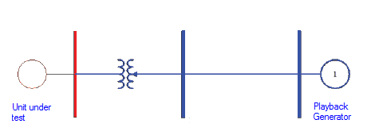
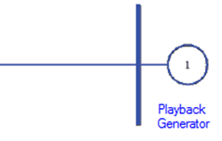
Playback Application
Playback feature available in the commercial software is used to examine the model responses using the actual frequency and voltage measurements.
For frequency events, it can be also used with a group of generators (a Combined Cycle plant, etc.)
G1
G2
G3

Slide 5
Tool Development and Functions
FME data
Python code
Dynamic Stability Assessment Criteria
-> A single run to produce power output (Pout) plots (measured v. simulated) of all online units recorded in the FME report.
-> A single run to produce Pout plots (measured v. simulated) of same unit for all FMEs.

Slide 6
Tool Implementation
Study Data
Study Data
FME
For a FME file,
Select a generator to test its governor response.
Using playback model, simulate machine governor response.
Plot measured v. simulated Pout of machine.
FMEi
Geni
Pmeas
Geni
Pmeas
Playback Simulation
Playback Simulation
Plots
Plots
Y
more
Gens
Y
more
FMEs
N
N
Stop
Stop

Slide 7
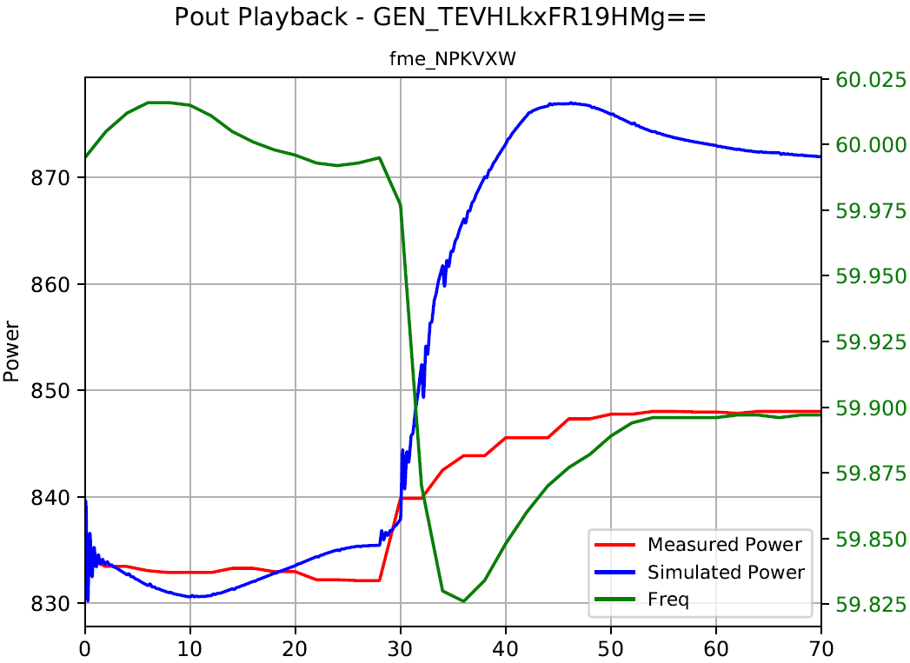
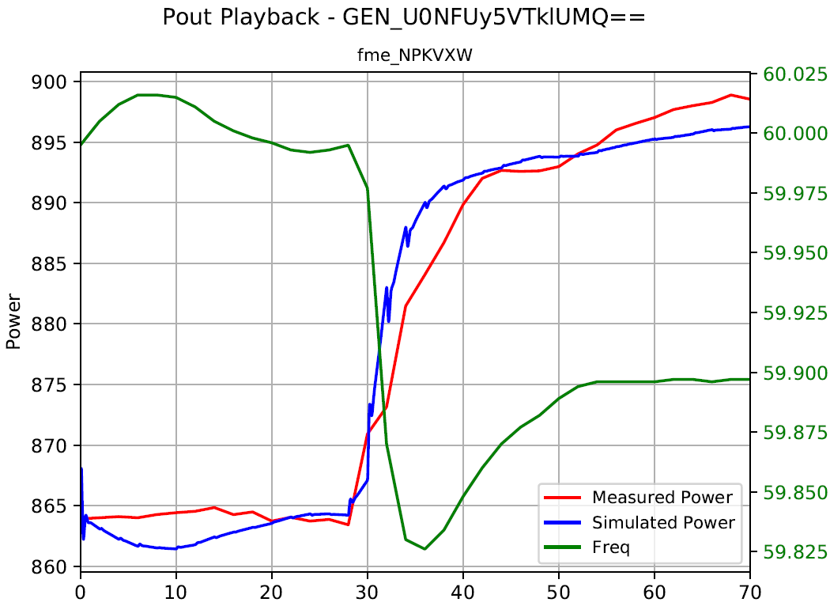
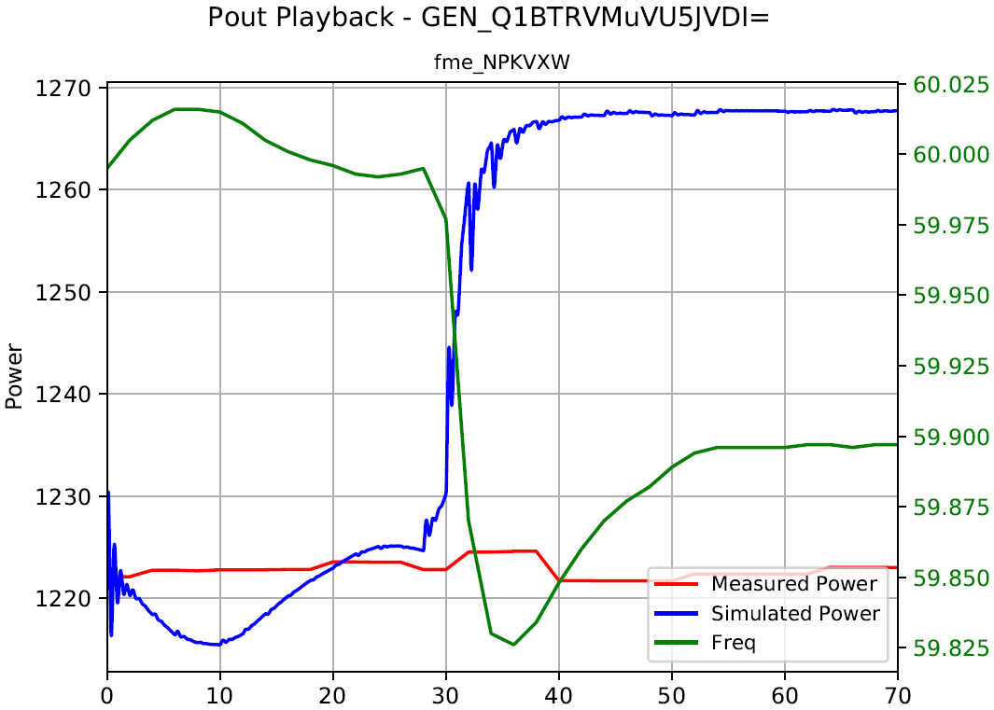
Examples: Single Unit
<- OK v. not OK ->

Slide 8
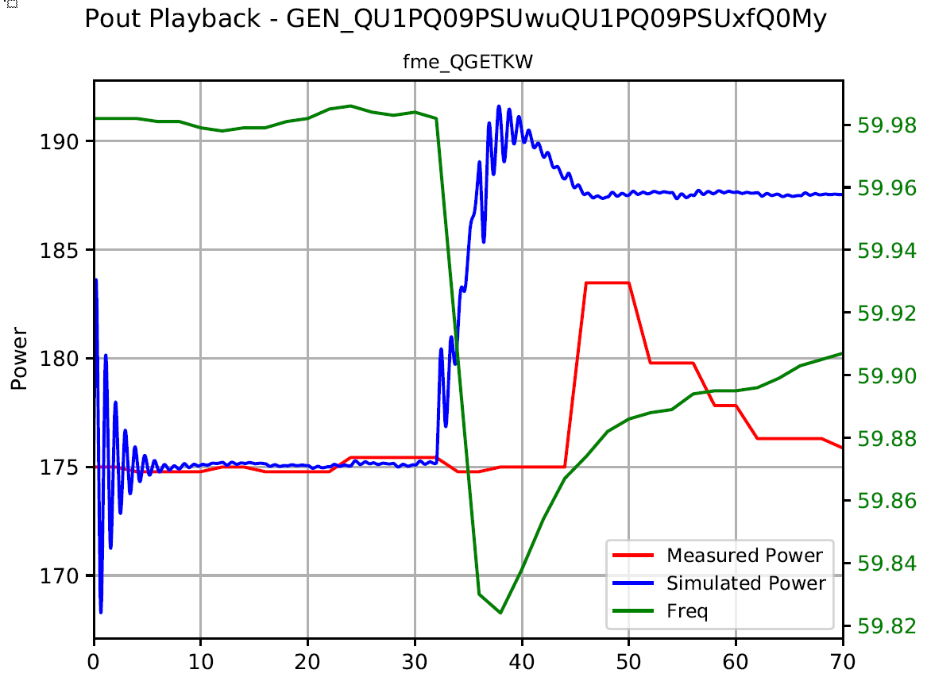
Examples: Combined Cycle Plants

Slide 9
Thanks!
José Conto
Principal, Dynamic Studies ERCOT System Planning
Phone: +1 (512) 248-3141 E-mail: Jose.Conto@ercot.com
Acknowledgement – Many thanks to Fred Huang, Ehsan Rehman (ERCOT Dynamic Studies Dept.) and members of ERCOT Operations for providing advice and data critical to this project.

