Slide 1
TDTMS Update
September 10th, 2019

Slide 2
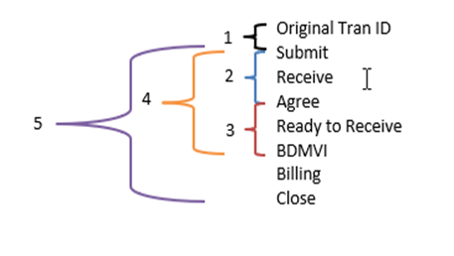
TDTMS
Recreating Reports
TDTMS suggested five reports based off of status types. These reports could be applied to all three subtypes.
TDTMS was requested by RMTTF to review the MarkeTrak User Guide Manual. TDTMS agreed to take this on at some point later this year or early next year.
Findings
IAG
Approximately 33% of IAG regain MTs are submitted within 3 days
Approximately 77% of IAS regain MTs are submitted within 12 days
IAL
Approximately 24% of IAL MTs are submitted within 3 days
Approximately 65% of IAL MTs are submitted within 10 days
Rescission
Approximately 29% are submitted within 3 days
Approximately 80% are submitted within 10 days
Approximately 94% are submitted within 15 days

Slide 3
TDTMS
Next Meeting October 18th
ERCOT MetCenter

