Slide 1
ERCOT Retail Market Training Task Force
Update to RMS
Tuesday, September 10th, 2019

Slide 2
2019 Instructor Led Retail Training
2019 UPCOMING RETAIL TRAINING
HOUSTON |  | CenterPoint
WEDNESDAY | September 25th | RETAIL 101 | 9:00 – 4:00
THURSDAY | September 26th | TxSET | 9:00 – 4:00
BOTH CLASSES ARE FULL
Both classes are completely full – please sign up to be on the wait list. Some cancellations will occur!

Slide 3
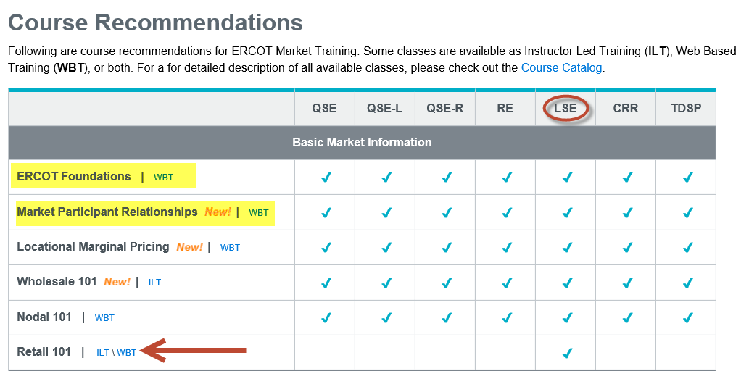
Retail 101 Training Modified
Retail 101 has been updated, moving some material to introductory courses now available as Web Based Training.
Recommended for those who signed up for Retail 101 in September, take these two courses:
ERCOT Foundations - ~60 minutes
Market Participants Relationships - ~20 minutes

Slide 4
TxSET Training Highlights
What is TXSET? | What is TxSET? Why do we have TxSET? NAESB When is TxSET used?
Tools / References | ERCOT Protocols Retail Market Guide TxSET Web page links
TxSET Interactive | Transaction Flows Swimlanes Stacking Logic EDI Transaction Guides & Examples How to read ERCOT MIS
TxSET Working Group | What is TxSET WG? Change Controls Flight Information

Slide 5
UPDATED MarkeTrak & Inadvertent Gain Training

Slide 6
MarkeTrak On-line Training Modules Available
Marketrak Overview
Switch Hold Removal
Cancel With/Without Approvals
Inadvertent Gains/Losses & Rescissions
Usage and Billing
Other D2D Subtypes
Bulk Insert
MarkeTrak Admin Functionality
Data Extract Variances (DEV) LSE Subtypes
Data Extract Variances (DEV) Non-LSE Subtypes
Emails and Notifications
Reporting – Background & GUI

Slide 7
Retail Market Training - Registration
How do I register for Training?
Go to the ERCOT Training Website at http://www.ercot.com/services/training/
Select the course you are interested in attending
On the ‘Schedule/Registration’ tab, select the ‘enroll online’ link under ‘Registration’ to register for the course.
If you find the course is not listed under the Web-based training…
Go to ERCOT Training Website as shown above
Select the ‘ERCOT Learning Management System’ (LMS) link in the upper right hand corner under RELATED CONTENT
If necessary, set up a log on
Once in LMS, follow drop downs for ‘web-based training’ and ‘retail market’. Available modules will appear
Select ‘start course’
Note! Most modules are able to be completed in less than 30 minutes.

Slide 8
Upcoming RMTTF Meeting
September 11, 2019
9:30 AM
ERCOT Met Center Room 102
Please join us!

Slide 9
Thank you!

