Slide 1
Improving Load Distribution Factors Update
Calvin Opheim
CMWG Meeting
September 9, 2019

Slide 2
Objective
Explore techniques to improve the accuracy of the non-PUN LDFs
Take into account weather forecast
Shape can change on a daily basis

Slide 3
Work Plan
Near-term (completed):
Explore using Mid-Term Load Forecast (MTLF) models for non-PUN LDFs
In progress:
Explore improving the accuracy of PUN LDFs
Determination of auto error correction settings

Slide 4
Model
Model form
Use neural network model with 3 sigmoid nodes and 1 hidden layer
Why use a neural network?
Provides faster results than other techniques
Don’t have the staff to build 6,000+ models on a one-by-one basis
Hoping to find a single model that improves the current forecast by at least 20%

Slide 5
Model
Model variables
Dry Bulb Temperature
Month
Day of Week
Hour Ending
Actual Load from 48 hours before

Slide 6
Error Correction
Currently error correction is automatically applied to the top 10% of buses with the highest forecast error for each weather zone
Based on the most recent day where actual values are available (yesterday)
This changes on a daily basis
Exploring expanding the use of this technique

Slide 7
Weather Sensitive – Error Correction Effective
Actuals (through 02SEP2019), pre-, and post-error-correction Forecast (through 04SEP2019) COAST HB*TR5

Slide 8
Non-Weather Sensitive – Error Correction Effective
Actuals (through 02SEP2019), pre-, and post-error-correction Forecast (through 04SEP2019) COAST AI*TR2

Slide 9
Weather Sensitive – Error Correction Sometimes Better
Actuals (through 30AUG2019), pre-, and post-error-correction Forecast (through 01SEP2019) COAST BAR*TR1

Slide 10
Weather Sensitive – Error Correction Questionable
Actuals (through 30AUG2019), pre-, and post-error-correction Forecast (through 01SEP2019) COAST BAR*TR3

Slide 11
Non-Weather Sensitive – Error Correction Questionable
Actuals (through 30AUG2019), pre-, and post-error-correction Forecast (through 01SEP2019) COAST CAM*TR1

Slide 12
Non-Weather Sensitive – Recent Load Change
Actuals (through 30AUG2019), pre-, and post-error-correction Forecast (through 01SEP2019) COAST CAM*TR2

Slide 13
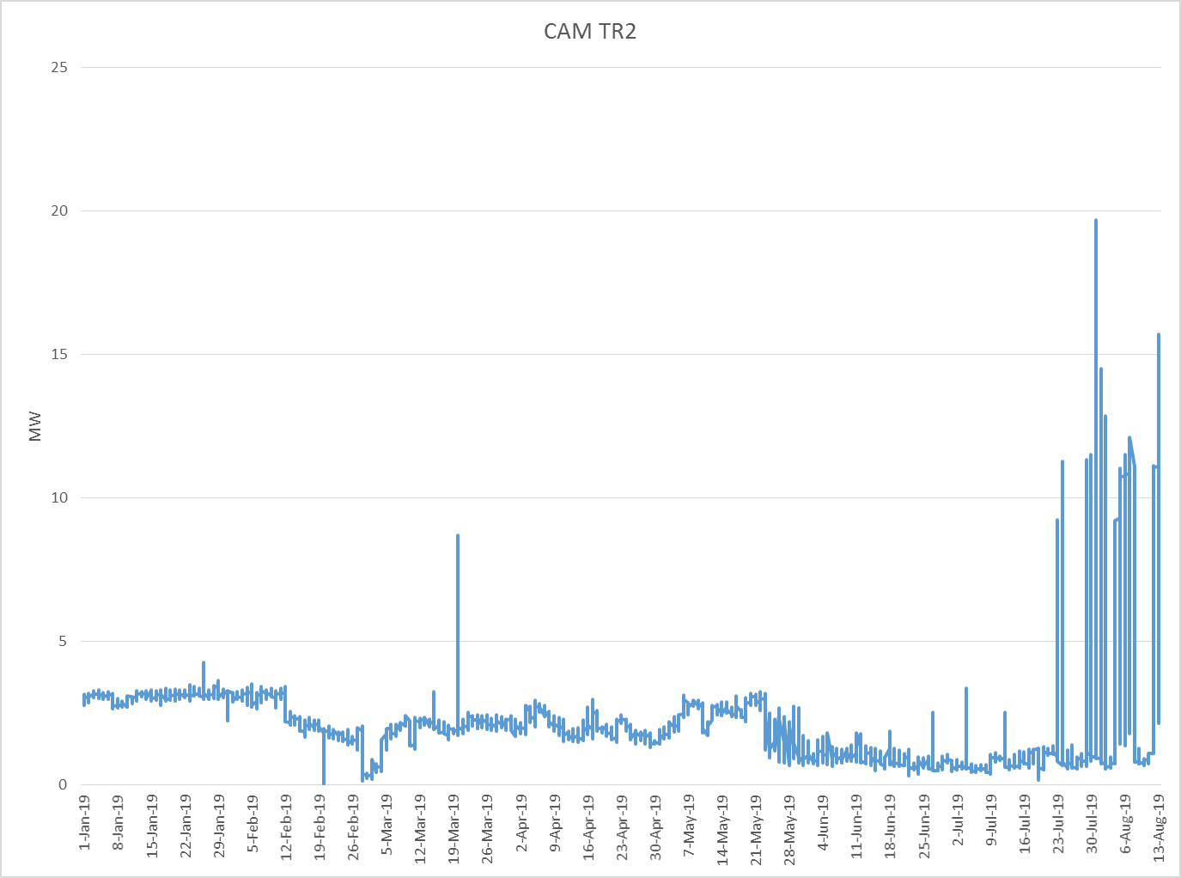
Non-Weather Sensitive – Recent Load Change

Slide 14
Weather Sensitive – Error Correction Worse
Actuals (through 30AUG2019), pre-, and post-error-correction Forecast (through 01SEP2019) COAST TWG*TR2

Slide 15
Weather Sensitive – Error Correction Worse
Actuals (through 30AUG2019), pre-, and post-error-correction Forecast (through 01SEP2019) COAST TWG*TR2
Actuals (through 30AUG2019), pre-, and post-error-correction Forecast (through 01SEP2019) COAST TWG*TR2

Slide 16
For Discussion
Prioritize locations with a history of high costs?
Forecast must be available by 6 am? What if it is late?
  Use prior days forecast?
  Load Forecasting is not staffed for consistent round the clock support. Is this required?
Models are currently developed using State Estimator values. If SCADA is available should it be used?

Slide 17
Current Status
Determining the optimum use of error correction for each location
Daily monitoring of LDFs
Evaluating model updates to improve accuracy (4 CP, other lagged load values like daily maximum demand or minimum demand, etc)
Providing the new LDFs to the Market Operations team for their evaluation

Slide 18
Outstanding Tasks
Need to develop a process which will pass the new LDFs into the EMS system
Update Load Distribution Factor Other Binding document and Protocols

Slide 19

Questions?

