Slide 1
Supply Analysis Working Group Report to WMS
September 4, 2019

Slide 2
SAWG August Meeting – ERCOT Preliminary Review of Controllable DG Response during Summer 2019 EEA Events
ERCOT data was based on DG Mapping enabled by NPRR866 and represents a subset of DG considered “controllable”
Results from EEA events on August 13th and August 15th indicate at least 3 different deployment strategies used by groups of controllable DG:
1) group responded prior to increased prices and response lasted ~1 hour after pricing decreased
2) group responded to increased prices and response lasted ~ 20 min after pricing decreased
3) group in response to ERS deployment

Slide 3
SAWG August Meeting – ERCOT Preliminary Review of Controllable DG Response during Summer 2019 EEA Events
Next Steps:
ERCOT currently doesn’t have visibility in to what type of DG is responding in what way and why
Would like direction from WMS on what information we need from ERCOT before this response is at critical mass
What additional data does ERCOT need in order to have the necessary information?
Roadmap of what information and action is by ERCOT needed before response strategies are impactful

Slide 4
SAWG August Meeting – Update on Distributed Generation Forecasting and CDR Capacity Contribution Estimation Initiatives
At July and August meetings, ERCOT discussed growth forecasted in residential solar, utility scale solar (<10 MW) and natural gas:
Forecasting Residential Solar Growth
ERCOT estimated long-term growth using S-curve and found a Summer Peak Capacity Factor at 36% based on AWS Truepower analysis
Next Step: Will continue this discussion at November 15th SAWG
Forecasting Utility Scale Solar Growth
No current forecast tool developed
Next Step: roundtable discussion at November 15th SAWG
Forecasting Natural Gas Growth Projects
No current forecast tool developed
Next Step: Instead of a poll/survey, ERCOT will hold a day-long workshop with DSPs for two-way dialogue

Slide 5
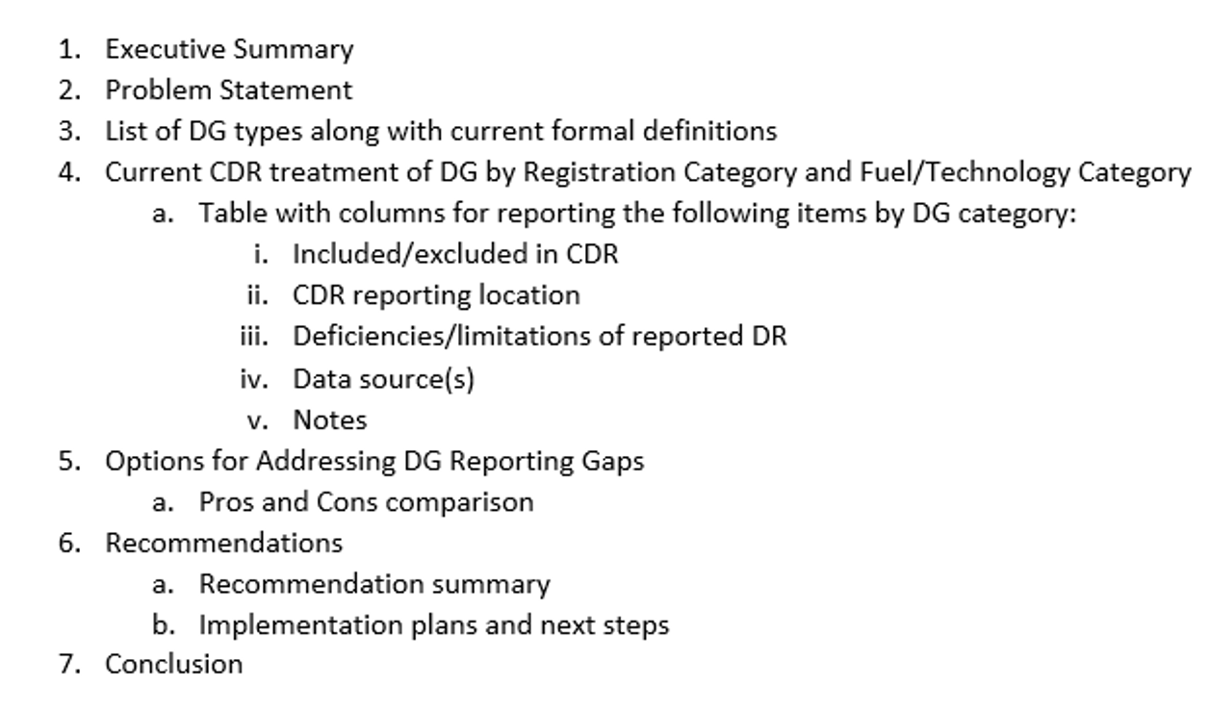
SAWG August Meeting – Gap Analysis for DG Reporting in the CDR
ERCOT presented an outline for a whitepaper for reporting DG in the CDR

Slide 6
SAWG August Meeting – Gap Analysis for DG Reporting in the CDR
ERCOT presented an outline for a whitepaper for reporting DG in the CDR
Next Steps:
ERCOT to put outline in a presentation for September SAWG
ERCOT to update September SAWG on timeline for a future whitepaper outline on Storage Reporting in CDR

Slide 7
SAWG August Meeting – Unconfirmed Retirements in the CDR
ERCOT proposed a layout for including announced retirements in supplemental tab

Slide 8
SAWG August Meeting – Unconfirmed Retirements in the CDR
ERCOT proposed a layout for including announced retirements in supplemental tab
SAWG discussed changes:
including “or” to “and” in (2)
Removing (3)
Next Steps:
ERCOT to present a “final” version at September SAWG

Slide 9
SAWG August Meeting – CONE Study
ERCOT spoke to Brattle to get an estimate based on an “bottom-up” approach specific to ERCOT
Cost estimate of $230,000-$260,000
Time estimate of 3-4 months
SAWG Recommendation
Perform this type of study every 4 years (every other LTSA)
Use an RFP for a vendor
Implement the value with the calendar year
Next Steps:
SAWG recommends this as a voting item for October WMS

Slide 10
SAWG – Subcommittee Review
Review of Scope – Is the Scope still valid and is the subcommittee/working group/task force still performing these functions; Does the scope need to be revised?
Current Scope:
“At the direction of the Wholesale Market Subcommittee (WMS), SAWG evaluate proposals for market design as they pertain to Resource adequacy and the resource reporting methodologies. SAWG Annually reviews the components and construction of the Capacity, Demand, and Reserves Report (CDR), the Seasonal Assessment of Resource Adequacy Report (SARA), the Long Term Load Forecast, the NERC Long Term Reliability Assessment, and recommend necessary changes to WMS. SAWG also reviews and recommends market design principles, issues, and proposals related to supply side adequacy as assigned by WMS.”
Recommendation: Add review and recommendation of Peaker Net Margin/CONE study and implementation to the scope

Slide 11
SAWG – Subcommittee Review
Review Open Action Items list – Is the subcommittee/working group/task force discussing open issues, ongoing issues, etc.
TAC Assignment: Review Methodology used to determine Peaker Net Margin (PNM) -- 06/05/2019
Planning to bring voting items to WMS and continue work on methodology and implementation of methodology
How often does the subcommittee/working group/task force meet and how long are their meetings? Are meetings well attended?
Once a month (cancel if necessary); have had 6 meeting so far 2019
usually end by Noon
Well attended
Does the subcommittee/working group/task force have a similar scope with another subcommittee/working group/task force – if so, can the groups be consolidated?
No
Is the subcommittee/working group/task force still necessary?
Yes

Slide 12
Next SAWG Meetings
September 27th
November 15th

