Slide 1
Brief Review of EEA Events For ROS
(8/13 & 8/15)
Dan Woodfin
Sr. Director, System Operations
9/5/2019

Slide 2
Overview
August peak demands and EEA days in context
Comparisons of August 12th-16th
August 13 EEA
August 15 EEA
Questions

Slide 3
Daily Peak Hour Demands
Higher Demands in August
July was warm and dry
June was cool and wet

Slide 4
New Peak Days
Will focus in on this week for subsequent slides
New Weekend Peak
New All-Time Peak
EEA Days

Slide 5
System Load

Slide 6
Load Patterns – 13:00-20:00 on 8/12-8/16

Slide 7
Hourly Wind and Solar

Slide 8
Resource Outages
Outages Shown are non-IRR Outages

Slide 9
Difference of Load and Net Load Peak Times

Slide 10
Load, Wind, and Outage Differences – 8/12-8/13
+504
-1431
-525
Outages Shown are non-IRR Outages

Slide 11
Load, Wind, and Outage Differences – 8/12-8/15
-2968
-3769
+1087
Outages Shown are non-IRR Outages

Slide 12
Load, Wind, and Outages at Peak
16:45
15:18
16:25
16:50

Slide 13
PRC and Online Reserves (RTOLCAP)

Slide 14
System Prices and Load (2pm-6pm)

Slide 15
August 13, 2019 EEA Level 1 Timeline
Time | Events
05:00 | Issued OCN for HE 14 to HE 18
13:50 | Issued Advisory for PRC < 3,000 MW
14:55 | Issued Watch for PRC < 2,500 MW
15:10 | Issued EEA 1 for PRC < 2,300 MW
15:16 | Issued a public appeal for voluntary energy conservation
15:16 | Deployed all 10-min and 30-min ERS (926.30 MW)
15:56 | Recalled 10-min ERS (93.01 MW)
16:02 | Re-deployed all 30-min ERS (10 MW)
16:14 | Recalled 30-min ERS (833.39 MW)
17:00 | Cancelled EEA 1
17:30 | Cancelled Watch
18:00 | Cancelled Advisory and OCN

Slide 16
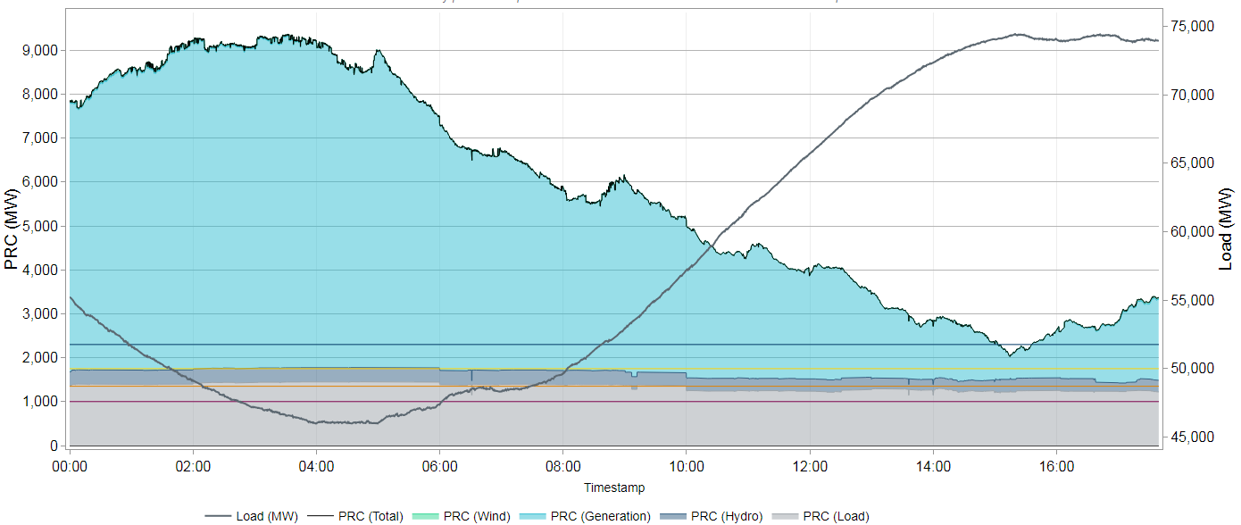
Physical Responsive Capability (PRC) – 8/13/19
ERCOT declared EEA Level 1 at 15:10 when the PRC was 2,156 MW.
PRC was under 2,300 MW for 35 minutes.
EEA Level 1 continued for 1 hour and 50 minutes until deployed resources were recovered and reserves sustained an upward trend.
EEA Level 1
PRC < 2,300 MW
Minimum PRC:
2,025 MW @ 15:14
15:10
17:00

Slide 17
Frequency and RRS Deployment - 8/13/19
System Frequency dropped to 59.941 Hz at 15:13.
Frequency was restored after deploying additional RRS.

Slide 18
August 15, 2019 EEA Level 1 Timeline
Time | Events
05:00 | Issued OCN for HE 14 to HE 18
13:30 | Issued Advisory for PRC < 3,000 MW
15:00 | Issued Watch for PRC < 2,500 MW
15:05 | Declared EEA 1 for PRC < 2,300 MW
15:15 | Issued a public appeal for voluntary energy conservation
15:11 | Deployed 30-min ERS (715 MW)
15:30 | Sent VDI for Emergency Energy across the Railroad DC Tie to ERCOT
15:53 | Sent VDIs to keep two generators online for HE16 and HE17
16:54 | Recalled all 30-min ERS
17:05 | Terminated EEA 1
17:15 | Ended VDI for Emergency Energy across the Railroad DC Tie
17:35 | Cancelled Watch
18:00 | Cancelled Advisory and OCN

Slide 19
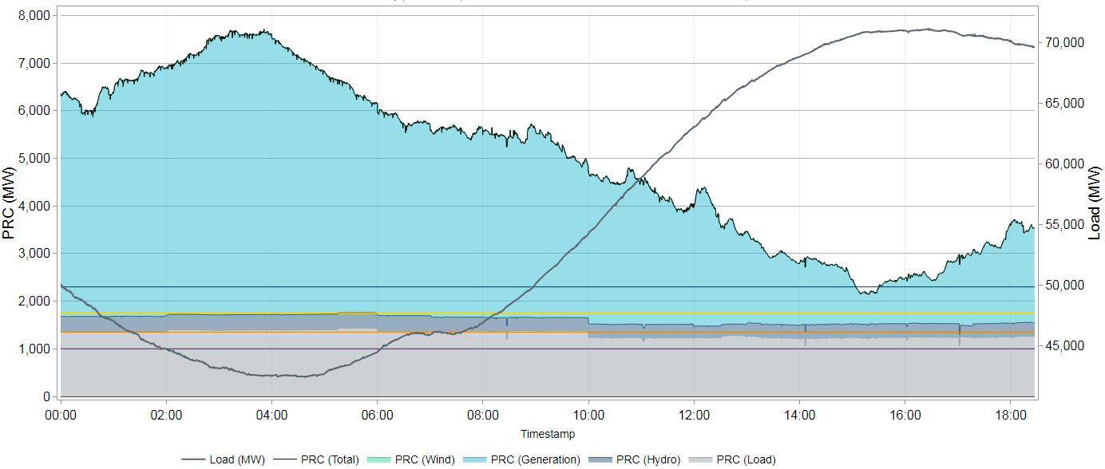
Physical Responsive Capability (PRC) – 8/15/19
ERCOT declared EEA Level 1 at 15:05 when the PRC was 2,245 MW.
PRC was under 2,300 MW for 26 minutes.
EEA Level 1 continued for 2 hours until deployed resources were recovered and reserves sustained an upward trend.
EEA Level 1
PRC < 2,300 MW
Minimum PRC:
2,134 MW @ 15:18
15:05
17:05

Slide 20
Frequency and RRS Deployment - 8/15/19
System Frequency dropped to 59.944 Hz at 14:50.
Frequency was restored after deploying RRS.

Slide 21
Questions?

