Slide 1
Preliminary Review of Controllable DG Response during EEA Events 8/13/2019 and 8/15/2019
SAWG

Slide 2
“Controllable” Settlement Only DG (SODG) Response
Data is based on DG Mapping enabled by NPRR866.
Load Data is from the aggregate of CIM Loads which have SODG mapped to them.
Affected by multiple items: bad telemetry, distribution circuit changes, load changes, etc.
Not “telemetered” data from the SODG.
This Subset of all SODG only includes units that have previously been observed to be “controllable”
Excludes Intermittent DG: Wind, Solar, and Hydro.
Also excludes a number of self-dispatched DG that are not typically “controllable”:
Landfill Gas – normally runs 24/7
Diesel, Natural Gas – some units do not appear to be price responsive
Installed for specific reasons known by owner
Small units in relation to substation load – poor signal to noise
Because this data is a subset of SODG and the analysis is preliminary, the MW impacts are not shown – the purpose of the graphs is to illustrate the pattern of the response
Mapped data was also observed during the EEA1 event on Aug 15, 2019. (not a peak day)

Slide 3
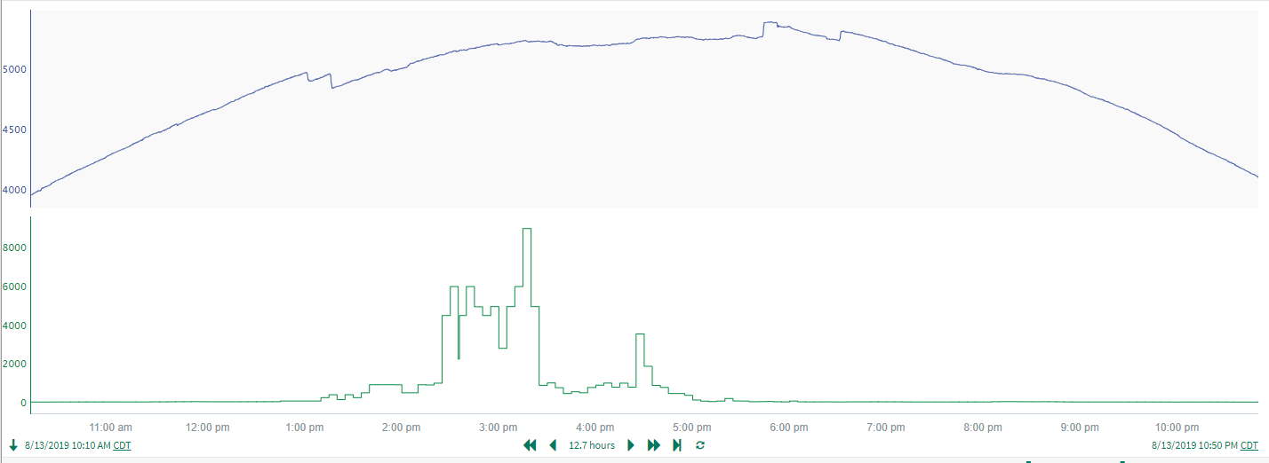
Mapped data observed during the (current) peak day of Aug 13, 2019
The blue line represents the composite (aggregate) Load (MW) of all of the CIM Load points with Controllable SODG mapped.
Note that first response group lasted ~1 hr after ERCOT pricing returned to ‘normal’
Note that first response group was prior to increased ERCOT system wide prices
The green line represents the ERCOT System lambda (without ORDC adder).

Slide 4
Mapped data observed during the (current) peak day of Aug 13, 2019
Note that second response group was in response to increased ERCOT prices (ORDC adder not included in these prices)
Note that second response group lasted ~20 min after ERCOT pricing returned to ‘normal’

Slide 5
Mapped data observed during the (current) peak day of Aug 13, 2019
Note that third response group was in response to ERCOT ERS deployment

Slide 6
Mapped data observed during Aug 15, 2019
Note that first response group lasted ~1 hr after ERCOT pricing returned to ‘normal’
Note that first response group was prior to increased ERCOT system wide prices

Slide 7
Mapped data observed during Aug 15, 2019
Note that second response group was in response to increased ERCOT prices (ORDC adder not included in these prices)
Note that second response group lasted ~20 min after ERCOT pricing returned to ‘normal’

Slide 8
Mapped data observed during the (current) peak day of Aug 13, 2019
Note that third response group was in response to ERCOT ERS deployment

Slide 9
Observations
Data examined represents a subset of mapped DG that has previously been determined as “controllable”.
Responses during 8/13 and 8/15 indicate at least 3 different deployment mechanisms/strategies

