Slide 1
Ancillary Services in ERCOT
Participation by Energy Storage Resources
Julia Matevosyan
Planning Engineer
Resource Adequacy
8/21/2019

Slide 2
Existing Ancillary Services
Regulation Up Reserve Service
Fast Responding Regulation Service Up
142 to 669 MW*
Frequency restoration reserve
Regulation Down Reserve Service
Fast Responding Regulation Service Down
148 to 604 MW
Responsive Reserve (RRS)
Frequency containment reserve
Primary Frequency Response
Load Resources on Under Frequency Relays
10 minute ramp
2,300 to 3,016 MW
Replacement reserve
Non-Spinning Reserve Service
980 to 2,132 MW
*The numbers are showing 2019 AS amounts
Notes:
Fast Responding Regulation Service (FRRS) is a subproduct of the Regulation Service. Regulation Service is deployed through Automatic Generation Control while FRRS is using a different deployment logic

Slide 3
Ancillary Services procurement
All AS are procured by ERCOT in the Day-Ahead Market
Each Service is procured on an hourly basis
Qualified Resources are awarded based on their capacity values and price
Marginal price sets the Market Clearing Price of Capacity (MCPC) for all Resources cleared in that Service for that hour
A QSE may move AS responsibility to other Resources in its Portfolio all the way up to real time
QSEs may also self-arrange AS (i.e., not participate in the auction)

Slide 4
Ancillary Services (AS) in ERCOT Protocols
AS requirements are defined in ERCOT Protocols based on ERCOT system needs
Procurement quantities for all AS are
Determined based on ‘Methodology for Determining Minimum Ancillary Service Requirements’: www.ercot.com/mktinfo/dam/index.html
Published on ERCOT Market Information System at the end of December for the upcoming year
Due to system limitations, energy storage currently register with ERCOT as Generation Resources and Controllable Load Resources (GR/CLR)
Currently, AS qualification testing and performance requirements that apply to GR and CLR in ERCOT protocols would apply to energy storage in discharging (GR) and charging (CLR) modes respectively

Slide 5
Responsive Reserve Service (RRS)
RRS provides operating reserves intended to:
Arrest frequency decay within the first few seconds of a significant frequency deviation on the ERCOT grid
After a significant frequency deviation, to help restore used-up reserves
Provide energy during emergency situations
RRS may be provided by:
Unloaded, online Generation Resource capacity, through Primary Frequency Response
Load Resources controlled by high-set under-frequency relays (0.5 second response time, ≥59.7 Hz trigger)
Controllable Load Resources, through Primary Frequency Response (PFR)
Hydro Generation Resources in synchronous condenser mode
Ancillary Service Resource Responsibility for RRS is one hour
Notes:
Hydro generators in synchronous condenser mode. These are generators that are on line for local voltage support. The turbine is declutched from the generator is not producing any active power. If providing RRS such resource will responds at 59.8 Hz and will provide full active power response (here 100% of it’s active power rating) within 20 seconds. This is response is not the same as governor response on other generators.

Slide 6
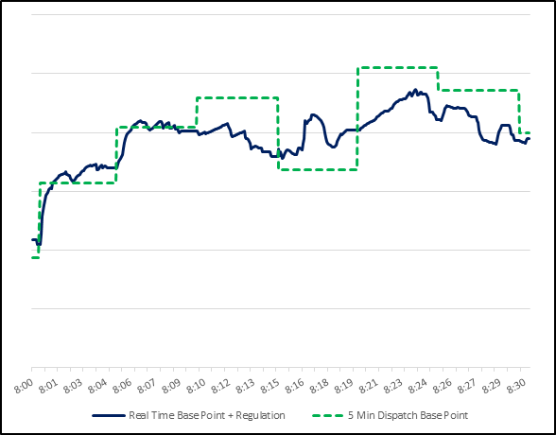
Regulation Reserve Service
Deployed to balance net load variability between SCED runs (5 minutes)
Reg-Up is used during negative imbalance between generation and load (i.e., shortage)
Reg-Down is used during positive imbalance between generation and load (i.e., surplus)
Deployed by ERCOT through Load Frequency Control (LFC) that proportionally divides Regulation needed between all participating generators and issues deployment signals every 4 seconds
Regulation can be provided by online Generation Resource and online Controllable Load Resources.
Ancillary Service Resource Responsibility for Regulation is one hour

Slide 7
Fast Responding Regulation Service (FRRS)
FRRS is a subset of Regulation Service
FRRS can be provided by online Generation Resources or online Controllable Load Resources
Deployment signal separate from conventional Reg is used to deploy FRRS and local frequency measurement is used for self-deployment at +/-0.09 Hz
In qualification test upon deployment, the Resource is required to demonstrate that it can sustain the deployment for a minimum of 8 minutes
Currently FRRS-Up procurement is limited to 65 MW, while FRRS-Down is limited to 35 MW

Slide 8
Non-Spinning Reserve Service (NSRS)
Non-Spin may be deployed to:
Replace loss of generating capacity
Compensate for load, wind, solar forecast uncertainty
Address the risk of net load ramps
Assist when there is a limited amount of capacity available to SCED
Non-Spin Service is provided by:
GRs (online or offline) that are capable of being synchronized and ramped to a specified output within 30 minutes
Controllable Load Resources that qualify for SCED dispatch and are capable of ramping to a specific consumption level within 30 minutes
Most of the Non-spin is provided by 10-minute Quick Start Generation Resources (QSGR)
Ancillary Service Resource Responsibility for NSRS is one hour
Notes:
Historically, the need for Non-Spin has occurred during:
Forecast Errors - Unexpected hot weather (in shoulder seasons)
Net load ramp - Cold weather, early morning load ramp outpacing the ability of generation to follow
Following large unit trips to replenish reserves

Slide 9
Revision to the AS Product Set: NPRR 863 approved
Current target for FFR implementation is March 1, 2020
ECRS will be implemented no earlier than January 2022
Current Framework
NPRR 863
Regulation
Regulation
No Change
157 to 687 MW*
157 to 687 MW*
Responsive Reserve Service (RRS)
FFR
Triggered at 59.85 Hz and full response in 15 cycles
Once deployed, sustain for up to 15 mins. Once recalled, restore within 15 mins
PFR
PFR capable capacity reserved on generators or Controllable Load Resources (CLR)
Minimum 1,150 MW must be provided by resources capable of PFR
Load Resources on UFR
Triggered at 59.70 Hz and full response in 30 cycles
Sustain until recalled. Once recalled, restore within 3 hours
Beyond the minimum PFR, up to 60% of total RRS can come from Load Resources on UFR or FFR.
Fast Frequency Response (FFR)
Responsive Reserve Service
Load Resources on UFR
PFR
Load Resources on Under Frequency Relay (UFR)
10 minute ramp
Primary Frequency Response (PFR)
2,300 to 3,200 MW*
2,300 to 3,200 MW*
ERCOT Contingency Reserve Service (ECRS)
Generation
Online or offline capacity that can be converted to energy within 10 minutes
Dispatched by SCED
Load Resources (UFR not required)
Up to 50% of ECRS capacity can come from Load Resources with or without UFR
Once deployed, must respond within 10 minutes. Restoration within 3 hours
10 minute ramp
Load Resources may or may not be on UFR
508 to 1,644 MW**
Non-Spin
Non-Spin
No protocol changes.
Proposed methodology for Non-Spin Reserve Service quantities in this framework - quantities computed using 2018 A/S Methodology are reduced by ECRS quantities.
967 to 2,361 MW*
0 to 1,180 MW***
Overall A/S: 3,807 to 5,958 MW*
Overall A/S: 3,807 to 5,958 MW*
*Quantities computed/estimated using 2018 Ancillary Service Methodology. **Quantities estimated using this reference. ***Quantities estimated using this reference and method in box on far left.
For Discussion Purposes Only. The intent of this slide is to represent NPRR 863 (with STEC comments from 10/1/2018). Protocol language prevails to the extent of any inconsistency with this one page summary.

Slide 10
New: Fast Frequency Response (FFR), a subset of RRS
Resources providing FFR shall self-deploy within 15 cycles after frequency drops below 59.85 Hz and must continue to provide their response until the frequency increases above 59.98 Hz, but no longer than 15 minutes.
Resources which require recharging may do so once the frequency increases above 59.99 Hz
15 minute after a deployment Resources providing FFR must be available for subsequent deployments
Resources providing FFR shall be capable of governor response with ±17 mHz deadband, and droop setting ≤5.0%

Slide 11
New: ERCOT Contingency Reserve Service (ECRS)
ECRS is intended to:
Help restore the frequency to 60 Hz within 10 minutes of a significant frequency deviation (effectively, 10-minute Non-spin);
Provide energy to avoid or during the implementation of an EEA; and
Provide backup to Reg-Up
ECRS may be provided by:
Unloaded Generation Resources that are On-Line;
Quick Start Generation Resources (QSGRs);
Load Resources that may or may not be controlled by high-set under-frequency relays;
Generation Resources operating in the synchronous condenser fast-response mode; or
Controllable Load Resources

Slide 12
ERCOT Contingency Reserve Service (ECRS)
ERCOT shall deploy ECRS by one or more of the following:
Automatic dispatch instruction to release ECRS capacity from GR or CLR to SCED when frequency drops below 59.91 Hz and available Reg-Up is not sufficient to restore frequency; and/or
Dispatch Instruction for deployment of Load Resources energy via electronic Messaging System
The amount of ECRS provided by individual Generation Resources and Load Resources is limited to ten times its telemetered emergency ramp rate:
Each Resource providing ECRS must be capable of ramping the Resource’s Ancillary Service Resources Responsibility for ECRS within 10 minutes of the notice to deploy ECRS, and must be able to maintain the scheduled level of deployment for the period of service commitment

Slide 13
Participation of Energy Storage Resources in AS
Currently, based on the qualification and performance requirements in ERCOT Protocols:
Short duration (>15-minute, < 1h) storage may qualify for Fast Responding Regulation Service (in place now) and for Fast Frequency Response (implemented in early 2020)
Longer duration (≥ 1 hour) storage may qualify for any AS product
Conceptually, this is not expected to change with implementation of Energy Storage Resource in ERCOT systems as a single device.

Slide 14
Thank you! Questions?
Julia Matevosyan
jmatevosjana@ercot.com

Slide 15
APPENDIX

Slide 16
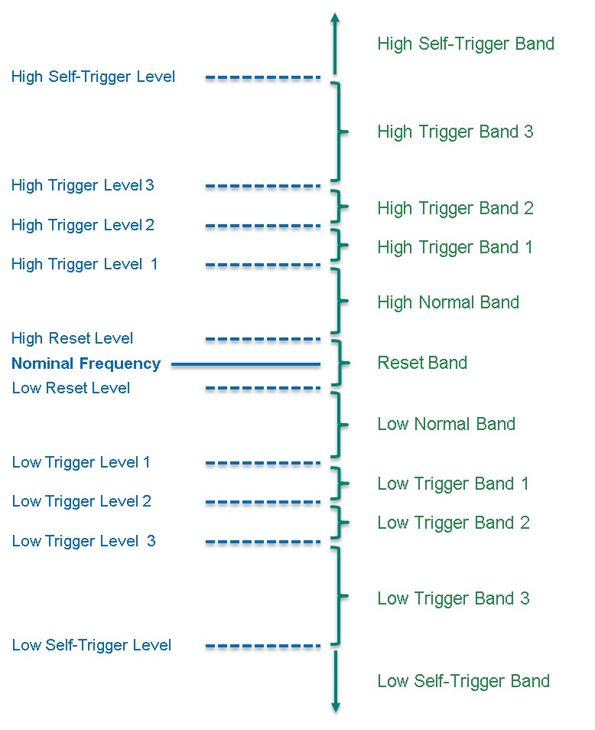
FRRS Deployment Logic
ERCOT FRRS Logic
Nominal Frequency | 60 Hz
Reset Level | 60 ± 0.01
Trigger Level 1 | 60 ± 0.03 | 40% Deployment
Trigger Level 2 | 60 ± 0.04 | 70% Deployment
Trigger Level 3 | 60 ± 0.05 | 100% Deployment
Self-Trigger Level | 60 ± 0.09 | 100% Deployment
Notes:
Fast Responding Regulation is a Subset of the Regulation Service. Separate deployment signal is used to deploy FRRS self-trigger means local deployment on frequency at the point of interconnection while at other trigger levels FRRS is deployed by sending signal from ERCOT.

