Slide 1
Market Credit Working Group update to the Wholesale Market Subcommittee
Bill Barnes NRG, Chair
Josephine Wan Austin Energy, Vice Chair
09/04/2019

Slide 2
MCWG update to WMS
General Update
August 21st Joint MCWG/CWG Meeting
8 NPRRS reviewed for their credit impacts
918NPRR Validation for PTP Obligations with Links to an Option.
930NPRR Process, Pricing, and Cost Recovery for Delayed Resource Outages.
941NPRR Create a Lower Rio Grande Valley Hub.
958NPRR Modifications to Wind and Solar Capacity Calculations in the CDR.
959NPRR Creation of a Panhandle Region for Calculation of Seasonal Peak Average Capacity Contributions for Wind.
960NPRR Phased Approach and Clarifications for NPRR863, Creation of ERCOT Contingency Reserve Service and Revisions to Responsive Reserve.
961NPRR Related to NOGRR194, Relocate Black Start Training Attendance Requirements to Nodal Operating Guides.
962NPRR Publish Approved DC Tie Schedules.
7 were operational without any credit impact. CWG determined that NPRR930 has positive credit implications.

Slide 3
MCWG update to WMS
ERCOT Surety Bond Review
Proposed Surety Bond replacement.
See proposed language at the link below. CWG and ERCOT credit/legal reviewing.
http://www.ercot.com/content/wcm/key_documents_lists/165426/Item_4A_proposed_ERCOT-Standard-Surety-Bond.doc

Slide 4
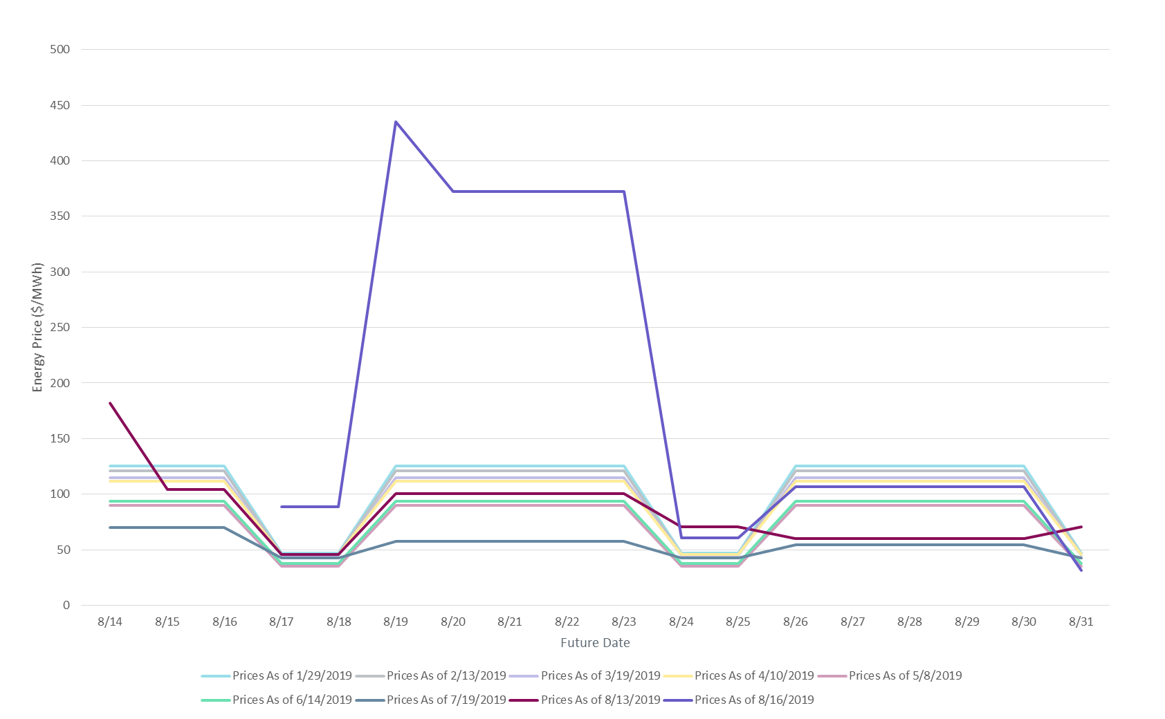
MCWG update to WMS
Credit Impacts of Summer 2019 Price Event
ICE Price Evolution

Slide 5
MCWG update to WMS
Credit Impacts of Summer 2019 Price Event

Slide 6
MCWG update to WMS
Credit Impacts of Summer 2019 Price Event

Slide 7
MCWG update to WMS
Credit Impacts of Summer 2019 Price Event

Slide 8
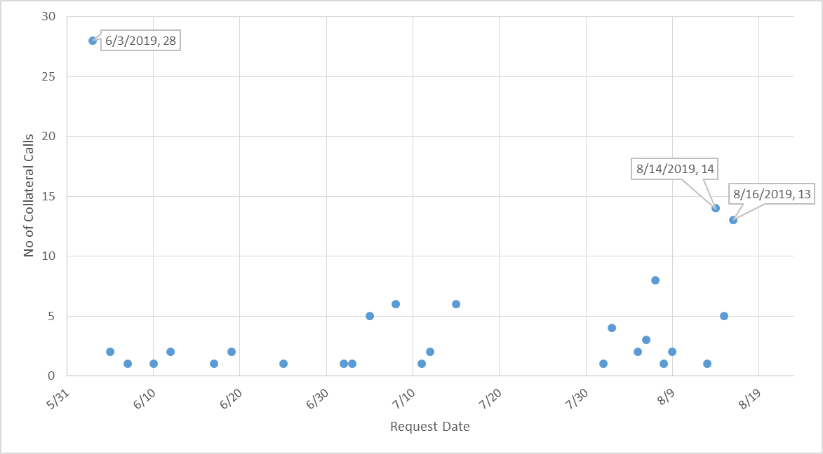
MCWG update to WMS
Credit Impacts of Summer 2019 Price Event
Collateral calls June-August 2019

