Slide 1
RIOO-RS Update
August 29, 2019

Slide 2
Wireframe Review

Slide 3
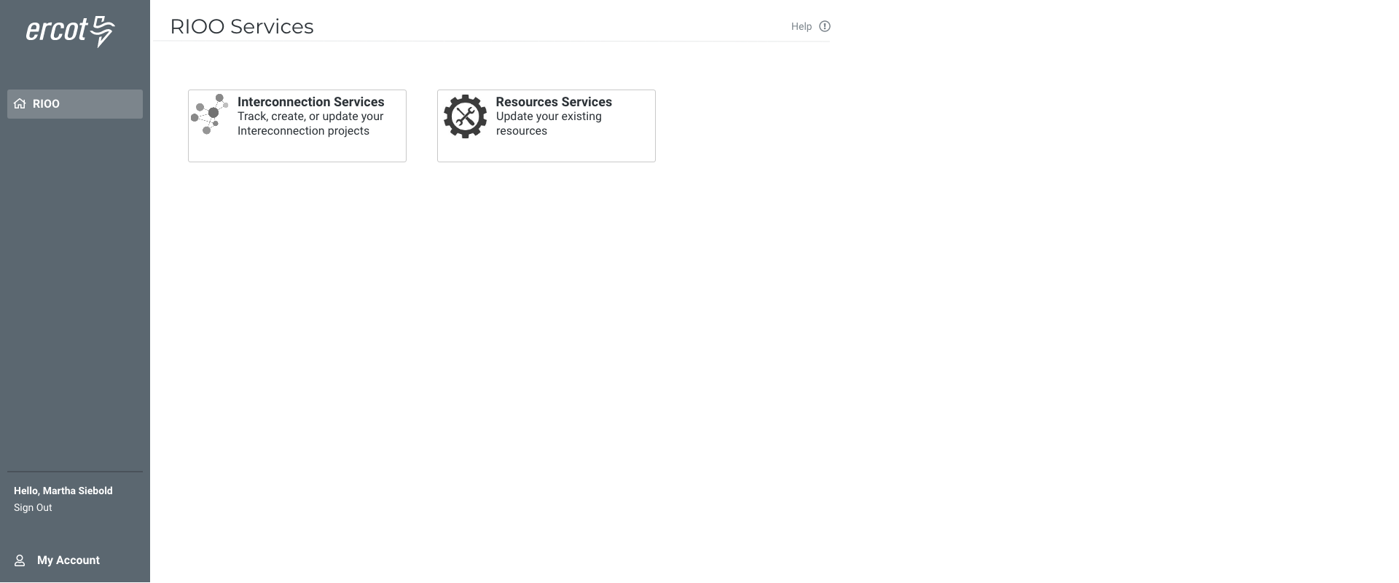

Slide 4
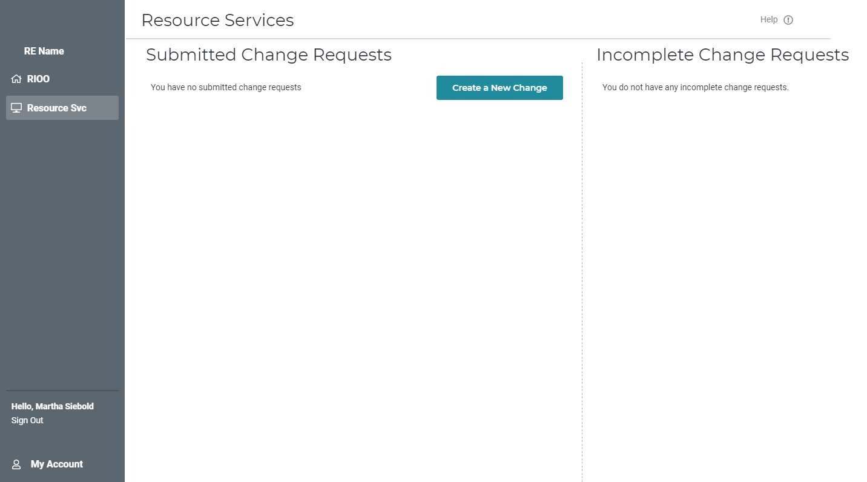

Slide 5
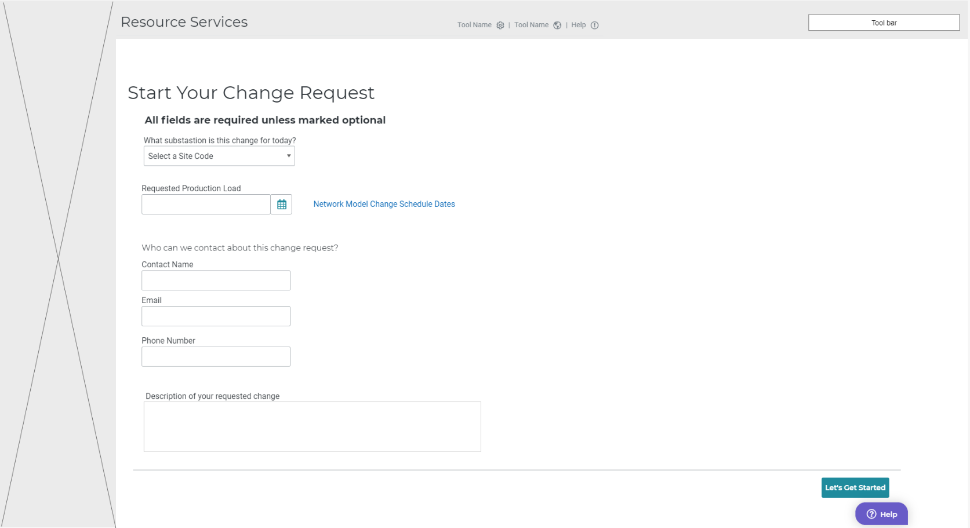

Slide 6
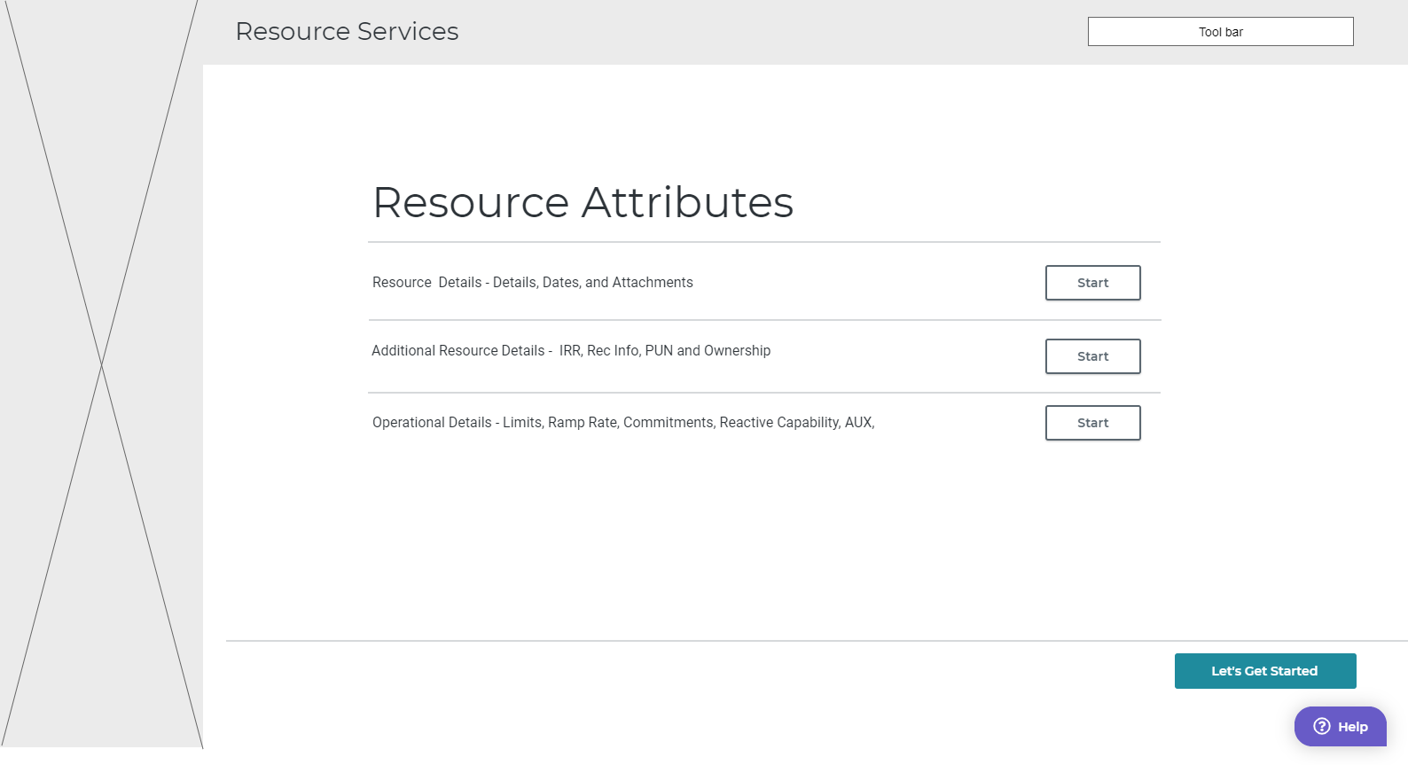

Slide 7
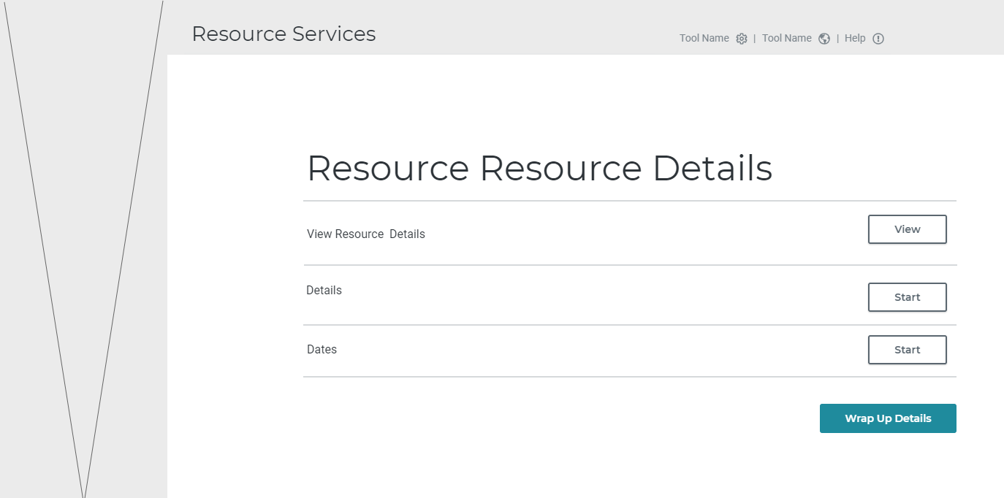

Slide 8
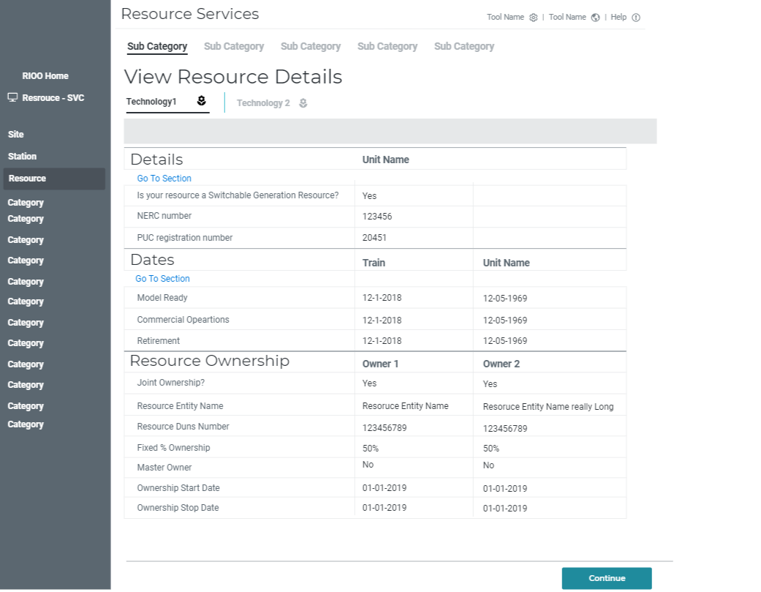

Slide 9
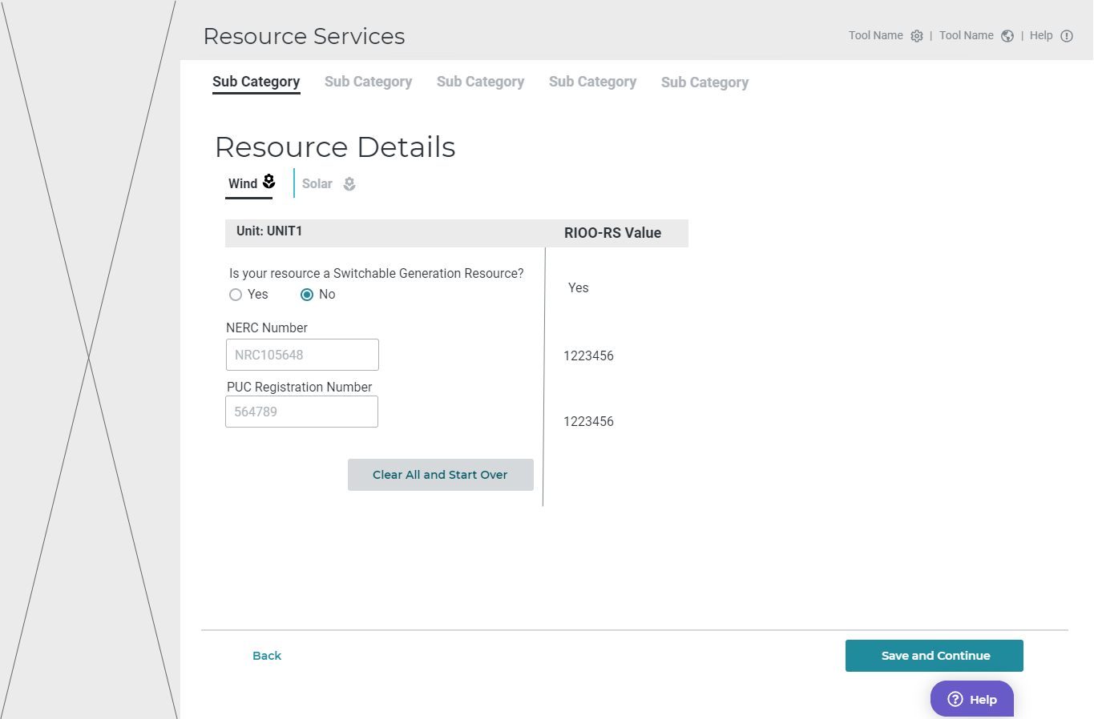


Slide 10


Slide 11
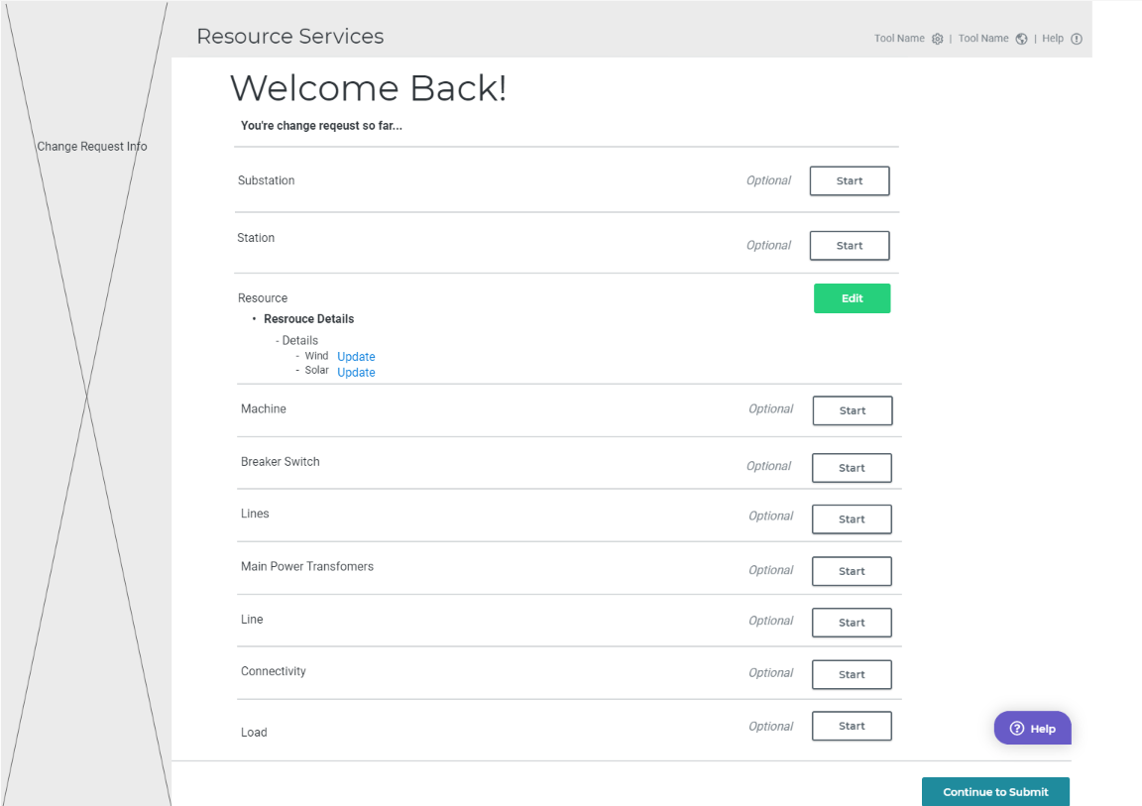
Revisit section
Revisit section

Slide 12
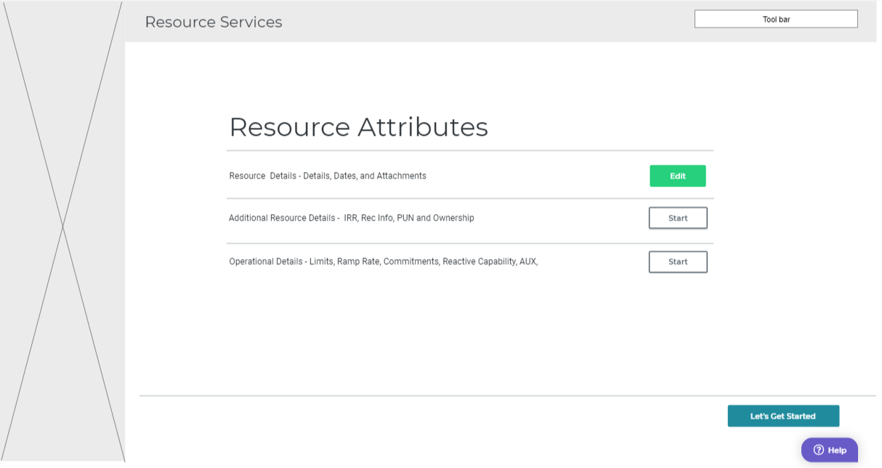

Slide 13
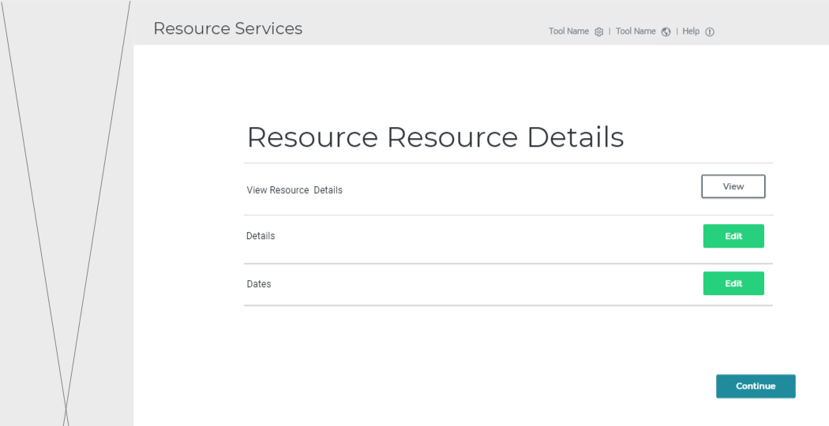
Notes:
And then click details

Slide 14
123456
123456

Slide 15
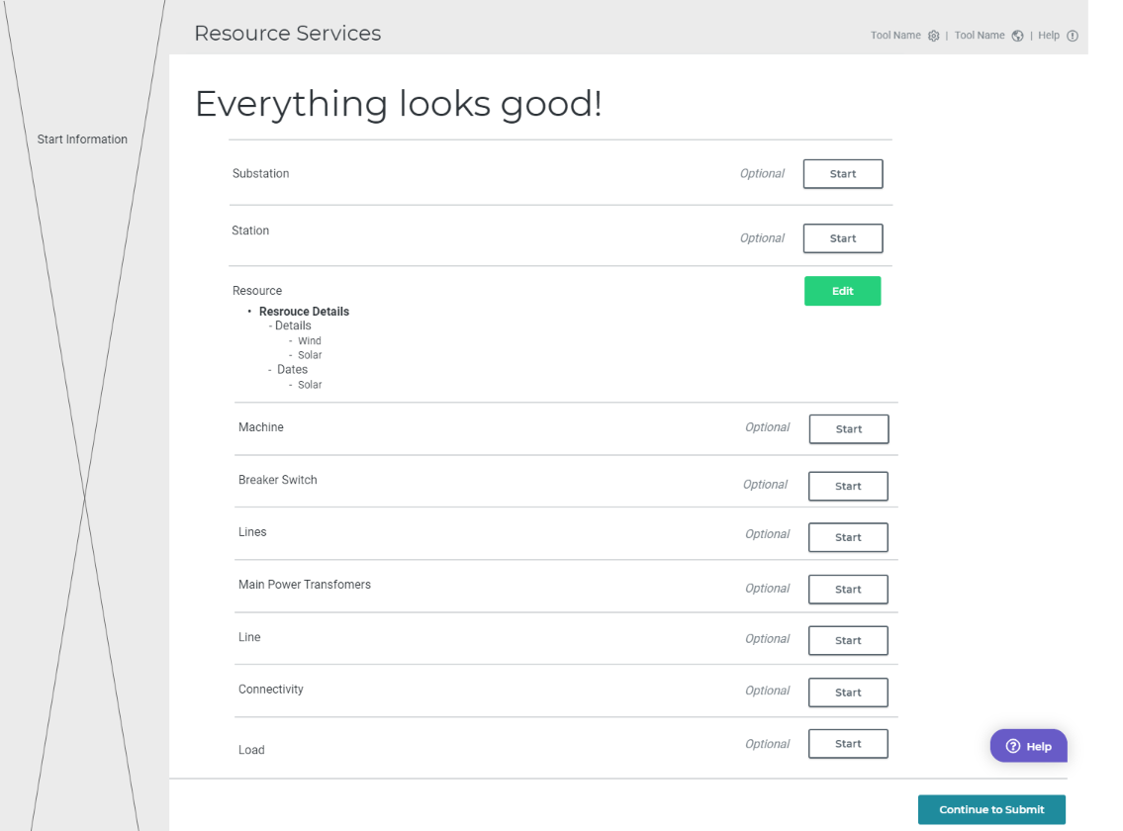
Notes:
This user is good to go. They have correct data on the panels they changed, so they have green a light and an active continue to submit button
User continues to submit
All right remove the red and green sub stop light

Slide 16
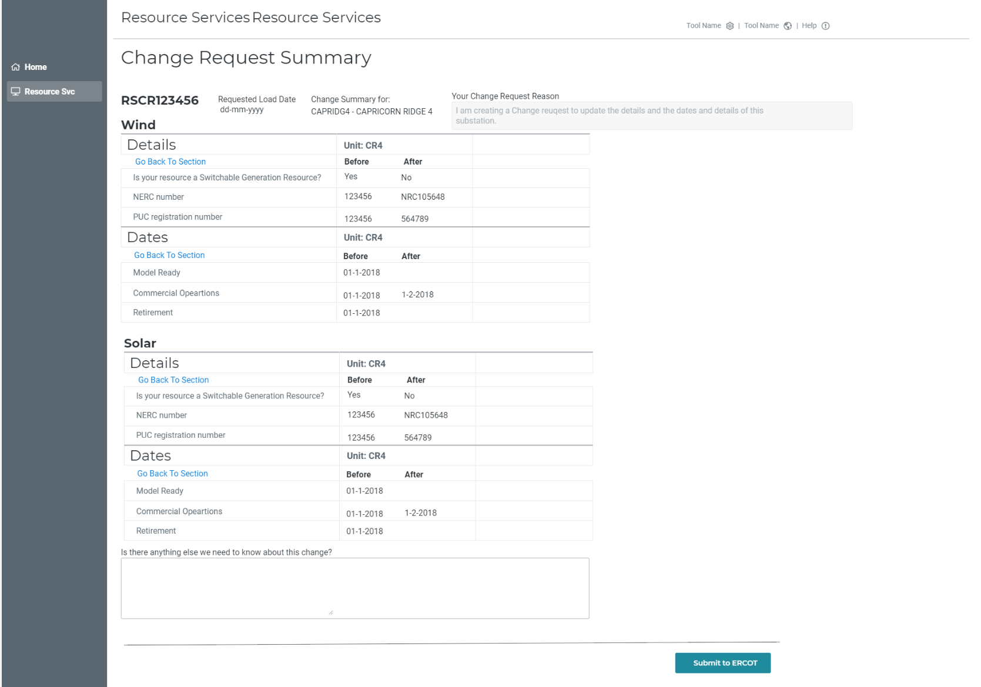
Martha-Martha Substation
back

Slide 17

back

Slide 18
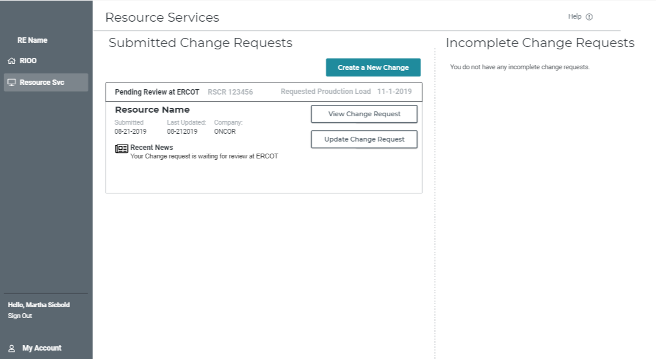
Notes:
My change request waiting for ercot to look at it. “Pending Review”
I can Update it. Or View it
Update – takes me stop light
View – shows me the delta like page that I submitted a slide ago, lets click the view button

Slide 19
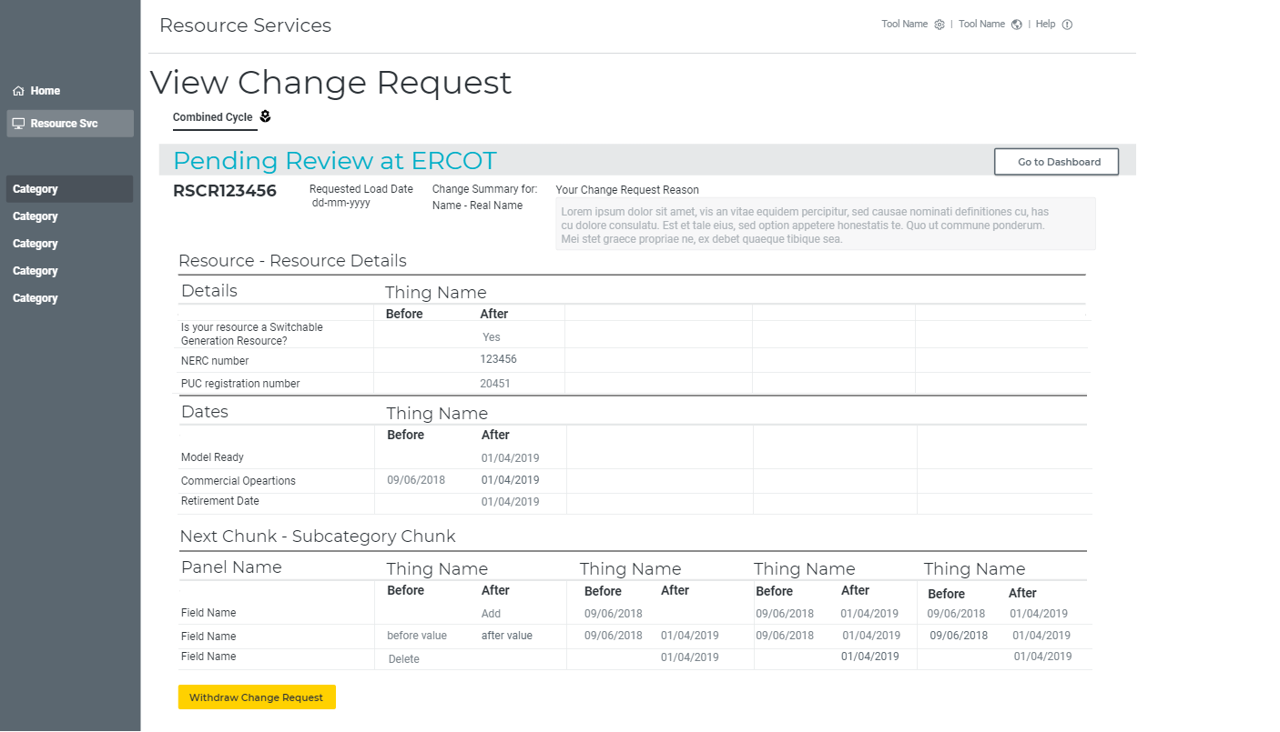
Back

Slide 21
ERCOT – Returns a Change Request

Slide 22
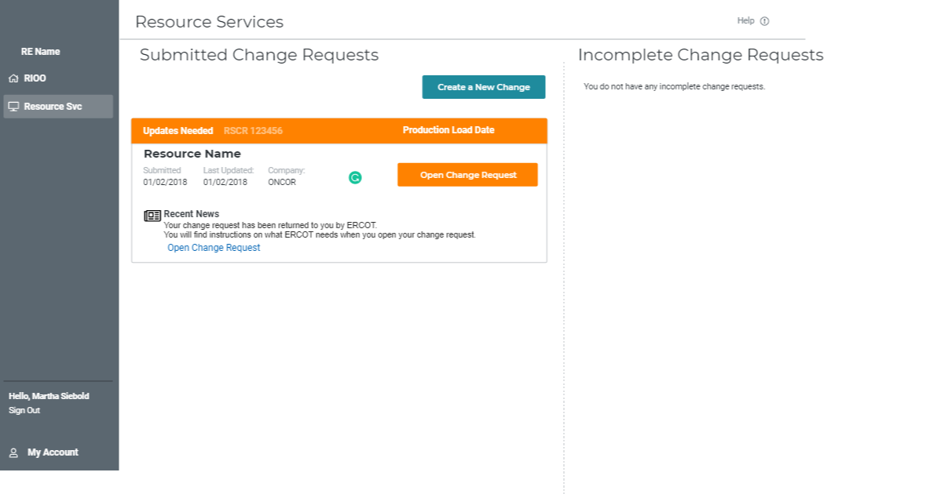

Slide 23
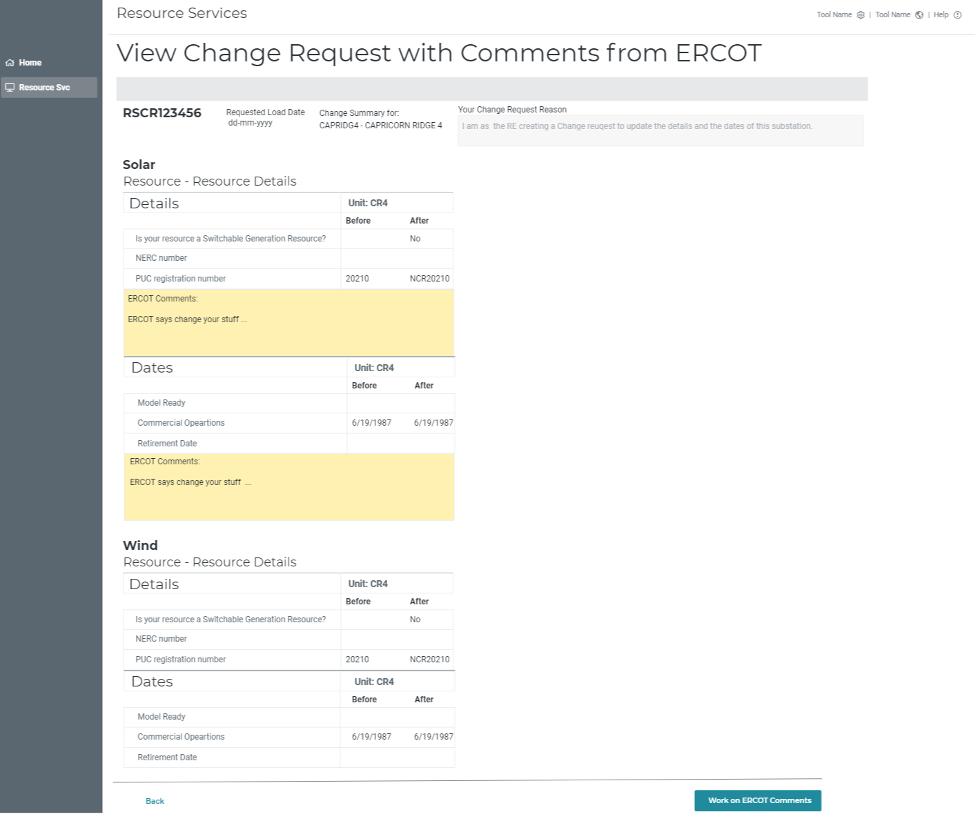

Slide 24
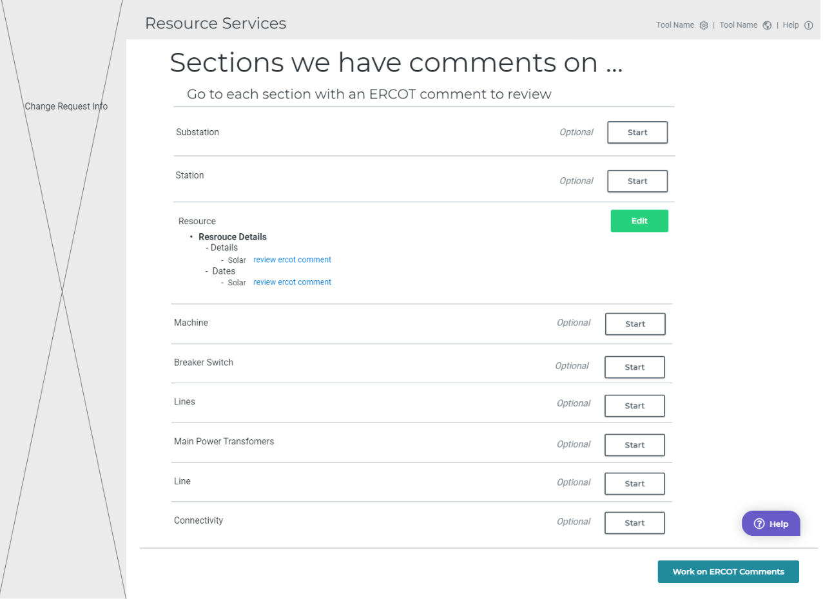
s

Slide 25
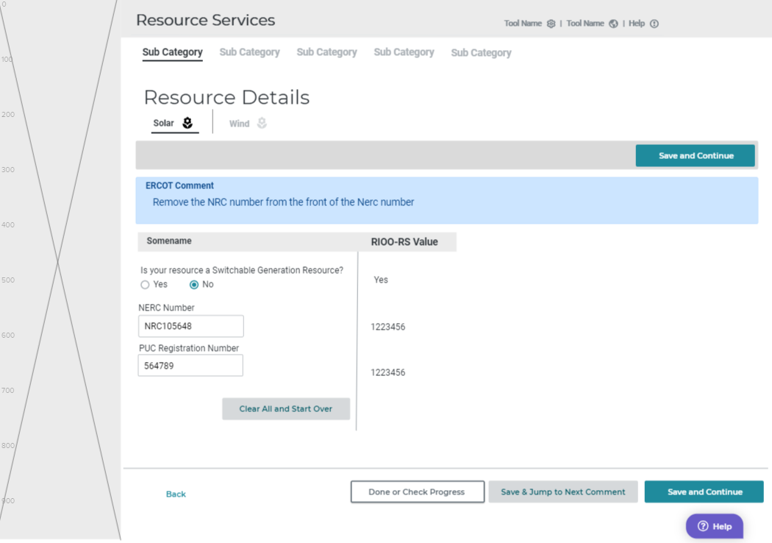

Slide 26
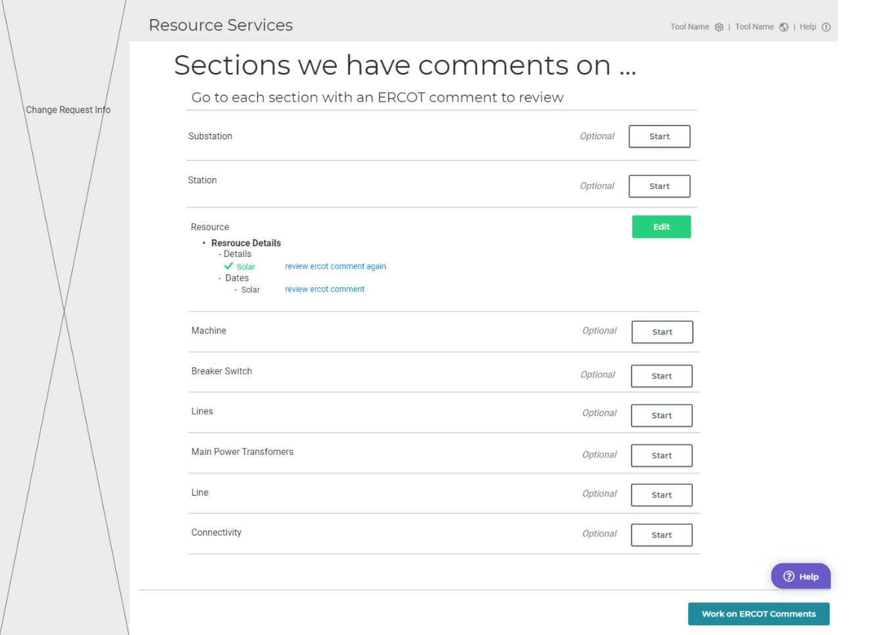

Slide 27
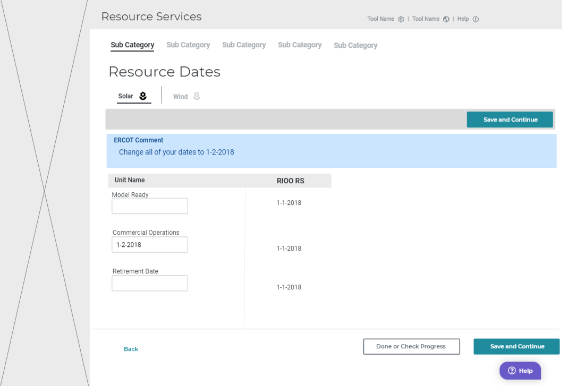
Notes:
We know this is the last ercot comment that has not been visited, so we remove the “jump CTA”, and only have the Done or Check Progress and save and continue

Slide 28
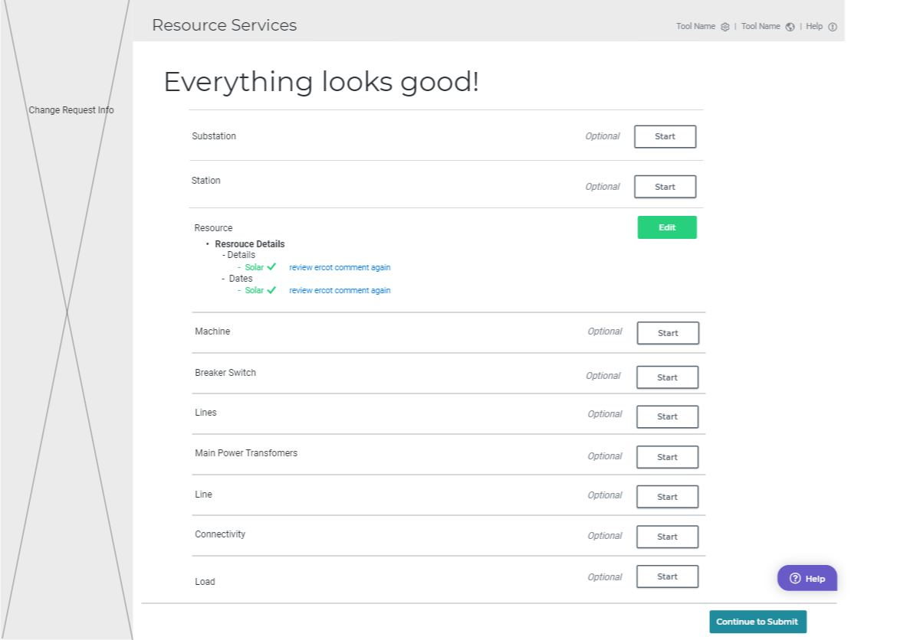

Slide 29
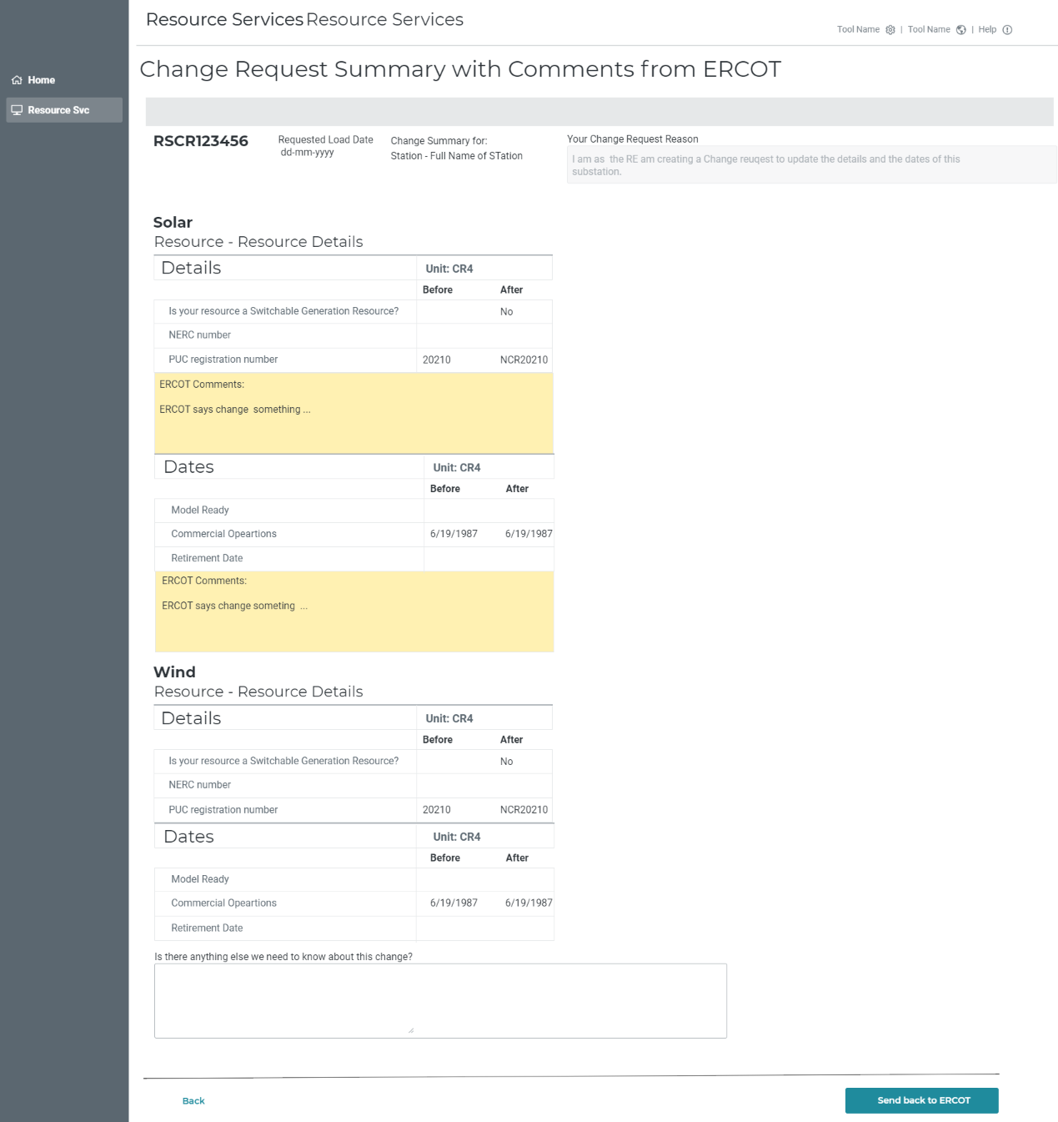

Slide 30
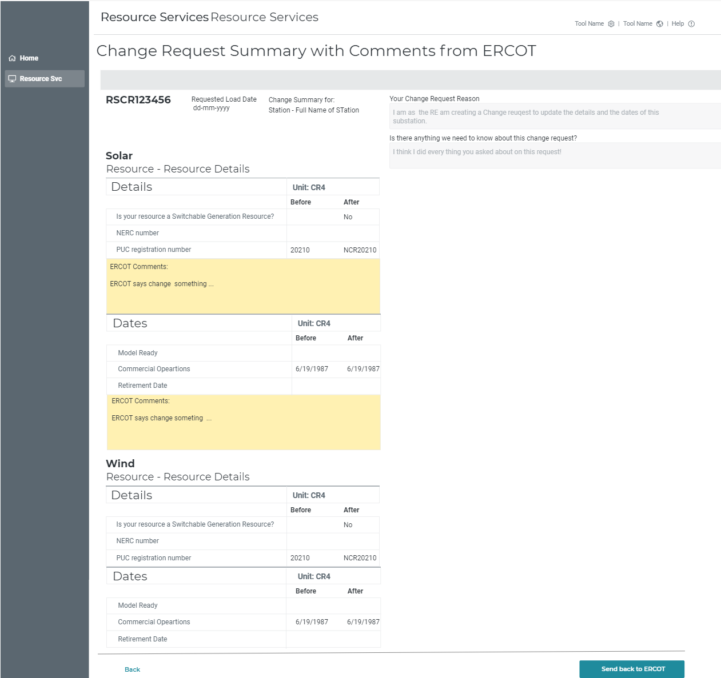
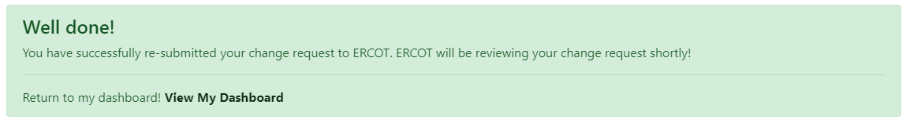

Slide 31
Questions?

Slide 32
Information/Data issues
What’s been found, what may need to be updated:
  Connectivity
  Data that does not match the updated validation rules; special characters (#, $, *)
ERCOT will provide an updated RARF, Delta Report, and Audit Report to the RE.
If the RE agrees with the updated RARF, the RE should submit the RARF to ERCOT.
If the RE does not agree with the changes, the RE should schedule a call with your Client Services Account Manager.
Audit Report may show errors if GIC data has not been submitted or validation rules have been updated.
Model may show that the RE owns equipment, an “ADD” was created, please verify ownership.
Sites may need to be split

Slide 33
Training / Test
System available mid-December for training and test
  Updates available for most frequently changed items first
  Data will be updated and over written with production data on a regular interval

Slide 34
Most frequent changes – top 10
Seasonal Limits
Operational Parameters
Capacitor and Reactor Data
Reactive Capability
General and Site Info (Contact information)
Ownership
Breakers / Switches
Transformer Tap Settings
Lines
Gen Load Sprint - ESIID

