Slide 1
REP / NOIE Demand Response Data Collection Process
DSWG - August 23, 2019

Slide 2
REP/NOIE DR Data Collection
Changes for 2019
  Reporting threshold to exclude smaller REPs and NOIEs
  Allow for REP data to be submitted to ERCOT via NAESB as in prior years or via
    For email submissions, ERCOT will post response files on the MIS
    ERCOT response files within 2 business days
  REPs can request ERCOT to provide a list of ESIIDs that they own on the snapshot date
    Will be posted to the MIS
    Start date of that period of ownership
    Current Profile Group (“RES” or “BUS”)
    Current Meter Data Type (“IDR(includes AMS)” or “NIDR”)
  Data submission deadline Oct 31, 2019

Slide 3
REP/NOIE DR Data Collection
NPRR 933
  Will remain tabled until we complete the 2019 process
  ERCOT will discuss with affected parties and draft comments based on lessons learned

Slide 4
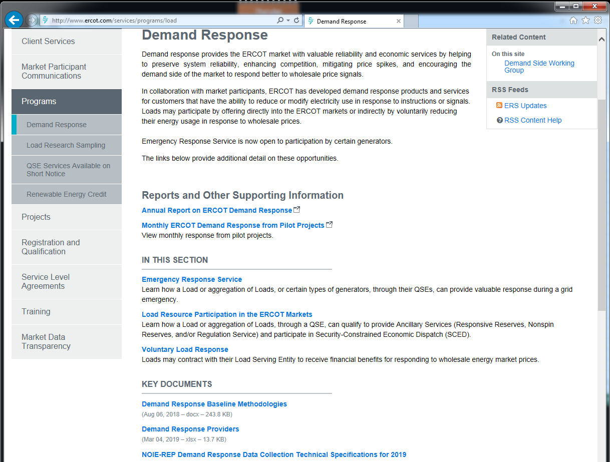
DR Data Collection Specifications
  http://www.ercot.com/services/programs/load

Slide 5
Data Collection Schedule 2019
August 1, 2019
  ERCOT sent a Market Notice to Authorized Representative to all REPs and NOIEs (LSE and TDSP)
  ERCOT posted a participation status report on the MIS – larger REPs and NOIEs notified they are required to participate, smaller not required
  Asked for acknowledgment email by August 15 from required participants
    Responses not received from 15 REPs and 2 NOIEs
    ERCOT Client Services following up with them
September 30, 2019 (Snapshot date)
  ERCOT provides 2019 event survey links to REPs and NOIEs that meet threshold
  REPs can start sending files to ERCOT and complete event surveys
  NOIEs can complete surveys
  REPs and NOIEs with no programs can inform ERCOT via email.
  Responses are required even if no programs

Slide 6
Data Collection Schedule 2019
October 7, 2019
  Upon request, ERCOT provides REPs with list of ESIIDs they own on snapshot date
October 31, 2019
  ESIID submission deadline for files to ERCOT that meet required accuracy
  REP event survey deadline with OLC, PR, OTH programs
  NOIE event survey deadline for customer counts and events
November 29, 2019 - ERCOT completes 2019 summer assessment
March 31, 2020 - 2019 Annual Report of Demand Response posted per Protocols

Slide 7
REP ESIID Data Submission
Program Start Date
  Must not precede the REP-of-Record date for the customer occupying the premise on the snapshot date (ERCOT will modify code to allow a tolerance before flagging as an error)
  Report the date that customer first started participation on the program
  If the same customer was on the program and subsequently renewed contract and/or continued participation report the initial start date
  If the REP-of-Record date and the program start date precedes the previous snapshot date, and the program start date for the two submissions should match

Slide 8
REP/NOIE Data Submission
Other Direct Load Control (OLC)
  Do not report if they participate on ERS or TDSP Standard Offer Programs
  Do not report ERS or TDSP Standard Offer related tests/events
Peak Rebate (PR)
  Report Customers/ESIIDs that were eligible to receive rebates even if no events were called
  Report all Customers/ESIIDs on the program … do not limit to those deemed to have responded
Other Voluntary Demand Response (OTH)
  Report all Customers/ESIIDs on the program … do not limit to those deemed by the REP to have responded

Slide 9
Questions?
ON
OFF
craish@ercot.com 512/248-3876

