Slide 1
AS Offer Structure and Proxy AS Offer Creation under RTC
Hailong Hui
August 27, 2019

Slide 2
Acronyms
Ancillary Service (AS)
Day-Ahead Market (DAM)
ERCOT Contingency Reserve Service (ECRS)
High Sustained Limit (HSL)
Nodal Protocol Revision Request (NPRR)
Non-Spinning Reserve Service (Non-Spin)
Qualified Scheduling Entity (QSE)
Real-Time Co-optimization (RTC)
Regulation Down Service (Reg-Down)
Regulation Up Service (Reg-Up)
Responsive Reserve Service (RRS)

Slide 3
Outlines
AS Offer Structure under RTC
NPRR863 will follow today’s linked AS Offer structure to minimize system changes
RTC will use the AS offer structure from NPRR863
AS Offer Submission Window under RTC
Proxy AS Offer Creation under RTC

Slide 4
AS Framework Changes under NPRR 863
Current Framework
NPRR 863 (approved by ERCOT Board Feb. 12, 2019)
Regulation
No Change
Regulation
157 to 687 MW
157 to 687 MW
FFR
Triggered at 59.85 Hz and full response in 15 cycles
Once deployed, sustain for up to 15 mins. Once recalled, restore within 15 mins
PFR
PFR capable capacity reserved on generators or Controllable Load Resources (CLR)
Minimum 1,150 MW must be provided by resources capable of PFR
Load Resources on UFR
Triggered at 59.70 Hz and full response in 30 cycles
Sustain until recalled. Once recalled, restore within 3 hours
Beyond the minimum PFR, up to 60% of total RRS can come from Load Resources on UFR or FFR.
Responsive Reserve Service
Responsive Reserve Service (RRS)
Fast Frequency Response (FFR)
Primary Frequency Response
Load Resources on Under Frequency Relay (UFR)
10 minute ramp
Load Resources on UFR
Primary Frequency Response (PFR)
2,300 to 3,200 MW
ERCOT Contingency Reserve Service (ECRS)
Generation
Online or offline capacity that can be converted to energy within 10 minutes
Dispatched by SCED
Load Resources (UFR not required)
Up to 50% of ECRS capacity can come from Load Resources with or without UFR
Must respond within 10 minutes. Restoration within 3 hours
2,300 to 3,200 MW
10 minute ramp
Load Resources may or may not be on UFR
Non-Spin
508 to 1,644 MW
967 to 2,361 MW
No protocol changes.
Proposed methodology for Non-Spin Reserve Service quantities in this framework - quantities computed using 2018 A/S Methodology are reduced by ECRS quantities.
Non-Spin
Overall A/S:
3,807 to 5,958 MW
0 to 1,180 MW
Overall A/S: 3,807 to 5,958 MW
Quantities are estimates based on historical procurements and projections.
For Discussion Purposes Only. The intent of this slide is to represent NPRR 863 (with STEC comments from 10/1/2018). Protocol language prevails to the extent of any inconsistency with this one page summary.

Slide 5
AS Offer Submission Window under RTC
The Energy Offer Curve (EOC) submission window is currently under discussion
Current deadline is end of Adjustment Period
Some stakeholders have proposed extending it to end of Operating Period
The AS Offer submission window should be consistent with the EOC submission window

Slide 6
Proxy AS Offer Creation under RTC
RTC will utilize existing linked AS Offer structure to create proxy AS Offers. This will be more efficient and minimize system changes.
Proxy AS Offer Creation for Generation Resource and Controllable Load Resource (CLR)
On-Line upward AS Product (Reg-Up, RRS, ECRS and On-Line Non-Spin)
For OFFQS Generation Resource qualified for ECRS and Non-Spin, On-Line ECRS and Non-Spin proxy AS Offer will be created
Reg-Down
Off-Line Non-Spin

Slide 7
On-Line Upward AS Offer Structure
AS Offer MW (up to 5 per Resource) | RegUp Price ($/MW/h) | RRS Price ($/MW/h) | ECRS Price ($/MW/h) | On-Line Non-Spin Price ($/MW/h)
AS_{MW}¹ | RegUp_{Price}¹ | RRS_{Price}¹ | ECRS_{Price}¹ | ONNS_{Price}¹
AS_{MW}² | RegUp_{Price}² | RRS_{Price}² | ECRS_{Price}² | ONNS_{Price}²
AS_{MW}³ | RegUp_{Price}³ | RRS_{Price}³ | ECRS_{Price}³ | ONNS_{Price}³
AS_{MW}⁴ | RegUp_{Price}⁴ | RRS_{Price}⁴ | ECRS_{Price}⁴ | ONNS_{Price}⁴
AS_{MW}⁵ | RegUp_{Price}⁵ | RRS_{Price}⁵ | ECRS_{Price}⁵ | ONNS_{Price}⁵
Same setup for:
On-Line RegDn AS Offer
Off-Line ECRS and Non-Spin AS Offers
Note: RRS offer may have sub-types (PFR/FFR/UFR) in NPRR863 depending on actual system implementation

Slide 8
Proxy AS Offer Creation for On-Line Upward AS Products
RTC will create a new linked proxy offer for Online upward AS Products
Add an additional segment MW ProxyAS_{MW} equal to HSL
If AS Offer doesn’t exist, ProxyAS_{MW} will be the first segment
If AS Offer exists, ProxyAS_{MW} will be an additional segment
Add proxy AS Offer price for each qualified AS product ONLY
The proxy AS Offer price will be empty for non-qualified AS product
AS Offer MW (up to 5 per Resource) | RegUp Price ($/MW/h) | RRS Price ($/MW/h) | ECRS Price ($/MW/h) | On-Line Non-Spin Price ($/MW/h)
AS_{MW}¹ | RegUp_{Price}¹ | RRS_{Price}¹ | ECRS_{Price}¹ | ONNS_{Price}¹
AS_{MW}² | RegUp_{Price}² | RRS_{Price}² | ECRS_{Price}² | ONNS_{Price}²
AS_{MW}³ | RegUp_{Price}³ | RRS_{Price}³ | ECRS_{Price}³ | ONNS_{Price}³
AS_{MW}⁴ | RegUp_{Price}⁴ | RRS_{Price}⁴ | ECRS_{Price}⁴ | ONNS_{Price}⁴
AS_{MW}⁵ | RegUp_{Price}⁵ | RRS_{Price}⁵ | ECRS_{Price}⁵ | ONNS_{Price}⁵
ProxyAS_{MW} | ProxyRegUp_{Price} | ProxyRRS_{Price} | ProxyECRS_{Price} | ProxyONNS_{Price}

Slide 9
Proxy AS Offer Creation for Reg-Down
RTC will create a new proxy offer for Reg-Down only when the Resource is qualified for Reg-Down (similar logic as Online upward AS products)
Add a new segment MW ProxyAS_{MW} equal to HSL
If Reg-Down Offer doesn’t exist, ProxyAS_{MW} will be the first segment
If Reg-Down Offer exists, ProxyAS_{MW} will be an additional segment
Add proxy AS Offer price for Reg-Down
AS Offer MW (up to 5 per Resource) | RegDn Price ($/MW/h)
AS_{MW}¹ | RegDn_{Price}¹
AS_{MW}² | RegDn_{Price}²
AS_{MW}³ | RegDn_{Price}³
AS_{MW}⁴ | RegDn_{Price}⁴
AS_{MW}⁵ | RegDn_{Price}⁵
ProxyAS_{MW} | ProxyRegDn_{Price}

Slide 10
Proxy AS Offer Creation for Off-Line Non-Spin
RTC will create a new proxy Offer for Off-Line Non-Spin for Resource with telemetry Resource Status ‘OFF’ and qualified to provide Off-Line Non-Spin
Add a new segment MW ProxyAS_{MW} equal to HSL
If Off-Line Non-Spin Offer doesn’t exist, ProxyAS_{MW} will be the first segment
If Off-Line Non-Spin Offer exists, ProxyAS_{MW} will be an additional segment
Add proxy AS Offer price for Off-Line Non-Spin
AS Offer MW (up to 5 per Resource) | Off-Line Non-Spin Price ($/MW/h)
AS_{MW}¹ | OFFNS_{Price}¹
AS_{MW}² | OFFNS_{Price}²
AS_{MW}³ | OFFNS_{Price}³
AS_{MW}⁴ | OFFNS_{Price}⁴
AS_{MW}⁵ | OFFNS_{Price}⁵
ProxyAS_{MW} | ProxyOFFNS_{Price}

Slide 11
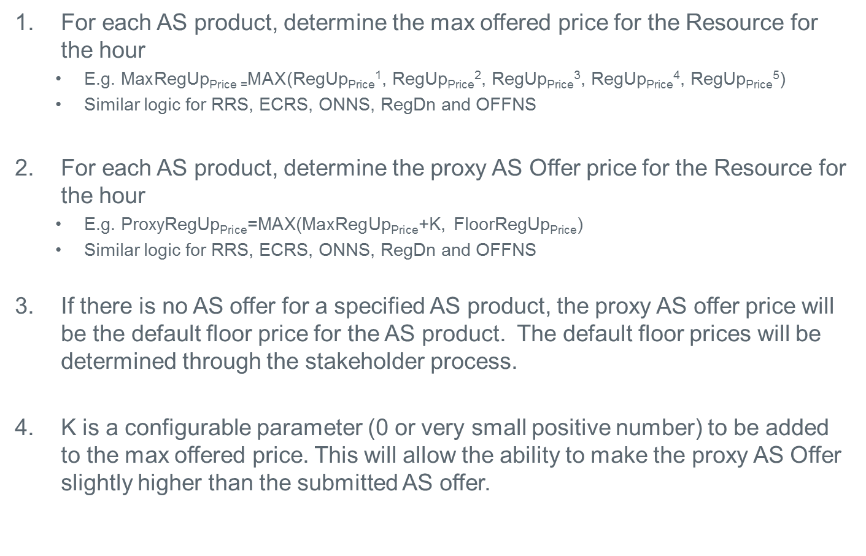
Determine Proxy AS Offer Prices
For each AS product, determine the max offered price for the Resource for the hour
E.g. $\text{Max}\text{RegUp}\text{Price}\text{ =}\text{MAX}$(RegUp_{Price}¹, RegUp_{Price}², RegUp_{Price}³, RegUp_{Price}⁴, RegUp_{Price}⁵)
Similar logic for RRS, ECRS, ONNS, RegDn and OFFNS
For each AS product, determine the proxy AS Offer price for the Resource for the hour
E.g. Proxy$\text{RegUp}\text{Price}$=MAX($\text{Max}\text{RegUp}\text{Price}$+K, $\text{Floor}\text{RegUp}\text{Price}$)
Similar logic for RRS, ECRS, ONNS, RegDn and OFFNS
If there is no AS offer for a specified AS product, the proxy AS offer price will be the default floor price for the AS product. The default floor prices will be determined through the stakeholder process.
K is a configurable parameter (0 or very small positive number) to be added to the max offered price. This will allow the ability to make the proxy AS Offer slightly higher than the submitted AS offer.

Slide 12
Example 1: Online Upward AS Offers for All AS Products
Example illustrates extension of On-Line upward AS Offers for a Resource with 100 MW HSL and only 20 MW of AS Offers submitted
AS Offer MW | RegUp Price ($/MW/h) | RRS Price ($/MW/h) | ECRS Price ($/MW/h) | Non-Spin Price ($/MW/h)
20 | 15 | 10 | 5 | 1
100 | 15 + K | 10 + K | 5 + K | 1 + K

Slide 13
Example 2: Online Upward AS Offers for Some AS Products
Example illustrates creation of proxy On-Line upward AS Offers for a Resource with 100 MW HSL and only 20 MW of offer for RegUp submitted
AS Offer MW | RegUp Price ($/MW/h) | RRS Price ($/MW/h) | ECRS Price ($/MW/h) | Non-Spin Price ($/MW/h)
20 | 15
100 | 15 + K | FloorRRS_{price} | FloorECRS_{price} | FloorONNS_{price}

Slide 14
Example 3: Multi-Segment Online Upward AS Offers
Example illustrates creation of proxy On-Line upward AS Offers for a Resource with 100 MW HSL and 3 segments submitted
AS Offer MW (up to 5 per Resource) | RegUp Price ($/MW/h) | RRS Price ($/MW/h) | ECRS Price ($/MW/h) | On-Line Non-Spin Price ($/MW/h)
20 | 22 | 18 | 15
30 | 23 | 17
10 | 21 |  | 16
100 | 23+K | 18+K | 16+K | FloorONNS_{price}

Slide 15
Example 4: No Online Upward AS Offers
Example illustrates creation of proxy On-Line upward AS Offers for a Resource with 100 MW HSL and no AS Offers submitted
AS Offer MW | RegUp Price ($/MW/h) | RRS Price ($/MW/h) | ECRS Price ($/MW/h) | Non-Spin Price ($/MW/h)
100 | FloorRegUp_{price} | FloorRRS_{price} | FloorECRS_{price} | FloorONNS_{price}

Slide 16
Example 5: No Online Upward AS Offers for OFFQS
Example illustrates creation of proxy On-Line upward AS Offers for a OFFQS Resource with 100 MW HSL and no AS Offers submitted
AS Offer MW | RegUp Price ($/MW/h) | RRS Price ($/MW/h) | ECRS Price ($/MW/h) | Non-Spin Price ($/MW/h)
100 |  |  | FloorECRS_{price} | FloorONNS_{price}

Slide 17
Example 6: No Online Reg-Down Offer
Example illustrates creation of proxy On-Line Reg-Down offers for a Resource with 100 MW HSL and no Reg-Down offers submitted
AS Offer MW | RegDn Price ($/MW/h)
100 | FloorRegDn_{price}

Slide 18
Example 7: No Off-line Non-Spin Offer
Example illustrates creation of proxy Off-line Non-Spin AS Offer for a Resource with 100 MW HSL and no Off-line Non-Spin Offer submitted
AS Offer MW | Non-Spin Price ($/MW/h)
100 | FloorOFFNS_{price}

Slide 19
Determine AS Award in RTC
RTC will always create a linked proxy AS Offer for the Resource with qualified AS product.
RTC will dynamically calculate Resource specific AS MW limit for each AS product based on new telemetry, qualified MW and ramp rates (if applicable).
The RTC optimization will enforce various Resource specific AS constraints to ensure the AS awards are feasible, considering both QSE submitted AS offers and RTC created proxy AS Offers
The RTC will not award an AS product if the telemetered max AS MW for the AS product is 0 even if a proxy AS Offer has been created for it.

Slide 20
More Discussion
Determine Default AS Offer price floor for different AS products.
Do we need to consider Proxy AS Offer for Non-Controllable Load Resources (NCLR)?
NO Proxy AS Offer for DAM.

Slide 21
Questions

