Slide 1
ERCOT management of cases where AS is infeasible in Real-Time (KP 1.3)
RTCTF Meeting Agenda # 3 (d)
Sandip Sharma
August 27, 2019

Slide 2
What is Ancillary Service (AS) Infeasibility?
Per Nodal Protocol Section 6.4.9.1.2 (1) “Replacement of Infeasible Ancillary Service Due to Transmission Constraints”, there are two scenarios under which AS is considered infeasible:
  During HRUC process, when Capacity reserved on a Resource to provide AS is needed to resolve the transmission constraint.
  If the deployment of Ancillary Services form a Resource would have a consistent, negative impact on a transmission constraint.
Today, AS Infeasibility may be identified in either the Adjustment Period or the Operating Period.

Slide 3
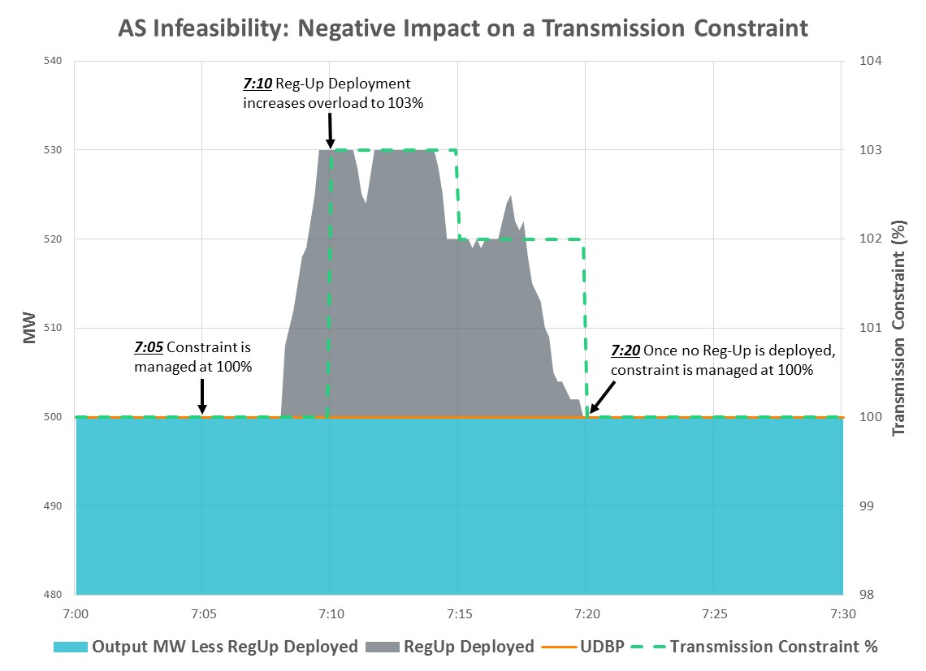
AS Infeasibility: Second Scenario Example

Slide 4
How is AS Infeasibility addressed today?
Per Nodal Protocol Section 6.4.9.1.2 (2), upon notification of AS infeasibility the QSE may do one or more of the following;
  Substitute capacity from other Resources represented by that QSE to meet its Ancillary Services Supply Responsibility;
  Substitute capacity from other QSEs using Ancillary Service Trades; or
  Inform ERCOT that all or part of the Ancillary Services capacity needs to be replaced.
If a QSE elects to substitute capacity, ERCOT shall determine the feasibility of the substitution.
If the substitution is deemed infeasible by ERCOT or the QSE informs ERCOT that the Ancillary Services capacity needs to be replaced, ERCOT shall procure, in its sole discretion that the service is still needed, the Ancillary Services capacity required under Section 6.4.9.2, Supplemental Ancillary Services Market.

Slide 5
AS Infeasibility Under RTC
Ancillary Service Infeasibility under RTC Market Design is limited to those Ancillary Services or subset of AS that are not deployed by RTC SCED.
  Regulation Ancillary Service primarily falls into this category since Regulation is deployed by LFC which is primarily focused on restoring frequency and does not take transmission security into account.
  Besides Regulation AS, Resources carrying RRS which respond as a block based on Frequency triggers may have adverse impact on transmission security if these resource respond.
During HRUC process only AS capability will be checked and AS capacity will not be reserved. No AS will be considered infeasible during HRUC.

Slide 6
Proposal To Address AS Infeasibility
Within RTC, ERCOT proposes to build functionality where Operators can block RTC from awarding Ancillary Services to Resources that when deployed, will result in transmission constraints being violated.

