Slide 1
Credit Exposure Update
Spoorthy Papudesi
Credit Work Group
ERCOT Public
August 21, 2019

Slide 2
Monthly Highlights Jun 2019- Jul 2019
Market-wide average TPE increased from $372.7million to $495.01 million
The increase in TPE is due to higher average Load in July compared to June as well as higher Forward Adjustment Factors
Discretionary Collateral is defined as Secured Collateral in excess of TPE,CRR Locked ACL and DAM Exposure.
Average Discretionary Collateral increased from $ 1,164.9 million to $1,219.8 million
The increase in Discretionary Collateral is largely due to increase in Secured Collateral
The increase in Secured Collateral more than offsets the increase in TPE and CRR Locked ACL
Number of active Counter-Parties decreased from 243 to 238
No unusual collateral call activity

Slide 3
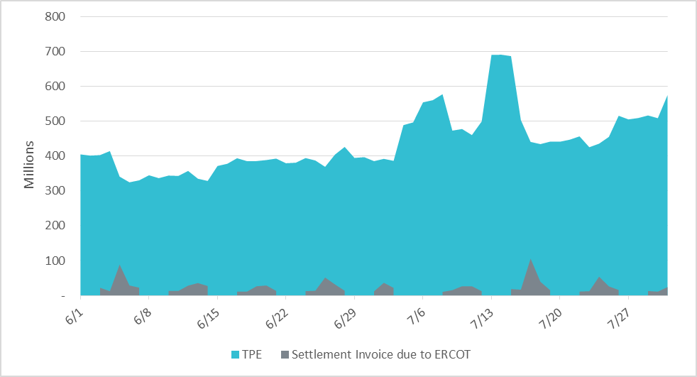
Settlement Invoice Charges/TPE Jun 2019- Jul 2019

Slide 4
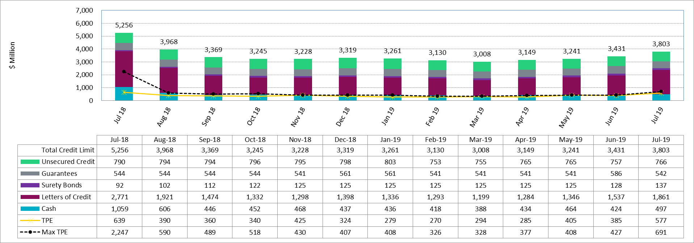
Available Credit by Type Compared to Total Potential Exposure (TPE)
*Numbers are as of month end except for Max TPE

Slide 5
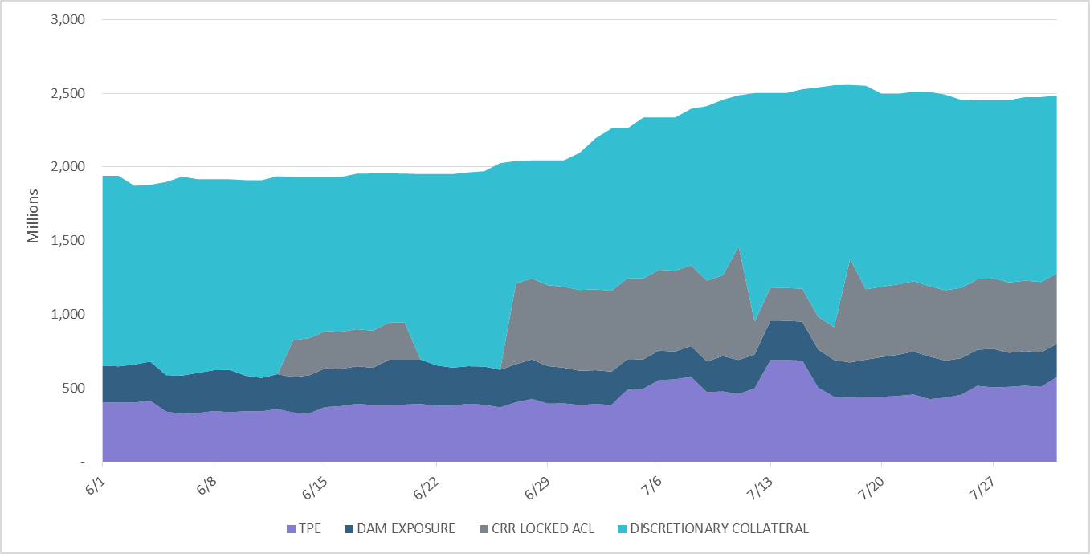
Discretionary Collateral Jun 2019- Jun 2019
At a Counter-Party level, no unusual changes were noted
Note: Discretionary collateral doesn’t include Unsecured Credit Limit or parent guarantees

Slide 6
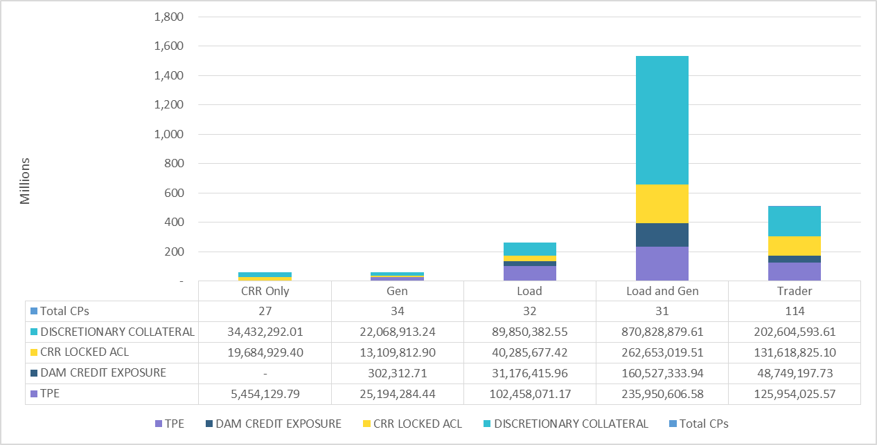
TPE and Discretionary Collateral by Market Segment- Jul 2019
Load and Generation entities accounted for the largest portion of discretionary collateral

Slide 7
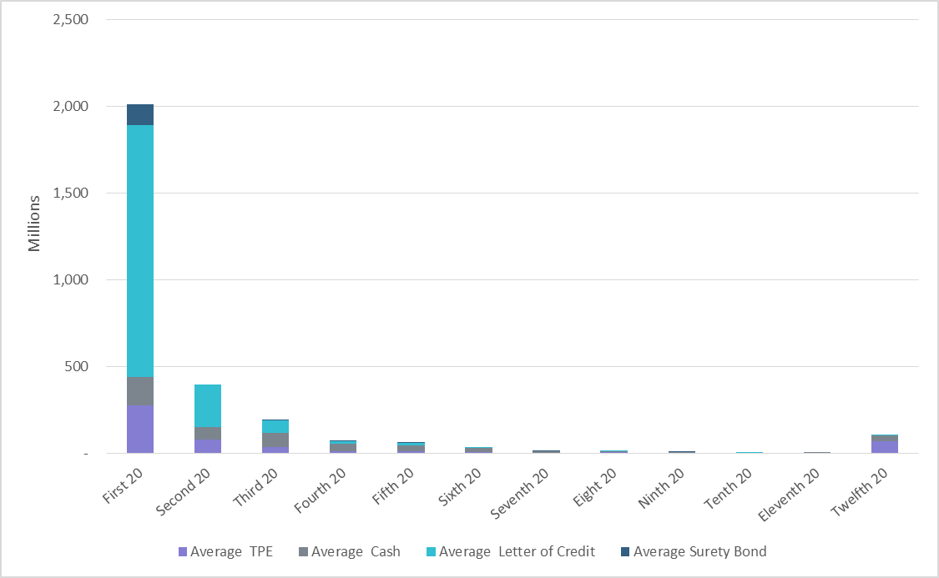
Secured Collateral distribution/ TPE- Jul 2019
Posting of discretionary collateral is relatively concentrated.
Secured Collateral: Letter of Credit, Surety Bond or Cash

Slide 8
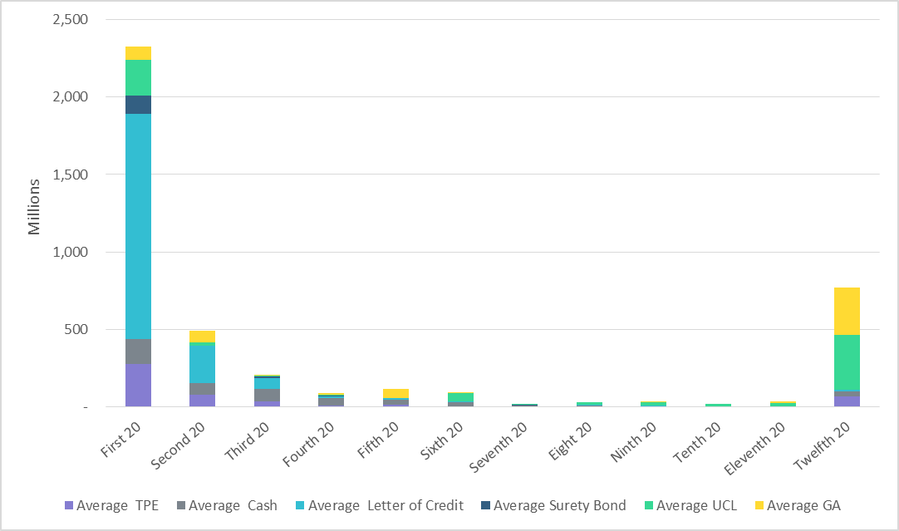
Secured Collateral and Unsecured Credit Limit (UCL) distribution/ TPE- Jul 2019
TPE in the last bucket is mostly covered by Guarantees and UCL

Slide 9
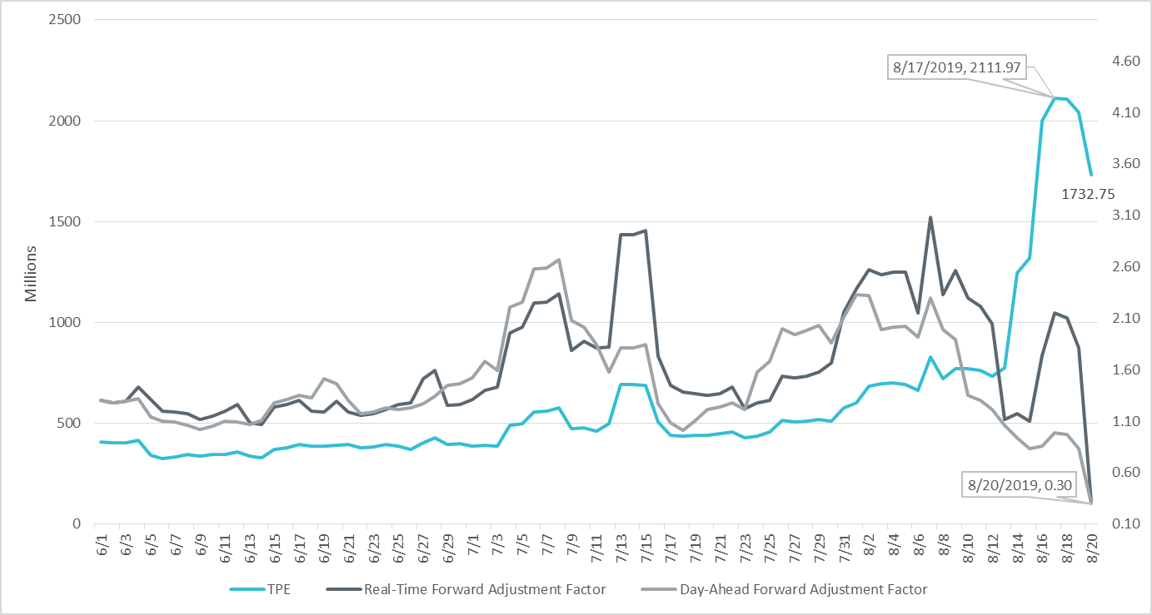
TPE and Forward Adjustment Factors Jun 2019- Aug 2019
TPE moved in conjunction with forward adjustment factors
The Real-Time (RFAF) and Day-Ahead (DFAF) forward adjustment factors capture the ratio of forward ERCOT North prices to actual prices.

Slide 10
Appendix

Slide 11
Summary of Distribution by Market Segment

Slide 12
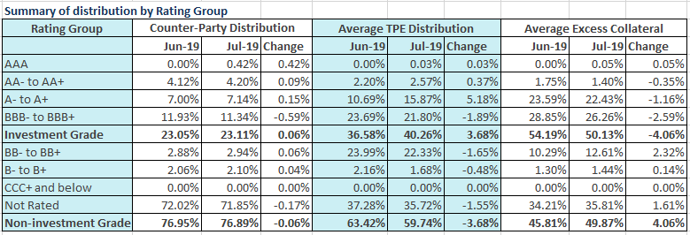
Summary of Distribution by Rating Group

Slide 13
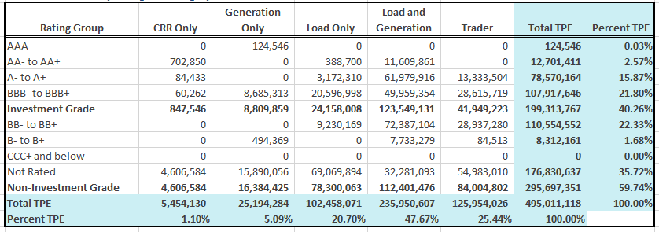
Distribution of TPE by Rating and Category

Slide 14
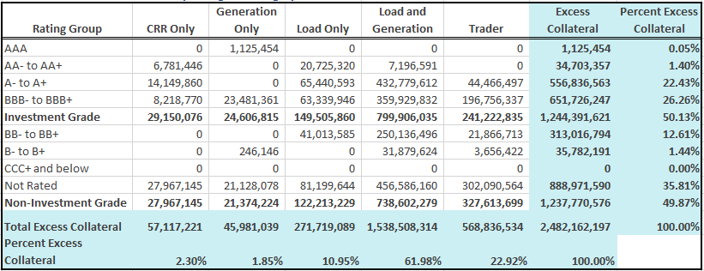
Distribution of Excess Collateral by Rating and Category
Note: Excess collateral doesn’t include Unsecured Credit Limit

Slide 15
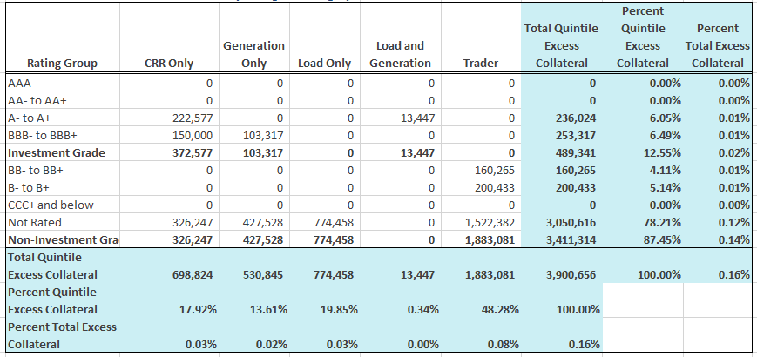
Bottom Quintile Distribution of Excess Collateral by Rating and Category

Slide 16
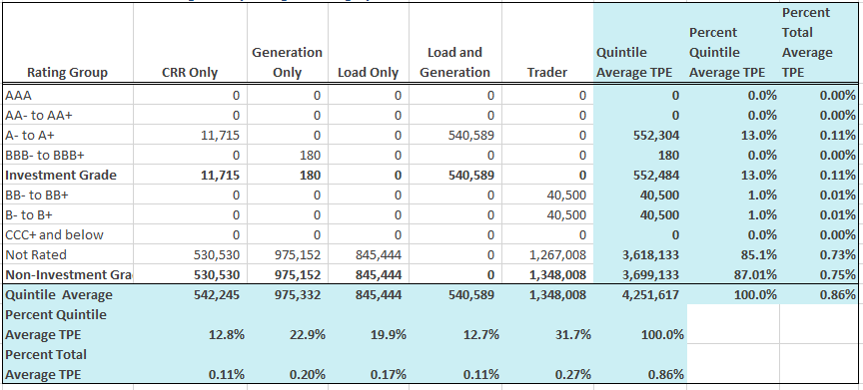
Bottom Quintile Distribution of Average TPE by Rating and Category

Slide 17
Questions

