Slide 1
Credit Impacts of 2019 Summer Price Event
Credit Work Group / Market Credit Working Group
ERCOT Public
August 21, 2019

Slide 2
Credit Impacts of Summer 2019 Price Event
ICE Futures as of August 19th

Slide 3
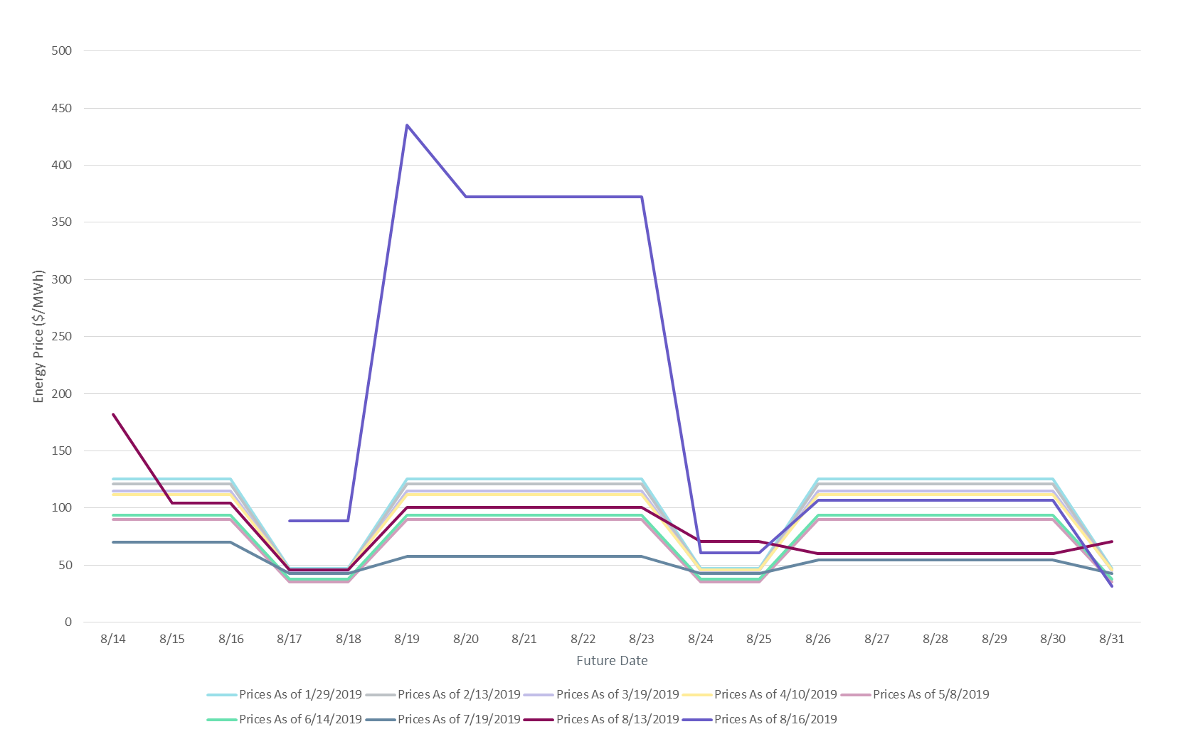
Credit Impacts of Summer 2019 Price Event
ICE Price Evolution

Slide 4
Credit Impacts of Summer 2019 Price Event
Forward Adjustment Factors

Slide 5
Credit Impacts of Summer 2019 Price Event
TPE & Collateral

Slide 6
Credit Impacts of Summer 2019 Price Event
TPE & collateral trajectory compared to July 2018

Slide 7
Credit Impacts of Summer 2019 Price Event
Credit in Excess of TPE

Slide 8
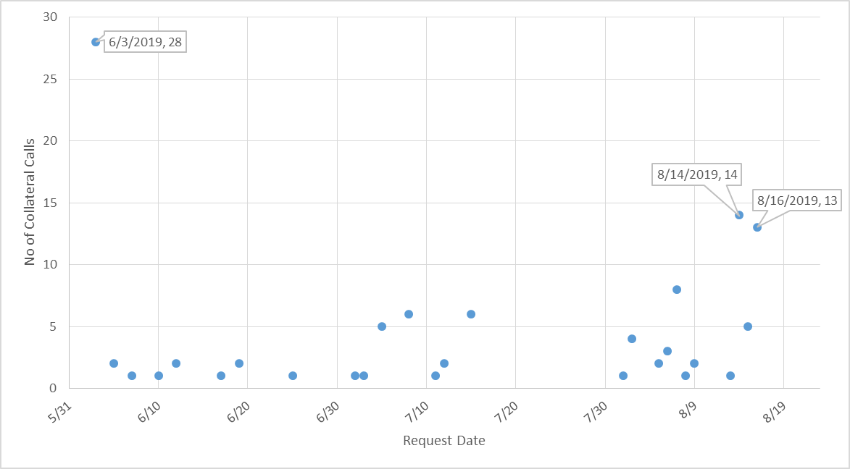
Credit Impacts of Summer 2019 Price Event
Collateral calls June-August 2019

Slide 9
Credit Impacts of Summer 2019 Price Event
Questions

