Slide 1
MarkeTrak Training
Bulk Insert Process

Slide 2
Bulk Insert: Overview
MarkeTrak Bulk Insert functionality…
Allows for automated method of submitting multiple MarkeTrak issues of the same subtype
Uses a CSV file containing data for each issue and is uploaded via the Bulk Insert workflow
Templates available for each subtype’s CSV file format containing the defined required field ordering for the issue type

Slide 3
Bulk Insert: Validations
Two levels of validations are performed on this MT Subtype:
Overall file format level validations upon submission
Business level validations on each row of data within CSV file
All validations will default to “off” unless otherwise flagged
Any “blank” validation flag assumes validation is turned “off”
If populated with “1” in the appropriate field, validation is “on”

Slide 4
Bulk Insert: File Format Validations
Performed on CSV file during the “Attach and Validate” transition
Determine if correct # of columns were uploaded
Comments will indicate # of rows that successfully uploaded (with correct # of columns) and # of rows not uploaded from CSV file

Slide 5
Bulk Insert: Business Level Validations
Performed on required fields of template
Report posted to destination of choice: MarkeTrak attachment or MIS
Report includes following five additional columns added at end of each row, representing following data:
Success or Fail: “success” indicates successfully submitted via Bulk Insert and “fail” indicates issue was not submitted
Error Code: if an issue fails, a code will populate in this field
Error Message: field contains error message why the issue failed to submit
Date/Time Stamp: contains date and time stamp of when the issue was submitted
Issue ID: MarkeTrak issue ID for successfully submitted issues
Allow adequate time for processing individual issues. Average processing time is a few seconds per row.

Slide 6
Bulk Insert: CSV File Validations
Validation | Populate “1” | Populate “0” | Leave Blank
ESI ID Duplicate Check | Will not submit issue if duplicate issue exists containing ESI ID for which submitter has access | Duplicate check overridden, issue will submit provided criteria is met | “0” will automatically default and check will not be performed
Global ID Duplicate Check | Will not submit issue if a duplicate issue is located in MarkeTrak containing ESI ID for which submitter has access | Duplicate check overridden, issue will submit provided criteria is met | “0” will automatically default and check will not be performed
ESI ID Validation- must be enabled for Premise Type to return | Submit for validation of ESI ID against ERCOT registration system | Submit regardless if ESI ID is within ERCOT registration system | “0” will automatically default and check will not be performed
Evaluation Window Check – Global ID Validation must be enabled | Enables TRAN Type/Evaluation rules be applied for Cancel w/Approval issues | Ignores Evaluation rule and submits issue regardless of violation | “0” will automatically default and check will not be performed
Global ID Validation | Enables validation of Global ID against ERCOT registration system | Ignores validation of Global ID with ERCOT registration system | “0” will automatically default and check will not be performed

Slide 7
Bulk Insert: CSV File Validations
Validation | Populate “1” | Populate “0”
ESI ID Duplicate Check | Will not submit issue if duplicate issue exists containing ESI ID for which submitter has access | Duplicate check overridden, issue will submit provided criteria is met
Global ID Duplicate Check | Will not submit issue if a duplicate issue is located in MarkeTrak containing ESI ID for which submitter has access | Duplicate check overridden, issue will submit provided criteria is met
ESI ID Validation- must be enabled for Premise Type to return | Submit for validation of ESI ID against ERCOT registration system | Submit regardless if ESI ID is within ERCOT registration system
Evaluation Window Check – Global ID Validation must be enabled | Enables TRAN Type/Evaluation rules be applied for Cancel w/Approval issues | Ignores Evaluation rule and submits issue regardless of violation
Global ID Validation | Enables validation of Global ID against ERCOT registration system | Ignores validation of Global ID with ERCOT registration system
If Validation field is left blank, a “0” will automatically default and the check will not be performed.

Slide 8
Bulk Insert: CSV File Template
Bulk Insert templates for every applicable subtype are available on the MarkeTrak Information Page. Below is a sample of the template for the Usage/Billing Missing subtype:
The definition of the data fields is as follows:
Required (Req)
Optional (Opt)
Not Applicable (N/A)
Required or Optional (R/O)
Required or Not Applicable (R/NA)
Optional or Not Applicable (O/NA)
DateTime format = ccyy-mm-dd Thh:mm:ss eg: 2019-11-15T13:20:57
Date format = ccyy-mm-dd eg: 2015-11-15

Slide 9
Bulk Insert: Tips & Tricks
Before submission of the bulk insert CSV file the user should ensure all rows are accounted for in the file template to successfully pass validation for submission of the file.
Tip 1 – One template, one subtype
Only submit multiple issues via bulk insert for the same subtype
Tip 2 – Request all validations occur
Select all the validations to ensure data is valid and does not contain duplicates
Tip 3 – Caution when copying ESI IDs
Use caution when copying ESI IDs and pasting into the Excel Spreadsheet Bulk Insert Template.
A normal copy and paste can result in the 17 digit ESI ID being automatically formatted by Excel in Scientific Notation Format (example 1.04437E+16).
Changing the format of the cell in the spreadsheet will result in the last two digits of the 17 digit ESI ID to change to 00. This will cause the MarkeTrak issue to be created using the wrong ESI ID.
.

Slide 10
Bulk Insert: Tips & Tricks – cont.
Solution for accurate ESI ID format:
Open the Excel Spreadsheet Bulk Insert Template and Right Click in ESI ID cells.
Select Format Cells and choose Text from the list.
Copy ESI ID from source document and right click in the ESI ID cell and choose Paste Special and then choose Text.
This will paste the 17 digit ESI ID into the spreadsheet in text format and avoid Excel changing the ESI ID format.
Tip 4 – Avoid commas in comments
Avoid commas (,) in any comment on the MarkeTrak issue via Bulk Insert. As a CSV (Comma Separated Value) file, any comma in a comment field will be recognized as a delimiter and misalign the column count causing the file to fail.

Slide 11
Bulk Insert: Tips & Tricks
Tip 5 – Correct format on dates and times
ensure date/time field has correct format and populates the field in the T-format. If not formatted correctly, bulk insert file will not pass validation.
Correct format on dates and times
Tip 6 – Ensure all rows are accounted for
Before submission of the bulk insert CSV file the user should ensure all rows are accounted for in the file template to successfully pass validation for submission of the file.
Tip 7 – Delete the header row
Once all data has been entered into required fields on the bulk insert template, the header row should be deleted before saving the file in the CSV format.
Tip 8 – Checking validation errors
If you receive a validation error, go to notepad and open your CSV file to determine where the error has occurred and correct it. Once the error is corrected save the file with a new name. If you do not save with a new name your corrections will not be saved to the corrected file.
.

Slide 12
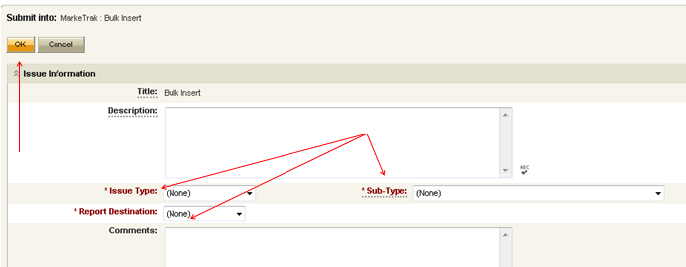
Bulk Insert: Submit
Submitting a Bulk Insert Issue:
Following fields must be populated for successful submission of Bulk Insert:
Issue Type
Sub-Type
Report Destination
Submitter selects OK

Slide 13
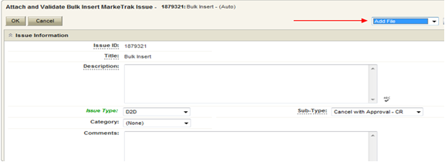
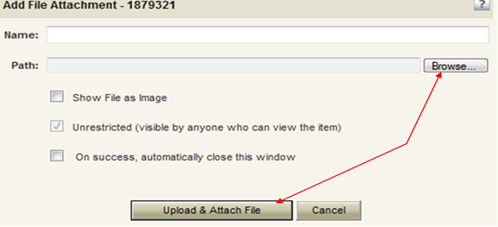
Bulk Insert: Submit (cont.)
From the Actions dropdown, select Add File
Select Browse, locate the CSV file, and press Upload & Attach File

Slide 14
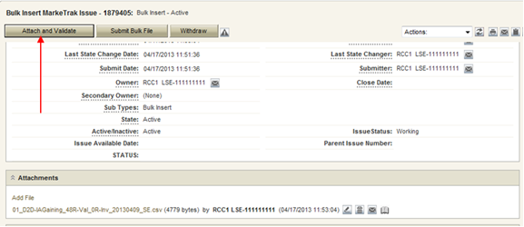
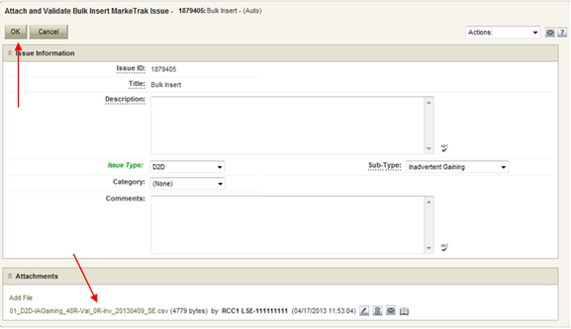
Bulk Insert: Submit (cont.)
Select Attach and Validate
Once the file has been attached select OK to validate the format of the CSV file

Slide 15
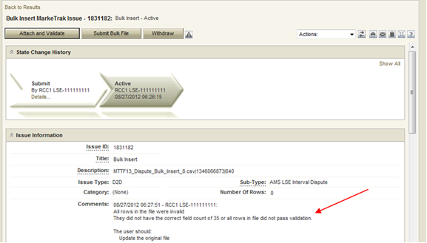
Bulk Insert: Submit (cont.)
Validation will be performed on the uploaded file
File failure possibilities:
incorrect number of columns
formatted incorrectly
Comments section to display failure message
Failures must be corrected
Once corrected, original file must be deleted before it can be reattached
To delete the file, select trash can icon next to file name
Select ‘delete file’

Slide 16
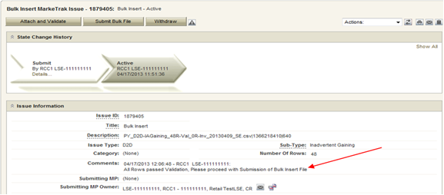
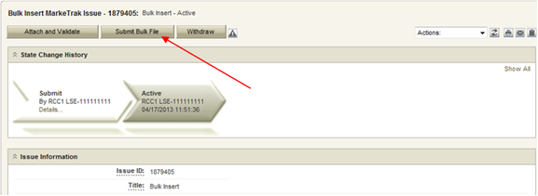
Bulk Insert: Submit (cont.)
If the upload is successful, a message indicating “All rows passed validation” will appear
Select ‘Submit Bulk File’ to create individual issues

Slide 17
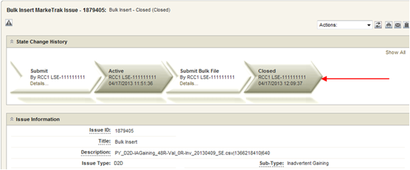
Bulk Insert: Submit (cont.)
After submitting the issue it will automatically close the Bulk Insert issue
Once submitted, Bulk Insert MarkeTrak Number becomes the “parent” and will be populated on each individual MarkeTrak issue (which are the “children”) created by the Bulk Insert

Slide 18
Bulk Insert: Report Destination Options
User chooses report destination as either:
file attached to the MarkeTrak issue
posted to reports section on MIS
user to download the file via MIS
access to MIS can be selected at top of the MarkeTrak GUI screen

Slide 19
Bulk Insert: Report Destination
From within MIS, select the Retail link to access the reports

Slide 20
Bulk Insert: Report Destination
Select the MarkeTrak Bulk Submissions Report link to access the .csv file

Slide 21
Checkpoint Question
In what format should your Bulk Insert file be saved, prior to uploading into MarkeTrak?
*.pdf
*.txt
*.csv
*.xlsx
*.csv

Slide 22
Checkpoint Question
True or False:
Bulk Insert templates for every applicable subtype are available on the MarkeTrak Information Page.
True

