Slide 1
KP 1.3 RTC Constraints
Pricing Run
System Wide AS Constraints
Resource Status
New Telemetry for ECRS,Non-Spin
Off-Line Non-Spin Deployment
QSGR in OFFQS mode
UFR Load Resource Treatment
  Settlement Examples
Sai Moorty, Pamela Shaw
Market Design and Analysis
August 9, 2019

Slide 2
ERRATA: July 12th Posting of KP1.3 Constraint Examples
KP1.3 PowerPoint presentation corrected and reposted to July 12th RTCTF meeting page:
http://www.ercot.com/content/wcm/key_documents_lists/180266/KP_1.3_Contraints_Examples-corrected_examples.pptx
  Example 3 and Example 6 results corrected

Slide 3
Items For Discussion
This presentation is based on the working document “RTC_Constraints_KP1.3_080919_v3.docx” posted to the August 9, RTCTF meeting page
http://www.ercot.com/content/wcm/key_documents_lists/180260/RTC_constraints_KP1.3_080919_v3.docx
Pricing Run
System Wide AS Constraints
Resource Status
New Ramp Rate Telemetry for ECRS, Non-Spin
Off-Line Non-Spin Deployment
QSGR in OFFQS mode
UFR Load Resource Treatment
  Settlement Examples

Slide 4
Pricing Run (NPRR 626) Under RTC
Intent, like today, is to capture system wide pricing impacts on energy and each AS type MCPC when “out-of-market” actions are taken
Note: Changes to current Pricing Run (locational impacts, others) will be analyzed and the intent of these changes will be incorporated into RTC.
Proposal for Pricing Run Under RTC:
  No Make Whole payment to Resources (Same as today)
  Reliability Deployment Price Adder (RDPA) for Resource headroom does not exist anymore
  Same categories of reliability deployments that initiate pricing run as today (6.5.7.3.1)

Slide 5
Pricing Run (NPRR 626) Under RTC
  Change inputs to pricing run:
    Relax HDL/LDL for certain On-Line Resources (6.5.7.3.1)
    ONRUC/On-Line RMR Resource:
      LSL,LDL set to zero (Refer to Protocols for combined cycle RUCed to different configuration)
      Remove AS Offers or high priced AS Offers
    ERS and UFR type Load Resource deployed due to ERCOT XML Instruction (RRS/ECRS)
      Remove AS offers or high priced AS Offers
    GTBD (same as today):
      Add deployed MW (as per ERCOT XML Instruction) to GTBD(e.g. relax LSL of ONRUC to zero, modify HDL/LDL of certain Resources, etc.)
      Modify GTBD related to “out of market actions” on DC Ties and Block Load Transfers
  Rerun Step1 and Step2 (energy and AS co-optimization)

Slide 6
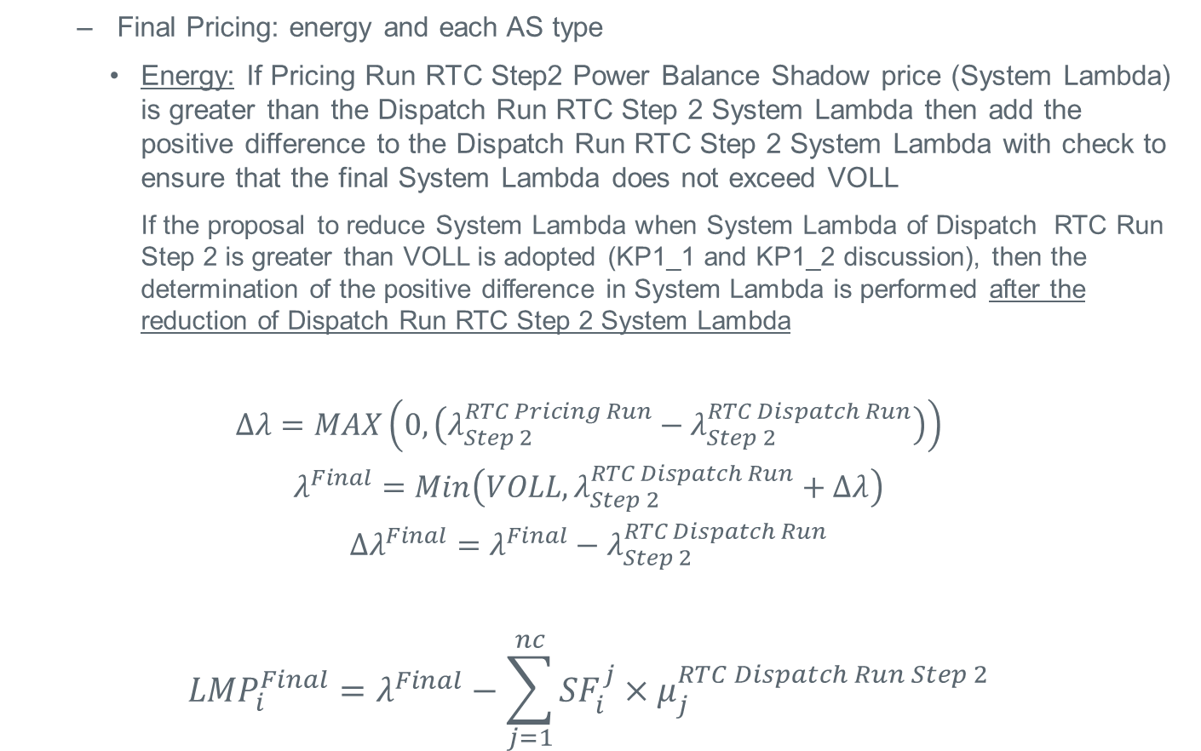
Pricing Run (NPRR 626) Under RTC
  Final Pricing: energy and each AS type
    Energy: If Pricing Run RTC Step2 Power Balance Shadow price (System Lambda) is greater than the Dispatch Run RTC Step 2 System Lambda then add the positive difference to the Dispatch Run RTC Step 2 System Lambda with check to ensure that the final System Lambda does not exceed VOLL
    If the proposal to reduce System Lambda when System Lambda of Dispatch RTC Run Step 2 is greater than VOLL is adopted (KP1_1 and KP1_2 discussion), then the determination of the positive difference in System Lambda is performed after the reduction of Dispatch Run RTC Step 2 System Lambda
$$Δλ=MAX\left(0,\left(λ_{Step 2}^{RTC Pricing Run}−λ_{Step 2}^{RTC Dispatch Run}\right)\right)$$
$$λ^{Final}=Min\left(VOLL,λ_{Step 2}^{RTC Dispatch Run}+Δλ\right)$$
$${Δλ}^{Final}=λ^{Final}−λ_{Step 2}^{RTC Dispatch Run}$$
$${{LMP}_{i}^{Final}=λ}^{Final}−\sum_{j=1}^{nc}{{SF}_{i}^{j}×μ_{j}^{RTC Dispatch Run Step 2}}$$
LMP Price Adder

Slide 7
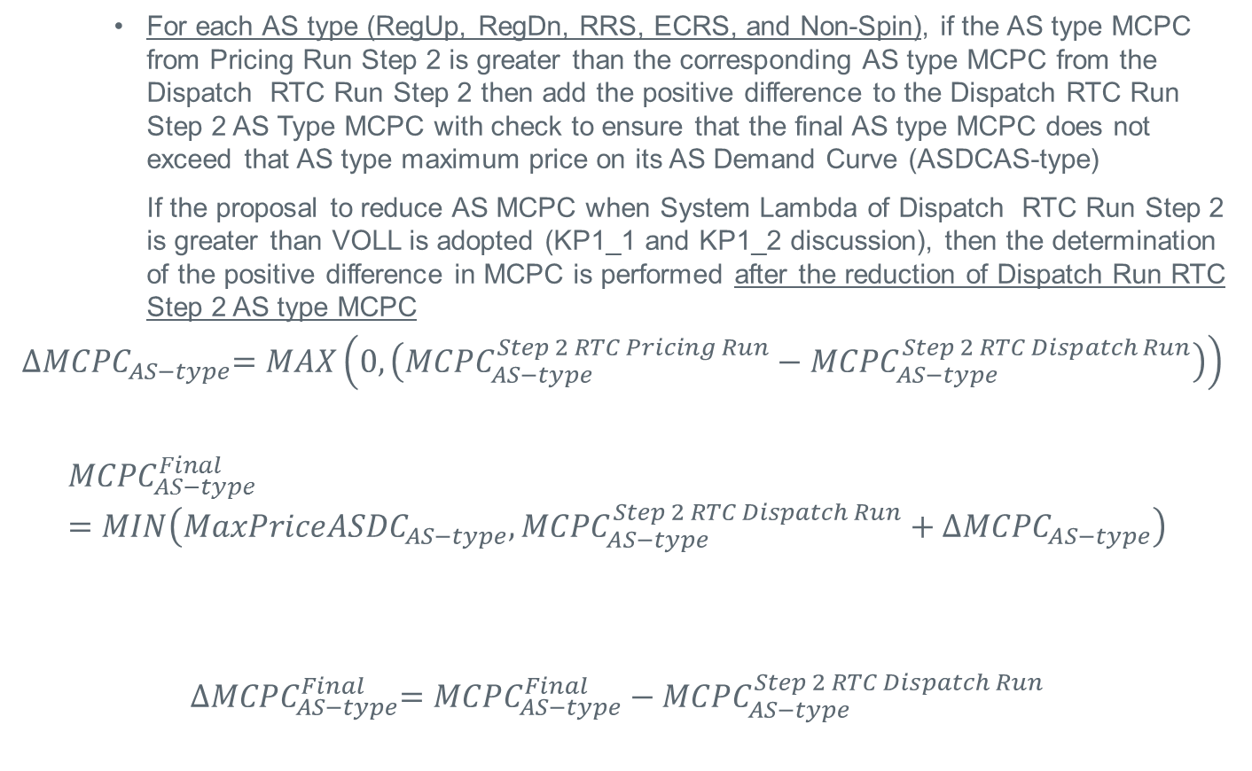
Pricing Run (NPRR 626) Under RTC
    For each AS type (RegUp, RegDn, RRS, ECRS, and Non-Spin), if the AS type MCPC from Pricing Run Step 2 is greater than the corresponding AS type MCPC from the Dispatch RTC Run Step 2 then add the positive difference to the Dispatch RTC Run Step 2 AS Type MCPC with check to ensure that the final AS type MCPC does not exceed that AS type maximum price on its AS Demand Curve (ASDCAS-type)
    If the proposal to reduce AS MCPC when System Lambda of Dispatch RTC Run Step 2 is greater than VOLL is adopted (KP1_1 and KP1_2 discussion), then the determination of the positive difference in MCPC is performed after the reduction of Dispatch Run RTC Step 2 AS type MCPC
$${∆MCPC}_{AS−type}=MAX\left(0,\left({MCPC}_{AS−type}^{Step 2 RTC Pricing Run}−{MCPC}_{AS−type}^{Step 2 RTC Dispatch Run}\right)\right)$$
$${MCPC}_{AS−type}^{Final}=MIN\left({MaxPriceASDC}_{AS−type},{MCPC}_{AS−type}^{Step 2 RTC Dispatch Run}+{∆MCPC}_{AS−type}\right)$$
$${∆MCPC}_{AS−type}^{Final}={MCPC}_{AS−type}^{Final}−{MCPC}_{AS−type}^{Step 2 RTC Dispatch Run}$$
MCPC_{AS-type} Price Adder

Slide 8
System Wide AS Constraints
$/MW/h
AS_{type} Supply MW Offer Awarded = AS_{type} Demand MW Awarded
As_{type} Demand Curve
AS_{type} Demand MW Awarded
As_{type} MCPC
$/MW/h
As_{type} Supply MW Offer Awarded
MW

Slide 9
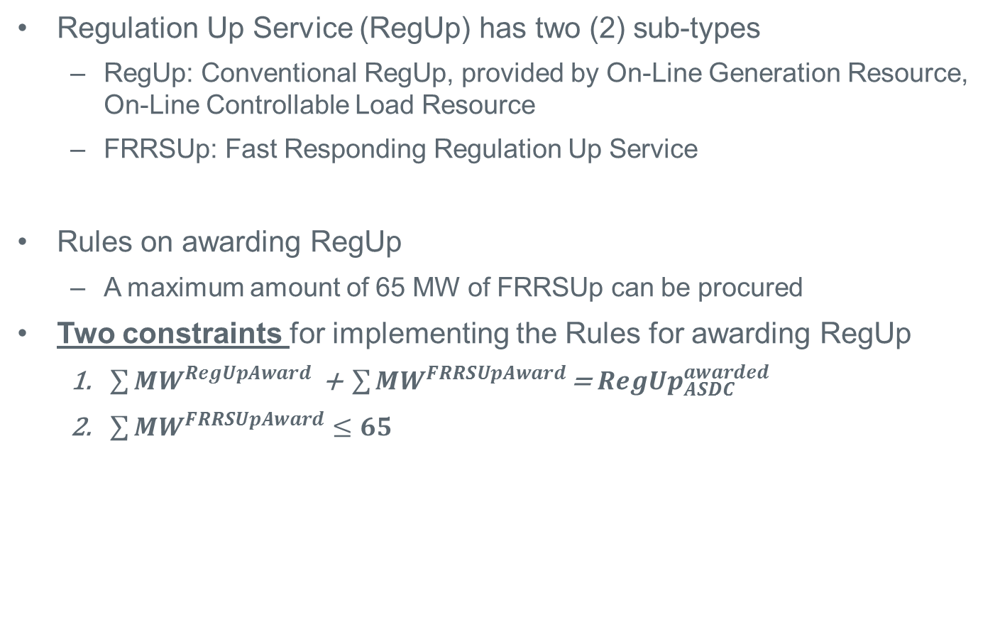
System Wide Regulation Up Service (RegUp) Constraints
Regulation Up Service (RegUp) has two (2) sub-types
  RegUp: Conventional RegUp, provided by On-Line Generation Resource, On-Line Controllable Load Resource
  FRRSUp: Fast Responding Regulation Up Service
Rules on awarding RegUp
  A maximum amount of 65 MW of FRRSUp can be procured
Two constraints for implementing the Rules for awarding RegUp
  $\sum{{MW}^{RegUpAward}}\text{ +} \sum{{MW}^{FRRSUpAward}}\text{= }{RegUp}_{ASDC}^{awarded}$
  $\sum{{MW}^{FRRSUpAward}}≤65$

Slide 10
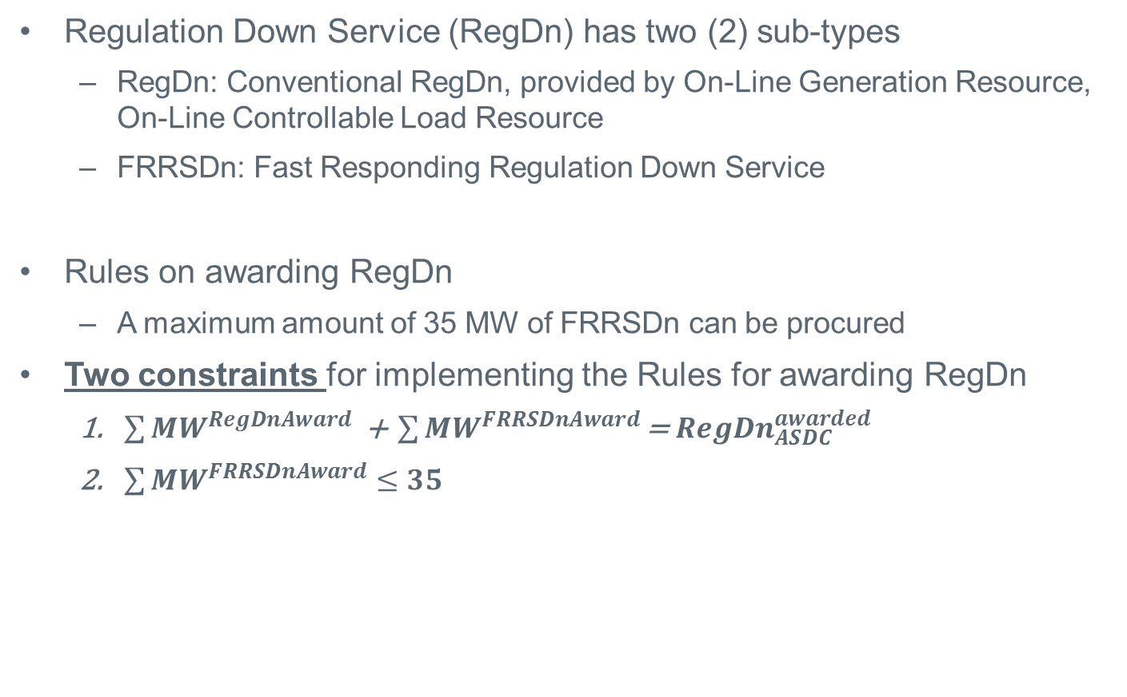
System Wide Regulation Down Service (RegDn) Constraints
Regulation Down Service (RegDn) has two (2) sub-types
  RegDn: Conventional RegDn, provided by On-Line Generation Resource, On-Line Controllable Load Resource
  FRRSDn: Fast Responding Regulation Down Service
Rules on awarding RegDn
  A maximum amount of 35 MW of FRRSDn can be procured
Two constraints for implementing the Rules for awarding RegDn
  $\sum{{MW}^{RegDnAward}}\text{ +} \sum{{MW}^{FRRSDnAward}}\text{= }{RegDn}_{ASDC}^{awarded}$
  $\sum{{MW}^{FRRSDnAward}}≤35$

Slide 11
System Wide Responsive Reserve Service (RRS) Constraints
Responsive Reserve Service (RRS) has three (3) sub-types
  Primary Frequency Response (RRS-PFR) from Generation Resource and Controllable Load Resource
  RRS from Load Resources (RRS-BLK) armed with high set Under Frequency Relay (UFR) - UFR setting at 59.7 Hz and must deploy within 30 cycles (0.5 seconds).
  Fast Frequency Response (RRS-FFR) from very fast responding Resources. Frequency setting at 59.85 Hz and must deploy within 15 cycles (0.25 seconds)
Rules on awarding RRS
  A minimum of 1150 MW of RRS-PFR is required to be procured
  A maximum amount of 60% of the total RRS requirement can be procured from the combined RRS-BLK plus RRS-FFR
  In addition, the maximum amount of RRS-FFR that can be procured is (MAX-RRS-FFR)

Slide 12

System Wide Responsive Reserve Service (RRS) Constraints
Three constraints for implementing the Rules for awarding RRS
$\sum{{MW}^{RRS−PFRAward}}\text{+}\sum{{MW}^{RRS−BLKAward}}\text{+}\sum{{MW}^{RRS−FFRAward}}\text{= }{RRS}_{ASDC}^{awarded}$
The maximum allowable RRS from the sum of RRS-BLK and RRS-FFR is capped at MIN(60% of Total_RRS_Req, (Total_RRS_Req – 1150))
$$\sum{{MW}^{RRS−BLKAward}}\text{+}\sum{{MW}^{RRS−FFRAward}}\text{<= }\text{MIN}\text{(0.6}×\text{Total}\text{_}\text{RRS}\text{_}\text{Req}\text{, (}\text{Total}\text{_}\text{RRS}\text{_}\text{Req}\text{ – 1150))}$$
  The maximum allowable RRS of RRS-FFR type is MAX-RRS-FFR
  $$\sum{{MW}^{RRS−FFRAward}}≤\text{MAX}\text{−}\text{RRS}\text{−}\text{FFR}$$
 | Total_RRS_Req.(a) | Min RRS-PFR (b) | Total_RRS_Req – RRS-PFR (c) | 60% of Total_RRS_Req (d). | Min(c,d) RRS-BLK+RRS-FFR <= Min(c,d)
Ex. 1 | 2300 MW | 1150 MW | 1150 MW | 1380 MW | 1150 MW
Ex. 2 | 2840 MW | 1150 MW | 1690 MW | 1704 MW | 1690 MW
Ex. 3 | 3000 MW | 1150 MW | 1850 MW | 1800 MW | 1800 MW

Slide 13

System Wide Responsive Reserve Service (RRS) Constraints
  For each UFR Load Resource, the total RRS award is
    ${MW}_{i}^{RRS−BLK}={MW}_{i}^{RRS−BLKOfferAward}+{MW}_{i}^{RRS−BLKSelf}$
    Note 1: For every RTC run, a UFR Load Resource RRS-BLK award is the sum of the validated self-provided RRS-BLK and additional RRS-BLK award
    Note 2: AS Imbalance settlement process for UFR Load Resource, will use the RRS-BLK Award output from each RTC run

Slide 14
System Wide Responsive Reserve Service (RRS) Constraints
$/MW/h
RRS ASDC
1150
Total_RRS_Req.
60%
100%
MW
Total awards for RRS-BLK+RRS-FFR capped at lesser of 60% of Total_RRS_Req or Total_RRS_Req-1150

Slide 15
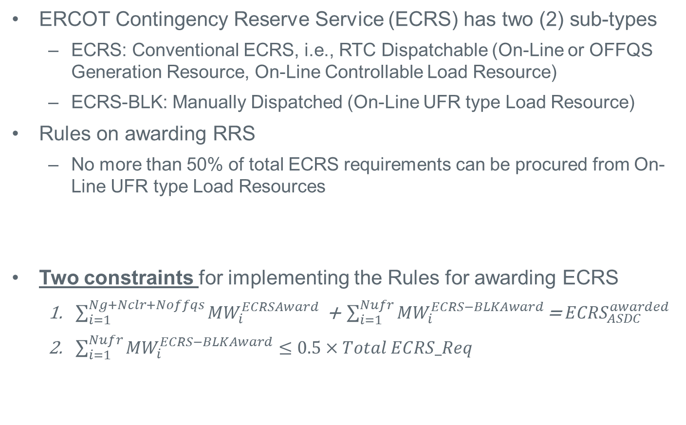
System Wide ERCOT Contingency Reserve Service (ECRS) Constraints
ERCOT Contingency Reserve Service (ECRS) has two (2) sub-types
  ECRS: Conventional ECRS, i.e., RTC Dispatchable (On-Line or OFFQS Generation Resource, On-Line Controllable Load Resource)
  ECRS-BLK: Manually Dispatched (On-Line UFR type Load Resource)
Rules on awarding RRS
  No more than 50% of total ECRS requirements can be procured from On-Line UFR type Load Resources
Two constraints for implementing the Rules for awarding ECRS
  $\sum_{i=1}^{Ng+Nclr+Noffqs}{{MW}_{i}^{ECRSAward}}\text{ + }\sum_{i=1}^{Nufr}{{MW}_{i}^{ECRS−BLKAward}}\text{= }{ECRS}_{ASDC}^{awarded}$
  $\sum_{i=1}^{Nufr}{{MW}_{i}^{ECRS−BLKAward}}≤0.5×Total ECRS_Req$

Slide 16
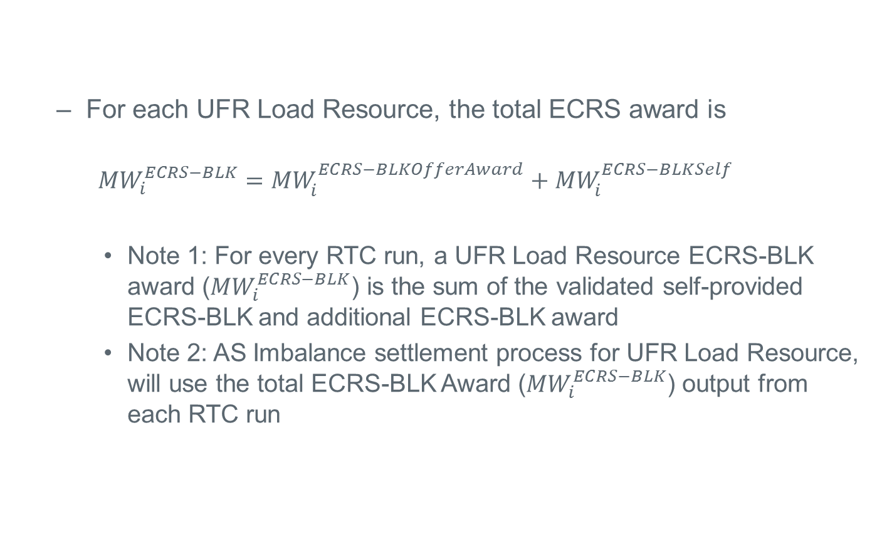
System Wide ERCOT Contingency Reserve Service (ECRS) Constraints
  For each UFR Load Resource, the total ECRS award is
    $${MW}_{i}^{ECRS−BLK}={MW}_{i}^{ECRS−BLKOfferAward}+{MW}_{i}^{ECRS−BLKSelf}$$
    Note 1: For every RTC run, a UFR Load Resource ECRS-BLK award (${MW}_{i}^{ECRS−BLK}$) is the sum of the validated self-provided ECRS-BLK and additional ECRS-BLK award
    Note 2: AS Imbalance settlement process for UFR Load Resource, will use the total ECRS-BLK Award (${MW}_{i}^{ECRS−BLK}$) output from each RTC run

Slide 17
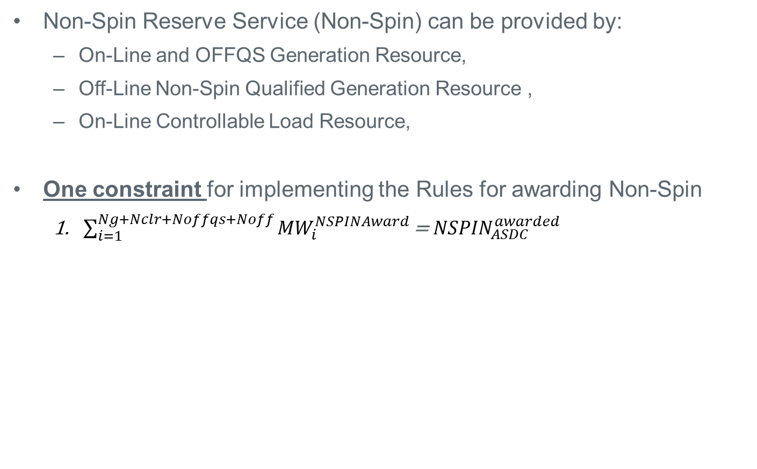
System Wide Non-Spin Reserve Service (Non-Spin) Constraints
Non-Spin Reserve Service (Non-Spin) can be provided by:
  On-Line and OFFQS Generation Resource,
  Off-Line Non-Spin Qualified Generation Resource ,
  On-Line Controllable Load Resource,
One constraint for implementing the Rules for awarding Non-Spin
  $\sum_{i=1}^{Ng+Nclr+Noffqs+Noff}{{MW}_{i}^{NSPINAward}}\text{= }{NSPIN}_{ASDC}^{awarded}$

Slide 18
Review Use of Generation Resource Statuses under RTC
Some feedback provided so far:
  Need to ensure that RTC has a check that estimation of PRC from available AS Offers is greater than the actual PRC, otherwise RTC dispatch is invalid – related to AS participation rules/Proxy AS Offer
  Consider use of existing status telemetry of Raise Block Status (RBST) and Lower Block Status (LBST) in RTC to limit Base Point and AS awards
    Currently, used only in LFC for the intra 5 minute period to freeze UDBP
  On proposed new telemetry to limit AS awards by RTC, are all of them required?
    Why would a QSE provide a Resource specific telemetry limiting awards for ECRS but the HDL for Resource indicates it can receive a Base Point higher than its current output level ?
  Before finalizing list of Resource Statuses and proposed new telemetry – a combined review of interactions required
  Consider a new Resource Status indicating transition (ONTR). For this status RTC will not award any AS and Base Point = telemetered output

Slide 19
Review Use of Generation Resource Statuses under RTC
Resource Status | Proposed use of Generation Resource Status under RTC
ON | Available for energy and AS awards
ONOPTOUT | Considered to be same as ON
ONRUC | Considered to be same as ON (may have special treatment, e.g., AS offer floors)
OFFQS | Considered to be same as ON for energy, ECRS and NSPIN. Cannot be awarded Regulation or Responsive Reserve
OFF | Not available to for energy, Regulation, Responsive Reserve, or ECRS awards Available for NSPIN if qualified
ONTEST | Energy participation same as today. Cannot be awarded AS by RTC.
ONEMR | Considered to be same as ON, Not eligible for AS award QSE may appropriately set LSL and HSL to reflect operating limits
OUT | Not available for energy or AS awards
EMR | Not available for energy or AS awards
STARTUP | Energy participation same as today. Cannot be awarded AS (BP=telMW+5*RRup) Exception is when OFF Resource deployed for Non-Spin and OFFQS awarded BP>0
SHUTDOWN | Energy participation same as today. Cannot be awarded AS (BP=telMW-5*RRdn)
EMRSWGR | Not available for energy or AS awards

Slide 20
Review Use of Generation Resource Statuses under RTC
Resource Status | Proposal to remove the following Generation Resource Status under RTC
ONREG | Status no longer needed
FRRSUP | Status no longer needed
ONOSREG | Status no longer needed
ONDSRREG | Status no longer needed
OFFNS | Status no longer needed

Slide 21
Review Use of Generation Resource Statuses under RTC
Resource Status | Needs more discussion:
ONOS | Energy participation same as today. Today, can carry all AS products. What should be the case with RTC? Today, Resource with status of ONOS generally do not submit Inc/Dec EOC. Under RTC, if awarded ECRS, Non-Spin, RTC will hardly ever convert this capacity to energy due to economics
ONDSR | Energy participation same as today. Todays can carry all AS products. What should be the case with RTC? There does not seem to be any Resource using this status Status no longer needed?
ONRR | Hydro in Synchronous Condenser mode. Today, BP=telMW. Under RTC, setting BP=telMW, i.e.; RTC does not dispatch Resource for energy, allows for Resource to be awarded RRS-PFR, however more discussion required if Resource wishes to participate in ECRS to determine how capacity awarded ECRS will be converted to energy if RTC cannot dispatch.
ONECRS | Hydro in Synchronous Condenser mode. See notes on ONRR. More discussion required on both energy and AS participation. How is ECRS awarded capacity converted to energy?
ONFFRRRS | Status no longer needed ? Replace with ON?

Slide 22
Review Use of Load Resource Statuses under RTC
Resource Status | Proposed use of Load Resource Status under RTC
ONRL | Replace with ON
ONRGL | Replace with ON
ONCLR | Replace with ON. Similar to GR with ON status
ONECL | Replace with ON
ONFFRRRSL | Replace with ON
OUT | Not available for energy or AS, already captured in Generation Resource statuses
FRRSDN | Status no longer needed
FRRSUP | Status no longer needed
Feedback requested:
Please review table of Resource status and ERCOT comments and provide feedback

Slide 23
AS Offer Structure
On-Line Upward AS Offer: RegUp, RRS, ECRS, Non-Spin
    On-Line Generation Resource (RegUp,RRS-PFR,ECRS,Non-Spin)
    On-Line Controllable Load Resource (RegUp,RRS-PFR,ECRS,Non-Spin)
    UFR type Load Resource (RRS-BLK, ECRS-BLK)
    Fast Resources (RRS-FFR)
    OFFQS Generation Resource (ECRS, Non-Spin) – co-optimized with Energy Offer Curve (EOC)
On-Line Down AS Offer: RegDn
    On-Line Generation Resource
    On-Line Controllable Load Resource
Off-Line AS Offer: ECRS, Non-Spin
    Off-Line Non-Spin qualified Generation Resource (Non-Spin)

Slide 24
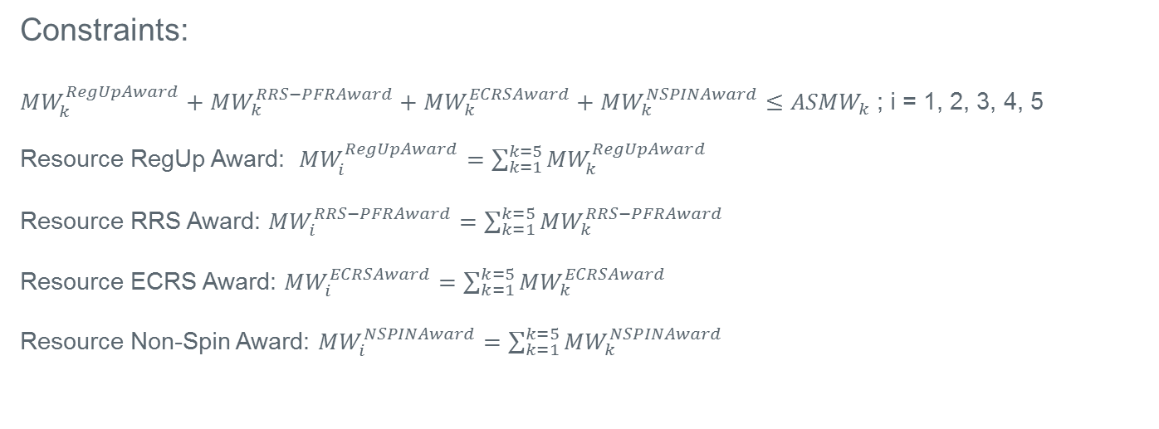
On-Line Upward AS Offer Structure And Constraints
AS Offer MW (up to 5 per Resource) | RegUp Price ($/MW/h) | RRS Price ($/MW/h) | ECRS Price ($/MW/h) | Non-Spin Price ($/MW/h)
AS_{MW}¹ | RegUp_{Price}¹ | RRS_{Price}¹ | ECRS_{Price}¹ | Non-Spin_{Price}¹
AS_{MW}² | RegUp_{Price}² | RRS_{Price}² | ECRS_{Price}² | Non-Spin_{Price}²
AS_{MW}³ | RegUp_{Price}³ | RRS_{Price}³ | ECRS_{Price}³ | Non-Spin_{Price}³
AS_{MW}⁴ | RegUp_{Price}⁴ | RRS_{Price}⁴ | ECRS_{Price}⁴ | Non-Spin_{Price}⁴
AS_{MW}⁵ | RegUp_{Price}⁵ | RRS_{Price}⁵ | ECRS_{Price}⁵ | Non-Spin_{Price}⁵
Constraints:
${MW}_{k}^{RegUpAward}+{MW}_{k}^{RRS−PFRAward}+{MW}_{k}^{ECRSAward}+{MW}_{k}^{NSPINAward}≤{ASMW}_{k}$; i = 1, 2, 3, 4, 5
Resource RegUp Award: ${MW}_{i}^{RegUpAward}=\sum_{k=1}^{k=5}{{MW}_{k}^{RegUpAward}}$
Resource RRS Award: ${MW}_{i}^{RRS−PFRAward}=\sum_{k=1}^{k=5}{{MW}_{k}^{RRS−PFRAward}}$
Resource ECRS Award: ${MW}_{i}^{ECRSAward}=\sum_{k=1}^{k=5}{{MW}_{k}^{ECRSAward}}$
Resource Non-Spin Award: ${MW}_{i}^{NSPINAward}=\sum_{k=1}^{k=5}{{MW}_{k}^{NSPINAward}}$
Same setup for:
On-Line RegDn AS Offer
Off-Line ECRS,Non-Spin AS Offer

Slide 25

Basic AS Award Constraints
Resource RegUp Award*
$${MW}_{i}^{RegUpAward}≤Min\left( {{TelMxRegUp}_{i},RegUpQualifiedMW}_{i},\left({NRRUp}_{i}×5\right)\right)$$
Resource RegDn Award*
$${MW}_{i}^{RegDnAward}≤Min\left({TelMxRegDn}_{i},{RegDnQualifiedMW}_{i},\left({NRRDn}_{i}∗5\right)\right)$$
Resource RRS-PFR Award*
${MW}_{i}^{RRS−PFRAward}≤Min\left({{TelMxPFR}_{i},PFRQualifiedMW}_{i}, 20\%×HSL\right)$
* There are additional Resource level constraints for RegUp, RegDn, RRS-PFR
Resource ECRS Award
$${MW}_{i}^{ECRSAward}≤Min\left(TelMx{ECRS}_{i},{ECRSQualifiedMW}_{i},\left({ERRUp}_{i}^{10}×10\right)\right)$$
Resource Non-Spin Award
${MW}_{i}^{NSPINAward}≤Min\left({TelMx{NSPIN}_{i},NSPINQualifiedMW}_{i},\left({NRRUp}_{i}^{30}×30\right)\right)$
New: ERRUp¹⁰ , Emergency Ramp Rate (MW/Min) reflecting 10 minute capability
New: NRRUp³⁰ , Normal Ramp Rate (MW/Min) reflecting 30 minute capability

Slide 26
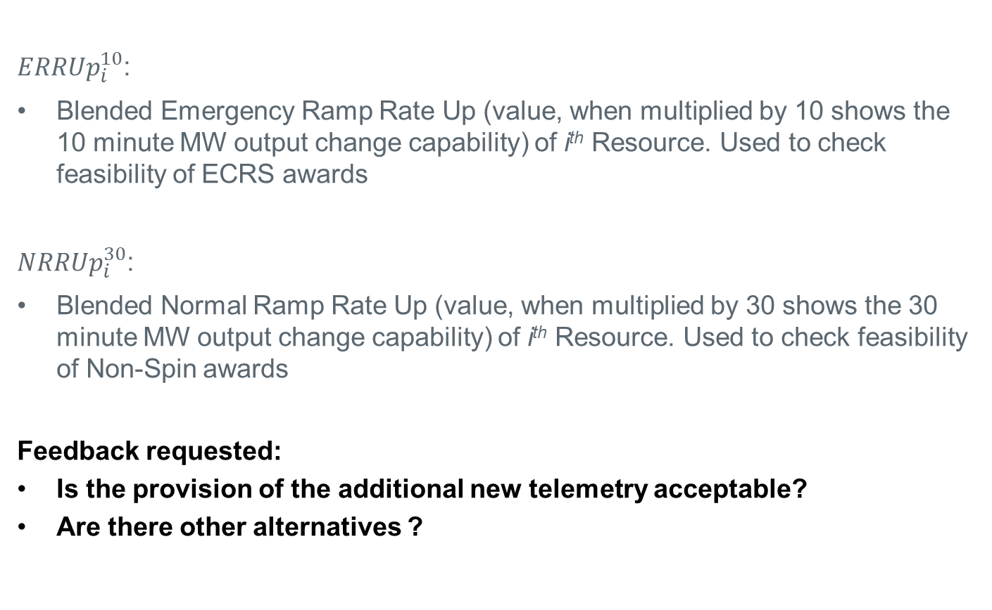
New Proposed Ramp Rate Telemetry To Check Feasibility Of ECRS And Non-Spin Awards
${ERRUp}_{i}^{10}$:
Blended Emergency Ramp Rate Up (value, when multiplied by 10 shows the 10 minute MW output change capability) of i^{th} Resource. Used to check feasibility of ECRS awards
${NRRUp}_{i}^{30}$:
Blended Normal Ramp Rate Up (value, when multiplied by 30 shows the 30 minute MW output change capability) of i^{th} Resource. Used to check feasibility of Non-Spin awards
Feedback requested:
Is the provision of the additional new telemetry acceptable?
Are there other alternatives ?

Slide 27
Off-Line Non-Spin Deployment
Non-Spin Award based on economics, Off-Line AS Offer and 30 min Ramp Rate capability
HSL
Non-Spin Award based on economics, On-Line AS Offer and 30 min Ramp Rate capability
Off-Line Gen
ERCOT XML: Deploys Non-Spin
Output MW
25 min. to LSL
LSL
ON, EOC co-optimized with
On-Line AS Offer
STARTUP
OFF, 0MW
RTC 0
RTC 5
RTC 10
RTC 15
RTC 20
RTC 25
RTC 30
RTC 35
Time

Slide 28
Off-Line Non-Spin Deployment
Upon ERCOT Instruction to deploy Off-Line Non-Spin:
  Resource must be On-Line @ LSL within 25 minutes of ERCOT XML instruction
  Resource will be on On-Line status until ERCOT XML Recall
  During STARTUP Resource Status, Resource is eligible to be awarded Non-Spin.
    This eligibility lasts for 25 minutes from the time of ERCOT instruction to deploy Non-Spin from Off-Line Generation Resource
    During STARTUP, RTC will determine Non-Spin Award based on Non-Spin Offer Price from the Resource On-Line AS Offer. i.e. will NOT use Off-Line AS Offer

Slide 29
QSGR Treatment in OFFQS Resource Status
OFFQS is treated by RTC in the same manner as an On-Line Generation Resource with the following exceptions :
  Cannot be awarded Regulation
  Cannot be awarded RRS
OFFQS is eligible to be awarded ECRS and Non-Spin using ECRS and Non-Spin prices from its On-Line Upward AS Offer
During the transition period from OFFQS to ON, i.e. Resource Status is STARTUP:
  During STARTUP, QSGR will continue to be eligible for ECRS and Non-Spin awards using ECRS and Non-Spin prices from its On-Line Upward AS Offer

Slide 30
QSGR Treatment in OFFQS Resource Status
Discussion Item:
ECRS is a 10 minute product. Currently, QSGRs have a 10 minute window to respond to non-zero Base Points. Should this 10 minute window apply to QSGRs that are given a Non-Zero Base Point that have been awarded ECRS?

Slide 31
UFR Load Resource Treatment Under RTC
UFR Load Resources are eligible to participate in RRS-BLK and ECRS-BLK AS markets
UFR Load Resource can be awarded both RRS-BLK and ECRS-BLK for their curtailable load amount
  Note that upon deployment, irrespective of whether the deployment is for RRS-BLK or ECRS-BLK, the full amount of curtailable load is deployed
Two ways in which RRS-BLK are deployed and recalled:
  RRS-BLK Automatic Self deployment: Low Frequency event causes UFR to trip
    ERCOT systems does not get explicit information from QSE that UFR trip has occurred
    ERCOT operations monitoring the grid usually detect UFR trips for large events, for smaller events, a UFR trip may go unnoticed. In such cases, QSE informs ERCOT operations that UFR trip has occurred
    UFR Load Resource remains deployed (curtail load) until ERCOT operations issues recall instruction (currently a phone call)
    After ERCOT issued recall instruction (currently a phone call), UFR Load Resource has up to 3 hours to come back into service

Slide 32
UFR Load Resource Treatment Under RTC
  RRS-BLK ERCOT operations directed deployment (not through RTC economic dispatch) :
    ERCOT operations issues XML deployment instruction for RRS-BLK
    UFR Load Resource remains deployed (curtail load) until ERCOT operations issues XML recall instruction
    After ERCOT issued XML recall instruction, UFR Load Resource has up to 3 hours to come back into service
ECRS-BLK deployment:
  UFR Load Resources with relay armed and providing ECRS-BLK can be deployed automatically on frequency or manually by ERCOT operations
  ERCOT operations directed deployment (not through RTC economic dispatch) :
    ERCOT operations issues XML deployment instruction for ECRS-BLK
    UFR Load Resource responds by curtailing all available load
    UFR Load Resource remains deployed until ERCOT operations issues XML recall instruction
    After ERCOT issued XML recall instruction, UFR Load Resource has up to 3 hours to come back into service

Slide 33
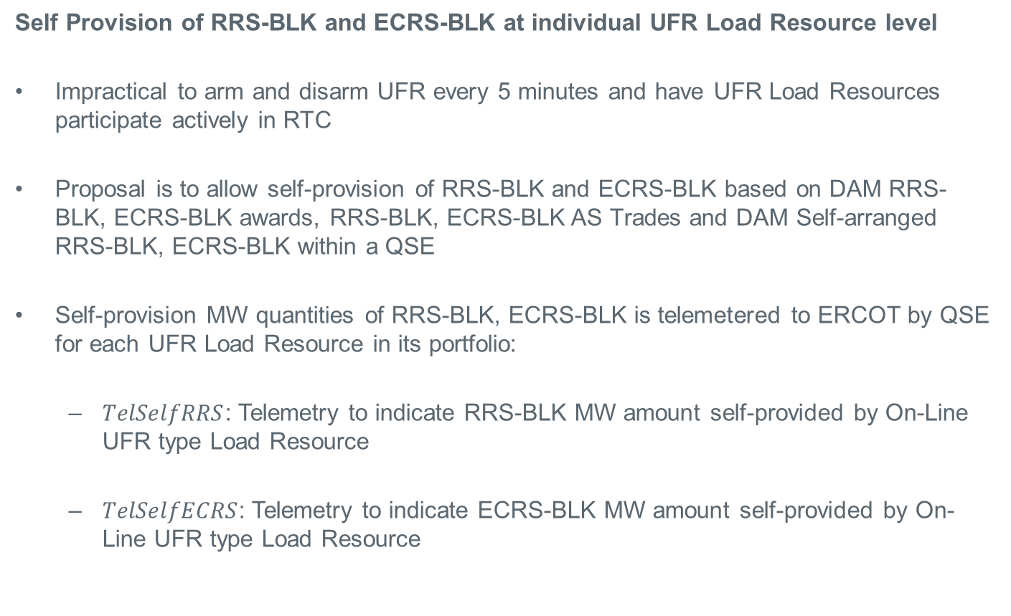
UFR Load Resource Treatment Under RTC
Self Provision of RRS-BLK and ECRS-BLK at individual UFR Load Resource level
Impractical to arm and disarm UFR every 5 minutes and have UFR Load Resources participate actively in RTC
Proposal is to allow self-provision of RRS-BLK and ECRS-BLK based on DAM RRS-BLK, ECRS-BLK awards, RRS-BLK, ECRS-BLK AS Trades and DAM Self-arranged RRS-BLK, ECRS-BLK within a QSE
Self-provision MW quantities of RRS-BLK, ECRS-BLK is telemetered to ERCOT by QSE for each UFR Load Resource in its portfolio:
  $TelSelfRRS$: Telemetry to indicate RRS-BLK MW amount self-provided by On-Line UFR type Load Resource
  $TelSelfECRS$: Telemetry to indicate ECRS-BLK MW amount self-provided by On-Line UFR type Load Resource

Slide 34
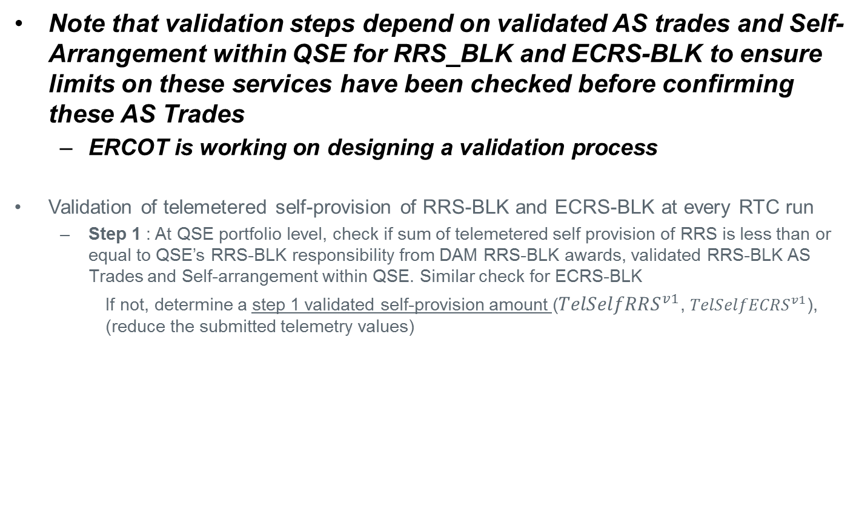
UFR Load Resource Treatment Under RTC
Note that validation steps depend on validated AS trades and Self-Arrangement within QSE for RRS_BLK and ECRS-BLK to ensure limits on these services have been checked before confirming these AS Trades
  ERCOT is working on designing a validation process
Validation of telemetered self-provision of RRS-BLK and ECRS-BLK at every RTC run
  Step 1 : At QSE portfolio level, check if sum of telemetered self provision of RRS is less than or equal to QSE’s RRS-BLK responsibility from DAM RRS-BLK awards, validated RRS-BLK AS Trades and Self-arrangement within QSE. Similar check for ECRS-BLK
    If not, determine a step 1 validated self-provision amount (${TelSelfRRS}^{v1}$, ${TelSelfECRS}^{v1}$), (reduce the submitted telemetry values)
 | QSE RRS DAM & AS Trade | QSE ECRS DAM & AS Trade | LR 1 Self Prov Tel. |  | LR 2 Self Prov. Tel. |  | LR 1 Validated - 1 |  | LR 2 Validated - 1
 |  |  | TelSelfRRS | TelSelfECRS | TelSelfRRS | TelSelfECRS | V1-RRS | V1-ECRS | V1-RRS | V1-ECRS
Ex. 1 | 40 | 20 | 20 | 10 | 20 | 10 | 20 | 10 | 20 | 10
EX. 2 | 40 | 20 | 25 | 15 | 20 | 10 | 20 | 10 | 20 | 10

Slide 35
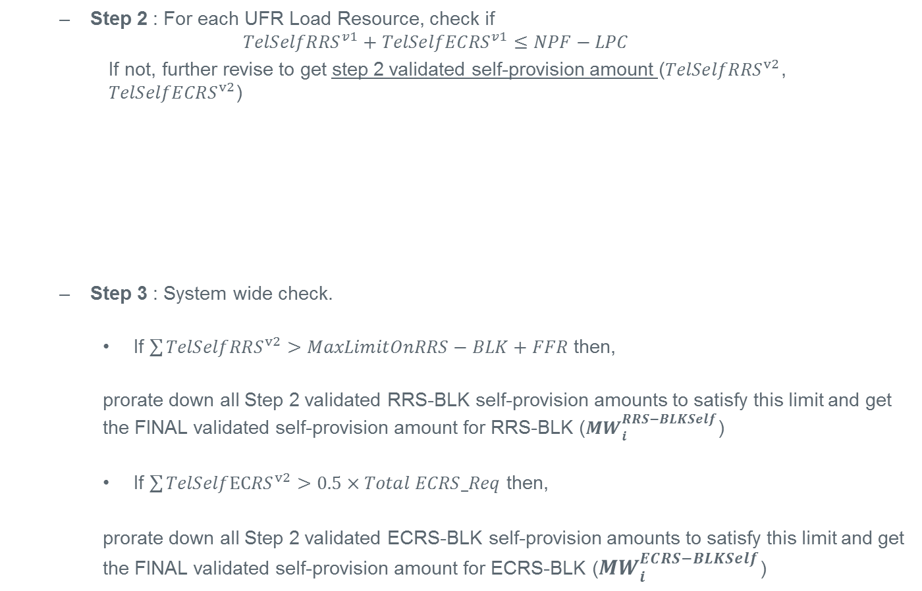
UFR Load Resource Treatment Under RTC
  Step 2 : For each UFR Load Resource, check if
  $${TelSelfRRS}^{v1}+{TelSelfECRS}^{v1}≤NPF−LPC$$
    If not, further revise to get step 2 validated self-provision amount (${TelSelfRRS}^{v2}$, ${TelSelfECRS}^{v2}$)
  Step 3 : System wide check.
    If $\sum{{TelSelfRRS}^{v2}>MaxLimitOnRRS−BLK+FFR}$ then,
    prorate down all Step 2 validated RRS-BLK self-provision amounts to satisfy this limit and get the FINAL validated self-provision amount for RRS-BLK (${MW}_{i}^{RRS−BLKSelf}$)
    If $\sum{{TelSelfECRS}^{v2}>0.5×Total ECRS_Req}$ then,
    prorate down all Step 2 validated ECRS-BLK self-provision amounts to satisfy this limit and get the FINAL validated self-provision amount for ECRS-BLK (${MW}_{i}^{ECRS−BLKSelf}$)
 | LR 1 Validated - 1 |  | LR1 | LR 1 Validated - 2 |  | LR 2 Validated - 1 |  | LR 2 | LR 2 Validated 2
 | V1-RRS | V1-ECRS | NPF-LPC | V2-RRS | V2-ECRS | V1-RRS | V1-ECRS | NPF-LPC | V2-RRS | V2-ECRS
Ex. 1 | 20 | 10 | 41 | 20 | 10 | 20 | 10 | 15 | 15 | 0
EX. 2 | 20 | 10 | 21 | 20 | 1 | 20 | 10 | 60 | 20 | 10

Slide 36
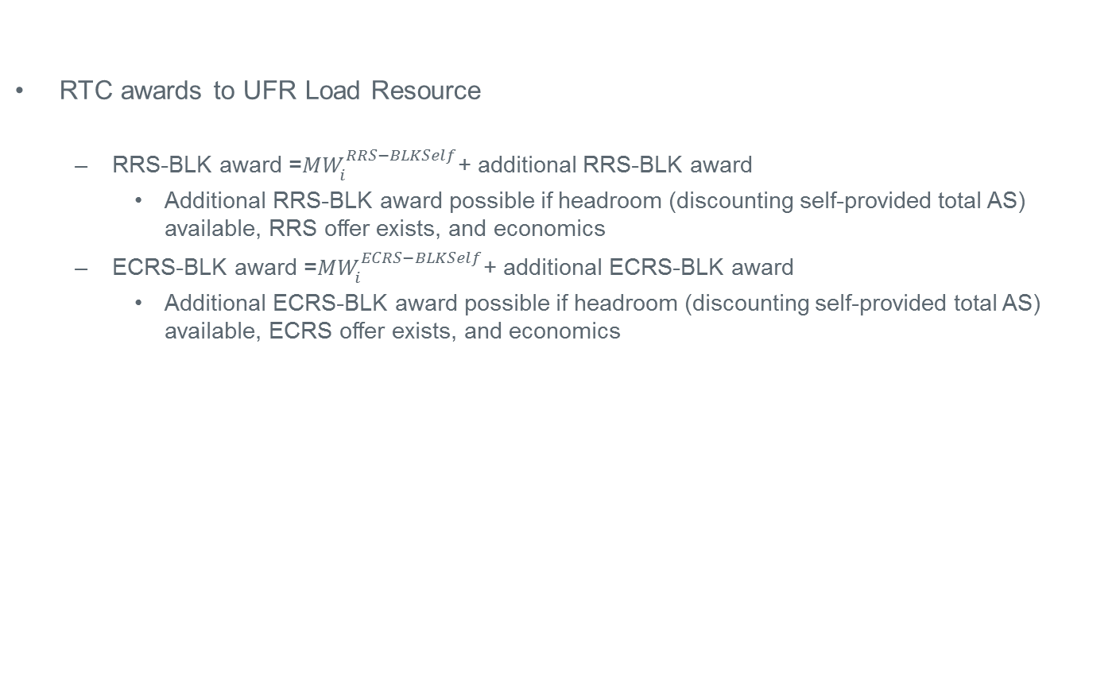
UFR Load Resource Treatment Under RTC
RTC awards to UFR Load Resource
  RRS-BLK award =${MW}_{i}^{RRS−BLKSelf}$+ additional RRS-BLK award
    Additional RRS-BLK award possible if headroom (discounting self-provided total AS) available, RRS offer exists, and economics
  ECRS-BLK award =${MW}_{i}^{ECRS−BLKSelf}$+ additional ECRS-BLK award
    Additional ECRS-BLK award possible if headroom (discounting self-provided total AS) available, ECRS offer exists, and economics
 | LR1 | LR 1 Validated - 2 |  | LR 1 Extra AS (RRS+ECRS) eligibility | LR 2 | LR 2 Validated 2 |  | LR 2 Extra AS (RRS+ECRS) eligibility
 | NPF-LPC | V2-RRS | V2-ECRS |  | NPF-LPC | V2-RRS | V2-ECRS
Ex. 1 | 41 | 20 | 10 | 11 | 15 | 15 | 0 | 0
EX. 2 | 21 | 20 | 1 | 0 | 60 | 20 | 10 | 30

Slide 37
UFR Load Resource Treatment Under RTC
UFR Load Resource - no deployment
RTC run will procure AS based on ASDC and validated AS self-provision
QSE subject to AS Imbalance Charge
MW eligible for additional ECRS / RRS award
MPC
Validated ECRS Self Prov
NPF
Tel. ECRS Self Prov
Validated ECRS Self Prov = Tel. ECRS Self Prov
0
Validated RRS Self Prov
Tel. RRS Self Prov
Validated RRS Self Prov = Tel. RRS Self Prov
LPC
RTC 0
RTC 5
RTC 10
RTC 15
RTC 20
RTC 25
RTC 30
Time

Slide 38
UFR Load Resource Treatment Under RTC
Summary of UFR Load Resource - no deployment
Each RTC run will award UFR Load Resource RRS-BLK and ECRS-BLK equal to the sum of the final validated self-provision of RRS-BLK and ECRS-BLK, and potentially additional RRS-BLK, ECRS-BLK
AS Imbalance Charge/Payment to QSE will use the RTC AS capacity awards for RRS-BLK and ECRS-BLK

Slide 39
UFR Load Resource Treatment Under RTC
UFR Load Resource – ERCOT XML Deployment (RRS-BLK or ECRS-BLK)
ERCOT XML Recall @ time Y
ERCOT XML Deployment
(MW Deploy amount= @”RTC 0” Total ECRS_UFR+RRS_UFR Award)
MW eligible for additional ECRS / RRS award
Recall Period (3 Hr)
Deployment Duration
10 min. to deploy
During Recall period (3 hours)
RTC run will procure AS based on ASDC and validated AS self-provision
QSE subject to AS Imbalance Charge
QSE can avoid AS Imbalance Charge by moving Self-Provision (ECRS+RRS) to another qualified UFR Load Resource – after Recall XML Instruction
MPC
NPF
Validated ECRS + RRS Self Prov = Tel. ECRS+RRS Self Prov
Tel. ECRS Self Prov
+
Tel. RRS Self Prov
During XML Deployment
RTC +
RTC Pricing Run (Using MW deployment from XML)
During deployment period,
UFR Load Resource total ECRS_UFR, RRS_UFR award = @”RTC 0” award
Validated
ECRS + RRS Self Prov
LPC
RTC 0
RTC 5
RTC 10
RTC 15
RTC X
RTC Y+5
RTC
Y+2Hr, 55min
RTC Y+3 Hr
Time

Slide 40
UFR Load Resource Treatment Under RTC
Summary of UFR Load Resource – ERCOT XML Deployment (RRS-BLK or ECRS-BLK)
Each RTC run will award UFR Load Resource RRS-BLK and ECRS-BLK equal to the sum of the final validated self-provision of RRS-BLK and ECRS-BLK, and potentially additional RRS-BLK, ECRS-BLK
AS Imbalance Charge/Payment to QSE will use the RTC AS capacity awards for RRS-BLK and ECRS-BLK
During Deployment period:
  Dispatch Run RTC will output the UFR Load Resource AS awards (RRS-BL,ECRS-BLK) to be equal to the ERCOT XML Instruction amount.
    These AS MW capacity awards are used in Settlements
  Pricing Run is triggered during deployment period
During Recall period:
  Pricing Run is NOT triggered
  Actual validated self-provision of RRS-BLK and ECR-BLK is used in RTC and Settlements
  QSE may be subject to AS Imbalance Charge (Buy Back)– can be avoided by moving self-provision to another UFR Load Resource during Recall period

Slide 41
UFR Load Resource Treatment Under RTC
UFR Load Resource – Automatic Self Deployment Due To UFR Trip
ERCOT Recall by Phone Call@ time Y
Automatic Self Deployment Due to UFR Trip
MW eligible for extra ECRS / RRS award
Recall Period (3 Hr)
Deployment Duration
MPC
NPF
During Recall period (3 hours)
RTC run will procure AS based on ASDC and validated AS self-provision
QSE subject to AS Imbalance Charge
QSE can avoid AS Imbalance Charge by moving Self-Provision (ECRS+RRS) to another qualified UFR Load Resource – after Recall By Phone Call
Validated ECRS + RRS Self Prov = Tel. ECRS+RRS Self Prov
Tel. ECRS Self Prov
+
Tel. RRS Self Prov
Validated
ECRS + RRS Self Prov. = 0
Validated
ECRS + RRS Self Prov
LPC
RTC 0
RTC 5
RTC 10
RTC 15
RTC X
RTC Y+5
RTC
Y+2Hr, 55min
RTC Y+3 Hr
Time

Slide 42
UFR Load Resource Treatment Under RTC
Summary of UFR Load Resource – Automatic Self Deployment Due To UFR Trip
Each RTC run will award UFR Load Resource RRS-BLK and ECRS-BLK equal to the sum of the final validated self-provision of RRS-BLK and ECRS-BLK, and potentially extra RRS-BLK, ECRS-BLK
AS Imbalance Charge/Payment to QSE will use the RTC AS capacity awards for RRS-BLK and ECRS-BLK
During Deployment and Recall period:
  Pricing Run is NOT triggered
  Actual validated self-provision of RRS-BLK and ECR-BLK is used in RTC and Settlements
  QSE may be subject to AS Imbalance Charge (Buy Back) – can be avoided by moving self-provision to another UFR Load Resource during Recall period

Slide 43
Summary Of Key Principles From This Presentation
(KP1.1) Pricing Run
  The existing process of having a pricing run to capture the effects of reliability deployments will continue. However, the pricing run will be modified to also co-optimize energy and AS. To account for the co-optimization in the pricing run, the following modifications will be made to the inputs:
  AS offers from RUC-instructed Resources, including RMR Resources, will be removed for the pricing run
  AS offers from Load Resources on UFRs that have been manually deployed by ERCOT for RRS or ECRS will be removed for the pricing run
(KP1.1) Real-time AS settlement will no longer include the Reliability Deployment Price Adder. Instead, the MCPCs for AS resulting from including the impacts of the pricing run will be used for real-time AS imbalance settlement.

Slide 44
Summary Of Key Principles From This Presentation
(KP1.3) RTC will not change limitations on sub-categories of AS products (e.g., FRRS, FFR, and RRS and ECRS provided via UFR).
(KP1.4) To better understand ramp capability for determining ECRS and Non-Spin awards, the following new telemetry points will be needed for Resources providing those services:
  A blended 10-minute Emergency Ramp Rate Up for the Resources that will be used to check the feasibility of ECRS awards. This value will be the 10-minute output change capability of the Resource divided by 10 (positive change for Resources injecting into the grid and negative change for Resources withdrawing from the grid).
  A blended 30-minute Normal Ramp Rate Up for the Resources that will be used to check the feasibility of Non-Spin awards. This value will be the 30-minute output change capability of the Resource divided by 30 (positive change for Resources injecting into the grid and negative change for Resources withdrawing from the grid).

Slide 45
Summary Of Key Principles From This Presentation
(KP1.3) Off-line Resources providing Non-Spin that are in startup due to a manual deployment of Non-Spin by ERCOT will continue to be eligible for being awarded Non-Spin for the first 25 minutes following the deployment. The eligible capacity will be based on the HSL of the Resource less its base point instruction.
(KP1.3) Resources operating in quick-start mode that are in startup due to a deployment from ERCOT will continue to be eligible for being awarded ECRS and Non-Spin. The eligible capacity will be based on the HSL of the Resource less its base point instruction.
(KP1.3) For Load Resources providing AS via a UFR that are deployed for the AS through a manual instruction from ERCOT:
  During the period of deployment, the real-time optimization will continue to award the Load Resource AS with the awards based on the ERCOT instruction amount.
  During recall of the deployment, AS awards will not be based on the deployment amount. Instead, AS awards will be based on self-provision amounts and limited by the physical capability of the Resource to provide AS.

Slide 46
Discussion

