Slide 1
Generation to be Dispatched Impact on System Lambda
ERCOT
Market Analysis & Validation
WMWG
August 19th, 2019

Slide 2
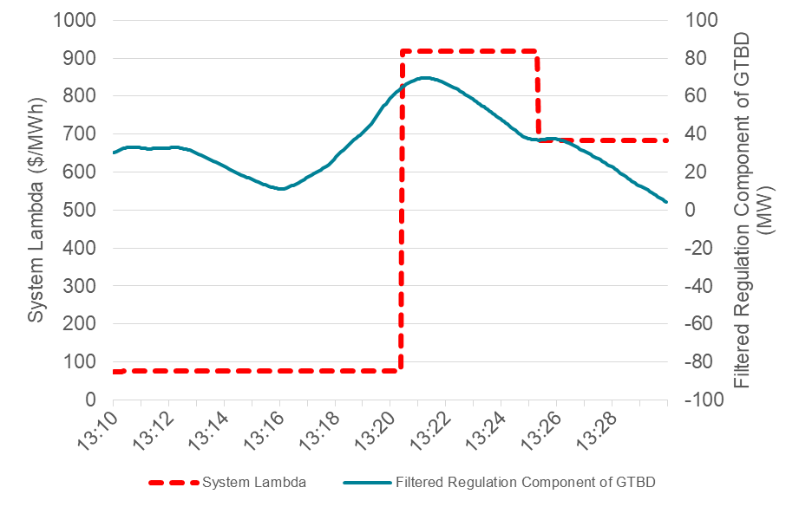
Component Contribution to GTBD
ERCOT was asked to examine the possible impact of GTBD and its components on System Lambda during the August 5th and 6th Operating Days
Found the contribution of each GTBD component from one SCED interval to the next, termed the Δ Component Contribution to GTBD
13:20
SCED Interval | Filtered Regulation Component of GTBD (MW)
13:15 | 16.1
13:20 | 59.5
13:15
Δ Component Contribution to GTBD
Of Filtered Regulation Component:
43.5MW

Slide 3
August 5th, 2019 Prices

Slide 4
August 6th, 2019 Prices

Slide 5
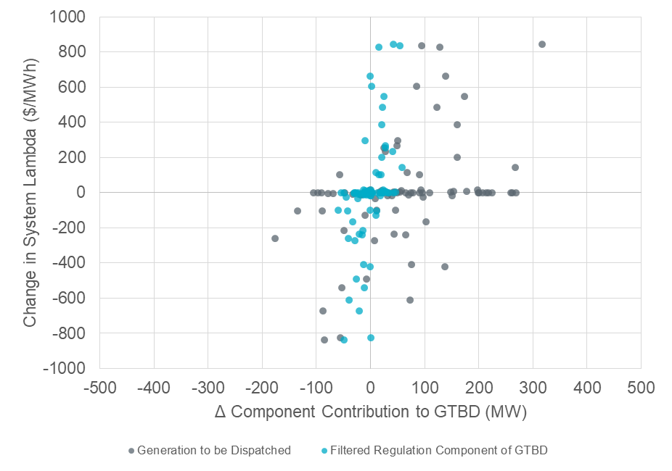
Regulation and GTBD
Regulation deployment as a part of total generation is a larger driver of GTBD changes than the Filtered Regulation Feedback Component of GTBD (K4)
Change in System Lambda vs. Δ Component Contribution to GTBD data from SCED intervals displayed in previous two charts:
August 5th, HE15 thru HE17
August 6th, HE14 thru HE17

Slide 6
Key Findings
System Lambda and GTBD are inherently correlated and become more correlated during periods of tight margins
No strong correlation between feedback components (STLF, Reg. Feedback, ACE Integral, and IHWF) and GTBD and thus System Lambda
Total generation is largest catalyst in GTBD change from one SCED interval to the next
Total generation includes regulation deployment and PFR

Slide 7
Questions?
Thank you!!

