Slide 1
MTLF Overview
Calvin Opheim
Load Forecasting & Analysis
WMWG
August 19, 2019

Slide 2
Outline of Today’s Presentation
MTLF Models
Input Variables
Forecast Horizons
Questions

Slide 3
MTLF Models

Slide 4
MTLF Models
7 models are currently available
5 are internally developed
Named E, E1, E2, E3, and M
2 are legacy “black box” models from GE
Named A3 and A6

Slide 5
MTLF Models
A3 Notes
Uses recent history to update the model coefficients
Prone to significantly over-forecast summer demands on very hot days
Prone to significantly over-forecast winter demands on very cold days

Slide 6
MTLF Models
A6 Notes
Uses recent history to update the model coefficients
Only uses one weather station per weather zone
Prone to significantly over-forecast summer demands on very hot days
Prone to significantly over-forecast winter demands on very cold days

Slide 7
MTLF Models
E Notes
Considered to be the overall best model for Day Ahead
Slow to change during shorter forecast horizons (1 – 4 hours ahead)
Calibrated based on most recent historical days (look back at the last 7 – 14 days)
Tuned based on forecast performance during the current day (look back at the last 3 hours)

Slide 8
MTLF Models
E1 Notes
Designed to be the most responsive model to changing conditions
Designed to perform well on very hot and very cold days
Does not do well on mild days
Can result in a jagged forecast shape
Tuned based on forecast performance from the last hour

Slide 9
MTLF Models
E2 Notes
Looks more at rain and cloud cover
More reliant on the weather forecast for the next 14 hours
Best at capturing Winter/Spring/Fall rain type and cloud cover patterns
Tendency to under forecast very hot conditions
Calibrated based on most recent historical days (look back at the last 7 – 14 days)
Tuned based on forecast performance during the current day (look back at the last 3 hours)

Slide 10
MTLF Models
E3 Notes
Provides more weight on weather for shorter term forecasts
Relatively slow to change
Input from additional weather stations
Calibrated based on most recent historical days (look back at the last 7 – 14 days)
Tuned based on forecast performance during the current day (look back at the last 3 hours)

Slide 11
MTLF Models
M Notes
The average of the 6 other models
Historically has shown to be the best Day Ahead forecast
Provides a good benchmark for other models

Slide 12
MTLF Models

Slide 13
Input Variables

Slide 14
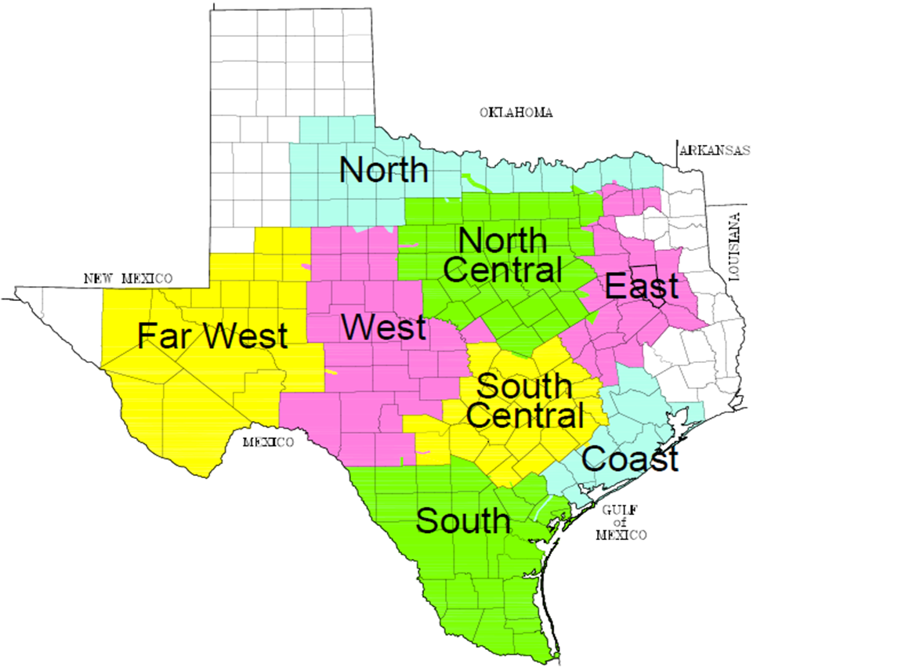
Weather Zones
Notes:
WEST peak was in July

Slide 15
Original Weather Stations

Slide 16
Current Weather Stations

Slide 17
Variables
Model | Day Of Week | Holiday | Daylight Savings | Season | Dry Bulb | Dew Point | Cloud Cover | Wind Speed | Heat Index
E | X | X | X | X | X | X | X | X | X
E1 | X | X | X |  | X | X |  | X
E2 | X | X | X | X | X | X | X | X | X
E3 | X | X | X | X | X | X | X | X | X
A3 | X | X | X |  | X | X | X | X | X
A6 | X | X | X |  | X | X
Model | Wind Chill | Wetbulb | Sunshine Minutes | Solar Irradiance | Relative Humidity | Precipitation | HDD | CDD
E | X | X |  | X | X |  | *E | *E
E1
E2 | X | X |  | X |  | X | *E | *E
E3 | X | X |  | X | X |  | *E | *E
A3 | X | X | X |  | X
A6 |  |  | X |  | X
Note *E indicates used in energy model only

Slide 18
Previous Load Values
Use previous observed load values
Examples: to predict the load at 5 pm, use the actual load from
4 pm
Referred to as an autoregressive model

Slide 19
Forecast Horizons

Slide 20
Forecast Horizons
Mid-Term Load Forecast (MTLF)
Hourly forecast for the next 7 days
Hour Ahead/Real Time Forecast
Day Ahead Forecast

Slide 21
Flowchart
Final Forecast
Tuning Adjustment
Blended Forecast
Backcast Adjustment
Hour Ahead Models
(autoregressive)
Day Ahead Models
(non autoregressive)

Slide 22
Real Time / Hour Ahead Forecast
Created every hour
Hourly forecast for the next 7 days beginning with the next hour
Hour Ahead models include lagged load values
The actual load from the previous hour is the most significant variable to predict the load for the current hour.
Example: to predict the load at 5 pm, use the actual load from
4 pm
Referred to as an autoregressive model

Slide 23
Day Ahead Forecast
Created at 2 pm every day
Hourly forecast for the next 7 days beginning tomorrow
Day Ahead models do not include any lagged load values
The last actual load value would be for 1 pm today. This is not a significant variable for predict the load for tomorrow

Slide 24
Summary
The E, E2, and E3 models consist of two different forecasting models (hour ahead and day ahead)
E1 only uses day ahead models
A3 and A6 only use a single model. They do not have a backcast feature. They recalculate the model coefficients based on recent performance. This is not the same as the tuning feature mentioned on the previous slide.

Slide 25
Summary
The hour ahead models are used to forecast the next few hours (1 to 4 hours). Then the day ahead models are used.
Day ahead models can incorporate adjustments based on performance from prior days (backcast)
The hour ahead and day ahead models can be blended together
The forecast can be adjusted based on the most recent forecast performance (tuning)

Slide 26
Questions?

