Slide 1
ERCOT Frequency Control Report
July 2019
ERCOT
Operations Planning
PDCWG | August 14th, 2019

Slide 2
Summary of July 2019
CPS1: 176.97%
Current CPS1 12-Month Rolling Average: 176.97%
3 BAAL Exceedances
3 hourly CPS1 scores below 100%
BAAL-003 Events have updated through 2018
2018 BAAL-003 FRM Performance: -843.17
2019 RMS1 Statistics
  Mean: 14.36 mHz
  Min: 11.81 mHz
  Max: 16.96 mHz
Energy Statistics
  Total Energy: 39,226,761 MWh
  Wind Energy: 6,150,047 MWh
  Percent Energy from Wind: 15.68%
  Solar Energy: 464,456
  Percent Energy from Solar: 1.18%
Minimum System Inertia
  Mean: 275,707
  Max: 324,355 on Jul 11th
  Min: 242,244 on Jul 27th

Slide 3
Frequency Control
CPS1, BAAL, & RMS1

Slide 4
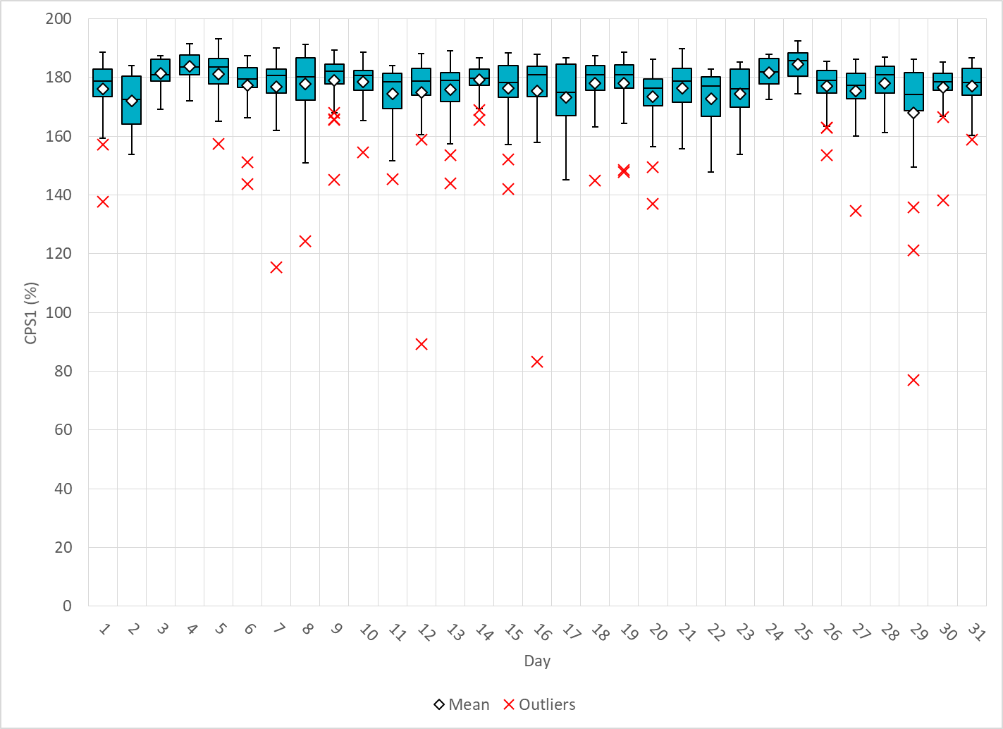
Hourly CPS1 by Day
Jul-19 CPS1 (%): 176.97
Notes:
Outliers:
7/12/2019 17:00 89.1%
Large expected generation deviation from conventional and IRRs for most of the hour.
7/16/2019 12:00 83.5%
Several units above their BPs due to changing configurations or in startup at top and end of hour. Also Unit runback/trip in middle of hour.
7/29/2019 18:00 78.5%
Large expected generation deviation from conventional and IRRs for most of the hour.

Slide 5
BAAL Exceedances & Violations
There were 3 BAAL exceedances in July
  July 29, 2019
    Unit Trip at 17:59:12
    Loss of 817 MW
    Less than 59.91 Hz for 3 minutes

Slide 6
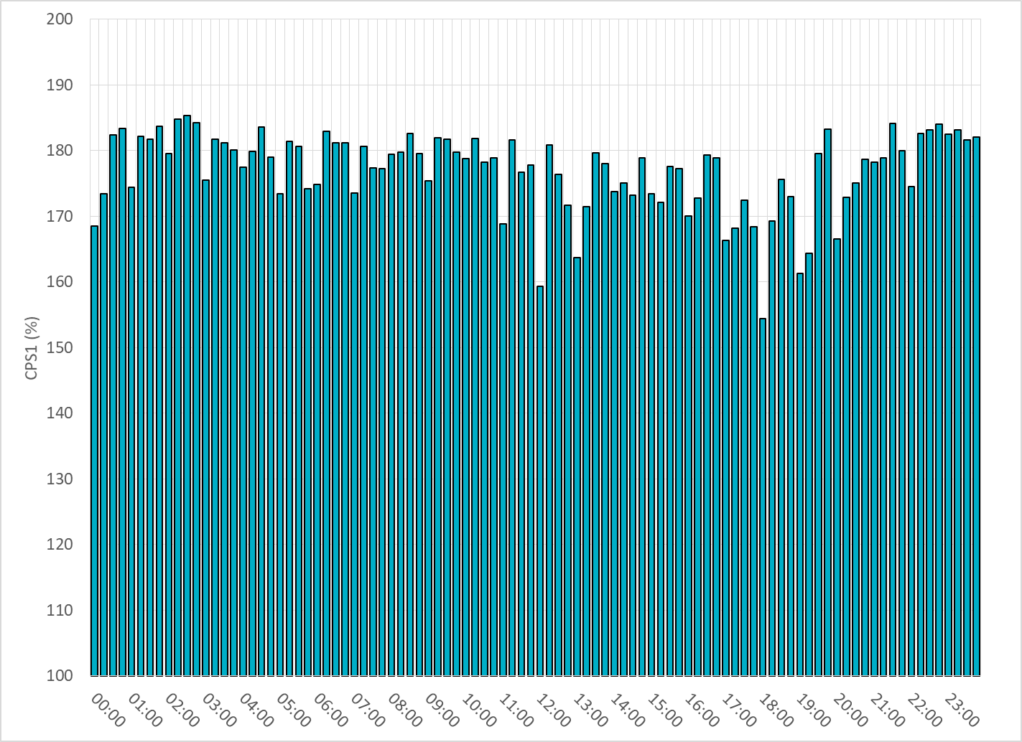
15-Minute Average CPS1%
Jul-19 CPS1 (%): 176.97

Slide 7
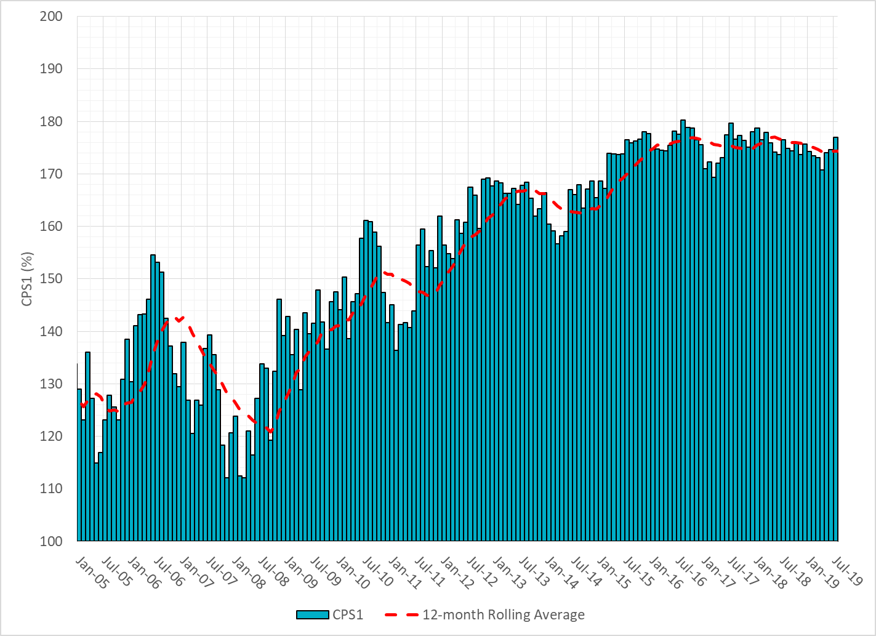
12-Month Rolling Average CPS1
Current 12-Month Rolling Average: 174.33%

Slide 8
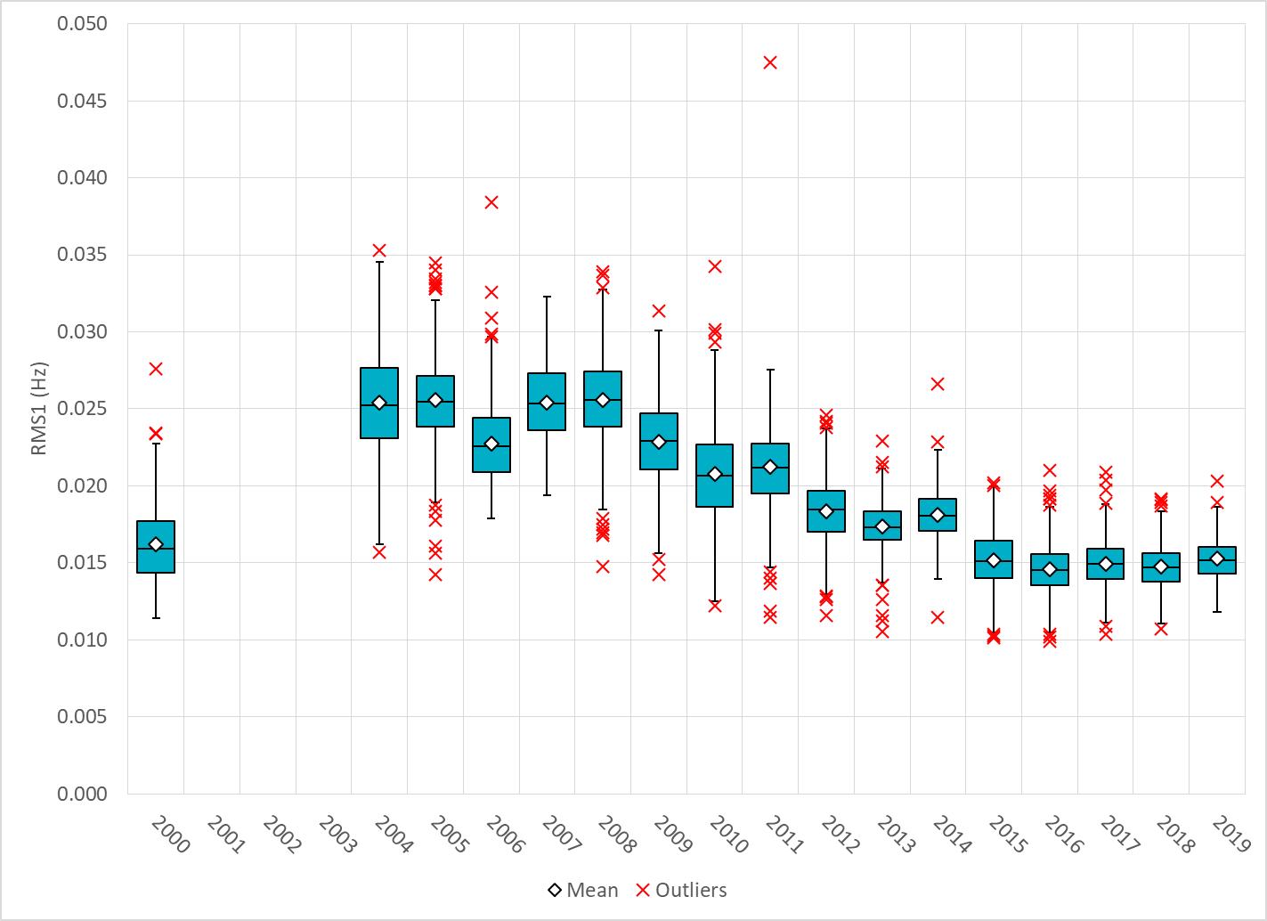
Daily RMS1 of ERCOT Frequency by Year
Notes:
Mean is 15.07 mHz

Slide 9
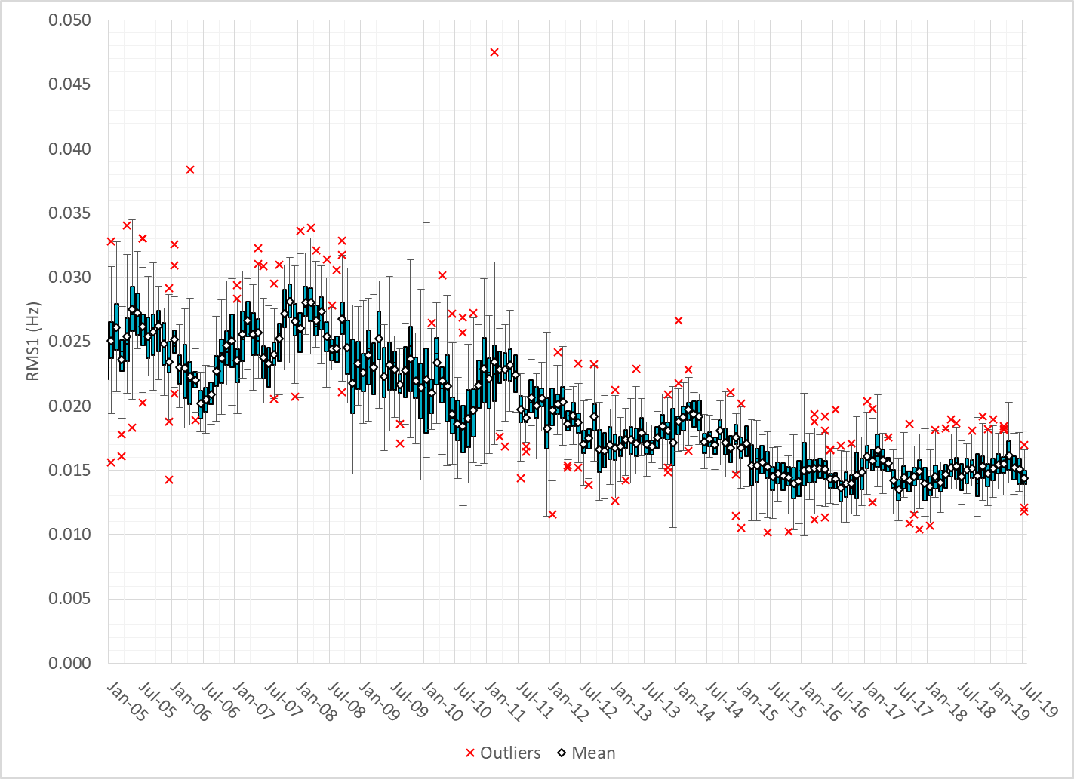
Daily RMS1 of ERCOT Frequency by Month

Slide 10
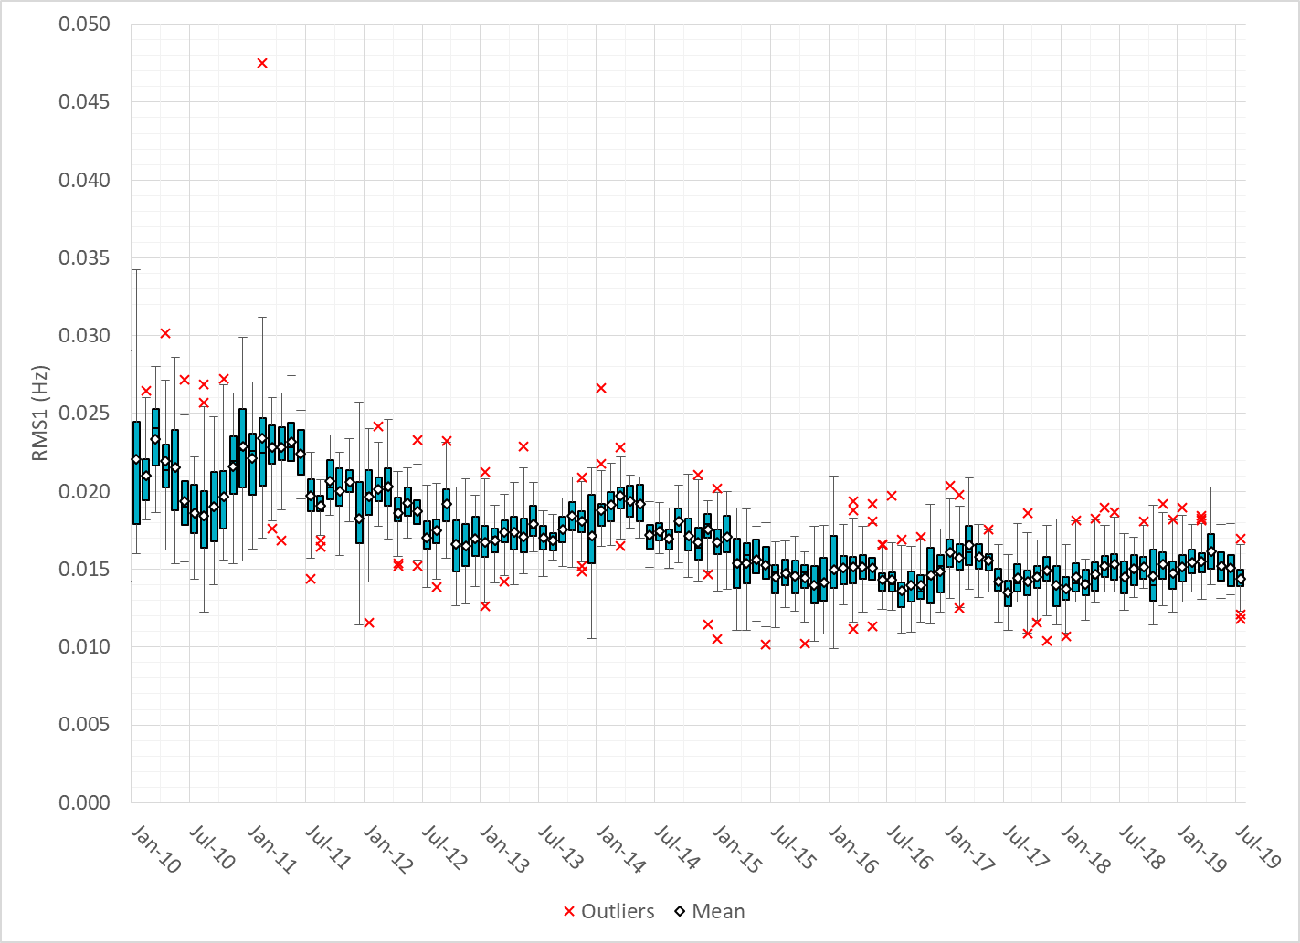
Daily RMS1 of ERCOT Frequency by Month
Notes:
Mean: 14.36 mHz
Min: 11.81 mHz
Max: 16.96 mHz

Slide 11
Frequency Profile Comparison

Slide 12
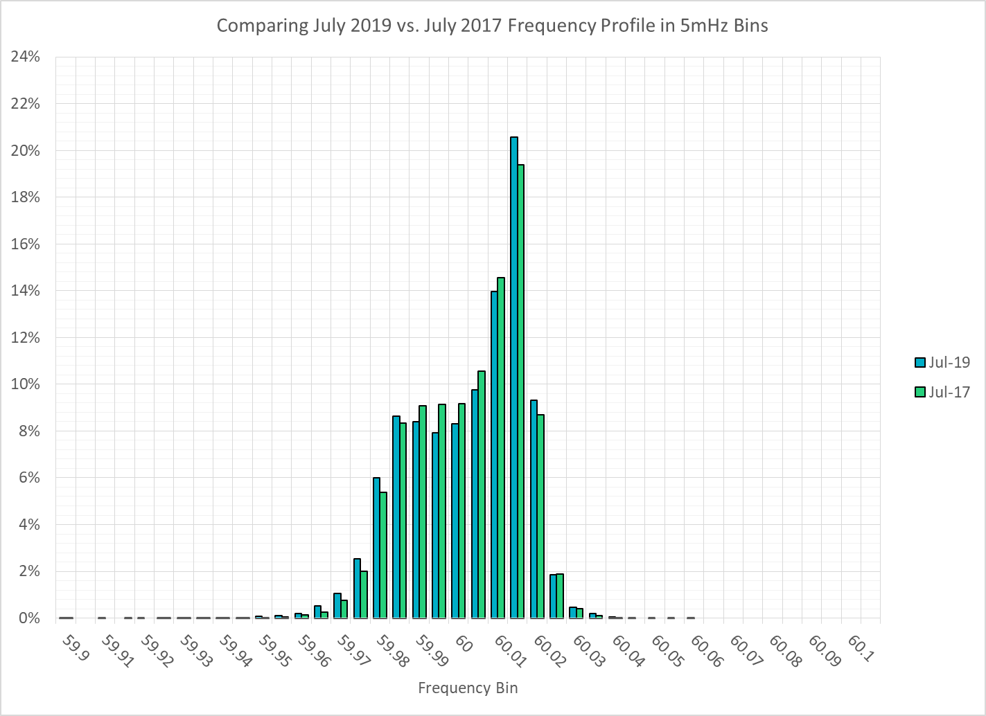
Frequency Profile Comparison

Slide 13
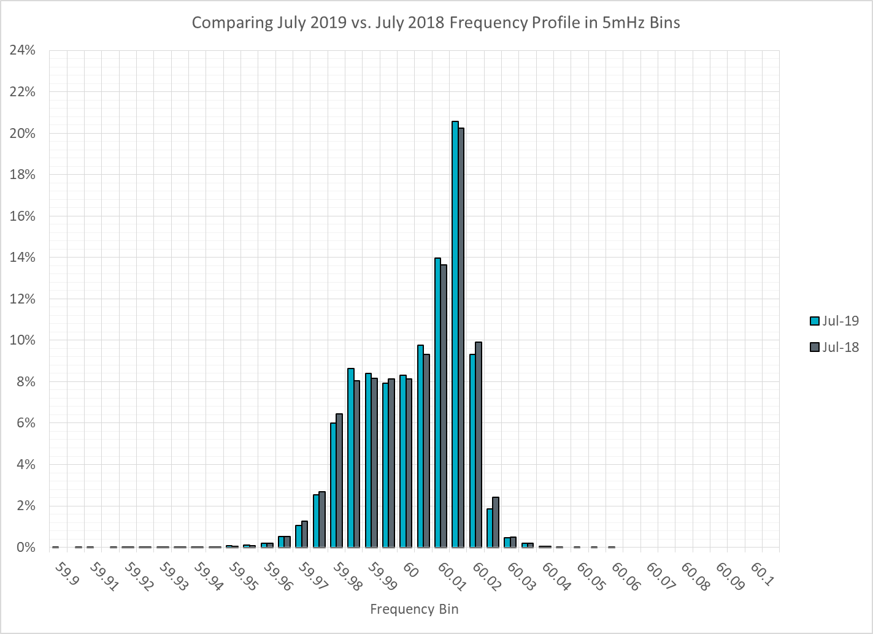
Frequency Profile Comparison

Slide 14
Time Error Correction

Slide 15
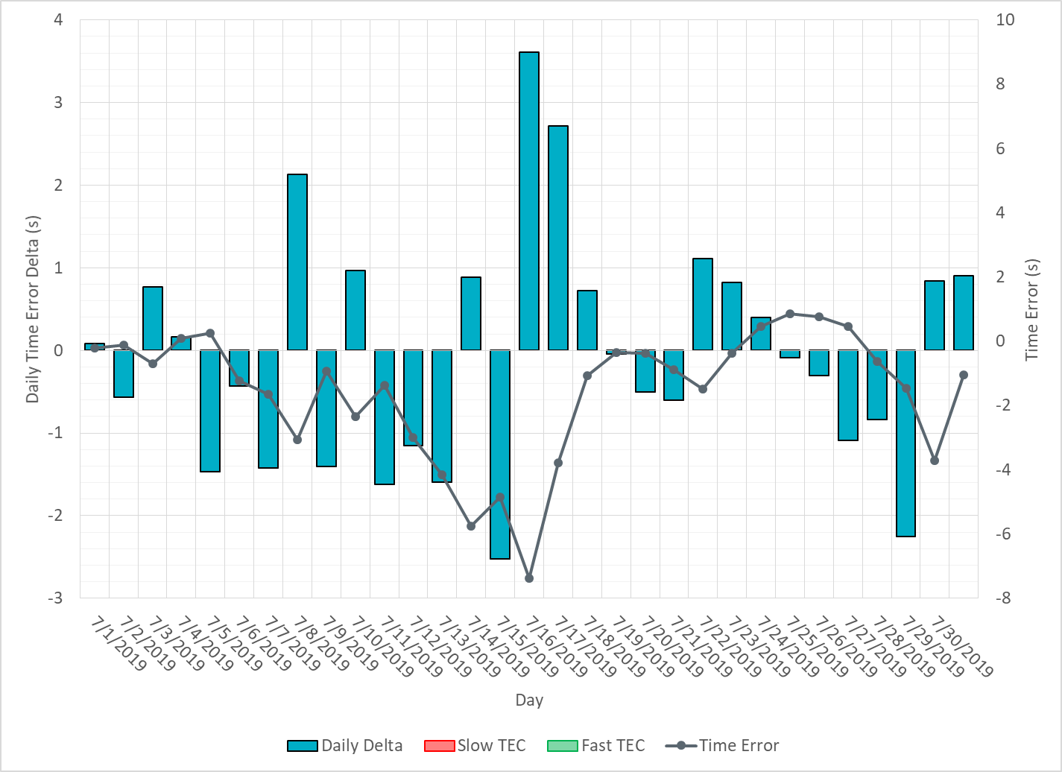
ERCOT Daily Time Error

Slide 16
Time Error Corrections Log Summary
There have been no time error corrections since December 2016

Slide 17
BAL-003 Performance

Slide 18
Op. Year 2018 BAL-003 Selected Events – Update
Notes:
BAL-003

Slide 19
Op. Year 2018 BAL-003 FRM Performance - Update

Slide 20
ERCOT Energy Statistics

Slide 21
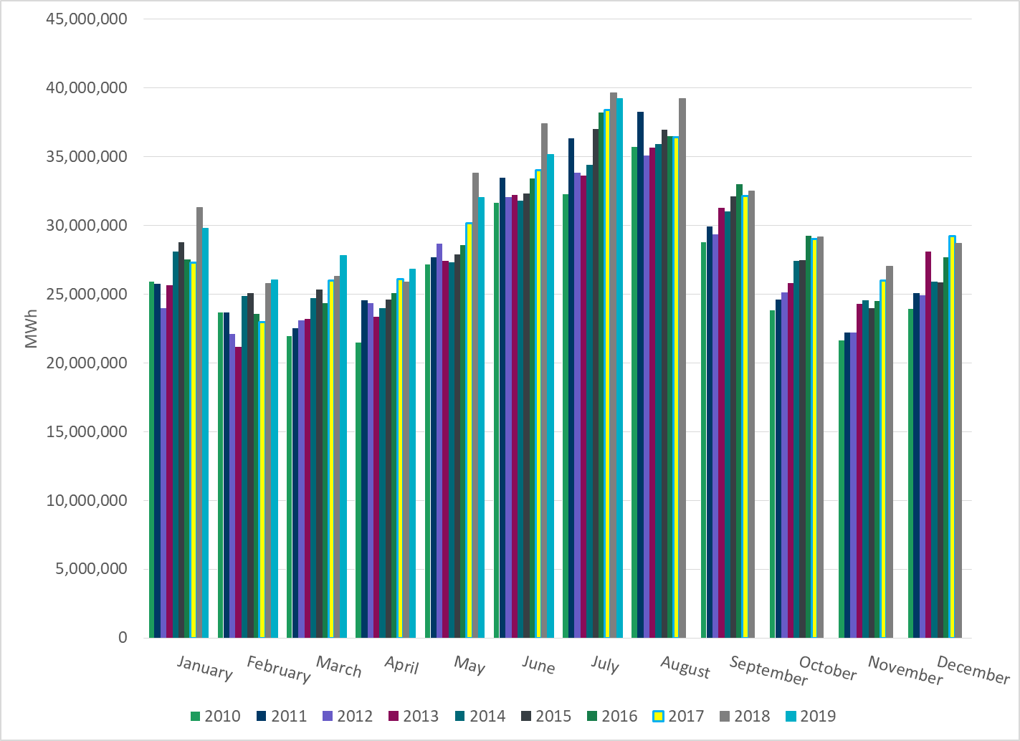
Total Energy
Notes:
39,226,761 MWh

Slide 22
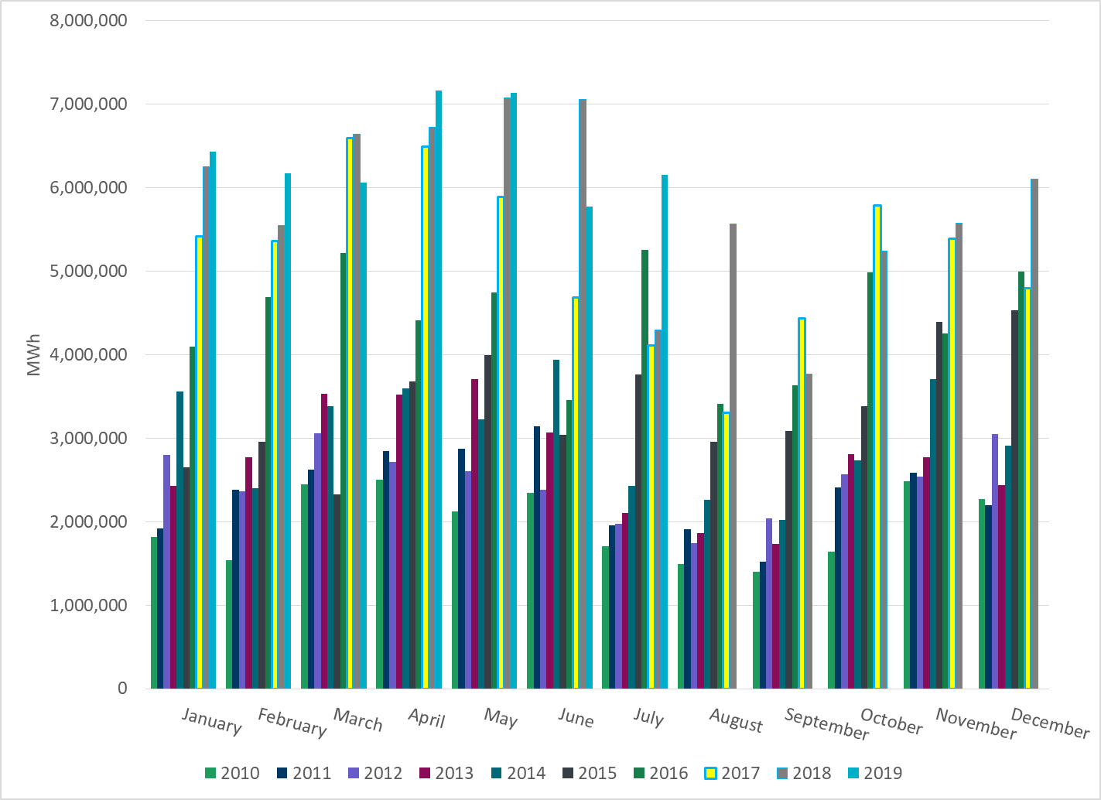
Total Energy from Wind Generation
Notes:
6,150,047 MWh

Slide 23
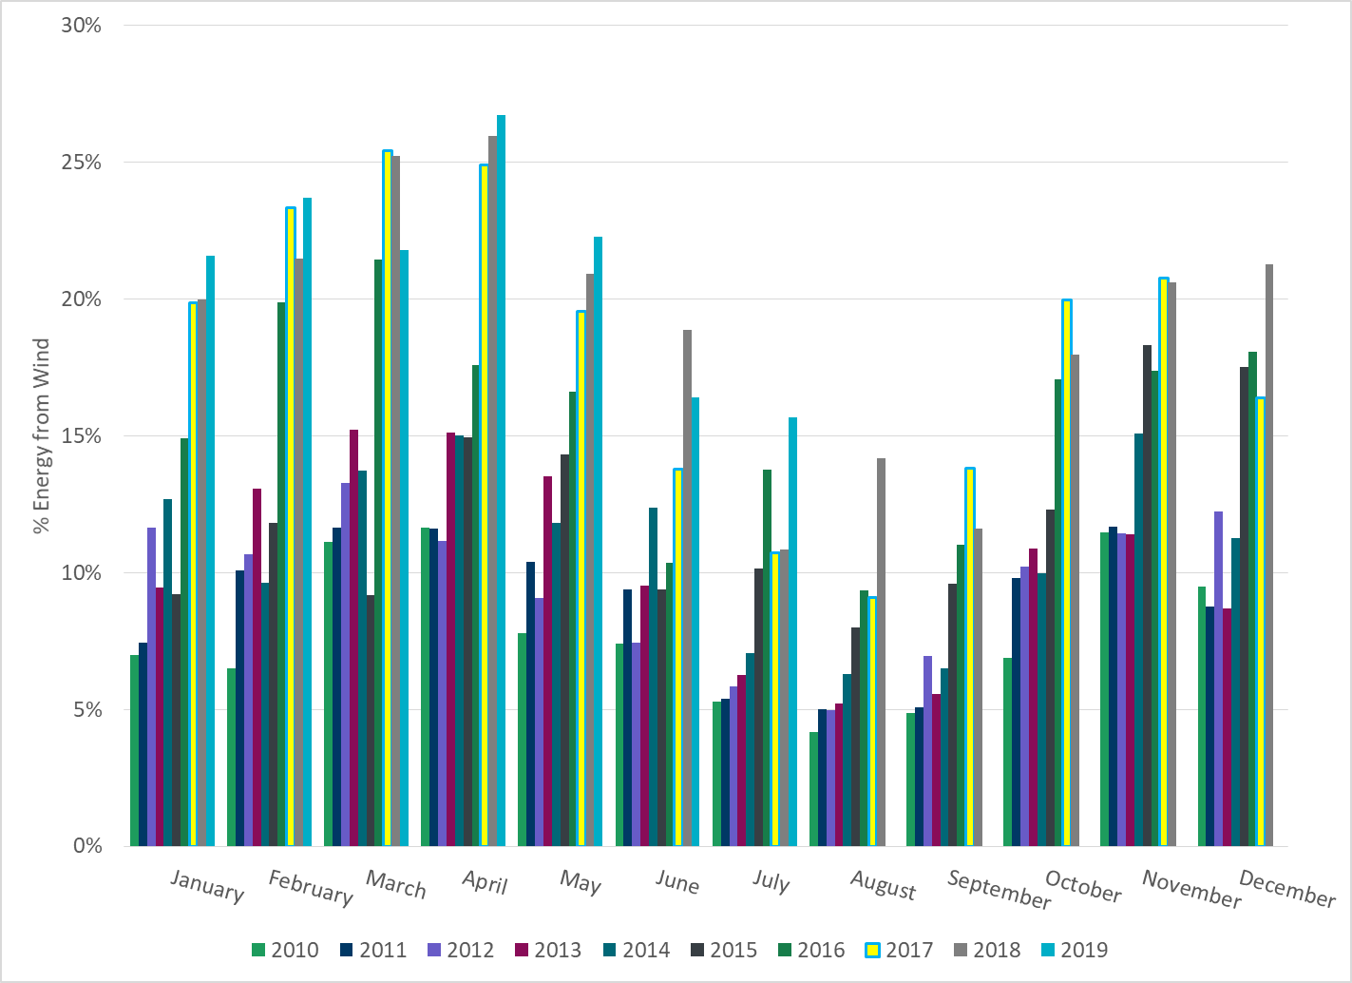
% Energy from Wind Generation
Notes:
15.68%

Slide 24
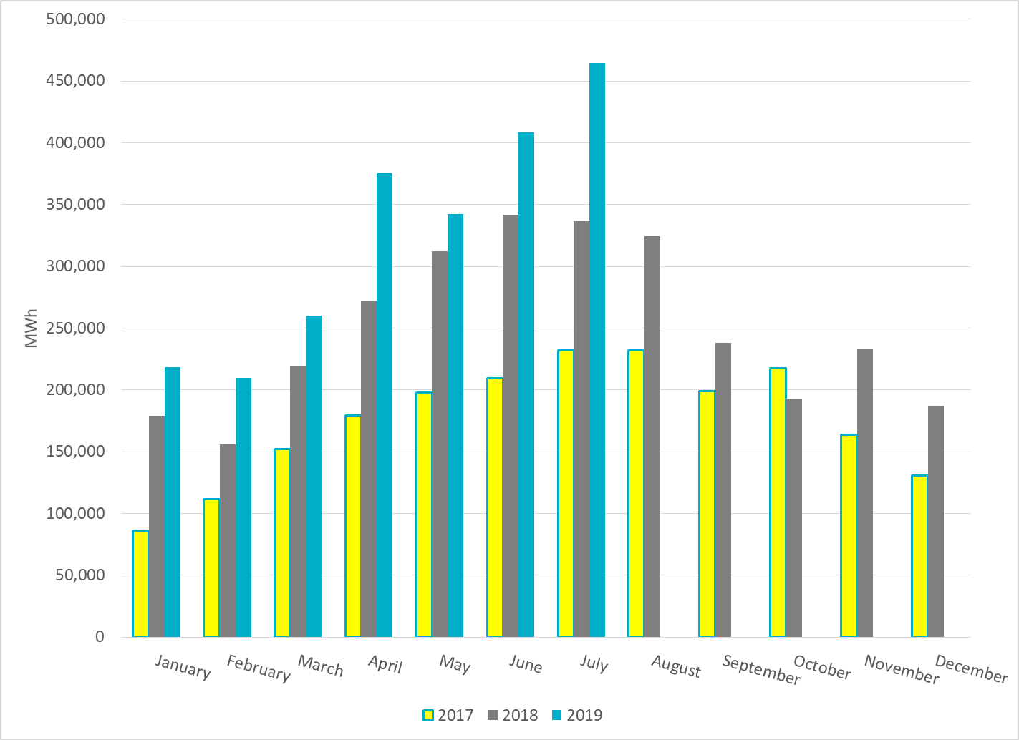
Total Energy From Solar Generation
Notes:
464,456 MWh

Slide 25
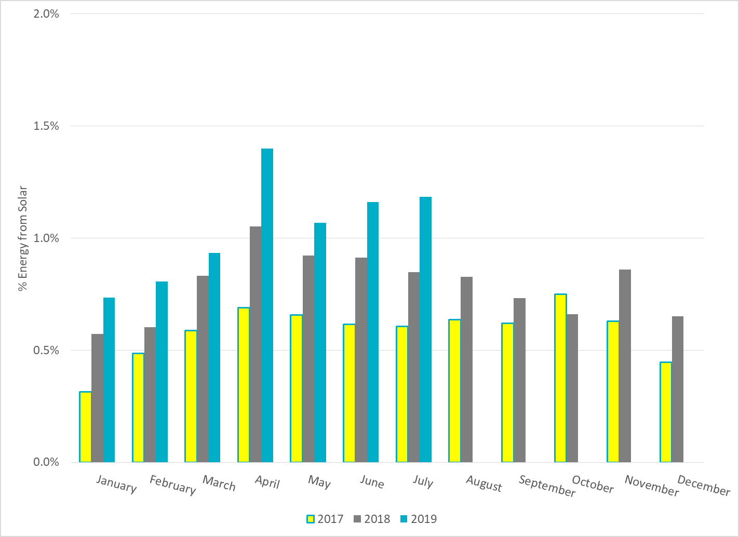
% Energy from Solar Generation
Notes:
1.18%

Slide 26
ERCOT System Inertia

Slide 27
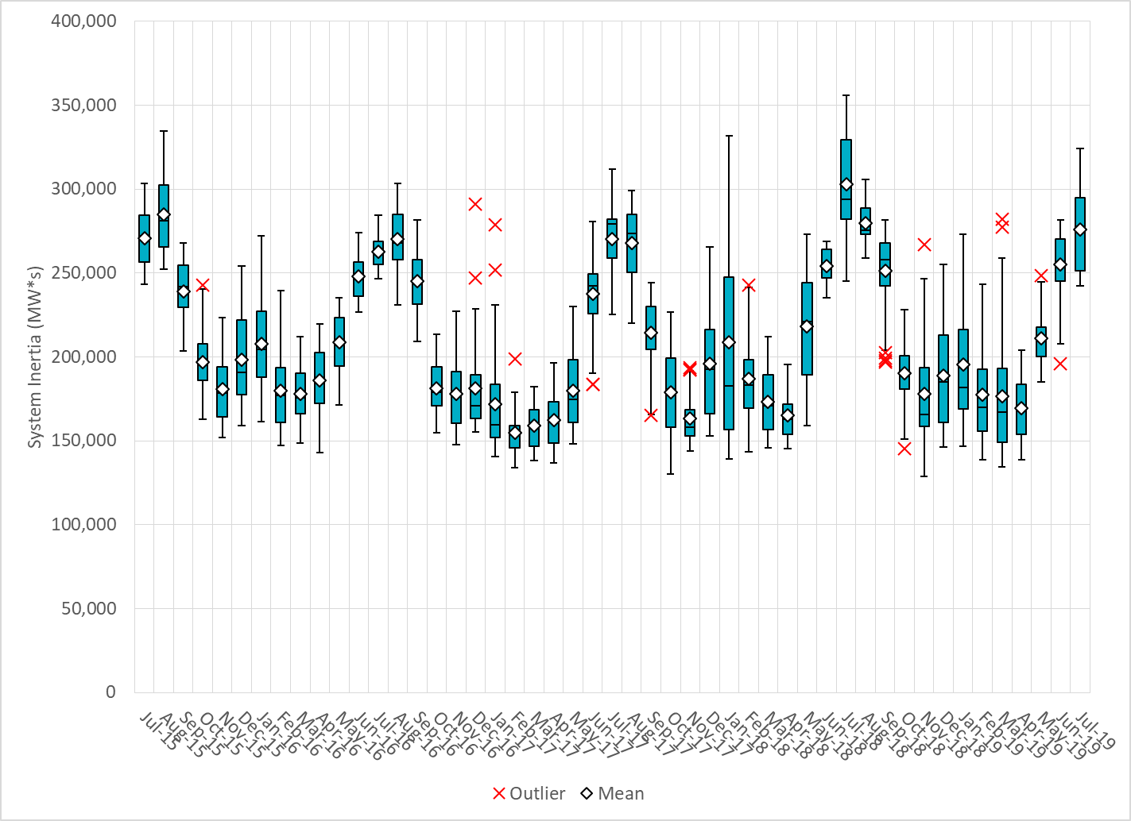
Daily Minimum System Inertia
Notes:
Minimum Inertia = 128,759 MW*s on 11/3/2018.
Previous Minimum was 130,014 MW*s on 10/27/2017. This was also our record wind day.
Data:
Mean: 275,707
Max: 324,355 on Jul 11th
Min: 242,244 on Jul 27th

Slide 28
Questions?
Thank you!

