Slide 1
Supply Analysis Working Group Report to WMS
August 7, 2019

Slide 2
SAWG July Meeting – Wind Capacity Calculations in the CDR – NEW NPRRs
NPRR 958 Modifications to Wind and Solar Capacity Calculations in the CDR
Changes the calculation from the simple average to a weighted average, where each year is weighted by its installed capacity
Solar capacity calculation would follow the same procedure as the wind capacity calculation, except using three years instead of ten year
NPRR 959 Creation of a Panhandle Region for Calculation of Seasonal Peak Average Capacity Contributions for Wind
Current regions are coastal and non-coastal
This NPRR separates the non-coastal region further into a Panhandle region

Slide 3
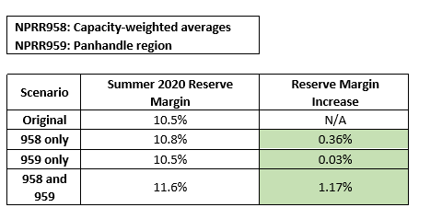
SAWG July Meeting – Wind Capacity Calculations in the CDR – NEW NPRRs
SAWG has been discussing these changes since January, and has consensus on both new NPRRs
Net effects as demonstrated on the May CDR:
NPRR 958 only – .36% change due to being weighted by a larger capacity, including solar
NPRR 959 only -- .03% change due to little planned Panhandle wind capacity in the May CDR
Both NPRR 958 and 959 – 1.17 % change due to much larger Panhandle wind capacity after 2015 and higher contribution, now being weighted by the higher amount of installed capacity

Slide 4
SAWG July Meeting – Distributed Generation Forecasting and CDR Capacity Contribution Estimation Initiatives
ERCOT discussed growth forecasted in residential solar, utility scale solar (<10 MW) and natural gas
Forecasting Residential Solar Growth
ERCOT estimated long-term growth using S-curve and found a Summer Peak Capacity Factor at 36% based on AWS Truepower analysis
Next Step: continue to work on use of S-curve for residential solar growth at SAWG
Forecasting Utility Scale Solar Growth
No current forecast tool developed
Next Step: roundtable discussion at next SAWG
Forecasting Natural Gas Growth Projects
No current forecast tool developed
Next Step: ERCOT offline discussions with DSPs to determine appropriate questions for possible polling

Slide 5
SAWG July Meeting – Unconfirmed Retirements in the CDR
Proposed PGRR072 removes publicly announced retirements from the planning models
SAWG and ERCOT discussed that there are already other discrepancies between planning models and CDR
Public announcements do not necessarily need to be removed from CDR
Discussed for possible options for treatment unconfirmed/publicly announced retirements:
Modified NSO form for unconfirmed retirements with set retirement dates; that would not trigger and RMR
Reflect unconfirmed retirements on Summary Tab
Reflect unconfirmed retirements on Supplemental Tab
Next Step:
Possibly include announced retirements in supplemental tab with ERCOT to formulate a clear criteria for when those retirements should be included

Slide 6
SAWG July Meeting – Non-operational and Mothballed Units in the CDR
ERCOT Proposal:
Treat extended outages units like mothballed units & add a new section at the bottom of the Capacities tabs named “Extended Outage Resources”
Keep the 180-day requirement
Discussion around whether an NSO can have Protected Information and whether this is consistent with Protocols Section 1.3.6
More discussion with ERCOT at next SAWG

Slide 7
SAWG July Meeting – CONE Draft NPRR
ERCOT presented an NPRR to revise Section 4.4.11 of the Nodal Protocols to introduce an Other Binding Document that would provide the CONE methodology, timetable, and past and current CONE and PNM threshold values
Stakeholders expressed a preference for the content of the OBD to be in the protocols
Next steps:
ERCOT to speak to Brattle about doing an ERCOT-specific methodology
SAWG and ERCOT to begin to develop content for NPRR or OBD (if methodology would be a lengthy document)

Slide 8
Next SAWG Meetings
August 30th
September 27th

