Slide 1
Item 3a – Ancillary Service Demand Curves for Real-Time Co-Optimization
Dan Jones
August 9, 2019

Slide 2
Objective and Approach
For RTC, produce individual ancillary service demand curves (ASDCs) that are, in aggregate, as consistent as possible with anticipated pricing outcomes for the ORDC methodology that will be effective March 1, 2020
Already specified by the PUCT:
NPRR 863 AS Products (Reg-Up, RRS, ECRS, NSRS)
VOLL = $9,000/MWh
SWOC = $2,000/MWh
Maximum ASDC value = $9,000/MWh (cover 0 to 2,000 MW of reserves)
Maximum Energy Price (exclusive of congestion) capped at $9,000/MWh
This presentation addresses the approach for:
Developing an aggregate, single curve representation for the 2020 ORDC as a function of total online and offline reserves; and
II. Dividing the single aggregate 2020 ORDC into individual ASDCs for Reg Up, RRS, ECRS and NSRS that vary by hour depending on the minimum AS requirements
Separately, also need to develop a Reg-Down demand curve

Slide 3
I. Developing an aggregate, single curve representation for the 2020 ORDC

Slide 4
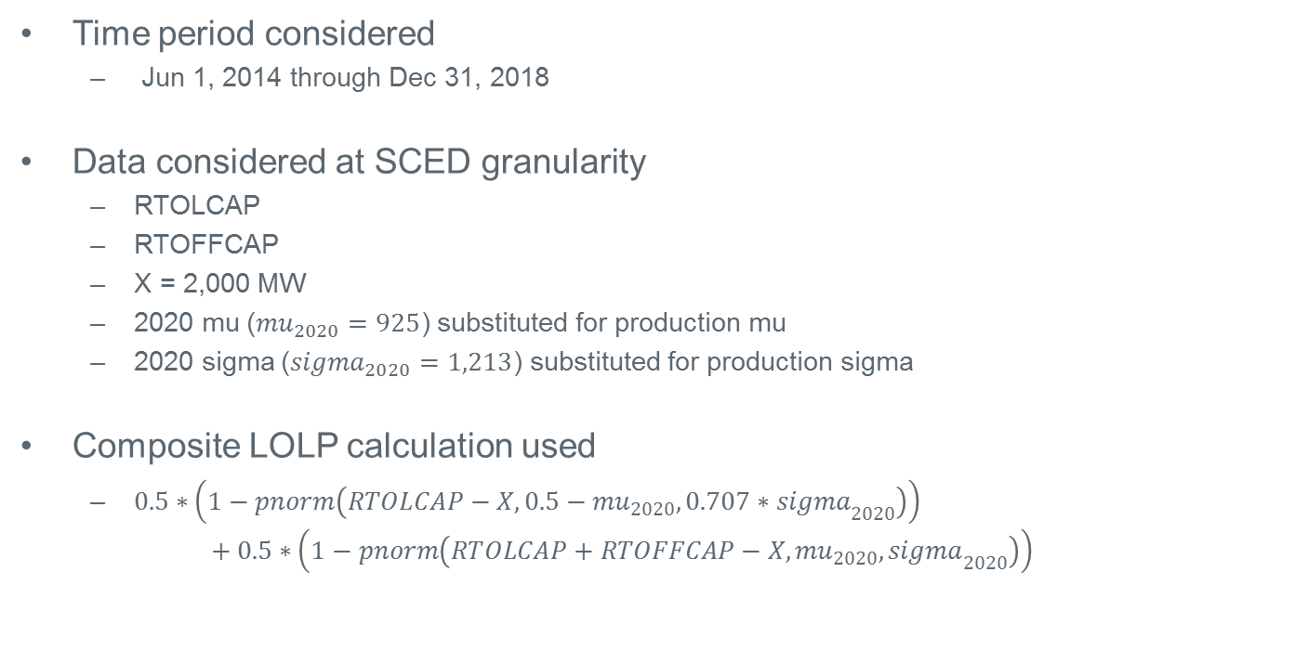
Developing a Single 2020 ORDC
Time period considered
Jun 1, 2014 through Dec 31, 2018
Data considered at SCED granularity
RTOLCAP
RTOFFCAP
X = 2,000 MW
2020 mu (${mu}_{2020}=925$) substituted for production mu
2020 sigma (${sigma}_{2020}=1,213$) substituted for production sigma
Composite LOLP calculation used
$0.5∗\left(1−pnorm\left(RTOLCAP−X,0.5−{mu}_{2020}, 0.707∗{sigma}_{2020}\right)\right)$
$$+ 0.5∗\left(1−pnorm\left(RTOLCAP+RTOFFCAP−X,{mu}_{2020}, {sigma}_{2020}\right)\right)$$

Slide 5
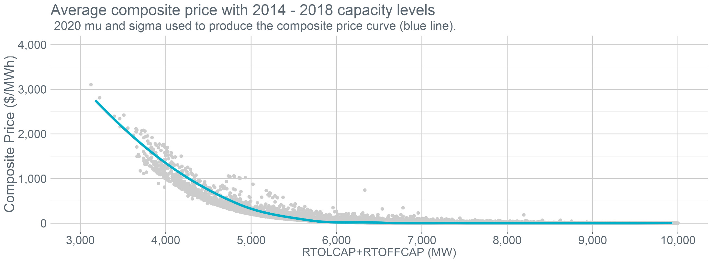
Capacity levels < 10,000 MW
Composite Price ($/MWh)
$$\left(0.5∗\left(1−pnorm\left(RTOLCAP−X, 0.5∗925, 0.707∗1213\right)\right)+0.5∗\left(1−pnorm\left(RTOLCAP+RTOFFCAP−X, 925, 1213\right)\right)\right)$$
$$∗\left(9000−min\left(System Lambda, 2000\right)\right)$$
~90k SCED intervals out of ~480k intervals examined where $RTOLCAP+RTOFFCAP<10GW$
A locally estimated scatterplot smoothing (LOESS) regression curve was added to the data to create a smooth composite LOLP curve
*System lambda is limited to $2,000 to be consistent with the maximum marginal cost of energy under RTC

Slide 6
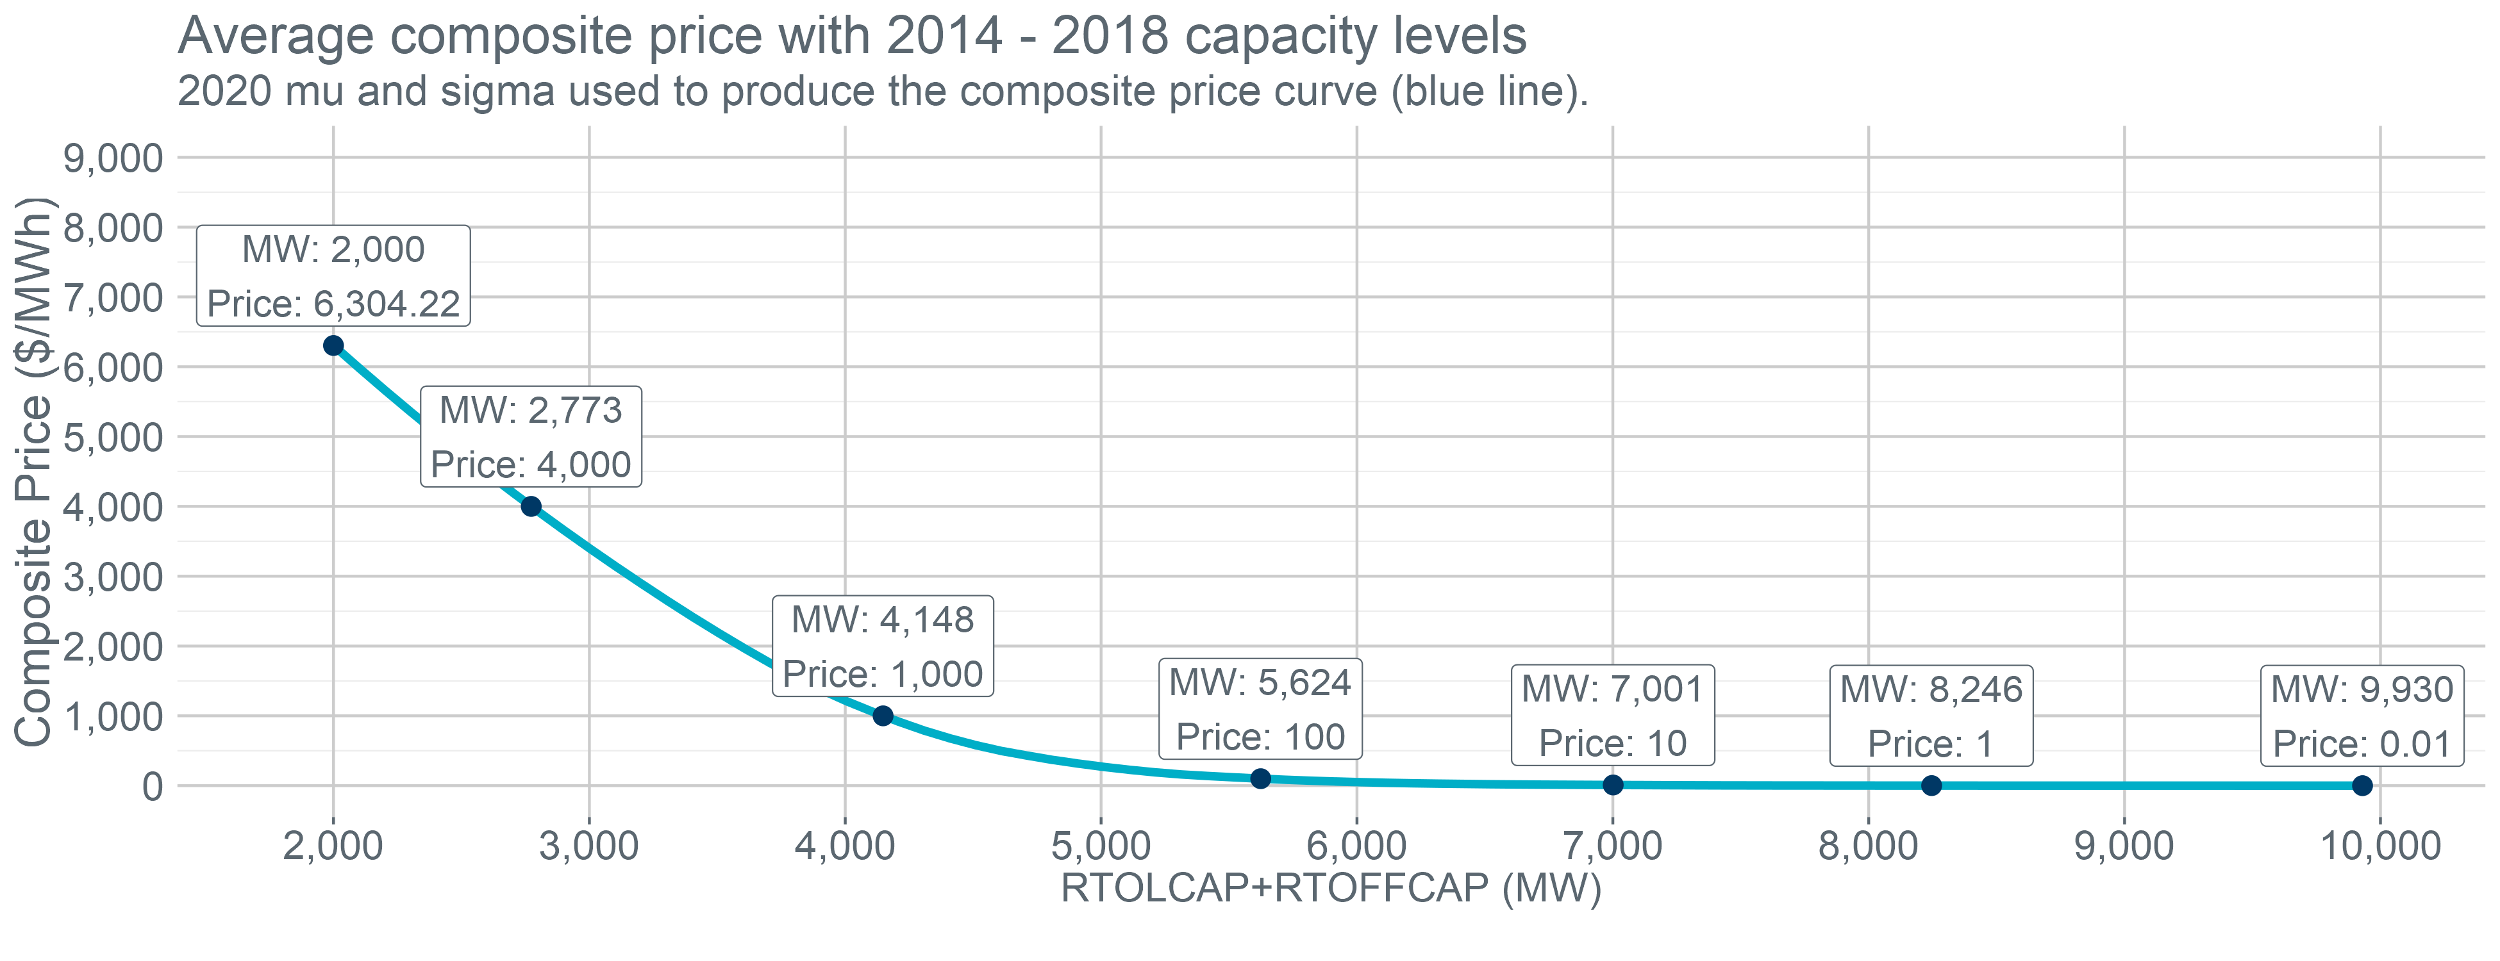
Capacity levels < 10,000 MW
Extended
Section
To extend the curve to 2,000 MW of total reserves due to the absence of historical data points
Used a system lambda of $493 which was the average system lambda for data points less than 4,000 MW of total reserves
Assumed $RTOFFCAP=0MW$
This is in alignment with the existing process of setting RTOFFCAP = 0 once EEA Level 1 is initiated

Slide 7
II. Dividing the single aggregate 2020 ORDC into individual ASDCs

Slide 8
Dividing the Aggregate ORDC into ASDCs: Approach
Current scarcity pricing consists of the combination of ORDC and PBPC
PBPC is a proxy for a Reg-Up demand curve in the current design
Can use the PBPC to inform where to “drop” AS MW into the Aggregate ORDC curve

Slide 9
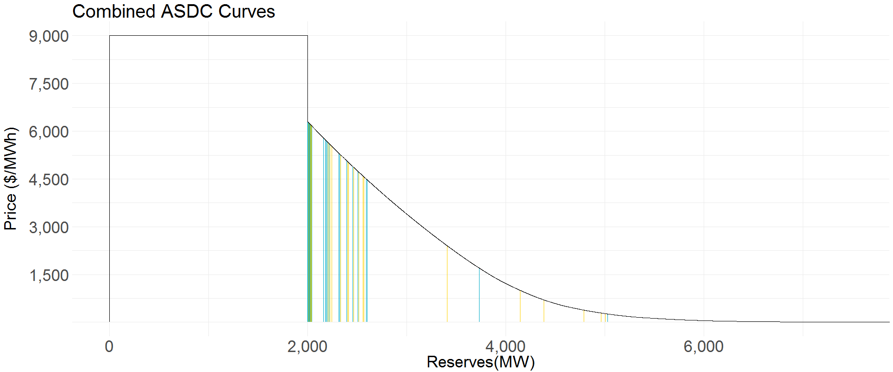
Dividing the Aggregate ORDC into ASDCs
Jul-19 HE22
NPRR 863 Requirements
Reg-Up RRS ECRS NSRS
175 2300 1268 107
Step 1: Reserve 100 MW each of Reg-Up and RRS on aggregate ORDC consistent with PBPC pricing

Slide 10
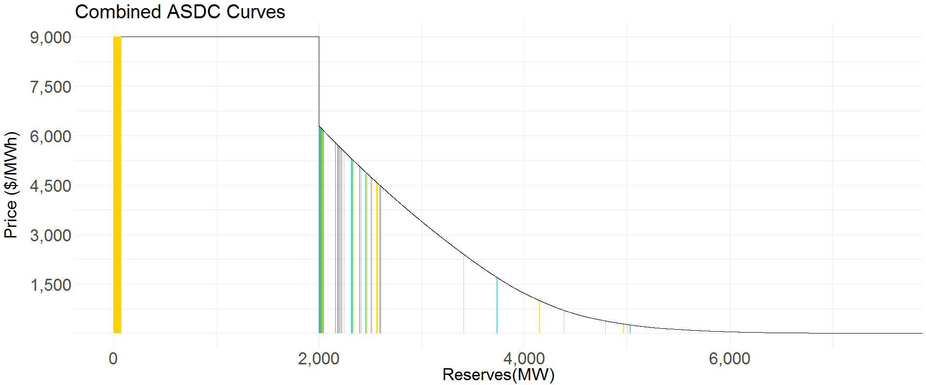
Dividing the Aggregate ORDC into ASDCs
Jul-19 HE22
NPRR 863 Requirements
Reg-Up RRS ECRS NSRS
175 2300 1268 107
Step 2: Place $(Reg Up Requirement −100MW)$ at highest priced open MWs on the aggregate ORDC

Slide 11
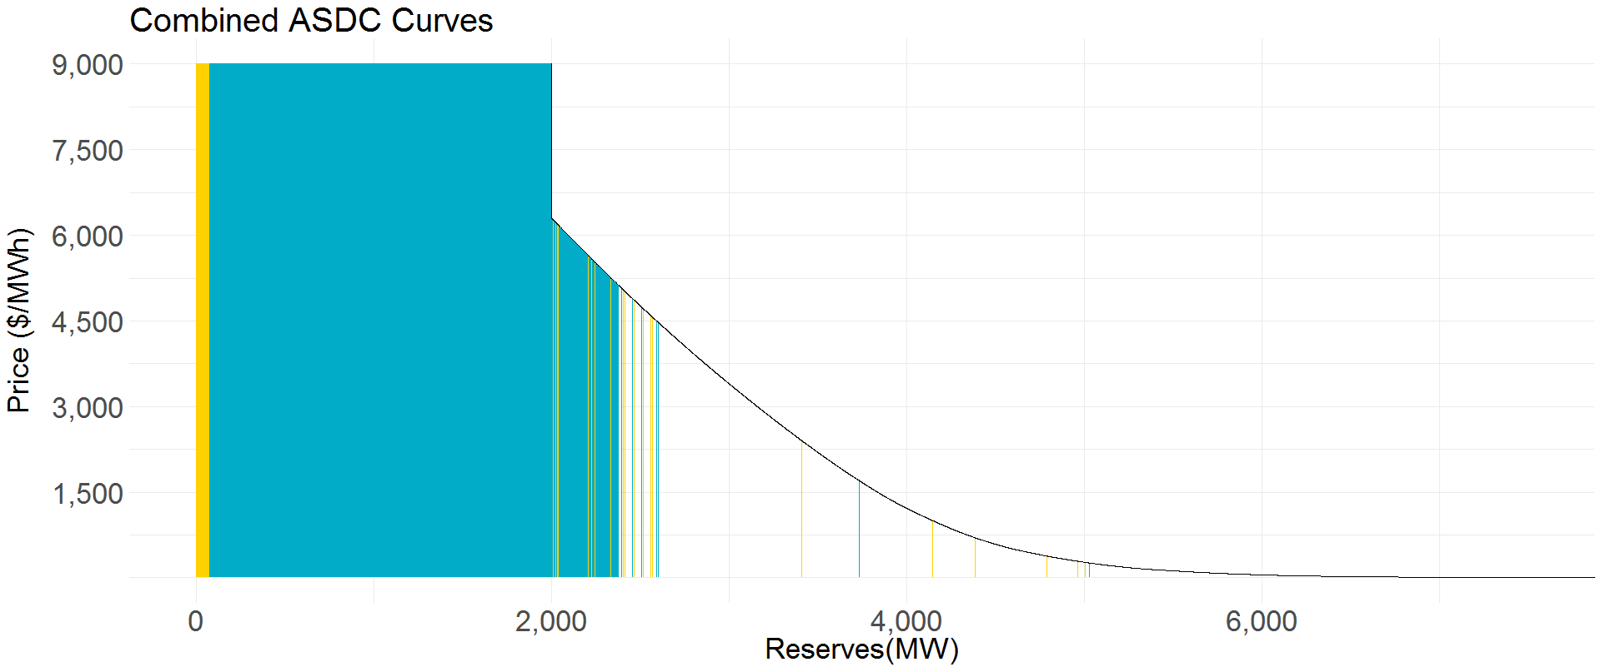
Dividing the Aggregate ORDC into ASDCs
Jul-19 HE22
NPRR 863 Requirements
Reg-Up RRS ECRS NSRS
175 2300 1268 107
Step 3: Place $(RRS Requirement −100MW)$ at highest priced open MWs on the aggregate ORDC

Slide 12
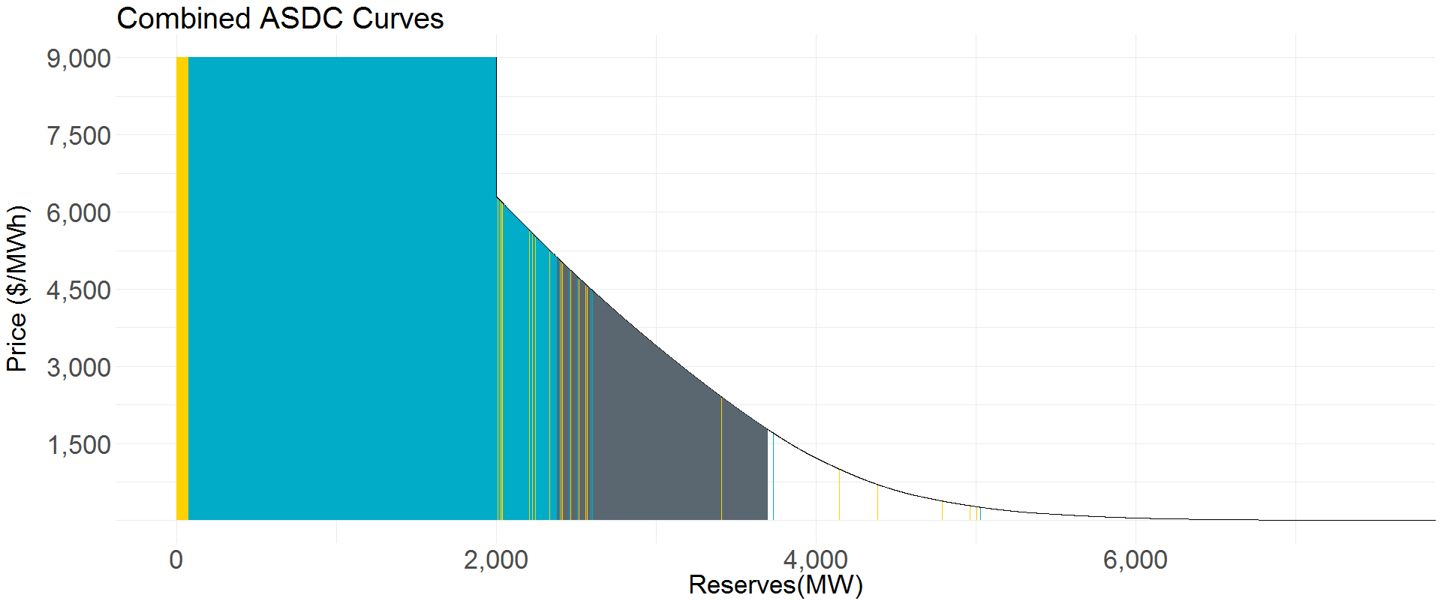
Dividing the Aggregate ORDC into ASDCs
Jul-19 HE22
NPRR 863 Requirements
Reg-Up RRS ECRS NSRS
175 2300 1268 107
Step 4: Place ECRS Requirement at highest priced open MWs on the aggregate ORDC

Slide 13
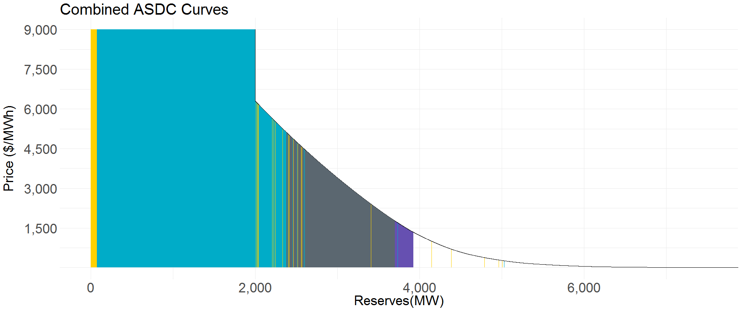
Dividing the Aggregate ORDC into ASDCs
Jul-19 HE22
NPRR 863 Requirements
Reg-Up RRS ECRS NSRS
175 2300 1268 107
Step 5: Place NSRS Requirement at highest priced open MWs on the aggregate ORDC

Slide 14
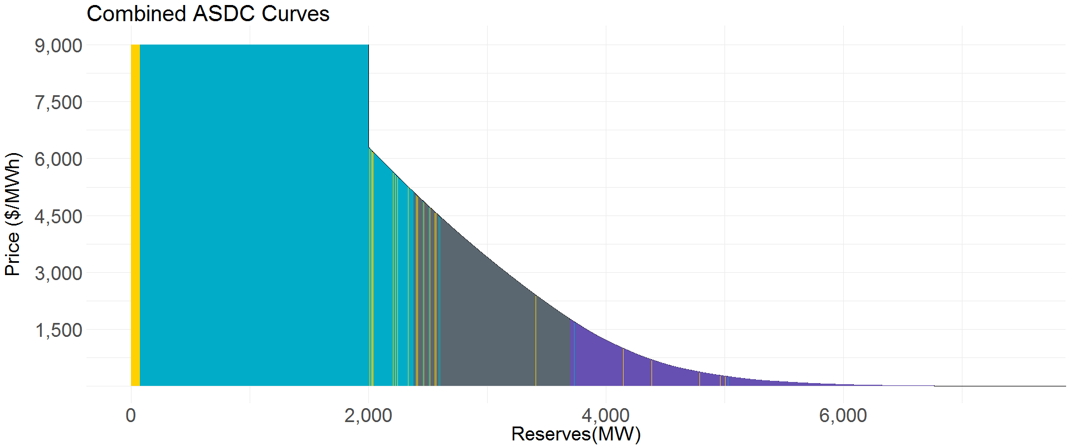
Dividing the Aggregate ORDC into ASDCs
Jul-19 HE22
NPRR 863 Requirements
Reg-Up RRS ECRS NSRS
175 2300 1268 107
Step 6: Fill remaining MWs on the aggregate ORDC priced at >= $0.01 as NSRS
ORDC reserves today are most similar to NSRS, so it seems appropriate to assign the remainder of the aggregate curve to that product (I.e., assigning it to other services would be more restrictive than the ORDC)

Slide 15
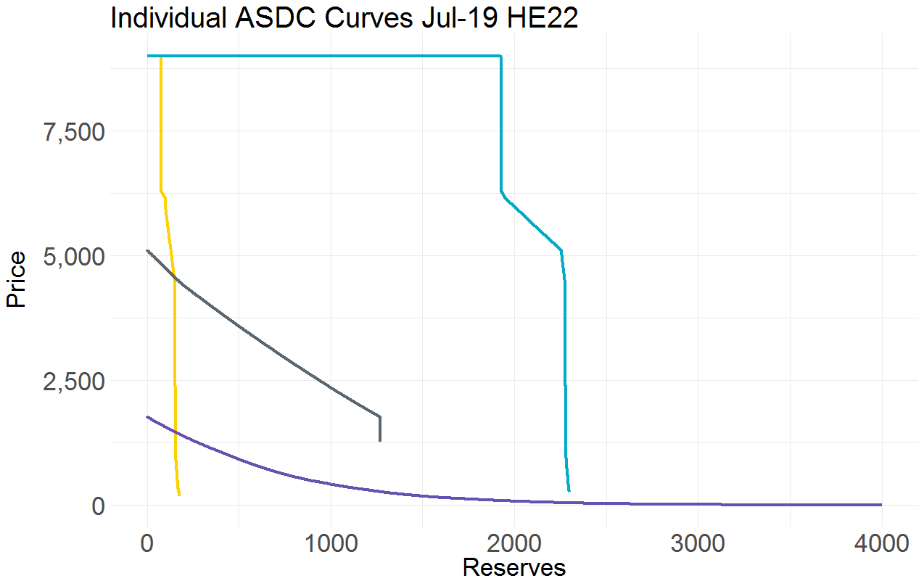
Resulting ASDCs: July-19 HE22
Jul-19 HE22
NPRR 863 Requirements
Reg-Up RRS ECRS NSRS
175 2300 1268 107

Slide 16
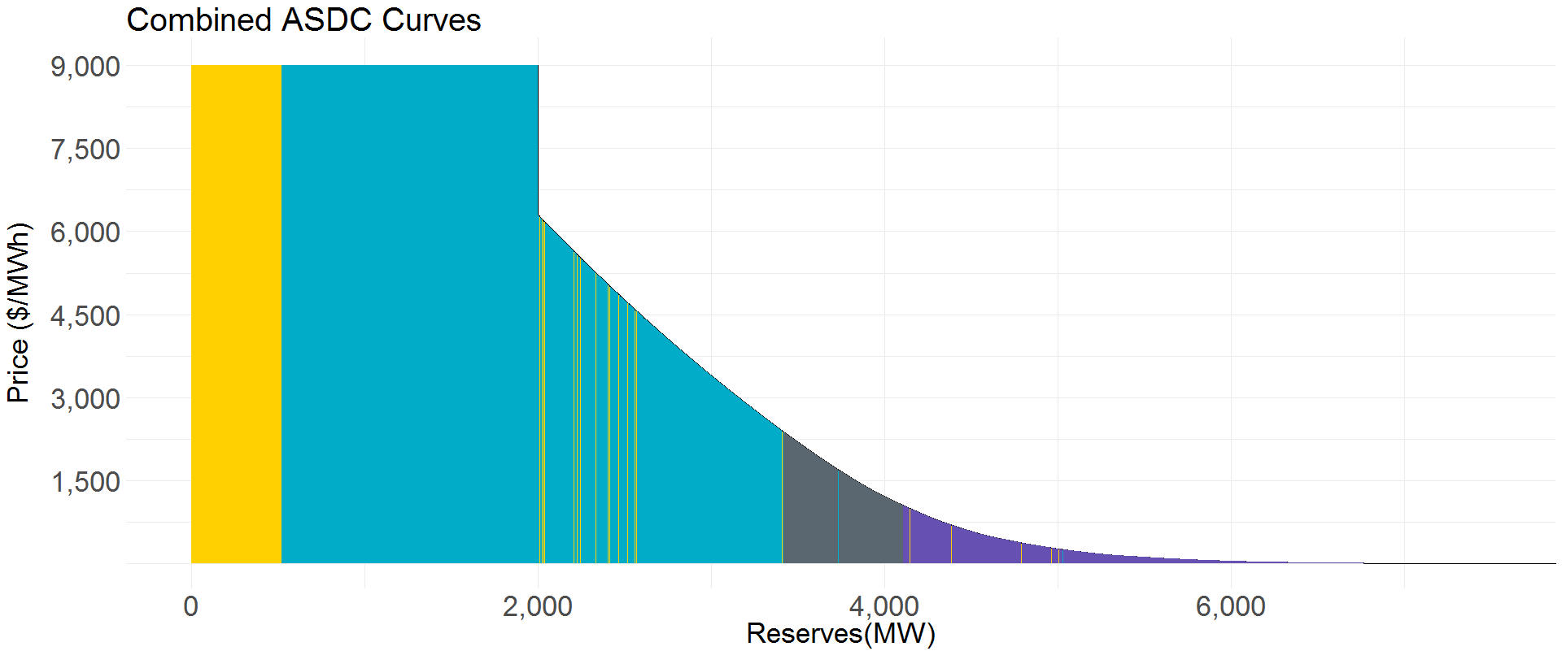
Resulting ASDCs: Feb-19 HE7
Feb-19 HE7
NPRR 863 Requirements
Reg-Up RRS ECRS NSRS
623 2840 690 1442
While the underlying composite curve would remain unchanged, the individual ASDCs would adjust hourly to reflect the change in AS requirements

Slide 17
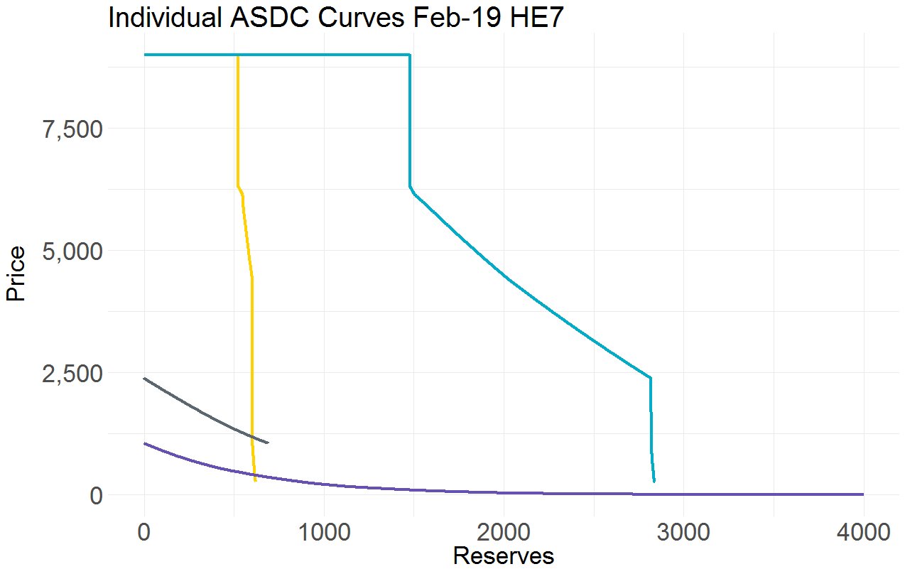
Resulting ASDCs: Feb-19 HE7
Feb-19 HE7
NPRR 863 Requirements
Reg-Up RRS ECRS NSRS
623 2840 690 1442
Non-Spin Requirement

Slide 18
Comparison of the Two Example Hours
Jul-19 HE22
Feb-19 HE7

Slide 19
Comparison of the Two Example Hours

Slide 20
Questions and Additional Discussion

