Slide 1
Market Credit Working Group update to the Wholesale Market Subcommittee
Bill Barnes NRG, Chair
Josephine Wan Austin Energy, Vice Chair
08/07/2019

Slide 2
MCWG update to WMS
General Update
July 25th Joint MCWG/CWG Meeting
4 NPRRS reviewed for their credit impacts
936NPRR CRR Account Holder Limits. This Nodal Protocol Revision Request changes the Congestion Revenue Right (CRR) Auction transaction limit to the Counter-Party level, rather than that of the CRR Account Holder.
951NPRR Active and Inactive SCED Constraint Reporting. This Nodal Protocol Revision Request (NPRR) expands the Network Security Analysis Active Constraints report and the Network Security Analysis Inactive Constraints report to include Megavolt Ampere (MVA) flows and limits.
952NPRR Use of Katy Hub for the Fuel Index Price. This Nodal Protocol Revision Request (NPRR) proposes fully replacing Houston Ship Channel with Katy Hub as the reference for the Fuel Index Price (FIP) for natural gas in ERCOT’s systems.
954NPRR Allow Opt Out of 867 EPS Data. This Nodal Protocol Revision Request (NPRR) allows a Transmission Service Provider (TSP), Distribution Service Provider (DSP), or Load Serving Entity (LSE) to opt out of receipt of Texas Standard Electronic Transaction (Texas SET) 867 data for Electric Service Identifiers (ESI IDs) with ERCOT Polled Settlement (EPS) Meters.
All operational without any credit impact.

Slide 3
MCWG update to WMS
Overview of Financial Industry Entry Qualification Processes
ERCOT reviewed registration/qualification requirements/processes for the following organizations within the financial sector:
Intercontinental Exchange (ICE)
Company that owns numerous exchanges including the New York Stock Exchange (NYSE) and ICE Futures U.S. (IFUS)
IFUS Membership
Registration
General information gathering
Criminal, financial, regulatory, bankruptcy, and civil judicial disclosures
Any other information requested by ICE
Qualifications
Be a natural person at least twenty-one (21) years of age
Be of good character, reputation and business integrity with adequate financial resources and credit to assume the responsibilities and privileges of membership
Application Review
Application includes consent to a background check
Timeline: As long as necessary
Appeals
Membership Committee
Trading without IFUS Membership
Status as an IFUS Member is not required to obtain trading access. Individuals can apply for trading access after receiving authorization from an IFUS Clearing Member (typically large banks), provided such access complies with all laws, rules, regulations, etc.

Slide 4
MCWG update to WMS
Overview of Financial Industry Entry Qualification Processes
NEXT STEPS
ERCOT Development of Objective Criteria
Credit Requirements
Past Acts
Criminal
Civil/Regulatory
Injunctions, sanctions, discipline, complaints
Length of the look-back period (e.g., 10 years)
Applicability and Scope:
Who
MP type
E.g., Principals, Officers, 10% ownership, Individuals with authority to transact/bind MP
When
Proactive
Application/Disclosure
Background Check
Continued Obligation
Attestation
Material Change
Retroactive
Appeals Process

Slide 5
MCWG update to WMS
ERCOT Credit Exposure Updates
Market-wide average TPE increased from $324.0 million to $372.7 million
The increase in TPE is due to higher Forward Adjustment Factors in June
Discretionary Collateral is defined as Secured Collateral in excess of TPE,CRR Locked ACL and DAM Exposure.
Average Discretionary Collateral increased from $ 870.7 million to $1,164.9 million
The increase in Discretionary Collateral is largely due to increase in Secured Collateral and decrease in the number of auction lock days in June compared to May
Number of active Counter-Parties increased from 239 to 243
No unusual collateral call activity

Slide 6
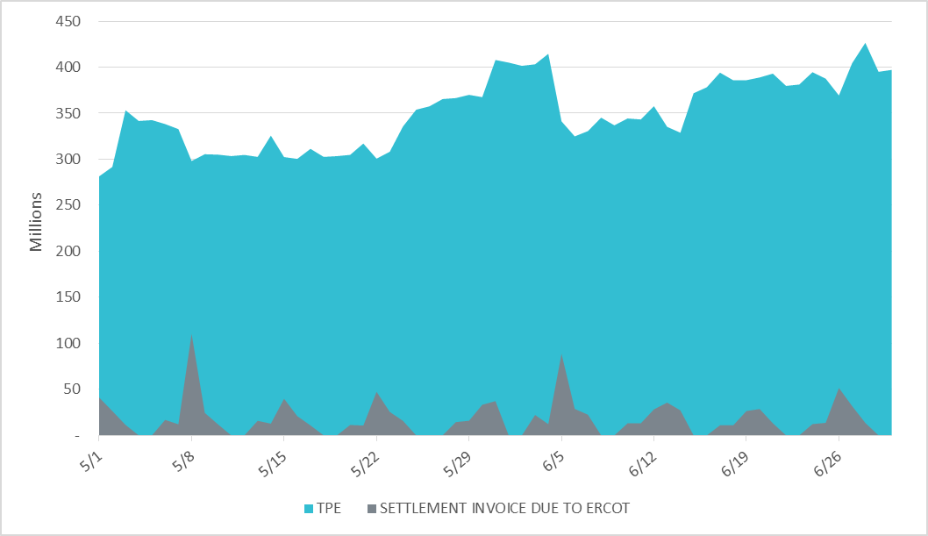
MCWG update to WMS

Slide 7
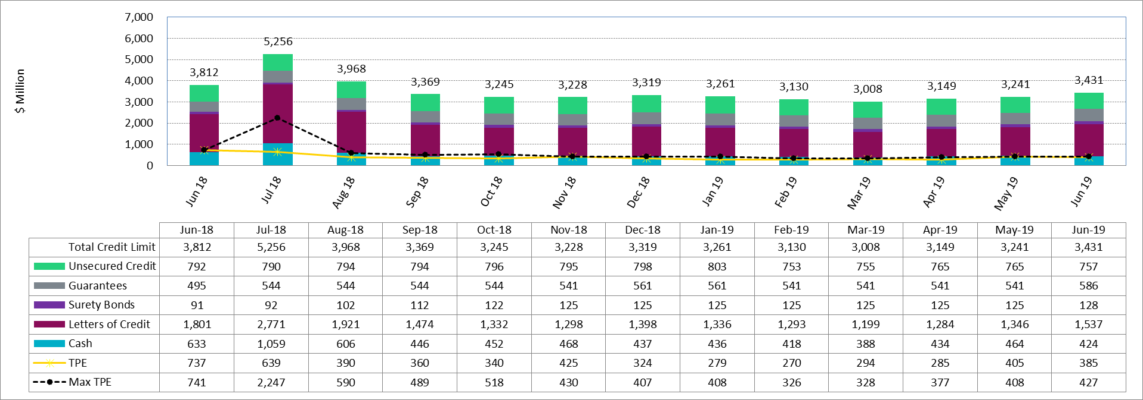
MCWG update to WMS

Slide 8
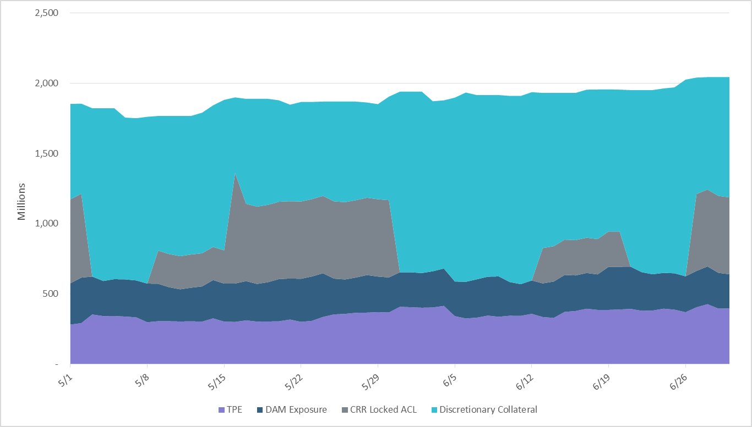
MCWG update to WMS
Note: Discretionary collateral doesn’t include Unsecured Credit Limit or parent guarantees

Slide 9
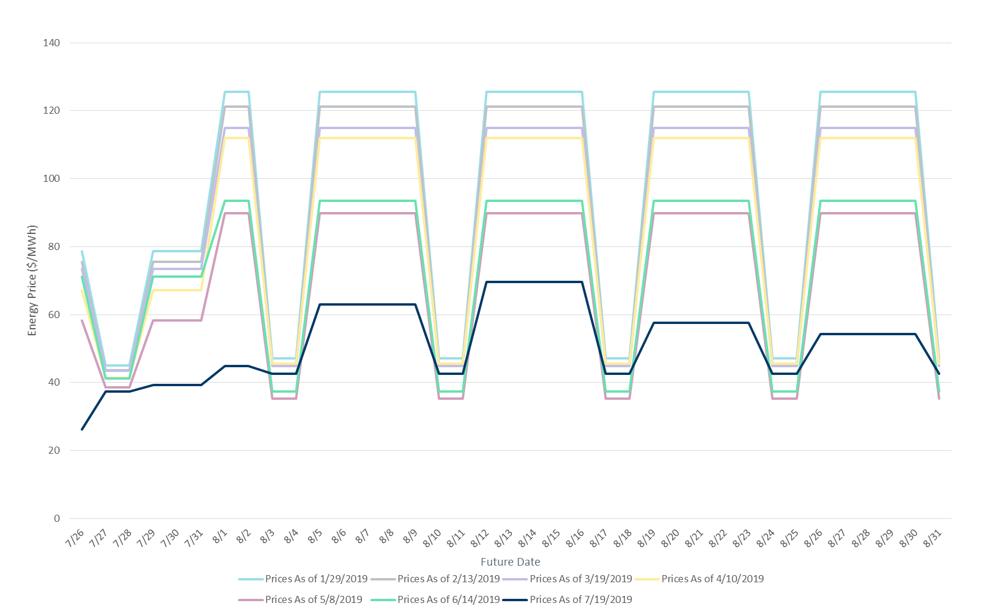
MCWG update to WMS

