Slide 1
KP 1.3
Examples:
Clarification of Telemetered Ramp Rates For All Generation Resources
Expected Outcomes For Combined Cycle Generation Resources (CCGR) Considering Frequency Responsive Capacity
Sai Moorty
Principal, Market Design and Analysis
July 12, 2019

Slide 2
ERRATA: June 21st Posting of two files (KP1.3)
KP1.3 PowerPoint presentation and KP1.3 Word document corrected and reposted to June 21st RTCTF meeting page
http://www.ercot.com/content/wcm/key_documents_lists/180301/5._RTC_constraints_KP1.3_062119_corrected_v2.pptx
http://www.ercot.com/content/wcm/key_documents_lists/180301/5._RTC_constraints_KP1.3_062119_corrected_v2.docx

Slide 3
Agenda
Review examples:
Clarification of Telemetered Ramp Rates for all Generation Resources
Expected Outcomes For Combined Cycle Generation Resources (CCGR) Considering Frequency Responsive Capacity

Slide 4
Clarification of Telemetered Ramp Rates for all Generation Resources
Ramp Rate (Up/Down):
Represent the total capacity (in MW) that the Resource can change from its current actual generation or consumption within the next five minutes divided by five.
This is what is expected today and does not change under RTC
Normal Ramp Rate Up/Down
(MW/min)
Tel. MW output | NRRUp (MW/min) | NRRDn (MW/min)
200 | 17.5 | 30
225 | 13.33 | 30
250 | 9.17 | 30
275 | 5 | 30
310 | 5 | 5
30
5
Telem. MW
output
275
350

Slide 5
Next: Combined Cycle Generation Resource (CCGR) Constraint Examples
Purpose of the examples is to illustrate the use of the proposed CCGR specific conditional constraints
The intent of these CCGR specific conditional constraints is to economically account for the frequency responsive capacity of the CCGR when awarding energy (Base Point), Regulation and RRS-PFR.
  Given the prices, the awards for energy, Regulation, RRS provides the best economic outcome for the CCGR
  In addition, these awards will be physically feasible
  Allows the QSE to telemeter data to ERCOT-RTC that reflects the frequency responsive capability in Real-Time
Homework:
Please review examples
Provide additional scenarios
Does this proposal for accounting for frequency responsive capacity of CCGR address concerns for awarding of energy, Regulation, RRS under RTC?

Slide 6
ERCOT Proposal: Conditional Constraints For CCGR
CCGR Capacity e.g. 2x1 configuration
Key constraints for ALL GR
HDL-BP-RegUp>=0
HSL-BP-RegUp-RRS
-ECRS-NSPIN>=0
BP-RegDn-LDL>=0
RegUp and RRS only provided by
frequency responsive capacity
Optimization engine does not
differentiate between
frequency and non frequency capacity
LSL
LDL
BP
Tel. MW
HDL
HSL
RespFactor*BP
(1-RespFactor)*BP
LowRespLim
HiRespLim
RegDn
RegUp
RRS
Frequency Responsive Capacity
Lo
Hi
Non Frequency Responsive Capacity
Cond. Constraint 2
If (RegDn > 0 then
RespFactor*BP-RegDn-LowRespLim >=0
Cond. Constraint 1
If (RegUp+RRS) > 0 then
HiRespLim - RespFactor*BP-RegUp-RRS >=0

Slide 7
Scenario Setup For Combined Cycle Generation Resource (CCGR)
CC component | LSL | HSL
CT1 | 75 | 100
CT2 | 75 | 100
ST3 including 25 MW Duct Burner | 50 | 150
2x1 CC configuration | 200 | 350
CT1
CT2
ST3 with 25MW
duct burner
Normal Ramp Rate Up/Down
(MW/min)
.
Energy Offer Curve $/MWh
60 $/MWh
30
21 $/MWh
5
Telem. MW
output
275
MW
350
325
350

Slide 8
Scenario Setup For Combined Cycle Generation Resource (CCGR) – cont’d
AS Offer for 2x1 CCGR
  20 MW RegUp @ $12/MW/h
  60 MW RRS-PFR @ $10/MW/h
  350 MW ECRS @ $1500/MW/h ← set high to ensure 0 MW awarded for simplicity
  350 MW NSPIN @ $1500/MW/h ← set high to ensure 0 MW awarded for simplicity
Note that ScalingFactorUp and ScalingFactorDn is set to 1 for the examples – i.e. no ramp sharing between energy and Regulation
Just like today, RTC will model CCGR (2x1 configuration) as a single Resource in the optimization engine
Regulation Up/Down and RRS-PFR can only be provided by the 2x1 configuration’s frequency responsive capacity
  i.e. the CT1+CT2 capacity = 200 MW
CCGR specific constraints to ensuring awards for RegUp, RegDn and RRS-PFR are feasible

Slide 9
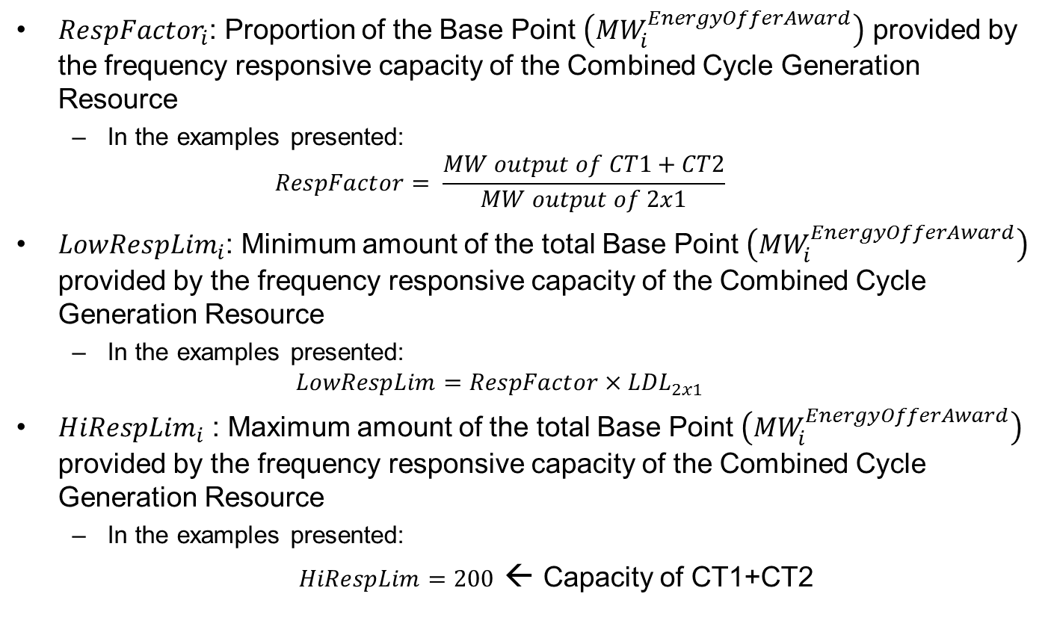
Scenario Setup For Combined Cycle Generation Resource (CCGR) – cont’d
${RespFactor}_{i}$: Proportion of the Base Point $\left({MW}_{i}^{EnergyOfferAward}\right)$ provided by the frequency responsive capacity of the Combined Cycle Generation Resource
  In the examples presented:
  $$RespFactor= \frac{MW output of CT1+CT2}{MW output of 2x1}$$
${LowRespLim}_{i}$: Minimum amount of the total Base Point $\left({MW}_{i}^{EnergyOfferAward}\right)$ provided by the frequency responsive capacity of the Combined Cycle Generation Resource
  In the examples presented:
  $$LowRespLim=RespFactor×{LDL}_{2x1}$$
${HiRespLim}_{i}$ : Maximum amount of the total Base Point $\left({MW}_{i}^{EnergyOfferAward}\right)$ provided by the frequency responsive capacity of the Combined Cycle Generation Resource
  In the examples presented:
  $HiRespLim=200$ ← Capacity of CT1+CT2

Slide 10
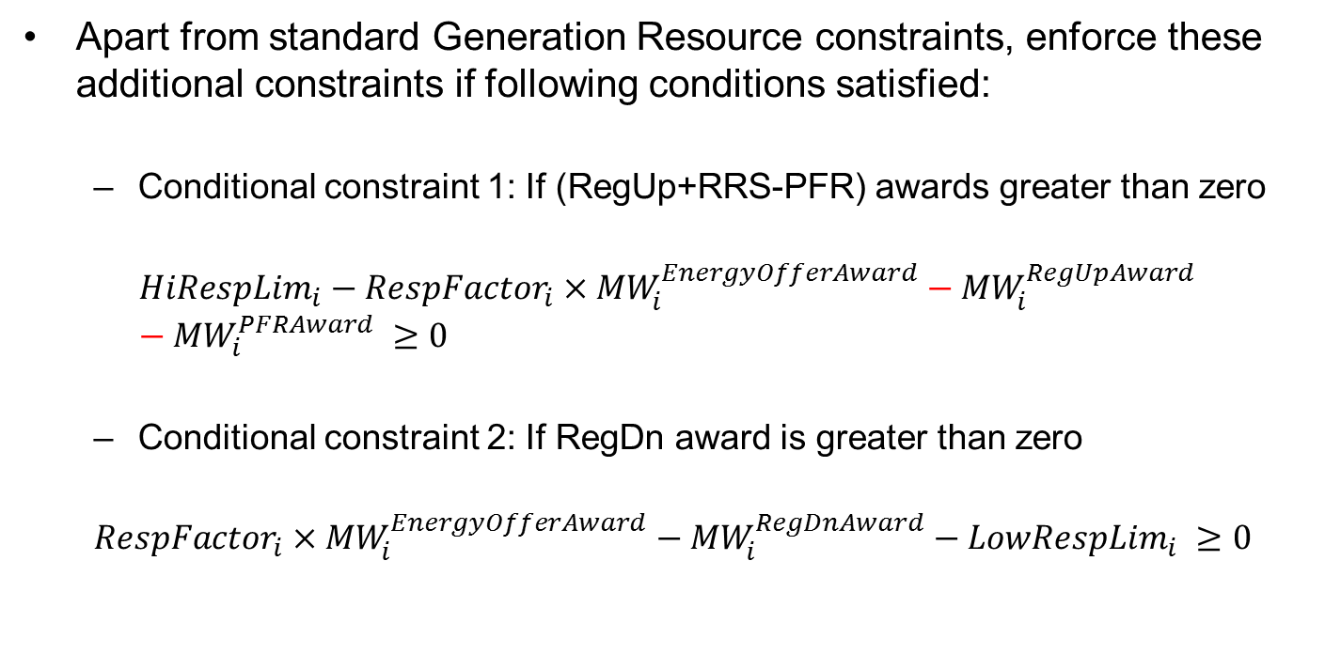
Scenario Setup For Combined Cycle Generation Resource (CCGR) – cont’d
Apart from standard Generation Resource constraints, enforce these additional constraints if following conditions satisfied:
  Conditional constraint 1: If (RegUp+RRS-PFR) awards greater than zero
$${HiRespLim}_{i}−{RespFactor}_{i}×{MW}_{i}^{EnergyOfferAward}−{MW}_{i}^{RegUpAward}−{MW}_{i}^{PFRAward} ≥0$$
  Conditional constraint 2: If RegDn award is greater than zero
  $${RespFactor}_{i}×{MW}_{i}^{EnergyOfferAward}−{MW}_{i}^{RegDnAward}−{LowRespLim}_{i} ≥0$$

Slide 11
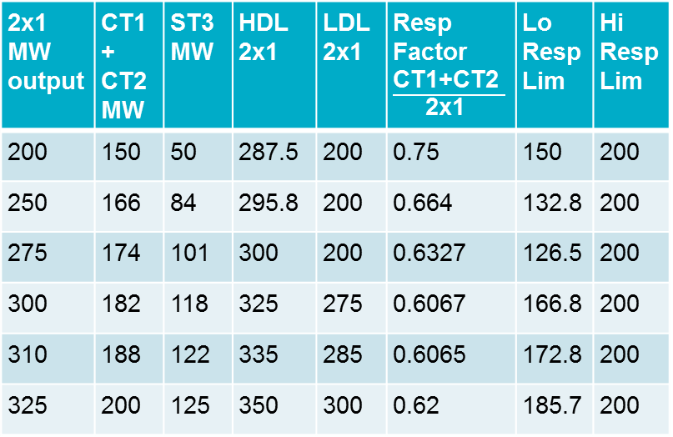
Scenario Setup For Combined Cycle Generation Resource (CCGR) – cont’d
CT1 and CT2 capacity is frequency responsive
Example of CT1+CT2 (frequency responsive capacity) vs Steamer output
2x1 MW output | CT1+ CT2 MW | ST3 MW | HDL 2x1 | LDL 2x1 | Resp Factor$\frac{\text{CT}\text{1+}\text{CT}\text{2 }}{\text{2}\text{x}\text{1 }}$ | Lo Resp Lim | Hi Resp Lim
200 | 150 | 50 | 287.5 | 200 | 0.75 | 150 | 200
250 | 166 | 84 | 295.8 | 200 | 0.664 | 132.8 | 200
275 | 174 | 101 | 300 | 200 | 0.6327 | 126.5 | 200
300 | 182 | 118 | 325 | 275 | 0.6067 | 166.8 | 200
310 | 188 | 122 | 335 | 285 | 0.6065 | 172.8 | 200
325 | 200 | 125 | 350 | 300 | 0.62 | 185.7 | 200
150
Duct
Burner
125
.
ST3 MW output
50
150
200
CT1+CT2 MW output

Slide 12
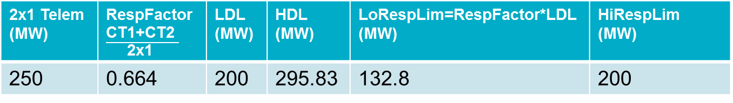
Example 1
Optimum solution is BP=295.83 MW, RegUp=0 MW, RRS=0 MW
Based on prices, energy is more profitable than RegUp and RRS
2x1 Telem (MW) | RespFactor$\frac{\text{CT}\text{1+}\text{CT}\text{2 }}{\text{2}\text{x}\text{1 }}$ | LDL (MW) | HDL (MW) | LoRespLim=RespFactor*LDL (MW) | HiRespLim (MW)
250 | 0.664 | 200 | 295.83 | 132.8 | 200
EOC/ LMP ($/MWh) | AS Offer/MCPC
 | RegUp ($/MW/h) | RRS ($/MW/h)
21/25 | 12/12 | 10/10
EnergyAward (Base Point) 2x1 MW | CT1+CT2 MW (RespFac*BP) | ST3 MW | RegUp Award (MW) | RRS Award (MW) | Revenue -OfferCost ($)
295.83 | 196.43 | 99.4 | 0 | 0 | 1183.32

Slide 13
Example 2
Optimum solution is BP=295.83 MW, RegUp=0 MW, RRS=3.57 MW
Based on prices, RegUp and RRS more profitable than energy
However the maximum revenue to 2x1 CCGR occurs when Energy Award (Base Point)=HDL and RegUp award is zero
  RRS award limited by the HiRespLim constraint (200-(BP+RegUp+RRS )>=0)
2x1 Telem (MW) | RespFactor$\frac{\text{CT}\text{1+}\text{CT}\text{2 }}{\text{2}\text{x}\text{1 }}$ | LDL (MW) | HDL (MW) | LoRespLim=RespFactor*LDL (MW) | HiRespLim (MW)
250 | 0.664 | 200 | 295.83 | 132.8 | 200
EOC/ LMP ($/MWh) | AS Offer/MCPC
 | RegUp ($/MW/h) | RRS ($/MW/h)
21/25 | 12/17 | 10/15
EnergyAward (Base Point) 2x1 MW | CT1+CT2 MW (RespFac*BP) | ST3 MW | RegUp Award (MW) | RRS Award (MW) | Revenue -OfferCost ($)
295.83 | 196.43 | 99.4 | 0 | 3.57 | 1201.17
290.83 | 193.11 | 97.72 | 0 | 6.89 | 1197.77
280.83 | 186.47 | 94.36 | 10 | 3.53 | 1190.97

Slide 14
Example 3
Optimum solution is BP=200 MW, RegUp=67.2 MW, RRS=0 MW
Based on prices, RegUp is most profitable followed by RRS and then energy
2x1 Telem (MW) | RespFactor$\frac{\text{CT}\text{1+}\text{CT}\text{2 }}{\text{2}\text{x}\text{1 }}$ | LDL (MW) | HDL (MW) | LoRespLim=RespFactor*LDL (MW) | HiRespLim (MW)
250 | 0.664 | 200 | 295.83 | 132.8 | 200
EOC/ LMP ($/MWh) | AS Offer/MCPC
 | RegUp ($/MW/h) | RRS ($/MW/h)
21/25 | 12/19 | 10/15
EnergyAward (Base Point) 2x1 MW | CT1+CT2 MW (RespFac*BP) | ST3 MW | RegUp Award (MW) | RRS Award (MW) | Revenue -OfferCost ($)
200 | 132.8 | 67.2 | 67.2 | 0 | 1270.4
271.1 | 180 | 91.1 | 20 | 0 | 1224.4
295.83 | 196.43 | 99.4 | 0 | 3.57 | 1201.17
280.83 | 186.47 | 94.35 | 10 | 3.53 | 1210.97
180.72 | 120 | 60.72 | 20 | 60 | 1162.89

Slide 15
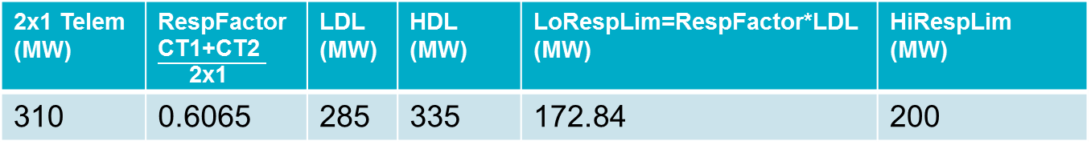
Example 4
Optimum solution is BP=325 MW, RegUp=0 MW, RRS=0 MW
Based on prices, energy is more profitable than RegUp and RRS
Energy award (Base Point) is 325 MW as the cost is $60/MWh above this level
2x1 Telem (MW) | RespFactor$\frac{\text{CT}\text{1+}\text{CT}\text{2 }}{\text{2}\text{x}\text{1 }}$ | LDL (MW) | HDL (MW) | LoRespLim=RespFactor*LDL (MW) | HiRespLim (MW)
310 | 0.6065 | 285 | 335 | 172.84 | 200
EOC/ LMP ($/MWh) | AS Offer/MCPC
 | RegUp ($/MW/h) | RRS ($/MW/h)
21/25 | 12/12 | 10/10
EnergyAward (Base Point) 2x1 MW | CT1+CT2 MW (RespFac*BP) | ST3 MW | RegUp Award (MW) | RRS Award (MW) | Revenue -OfferCost ($)
325 | 197.1 | 127.9 | 0 | 0 | 1300

Slide 16
Example 5
Optimum solution is BP=325 MW, RegUp=1.45 MW, RRS=1.45 MW
Based on prices, RegUp and RRS more profitable than energy
Energy award (Base Point) is 325 MW as the cost is $60/MWh above this level
2x1 Telem (MW) | RespFactor$\frac{\text{CT}\text{1+}\text{CT}\text{2 }}{\text{2}\text{x}\text{1 }}$ | LDL (MW) | HDL (MW) | LoRespLim=RespFactor*LDL (MW) | HiRespLim (MW)
310 | 0.6065 | 285 | 335 | 172.84 | 200
EOC/ LMP ($/MWh) | AS Offer/MCPC
 | RegUp ($/MW/h) | RRS ($/MW/h)
21/25 | 12/17 | 10/15
EnergyAward (Base Point) 2x1 MW | CT1+CT2 MW (RespFac*BP) | ST3 MW | RegUp Award (MW) | RRS Award (MW) | Revenue -OfferCost ($)
325 | 197.1 | 127.9 | 1.45 | 1.45 | 1314.52
290 | 175.87 | 114.13 | 10 | 14.13 | 1280.65

Slide 17
Example 6
Optimum solution is BP=285 MW, RegUp=27.16 MW, RRS=0 MW
Based on prices, RegUp and RRS more profitable than energy
2x1 Telem (MW) | RespFactor$\frac{\text{CT}\text{1+}\text{CT}\text{2 }}{\text{2}\text{x}\text{1 }}$ | LDL (MW) | HDL (MW) | LoRespLim=RespFactor*LDL (MW) | HiRespLim (MW)
310 | 0.6065 | 285 | 335 | 172.84 | 200
EOC/ LMP ($/MWh) | AS Offer/MCPC
 | RegUp ($/MW/h) | RRS ($/MW/h)
21/25 | 12/19 | 10/15
EnergyAward (Base Point) 2x1 MW | CT1+CT2 MW (RespFac*BP) | ST3 MW | RegUp Award (MW) | RRS Award (MW) | Revenue -OfferCost ($)
285=LDL | 172.84 | 112.16 | 27.16 | 0 | 1330.13
296.8 | 179.99 | 116.8 | 20 | 0 | 1327.24
290 | 175.87 | 114.13 | 20 | 4.13 | 1320.65
325=HDL | 197.1 | 127.9 | 2.9 | 0 | 1320.32

Slide 18
Discussion

Slide 19
Appendix

Slide 20
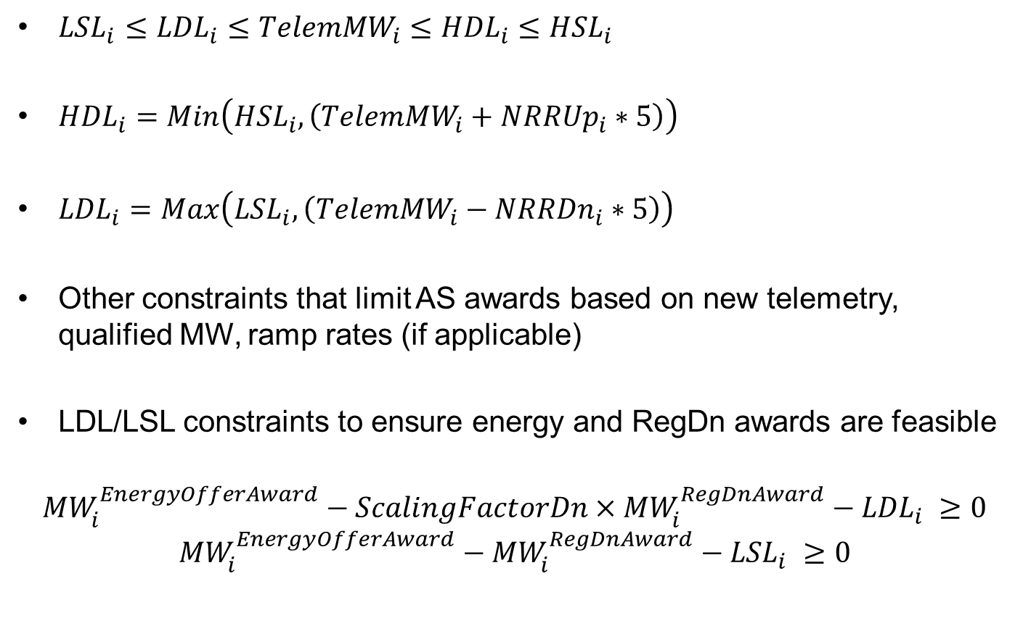
Recap: On-Line Generation Resource Constraints (ALL)
${LSL}_{i}≤{LDL}_{i}≤{TelemMW}_{i}≤{HDL}_{i}≤{HSL}_{i}$
${HDL}_{i}=Min\left({HSL}_{i},\left({TelemMW}_{i}+{NRRUp}_{i}∗5\right)\right)$
${LDL}_{i}=Max\left({LSL}_{i},\left({TelemMW}_{i}−{NRRDn}_{i}∗5\right)\right)$
Other constraints that limit AS awards based on new telemetry, qualified MW, ramp rates (if applicable)
LDL/LSL constraints to ensure energy and RegDn awards are feasible
$${MW}_{i}^{EnergyOfferAward}−{ScalingFactorDn×MW}_{i}^{RegDnAward}−{LDL}_{i} ≥0$$
$${MW}_{i}^{EnergyOfferAward}−{MW}_{i}^{RegDnAward}−{LSL}_{i} ≥0$$

Slide 21
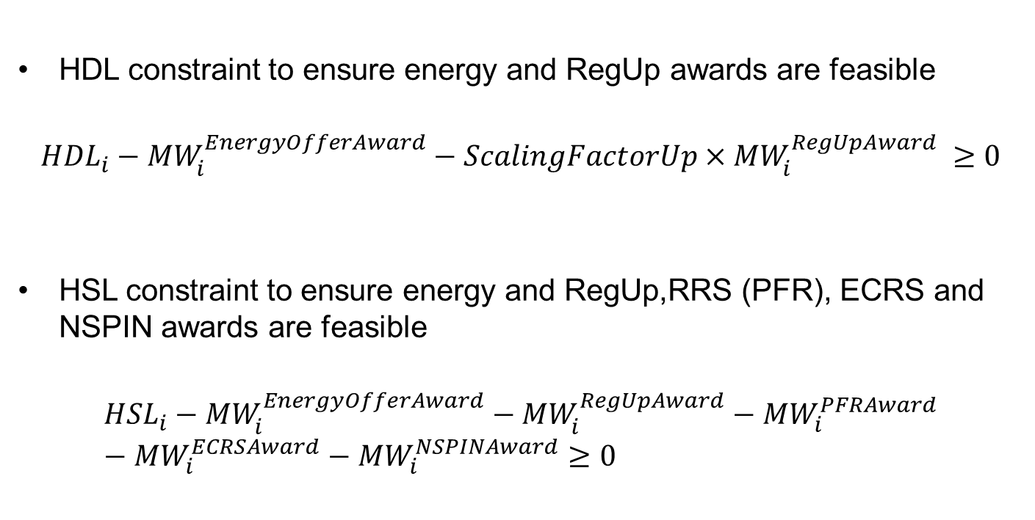
Recap: On-Line Generation Resource Constraints (ALL) – cont’d
HDL constraint to ensure energy and RegUp awards are feasible
$${HDL}_{i}−{MW}_{i}^{EnergyOfferAward}−{ScalingFactorUp×MW}_{i}^{RegUpAward} ≥0$$
HSL constraint to ensure energy and RegUp,RRS (PFR), ECRS and NSPIN awards are feasible
$${HSL}_{i}−{MW}_{i}^{EnergyOfferAward}−{MW}_{i}^{RegUpAward}−{MW}_{i}^{PFRAward}−{MW}_{i}^{ECRSAward}−{MW}_{i}^{NSPINAward}≥0$$

