Slide 1
Proposed Analysis of Locational Reliability Deployment Price Adder Proposals
Market Analysis
8/5/2019

Slide 2
Locational Price Adder Analysis
At the December QMWG meeting ERCOT presented an analysis of one locational price adder proposal
After a delay due to work on the system-wide price adder improvements, we are now ready to resume work on the locational price adder topic

Slide 3
Two Concepts Have Been Proposed
Two proposals to improve locational RTORDPA price signals have previously been discussed in the stakeholder process or at the PUC
The “but-for” concept proposed by the Hogan and Pope filing in PUC project 47199
The “positive LMP increase” concept proposed by Shams Siddiqi
ERCOT recently solicited additional proposals to compare to the two above via the CMWG email distribution list, but did not receive any additional proposals

Slide 4
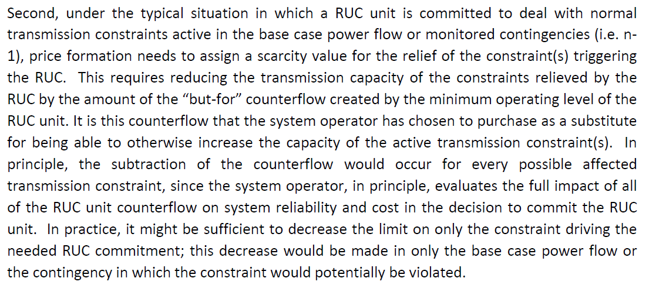
The Hogan and Pope “But-For” Proposal
The language from the Hogan and Pope filing in PUC project 47199 is below:

Slide 5
The Hogan and Pope “But-For” Proposal
Basic concept is to “…reduc[e] the transmission capacity of the constraints relieved by the RUC by the amount of the “but‐for” counterflow created by the minimum operating level of the RUC unit.”
For any constraints where an ONRUC Resource has a helping shift factor, modify the math limit of transmission constraint by the shift factor * LSL
This will remove the effect of the zero-to-LSL energy on the constraint and potentially send a stronger local price signal

Slide 6
“But-For” Local and System-Wide Price Impacts
Reducing the constraint limits in the dispatch run addresses local price impact but does not address any system-wide price impact
A pricing run would be used to address any system-wide price impact, as is done today
Improved locational prices would be through stronger LMP price signals in the dispatch run and the price adder would still be system-wide

Slide 7
“But-For” Proposal Variants
The “But-For” approach reduces the use of available transmission system capacity and therefore results in sub-optimal dispatch from an offer-based production cost perspective
Also has the potential for uplift due to reducing RTM limits compared to DAM limits
Variants on this proposal include using different shadow price cap values for the reduced portion of the transmission limit
Using a lower shadow price cap so that the SCED violates the soft constraint and the flow is closer to the original limit may mitigate both of these effects

Slide 8
“Positive LMP Increase” Proposal
Concept was proposed by Shams last year and refined recently due to NPRR826 and NPRR904
Instead of using the positive increase in system lambda between the dispatch and pricing runs, the proposed method would use the positive increase in individual LMPs between the dispatch and pricing runs
The system-wide price adder becomes a locational price adder
Added to LMPs
Also paid to headroom to maintain indifference to dispatch instructions
The pricing run would attempt to address both the locational and system-wide price signals

Slide 9
“Positive LMP Increase” Proposal
Additional treatment of reliability actions related to DC ties via reversing the reliability action and adding a pseudo-Resource at the DC tie load zones with a prescribed offer
We are still working through a few details of the proposal

Slide 10
Study Approach
Create a study SCED model able to model both proposals
Execute the model for a base case and the proposals against historical data
Compare the results in terms of:
SPPs and locational price impacts
Offer-based production costs
Congestion revenue
Uplift due to:
DAM PTP settlement
DAM energy-only transactions
RTM AS imbalance payments

Slide 11
Starting Point
NPRR904 contains changes to the pricing run. The base case will assume approval and implementation of these changes.
There is currently a proposal to include startup and minimum generation costs in MOCs for ONRUC Resources—should the base case include this proposal?

Slide 12
Scope of Analysis
This analysis is aimed at quantifying the relative advantages and disadvantages of the two approaches in terms of local price signals and uplift.
The two approaches would also have different advantages and disadvantages in terms of implementation cost and impact on routine operations. This analysis does not consider these impacts.

Slide 13
Plan Going Forward
Discuss concepts and plan at CMWG 8/5/2019 (today)
Continue to work with Shams to confirm details of proposal
Begin developing models for both proposals
Present final form of the proposals at the next CMWG
Run initial analysis on historical RUC cases
Bring results back to CMWG when initial analysis is complete
Discuss initial results and expansion of analysis to DC tie curtailments

