Slide 1
CRR Transaction Limits
Carrie Bivens
Manager, Forward Markets
August 5, 2019

Slide 2
Background
Coupled with WMS’ recommendation to approve NPRR936, a request was made of TAC that, if NPRR936 is approved and implemented, the current CRRAH transaction limits be converted to equivalent Counter-Party (CP) limits
Future CP limits = 3 x existing CRRAH limits
Only some CPs have registered multiple CRRAHs
Those that have registered 3 CRRAHs are most likely to be impacted by a future change in CP limits
There may be an opportunity to expand the CRR software limitation from 300k to 400k – this was referred to CMWG to consider
Would require Market Participant(s) to file a SCR and would have a system impact
This presentation shows current utilization (since framework upgrade only)

Slide 3
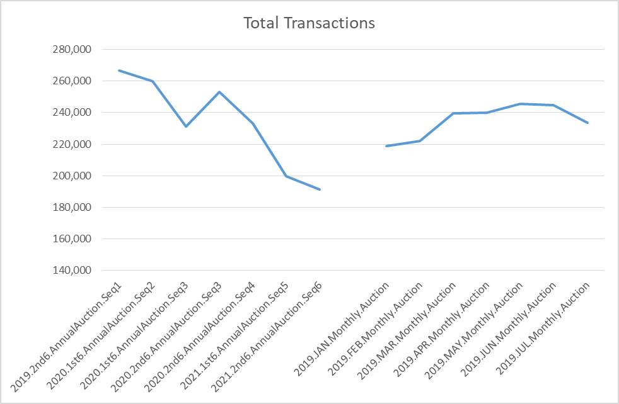
Total Transactions

Slide 4
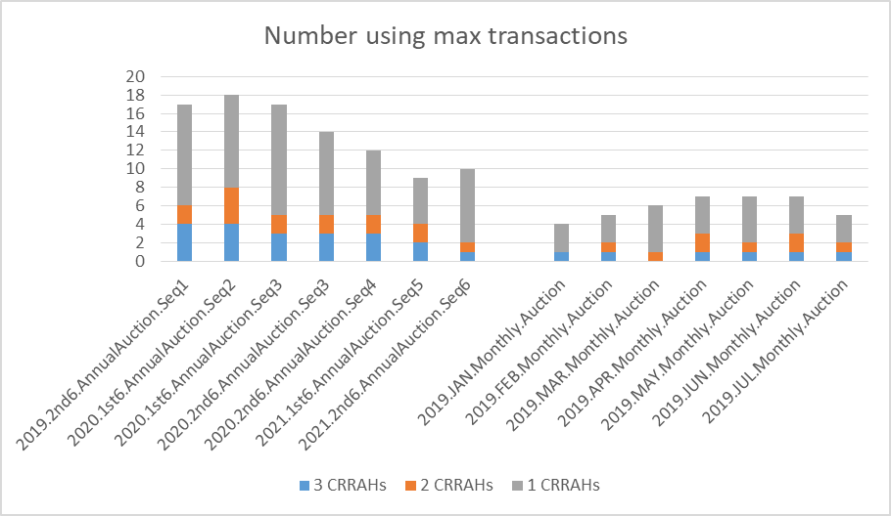
Usage information

