Slide 1
MarkeTrak Training
Missing Enrollment

Slide 2
D2D Issues: Missing Enrollment Transactions
Examples of missing enrollment transactions are if a CR is missing any 814’s, or an 867_04.
NOTE: The reprocessing of retail transactions by ERCOT will be limited to one year from the original processing date. If the missing transaction is to be reprocessed, or dependent upon another transaction being reprocessed, the original transaction dates must be within one year of submission of the MarkeTrak issue.
Allow the market time to process the transactions before submitting the MarkeTrak issue – especially new construction
A CR or TDSP can submit this subtype
Required Fields on Submit:
  Assignee
  ESI ID
  Original Tran ID
  Tran Type

Slide 3
Checkpoint Question
True or False
A CR should submit a Missing Enrollment Transaction MarkeTrak if they have not received an 867_04 one day after the ‘key date’ or response date from the TDSP.
FALSE

Slide 4
MarkeTrak Training
Usage Billing Issues

Slide 5
D2D Issues: Usage Billing Subtypes
867/810s Usage & Billing
Missing – CR is missing 867_03, 867_03F, 810s
Dispute – CR has an issue with the data found on the 867and/or 810
AMS interval data/LSE files
Missing – No LSE file or interval data for a period of time
Dispute – CR has an issue with the interval data on the LSE file

Slide 6
D2D Issues: Usage Billing - Missing
Examples of Usage/Billing Issues – Missing:
If a CR is missing an 867_03 Monthly usage transaction
If a CR is missing an 867_03 Final usage transaction
If a CR is missing an 810 transaction
If a CR is missing an 867_03 and an 810 transaction
Allow the market time to process the transactions before submitting a MT.

Slide 7
D2D Issues: Usage Billing - Missing
Submitting a Usage/Billing – Missing Issue:
  The following fields must be populated for successful submission of Day to Day issue sub type Usage/Billing-Missing Issues: (For this example, the submitter selects the TDSP.)
    Assignee
    ESIID
    Original Tran ID (Optional except for 867_03 Final) - BGN02 of the 814_01, 814_16 or 814_24. The TDSP will see it as the BGN06 of the 814_03/814_25.
    Tran Type (select from drop down)
    TNX Date – same as the Service period start date (or is the current date)
    IDR/Non-IDR (IDR indicates true IDR meter, does not include AMS meters)
    Start Time = Service Period Start Date

Slide 8
D2D Issues: Usage Billing - Missing
Submitting a Usage/Billing – Missing Issue:
  The Comments field is optional. Please include any additional information in this box. New field added: Stop Time = Service Period Stop Date. Although optional it is encouraged to be populated. If left blank it will be assumed that the Stop date is the date up to the most current read date. The submitting MP will be validated as the ROR for the Start Time provided on the issue to prevent users from submitting invalid issues.
Comments are highly recommended!

Slide 9
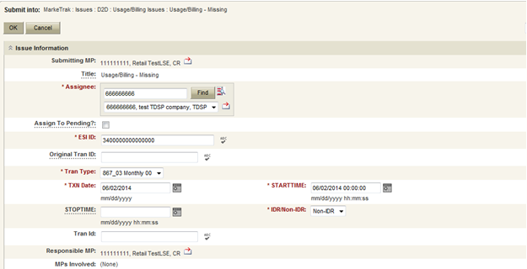
D2D Issues: Usage Billing - Missing
Submitting a Usage/Billing – Missing Issue (cont.):
TRAN TYPE:
867_03 F
867_03 Monthly 00- original
867_03 Monthly 01- cancel
867_03 Monthly 05- rebill
810_02 Monthly 00- original
810_02 Monthly 01- cancel
810_02 Monthly 05- replace
Select OK.

Slide 10
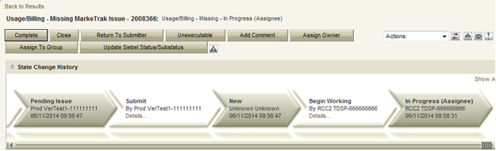
D2D Issues: Usage Billing - Missing
Submitting a Usage/Billing – Missing Issue (cont.)
  The issue enters TDSP queue in a state of New and is visible only by the Submitting CR and TDSP.
  The Submitting CR can Withdraw the issue at this point.
  The TDSP selects Begin Working and the issue is transitioned in a new state of In Progress-Assignee.
  At this point, the Submitting CR can no longer Withdraw the issue.
  TDSP reviews the issue and has the options:
    Unexecutable, which results in state Unexecutable- Pending Complete – requires comments
    Return to Submitter which requires comments and then the issue is transitioned back to the Submitter for additional information
    Complete which transitions to a state of Pending Complete. The Submitter has the option to close the issue by selecting Complete or the issue will be auto closed in 14 calendar days.

Slide 11
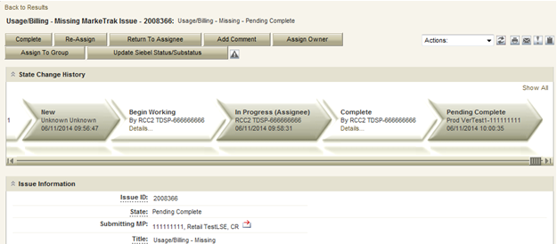
D2D Issues: Usage Billing - Missing
Submitting a Usage/Billing – Missing Issue (cont.)
  In this example the TDSP selects Complete, provides the required Tran ID of the missing transaction, and the issue is transitioned to the submitting CR in a state of Pending Complete. If the issue covers multiple service periods, information regarding those transactions should be provided in the comments.
  The Submitting CR has the option to close the issue by selecting Complete or the issue will be Auto Closed in 14 Calendar days.

Slide 12
D2D Issues: Usage Billing - Dispute
Examples of Usage/Billing Issues – Dispute:
  For use when a CR has an issue with any data found on an 867 or 810 which may pertain to one or more of the following examples:
    Consumption / Usage Data
    Bill Calculations – kW, kWh, power factor, meter multiplier
    Rate Issues – rate classifications/tariffs
    Discretionary Service Charge dispute
    Crossed Meter Situation
    Dispute of Estimated Bill
    Estimation Methodology

Slide 13
D2D Issues: Usage Billing - Dispute
Submitting a Usage/Billing – Dispute Issue:
The following fields must be populated for successful submission of Day to Day issue sub type Usage/Billing Issues: (For this example, the submitter selects the TDSP.)
  Assignee
  ESIID
  Original Tran ID (Optional except for 867_03 Final) - BGN02 of the 814_01, 814_16 or 814_24. The TDSP will see it as the BGN06 of the 814_03/814_25.
  Tran Type
  TXN Date
  Start Time - Service Period Start Date
  Dispute Category
    Priority Issue – defined as a subsequent MarkeTrak issue submitted/resubmitted due to initial MarkeTrak issue being auto closed without resolution or a follow-up MarkeTrak issue exceeding Market accepted SLA
    Consumption/Usage Issue
    Billing Calculations kWh
    Billing Calculations kW
    Billing Calculations Power Factor
    TDSP Charge Issue
    Rate Issue
    Crossed Meter Issues
    Non-Metered Issues
    Other – Comments Required
  Tran ID
  IDR/Non-IDR

Slide 14
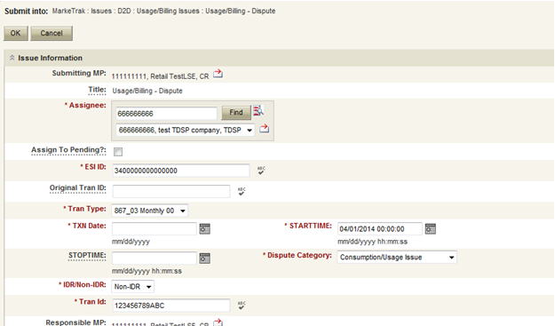
D2D Issues: Usage Billing - Dispute
Submitting a Usage/Billing – Dispute Issue (cont.):
NOTE: The Comments field is optional except when the Dispute Category is Other. Please include any additional information in this box. Stop Time = Service Period Stop Date. Although optional it is encouraged to be populated. If left blank it will be assumed that the Stop date is the date up to the most current read date. The submitting MP will be validated as the ROR for the Start Time provided on the issue to prevent users from submitting invalid issues.
Select OK.

Slide 15
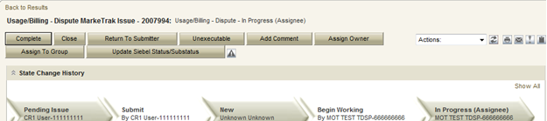
D2D Issues: Usage Billing - Dispute
Submitting a Usage/Billing – Dispute Issue (cont.):
The issue enters TDSP queue in a state of New and is visible only by the Submitting CR and TDSP.
The Submitting CR can Withdraw the issue at this point.
The TDSP selects Begin Working and the issue is transitioned in a new state of In Progress-Assignee.
At this point, the Submitting CR can no longer Withdraw the issue.
TDSP reviews the issue and has the options:
  Unexecutable, which results in state Unexecutable- Pending Complete – requires comments
  Return to Submitter which requires comments and then the issue is transitioned back to the Submitter for additional information
  Complete which transitions to a state of Pending Complete. The Submitter has the option to close the issue by selecting Complete or the issue will be auto closed in 14 calendar days.
In this example the TDSP selects Complete and the issue is transitioned to the submitting CR in a state of Pending Complete. The Submitting CR has the option to close the issue by selecting Complete or the issue will be Auto Closed in 14 Calendar days.

Slide 16
AMS LSE Interval Subtypes
AMS LSE Interval Subtypes are submitted for questions regarding AMS interval level data whereas questions regarding 867s or 810s are handled via Usage & Billing subtypes.
The Supplemental AMS Interval Data Extract is used as reference for AMS LSE Dispute subtype. The extract is posted daily to the ERCOT Market Information System (MIS) on ercot.com website.
Additional information about the extract can be found in the Supplemental AMS Interval Data Extract User Guide located on ERCOT.com.

Slide 17
AMS LSE Interval: Missing
Competitive Retailers (CRs) submit this Subtype when they discover an interval usage gap with the AMS LSE interval data from the TDSP.
Typically submitted requesting AMS data for one or more consecutive days of a service period. (Remember LSE files will have all 96 intervals completed for each day)
In order to submit this subtype, the following is required:
  The ESIID must have an AMS meter profile at ERCOT. (AMS Settlement Flag = true on Find ESI functionality)
  The CR must be the current Rep of Record for ALL usage days specified by the STARTIME and STOPTIME range.

Slide 18
AMS LSE Interval: Missing
How to submit this SubType?
From the MarkeTrak submit tree, under the D2D option:
  Select the Usage/Billing AMS LSE Interval Missing option.
  Enter the data for the required fields.

Slide 19
AMS LSE Interval: Missing
CR enters required information indicating STARTTIME and STOPTIME as formatted above for the missing period only and selects ‘OK’.

Slide 20
AMS LSE Interval: Missing
“Happy Path”
Requesting CR selects Missing under Usage/Billing AMS LSE Interval from the Submit Tree.
Requesting CR enters all required information and selects ‘OK’.
The issue is now in the state of ‘New’ with the TDSP as Responsible MP.
TDSP selects ‘Begin Working’.
The issue is now in a state of ‘In Progress (Assignee)’.

Slide 21
AMS LSE Interval: Missing
TDSP selects ‘Begin Working’ and then selects ‘Complete’ and enters optional Comments. TDSP selects ‘OK’.
NOTE: If CR is no longer ROR, SMT cannot be referenced and interval data should be attached to MarkeTrak.

Slide 22
AMS LSE Interval: Missing
“Happy Path” (cont.)
TDSP selects ‘Complete’, enters Comments (optional) and selects ‘OK’.
The issue is now in a state of ‘Pending Complete’ with the Submitting MP as the Responsible MP.
Submitting MP selects ‘Complete’ and the issue closes to ‘Complete’.

Slide 23
AMS LSE Interval: Missing
Submitting CR selects ‘Complete’ and the issue is closed to a state of ‘Complete.

Slide 24
AMS LSE Interval: Dispute
Competitive Retailers (CRs) submit this Subtype when they discover a discrepancy with the AMS LSE interval data from the TDSP.
Before submitting a Usage & Billing AMS LSE Dispute issue, the CR should allow 5 business days for transaction processing to complete.
In order to submit this subtype, the following is required:
  The ESIID must have an AMS meter profile at ERCOT.
  The usage data must be loaded in the ERCOT system and is identified by the unique identifier ‘UIDAMSINTERVAL’ from the Supplemental AMS Interval Data Extract. This code is retrieved and is a required field for this subtype.
Each issue should reflect the intervals from a single day or a consecutive period; a new issue should be created for each additional period.

Slide 25
AMS LSE Interval: Dispute
How to submit this SubType?
From the MarkeTrak submit tree, under the D2D section:
  Select the Usage/Billing AMS LSE Interval Dispute option.
  Enter the data for the required fields.

Slide 26
AMS LSE Interval: Dispute
Code retrieved from AMS Supplemental Extract for service interval in question or the last interval for the specific day or period in question. If past 30 days, enter the oldest date available
Comments are essential in efficiently and accurately processing the MT in a timely manner
STARTTIME = service period start time formatted as mm/dd/yyyy 00:00:00
STOPTIME = service period stop time (varies by TDSP)
mm/dd/yyyy 23:59:59

Slide 27
AMS LSE Interval: Dispute
“Happy Path”
Requesting CR selects Dispute under Usage/Billing AMS LSE Interval from the Submit Tree.
Requesting CR enters all required information and selects ‘OK’.
The issue is now in the state of ‘New’ with the TDSP as Responsible MP.
TDSP selects ‘Begin Working’.
The issue is now in a state of ‘In Progress (Assignee)’.

Slide 28
AMS LSE Interval: Dispute
TDSP selects ‘Begin Working’ and then selects ‘Complete’ and enters optional Comments. TDSP selects ‘OK’.

Slide 29
AMS LSE Interval: Dispute
“Happy Path” (cont.)
TDSP selects ‘Complete’, enters Comments (optional) and selects ‘OK’.
The issue is now in a state of ‘Pending Complete’ with the Submitting MP as the Responsible MP.
Submitting MP selects ‘Complete’ and the issue transitions to ‘Complete’.

Slide 30
AMS LSE Interval: Dispute
Submitting CR selects ‘Complete’ and the issue is closed to a state of ‘Complete.

Slide 31
Checkpoint Question
Which subtype should a CR submit if a customer is questioning the monthly consumption value they received on their monthly bill?
  Usage & Billing – Missing
  Usage & Billing – Dispute
  AMS LSE – Missing
  AMS LSE – Dispute
Usage & Billing – Dispute

Slide 32
Checkpoint Question
True or False
A CR should submit an AMS LSE – Dispute MarkeTrak as soon as they receive the 867_03 monthly from the TDSP.
FALSE

Slide 33
Checkpoint Question
True or False
When submitting any Usage & Billing MarkeTrak, if the STOP time is left blank it will be assumed it is the end of the 30 day period following the START time.
FALSE

Slide 34
Checkpoint Question
If a CR has submitted an 814_16 enrollment and has received an 814_05 and an 867_04, but has yet to receive the initial periodic, the CR should submit a ___________ MarkeTrak.
a) Missing Enrollment Transaction
b) Usage & Billing - Missing
c) AMS LSE - Missing
b) Usage & Billing - Missing

Slide 35

Questions

Slide 36
MarkeTrak Training
Additional D2D Subtypes

Slide 37
Additional Day to Day Subtypes - summary
Below is a summary of additional subtypes utilized for specific purposes:
Issue Subtype | Purpose | Submitter
Cancel w/ Approval | Manually cancelling an initiating transaction – MVI, MVO, or Switch Used by CR or TDSP when experiencing system issues CR requesting cancellation of a past-dated ‘scheduled’ transaction | CR or TDSP
997s | Verify if a 997 was sent or received | CR or TDSP
Projects | Project related requests, i.e. Meter Cycle change request | CR or TDSP
ERCOT Initiated | Used when exceptions are in ERCOT’s system (i.e. conflicting metering dates, etc.) | ERCOT
Safety Net Order | Request for follow up EDI transaction after CR submittal of safety net | TDSP

Slide 38
Additional Day to Day Subtypes – summary – cont.
Below is a summary of additional subtypes utilized for specific purposes:
Issue Subtype | Purpose | Submitter
Move Out w/ Meter Removal | TDSP notification of meter removal if 650_04 is not sent Follow up request for MVO transaction upon 650_04 notification | TDSP
Redirect Fees | When an IAG results in a lights out situation, allows Losing CR to submit within 3 days of receiving 810_02 for recovery of any discretionary fees from Gaining REP | Losing CR
Market Rule | Flexible for operationalizing PUCT rulemaking, i.e. AMS Opt-Out customer requests | TDSP or CR
Reject Transactions | CR or TDSP questions rejected transaction, i.e. invalid EDI, NFI, Dups | CR or TDSP

Slide 39
Additional Day to Day Subtypes – summary – cont.
Below is a summary of additional subtypes utilized for specific purposes:
Issue Subtype | Purpose | Submitter
REP of Record | CR questions who ERCOT or TDSP show as ROR – i.e. used in Mass Transition process | CR or TDSP
Service Order – 650 Issues | Inquiries related to service orders – missing 650_02 responses or rejects of 650_01 | CR or TDSP
Premise Type | Out of sync conditions for premise types requesting TDSP to submit 814_20 to update premise type | CR
Service Address | CR requests TDSP to submit 814_20 to update a service address for an ESI | CR

Slide 40
MarkeTrak Training
‘Other’ Issues

Slide 41
D2D Issues: Other
Examples of Other Issues but not limited to:
  Questions pertaining to discrepancy between sum of AMS Interval data and the 867 consumption value
  Questions pertaining to Siebel Reports
  Questions pertaining to request for filenames
  Questions pertaining to 997 reports
  Questions pertaining to CSAs
  Questions pertaining to missing information on non-required EDI fields
  Request for reprocessing of transactions
  Questions pertaining to Texas SET Transaction Issues
  Questions pertaining to MIS Portal
A CR or a TDSP can submit this subtype
Required Fields on Submit:
  Assignee

Slide 42
MarkeTrak Training
Common IAG Issues,
Best Practices, & Quick Tips

Slide 43
MVO vs IAG
Issue:
MVO’s are incorrectly being submitted for IAG situations
Solution:
CR’s SHOULD NOT issue MVOs for ESI IDs when IAG situations occur and/or while the MarkeTrak IAG/IAL process is in progress.
Best Practices:
Ask probing questions to ensure proper customer action is taken. (i.e. “Do you currently live here?”; “Was the original address provided incorrect?”)
For an incorrect address, review ERCOT’s MIS to see if the MVI resulted in an 814_06 Loss Transaction being sent to a Losing REP. If so, issue an IAG MT.
Transaction Flow for energizing premise
814_01 CR to ERCOT
814_03 ERCOT to TDSP
814_04 TDSP to ERCOT
814_05 ERCOT to CR
867_04 TDSP to CR
Transaction Flow for Inadvertent Gain situation
814_01 CR to ERCOT
814_03 ERCOT to TDSP
814_04 TDSP to ERCOT
814_05 ERCOT to CR
814_06 ERCOT to Losing CR
867_04 TDSP to CR
867_03F TDSP to Losing CR

Slide 44
3rd Party Transactions
Issue:
3rd party transaction has occurred, nullifying the IAG MarkeTrak therefore causing the Gaining CR to be left with charges they may not be able to recover.
Solution:
Utilize the applicable market approved process to regain a lost ESI ID via MarkeTrak. Educate the customer as to what the process entails and set proper expectations with the customer.
Best Practices:
Identify IAGs in progress for ESI IDs by:
Identifying IAGs on daily basis utilizing ERCOT MarkeTrak reporting or notification
Flagging within your own system the ESI IDs that have been IAG/IAL to ensure subsequent transactions are not submitted to the market until the IAG is completed.
Timely resolution of IAG/IAL MarkeTraks

Slide 45
Non-timely resolution of IAG’s
Issue:
MTs and/or Escalated MTs are not receiving responses or being completed in a timely manner
Solution:
Market participants should update their “rolodex” with the appropriate escalation contacts
Best Practices:
Designate one of the escalation contacts as a departmental mailbox instead of an individual
Audit the Rolodex list on Quarterly basis
Expected level of performance:
    After 3 calendar days if a MarkeTrak issue remains in “New Status” an automatic escalation email is generated.
    Initial Response – 10 calendar days
    Updating the issue thereafter – 7 calendar days
    Per 7.3.2.3.1 “Reinstatement Date” - The Backdate MVI must be sent No later than 12 days after the submittal of the Inadvertent MarkeTrak

Slide 46
No Current Occupant
Issue:
Losing REP responds to an IAG indicating “their customer no longer occupies the premise” and attempts to ‘unexecute’ the IAG MT issue.
Solution:
“Customer no longer occupies the Premise” is NOT a valid reason for unexecuting MT (RMG 7.3.2.5 Invalid Reject/Unexecutable Reasons)
Best Practice:
Losing REP must regain ESI ID and initiate a “current occupant” process
  Reference: PUCT Subst. R. 25.489(i)

Slide 47
Switch Hold on IAG
Issue:
A switch hold is active on account which has been identified as having an IAG
Solution:
When IAG is submitted and accepted, the switch hold should be removed in order prevent BDMVI from being rejected and any delay in completing the MarkeTrak
Best Practice:
When working IAL/IAG issues identify if your ESI ID currently has a Switch Hold active and remove as needed

Slide 48
Questions

Slide 49
MarkeTrak Training
IAG / IAL Reporting

Slide 50
Monthly IAG/IAL Reporting
What information is reported?
Monthly IAG/IAL Statistics
Top 10 Monthly – IAG/IAL
Top 10 – 12 Month Average IAG/IAL
  % of the aggregated totals for the last 12 months
Explanation of the IAG/IAL Stats
Top REPs – 12 Month Average Rescission
% of the aggregated totals for the last 12 months
Explanation of Rescission Stats
18 Month Running Market Totals

Slide 51
Monthly IAG / IAL Statistics
Total IAG+IAL % of Total Enrollments: 1.30%
IAG/IAL % Greater Than 1% of Enrollments
Total IAG+IAL Count: 2,888
IAG/IAL % Less Than 1% of Enrollments
Total IAG+IAL Count: 1,483
Retail Electric Provider Counts
 | Percent of Enrollments Resulting in IAG/IAL
Enrollment Total | .00% to .25% | .26% to .50% | .51% to .75% | .76% to 1.00%
<= 500 | 3 | 3 | 1 | 2
> 500 and <= 2500 | 3 | 5 | 7 | 5
> 2500 | 0 | 5 | 1 | 6
The above chart shows a count of REPs whose IAG/IAL percentage of their total enrollments is below 1%.
    Blue row shows counts of REPs that have less than 500 total enrollments by their % ranges
    Orange row shows counts of REPs that have between 500 and 2500 total enrollments by their % ranges
    Purple row shows counts of REPs that have greater than 2500 total enrollments by their % ranges

Slide 52
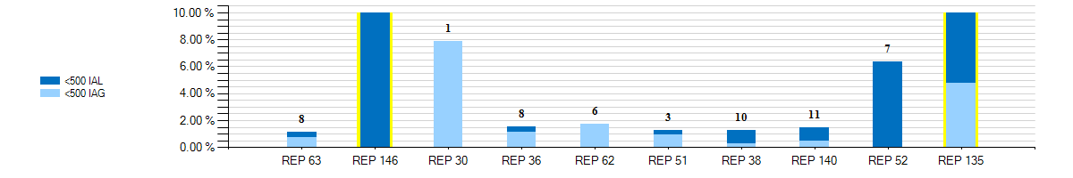
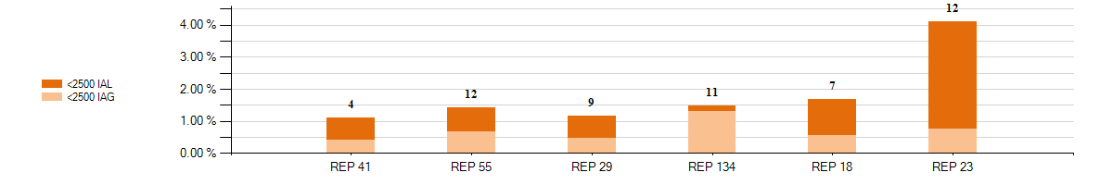
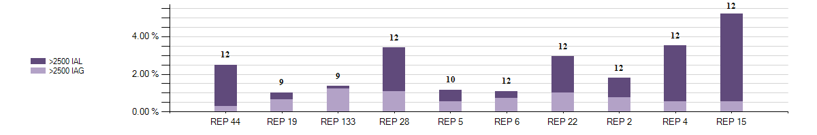
Monthly Top 10 – IAG / IAL Statistics
Top 10 – Monthly– IAG / IAL % Greater Than 1% of Enrollments With Number of Months Greater Than 1%

Slide 53
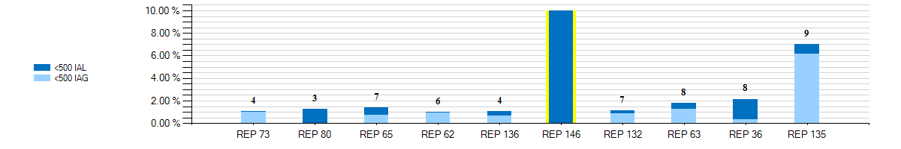
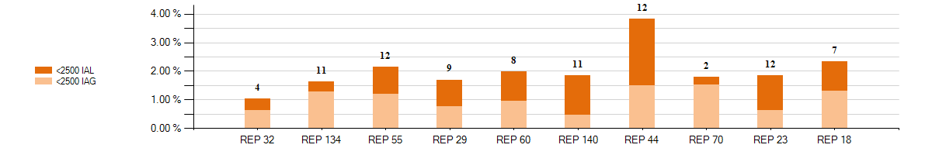
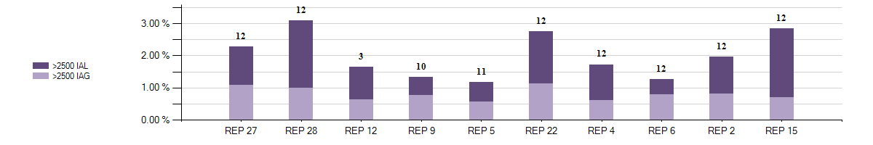
12 Month Average – IAG / IAL Statistics
Top 10 - 12 Month Average IAG / IAL % Greater Than 1% of Enrollments With Number of Months Greater Than 1%

Slide 54
Explanation of IAG / IAL Slides Data
Slide XX charts show the top 10 REPs whose IAG/IAL percentage of their total enrollments is above 1%.
  The blue chart shows enrollment totals of less than 500 for the month being reported
  The orange chart shows enrollment totals between 500 and 2500 for the month being reported
  The purple charts show enrollment totals of over 2500 for the month being reported
  REPs with the lowest AG/IAL totals start on the left, and move to the highest counts on the right
Slide XX charts show the top 10 REPs whose 12 month average IAG/IAL percentage of their total enrollments is above 1%.
  The blue chart shows enrollment total averages of less than 500 for the month being reported
  The orange chart shows enrollment total averages between 500 and 2500 for the month being reported
  The purple charts show enrollment total averages of over 2500 for the month being reported
  REPs with the lowest IAG/IAL averages start on the left, and move to the highest counts on the right
  Number labels represent the number of months the REP has been over 1% during the 12 month period

Slide 55
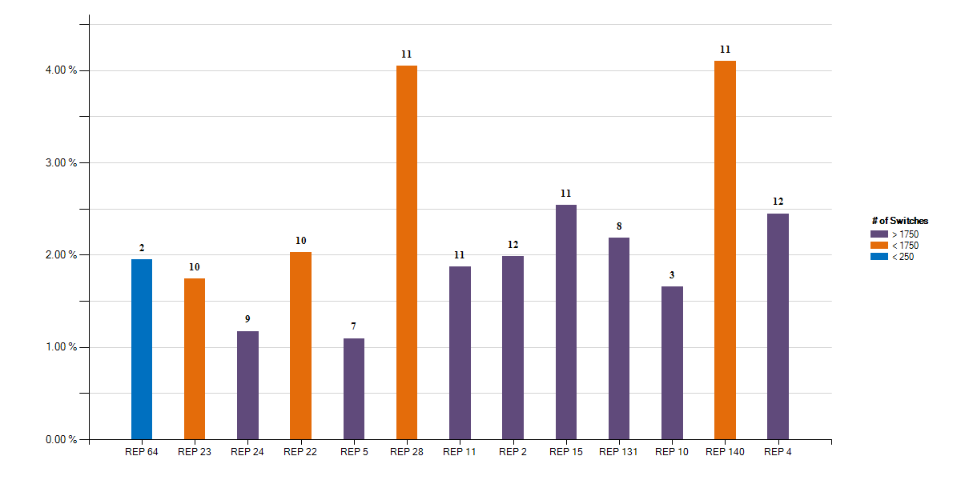
12 Month Average – Rescission Statistics
Top - 12 Month Average Rescission % Greater Than 1% of Switches With number of months Greater Than 1%

Slide 56
Explanation of Rescission Slide Data
NOTE:
A 10% chart range limit has been set. REPs data points that exceed 10% will be bordered in yellow. Please see the spreadsheet for actual percentages of these REPs.
Slide XX charts show the top REPs whose 12 month average Rescission percentage of their total Switches is above 1%.
  The blue shades show switch totals of less than 250 for the month being reported
  The orange shades show switch totals between 250 and 1750 for the month being reported
  The purple shades show switch totals of over 1750 for the month being reported
  The REPs with the lowest count of rescission totals start on the left, and move to the highest counts on the right
  Number labels represent the number of months the REP has been over 1% during the 12 month period

Slide 57
18 Month Running Market Totals
 | Enrollments |  |  | IAG, IAL, Rescission |  |  |  |  | Days to Resolution
Month | SWI | MVI | Total | IAG | IAL | Rescission | IAG,IAL,Res Total | Overall % | IAG | IAL | Rescission
2017-10 | 78,096 | 236,397 | 314,493 | 1,749 | 1,711 | 706 | 4,166 | 1.32% | 12 | 17 | 10
2017-11 | 77,860 | 207,921 | 285,781 | 1,626 | 1,489 | 741 | 3,856 | 1.35% | 13 | 18 | 11
2017-12 | 60,560 | 238,340 | 298,900 | 1,588 | 1,472 | 553 | 3,613 | 1.21% | 12 | 16 | 12
2018-01 | 88,933 | 230,409 | 319,342 | 1,879 | 1,759 | 778 | 4,416 | 1.38% | 12 | 16 | 9
2018-02 | 76,119 | 215,292 | 291,411 | 1,811 | 1,681 | 687 | 4,179 | 1.43% | 12 | 15 | 10
2018-03 | 95,159 | 224,289 | 319,448 | 2,077 | 1,737 | 718 | 4,532 | 1.42% | 11 | 15 | 11
2018-04 | 81,291 | 225,380 | 306,671 | 1,773 | 1,774 | 703 | 4,250 | 1.39% | 11 | 15 | 9
2018-05 | 96,828 | 244,431 | 341,259 | 1,849 | 1,715 | 1,105 | 4,669 | 1.37% | 12 | 15 | 10
2018-06 | 109,653 | 257,125 | 366,778 | 2,038 | 2,133 | 963 | 5,134 | 1.40% | 12 | 17 | 11
2018-07 | 121,926 | 270,122 | 392,048 | 2,195 | 2,449 | 940 | 5,584 | 1.42% | 13 | 16 | 11
2018-08 | 120,867 | 287,935 | 408,802 | 2,208 | 2,436 | 1,053 | 5,697 | 1.39% | 12 | 15 | 11
2018-09 | 89,078 | 230,635 | 319,713 | 1,934 | 1,730 | 759 | 4,423 | 1.38% | 12 | 15 | 10
2018-10 | 84,425 | 245,672 | 330,097 | 2,219 | 1,911 | 715 | 4,845 | 1.47% | 12 | 16 | 10
2018-11 | 185,003 | 213,210 | 398,213 | 1,643 | 1,830 | 696 | 4,169 | 1.05% | 12 | 16 | 11
2018-12 | 65,380 | 192,182 | 257,562 | 1,607 | 1,784 | 568 | 3,959 | 1.54% | 12 | 16 | 11
2019-01 | 108,941 | 236,129 | 345,070 | 2,499 | 2,534 | 930 | 5,963 | 1.73% | 11 | 14 | 9
2019-02 | 87,973 | 218,467 | 306,440 | 2,177 | 2,226 | 893 | 5,296 | 1.73% | 12 | 14 | 10
2019-03 | 97,148 | 238,133 | 335,281 | 1,873 | 2,498 | 720 | 5,091 | 1.52% | 11 | 13 | 9

Slide 58
How can we drive efficiency? Reporting
Reporting to measure success … New format!!
Impact by REP
% of IAG/IALs to total enrollments by REP
Each REP is assigned a REP # - this # won’t change
Enrollments are MVIs+SWIs for IAG/IALs
For Rescissions, enrollments are SWIs only
IAG/IAL totals & % are calculated using the counts of the acknowledged Inadvertent Gaining REP only for both IAG & IAL issues.
If the Gaining REP in a submitted IAL issue does not agree to return the ESI to the Losing REP, that issue will not be counted
The Losing REP is not represented in any of the totals or % in any data
Two month lag in reporting to allow for IAG/IALs to be tied to enrollment transaction
MVI sent in November that resulted in an IAG MT submitted in December, will be reported on the % IAG/IAL total for November

Slide 59
Market Performance - Volumes
CHALLENGE:
Reduce issue count by 10% !!
Drive % of enrollment volume to below 1.5% !!

Slide 60
Market Performance - % of enrollments

Slide 61
Market Performance – Resolution Days

Slide 62


Market Challenge
Together we can make it a …

Slide 63

Checkpoint Question #1
An Inadvertent Loss MT submitted by the Losing REP will count toward which REP’s % total?
  The Losing REP
  The Gaining REP
ANSWER
The Gaining REP – valid IAG & IAL MTs will only count toward the Gaining REP’s total

Slide 64
Checkpoint Question #2
The assigned REP’s # on the IAG report will change each month.
  True
  False
ANSWER
FALSE – Assigned REP #s will remain consistent for the market reporting

Slide 65
Checkpoint Question #3
Driving down the number IAGs / IALs / Rescissions in the market will result in which of the following:
  Fewer customer complaints
  Improved customer experience
  Addressing customer issues faster
  Fewer back-off resources
  All of the above
ANSWER
All of the above – If all REPs work to drive efficiencies in their processes, the market will benefit

