Slide 1
MarkeTrak Training
General MarkeTrak Navigation

Slide 2
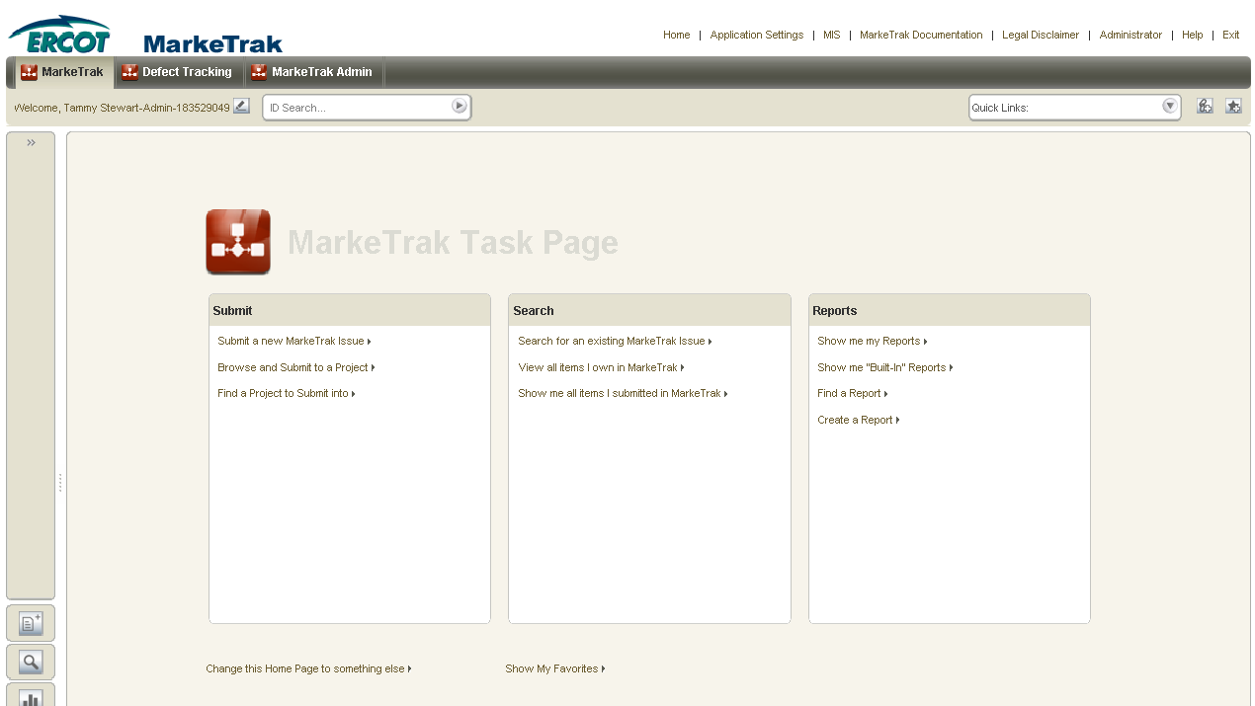
General Functionality: Navigating MarkeTrak
Launch Page
Upon successful login, the user is initially taken to the MarkeTrak Task Page. The Task Page can be used as the starting point for each login or a specific Home Page Report can be selected as the default login page.

Slide 3
General Functionality: Navigating MarkeTrak
Setting a specific Home Page Report
Select the link at the bottom of the Task Page to set a specific Home Page Report.

Slide 4
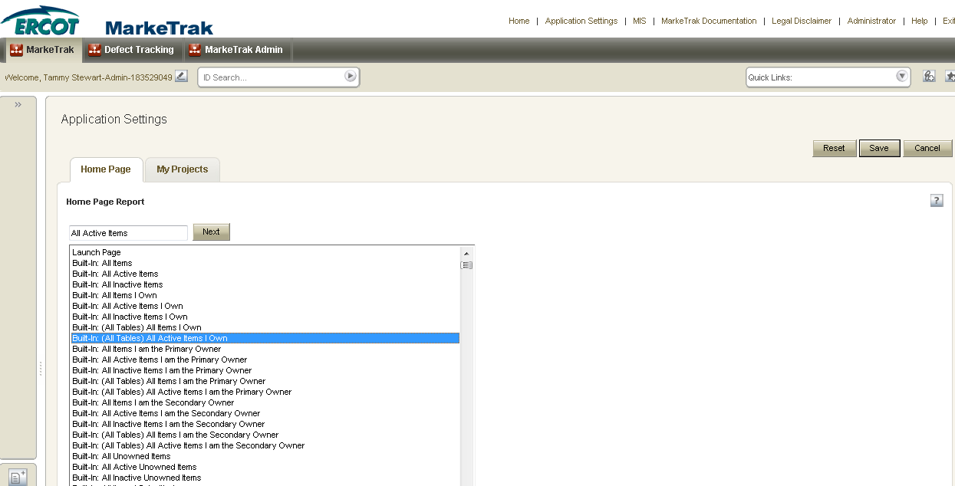
General Functionality: Navigating MarkeTrak
Select a report from the list displayed for your Home Page Report and click Save.

Slide 5
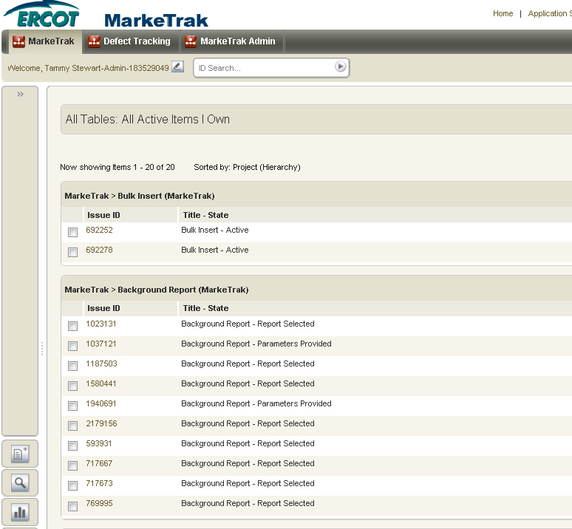
General Functionality: Navigating MarkeTrak
Home page now defaults to the selected report with each login.

Slide 6
General Functionality: Navigating MarkeTrak
MarkeTrak Tool Bar: The Home, Application Settings, MIS, MarkeTrak Documentation, Legal Disclaimer, Administrator, Help, and Exit links are available across the top of each window view in the MarkeTrak application.
Home: This button returns the user to the Home Page Report.
Application Settings: This link enables the user to select a Home Page Report and preferred projects for the application.
MIS: This link will take you directly to the main page of the Market Information System website. From there, you can select the Reports and Extracts Index link which will take you to your reports and extracts.
MarkeTrak Documentation: This link will take you to the MarkeTrak Information Page which contains several key documents such as the User Guide, Tips & Tricks document, bulk insert templates, etc.
Legal Disclaimer: A quick link to the legal disclaimer relevant to the MarkeTrak application.
Help: The help feature is an indexed and searchable resource with a thorough explanation of ‘out-of-the-box’ tool functionality. The purpose of this guide and appendix is to bridge the gap between the application and the ERCOT help documents
Exit: This is the method to log out of the MarkeTrak tool.

Slide 7
General Functionality: Navigating MarkeTrak
Quick Links: These are links updated to an individual user toolbar. This can include useful URLs such as ERCOT.com or common reports a user may wish to access in one click as demonstrated below:
To add a quick link:
Navigate to the report, form, view, or page to which you want to create a link.
Click the icon on the application toolbar. The Add to Quick Links dialog box opens.
Type a name for the quick link. This name is used to label the quick link on the application toolbar and in the Favorites view. Click Save.

Slide 8
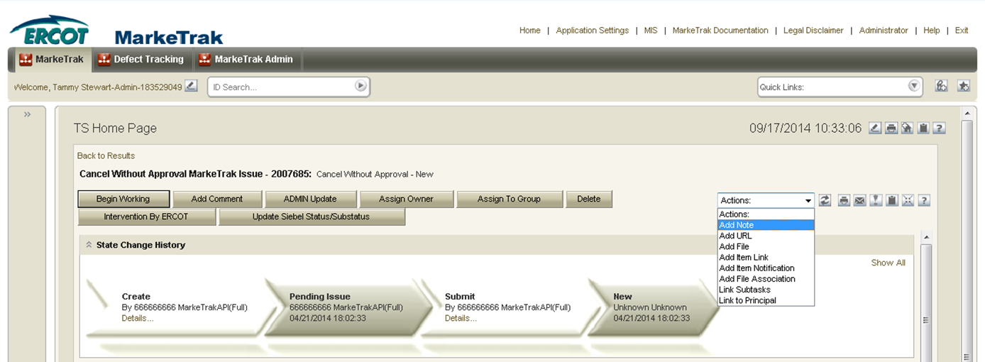
General Functionality: Navigating MarkeTrak
Actions dropdown: Available in the header of the issue details pane:
Add Note: This allows the user to include a text message on the individual issue.
Add URL: Creates a hyperlink on an individual issue to an external website.
Add File: Allows the user to locate and attach an external file to an item which will be visible by all MPs Involved. This is not to be used to submit a file of ESI IDs to be researched on the issue.
Add Item Link: This action gives the user the ability to create several different kinds of links to other issues within the MarkeTrak application. In order to successfully create these links, the current user must have visibility rights to both linked items.
Add Item Notification: Selecting this action allows the user to choose one of five distinct item notifications. These differ from the system generated notifications in that they are selected individually on items by any user with visibility.

Slide 9
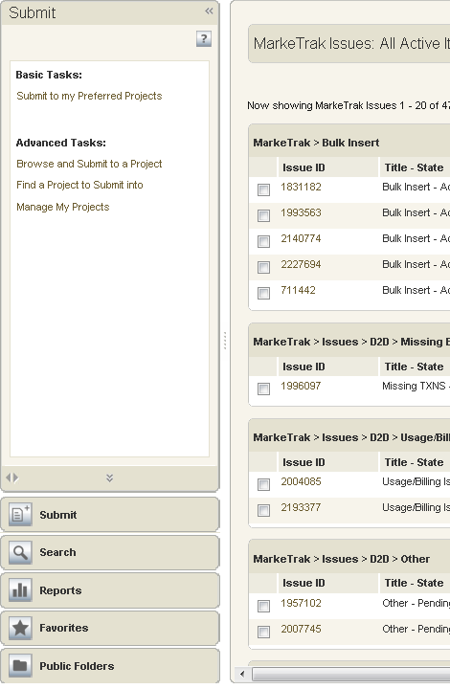
General Functionality: Navigating MarkeTrak
Navigation Pane: The navigation pane is available on the left side of the User Workspace. You can do the following in the navigation pane:
Submit: The Submit view provides links to submit issue subtypes.
Search: Provides links to the following search features in the MarkeTrak application.
Reports: Provides links to reports the user has permissions to run, modify, or delete.
Favorites: Favorites enable users to add links to frequently used features, items, and reports to folders that you create or that are provided by the system. Favorites can provide a personal view of items in the system; other users cannot view your favorites, nor can you view other users’ favorites.
Public Folders: Displays links, reports, URLs, etc that can be viewed by all other MarkeTrak users unless specifically restricted by MarkeTrak Administrators.

Slide 10
General Functionality: Navigating MarkeTrak
States and Transitions - All issues in the MarkeTrak tool are routed into one of several workflows based on the Type and Sub Type selected by the submitter. These Issue Type/Sub Types are: Day to Day Issues, Cancel with Approval, Cancel without Approval, and Inadvertent Gain related Sub Types as well as Data Extract Variance Issues- LSE Relationship.
States - A state is the position of an issue in the workflow process; this is often similar to the concept of an issue status combined with the issue’s current ‘owner’. Examples of this include: New (ERCOT), In Progress(Assignee), or Cancelled (Pending Complete).
Transitions - Transitions are the movement of an issue from one state to another. Available transitions are associated on the GUI with buttons. Selection of different buttons from the same state will typically result in the issue appearing in different states when the transition successfully completes. One example is a Day to Day Issue - Cancel with Approval currently in state In Progress with TDSP. If TDSP user selects transition button ERCOT Cancel, the item will move to state Auto Complete. Alternately if the TDSP user is unable to approve the cancel and selects transition button Unable to Cancel, the issue would appear in the submitting CR’s queue in state Unable to Cancel – (PC). Some transitions, such as Unable to Cancel, require additional steps to complete; in this case completion of a required field: Comments.

Slide 11
General Functionality: Navigating MarkeTrak
Issue Ownership: There are several varieties of ownership in the MarkeTrak application: Submitter, Responsible MP, MP’s Involved, and Assigned Owner.
Submitter: The Submitter of the item is indicated near the top of each primary data pane on the issue details window. Submitter Duns number is also incorporated into the title of each issue and listed in the MPs Involved field discussed below.
Responsible MP: Responsible MP is the single Duns number contained in the MPs Involved list that is considered to be the next participant responsible for transitioning the item towards a resolution. Examples include: the TDSP when an issue is waiting for approval to cancel a service order, ERCOT when the approval has been granted, and the CR when the cancel is complete and the issue is waiting for acceptance of the resolution.
MP’s Involved: MP’s Involved is a list of all MP duns numbers which are party to an issue. As additional assignments are made to an item the MPs Involved field will be updated with the selected DUNs numbers, reflecting an increase in market participants with the ability to view the item. As ERCOT can always view any issue in the system, this will always be reflected in the MPs Involved list.
Assigned Owner: Assigned Owner is null when an issue is initially assigned to a Market Participant. Assigned owners are individual users. These are assigned by the Responsible MP automatically as issue is acknowledged by way of transition, Begin Working. Taking this action will populate the associated individual’s user id as the Assigned Owner.

Slide 12
MarkeTrak Training
Admin Functionality

Slide 13
Admin Functionality: Roles & Responsibilities
The MP Administrator will be responsible for establishing and maintaining the users associated with their Market Participant organization. MP Administrators will only be able to establish or maintain users associated with their organization.
The MP Administrator will be responsible for maintaining the MarkeTrak Rolodex. This is the list owned by each MP Administrator which determines the destination of Notification Emails.
The MP Administrator will be responsible for maintaining the MarkeTrak Contacts List. This is the list owned by each MP Administrator which provides contact information for each MarkeTrak user for that company.
The MP Administrator will also be responsible for Report Management. – creating reports for use by multiple users registered under the same DUNS.

Slide 14
MarkeTrak Training
Email Notifications

Slide 15
Email Notifications
Automated Email Notifications
Automated emails are controlled by MarkeTrak’s Notification system and sent to MP Administrator assigned contacts. Receipt of these emails is an indication that an issue has exceeded the time allotted to complete a transition based upon the issue subtype.
For issues that remain in states of New for more than three calendar days an escalation email will be generated to the primary and secondary responsible contact.
Examples of scenarios which trigger automated email notifications are:
Inadvertent Issues:
Responsible MP Escalation: after 7 calendar days without transition
ERCOT Escalation: 48 hours to update/transition the issue from the “New (ERCOT)” or “In Progress (ERCOT)” states
Losing MP Escalation: The Regaining Transaction Status should be “Scheduled” or “Complete” within 72 hours of the “Regaining Transaction Submitted”
For all other D2D Sub Types without transition after 28 days, an escalation email will be generated to the primary and secondary responsible contacts.

Slide 16
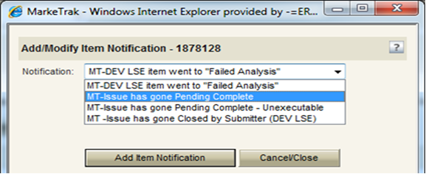
Email Notifications
Individual Email Notifications
Each user with access to an item has the ability to manually select a notification related specifically to that individual issue. The email address entered in MarkeTrak for the user who selects this option from the Actions: drop down list will be the destination for this email notification.
Recommend users utilize escalation emails via MarkeTrak tool.

Slide 17
MarkeTrak Training
ERCOT ListServ

Slide 18
ERCOT ListServ
To subscribe to an email distribution list on ERCOT ListServ, navigate to http://lists.ercot.com and create an account.
Users will receive a confirmation email sent to the email address provided which will be used to log into the listserv application.
Users will select the desired lists from the menu and click “submit”.
Users will receive an email with a verification link requesting confirmation of subscription to each list selected.
After clicking the link, the user will receive all subsequent emails sent to the selected list(s).
To unsubscribe to an email distribution list, users navigate to desired list and click “unsubscribe”.

