Slide 1
TDTMS Update
August 6th, 2019

Slide 2
TDTMS
ERCOT Update
Recreating Reports
  June
    Switch Hold
      Report 1: Unexecutable Reasons
      Report 2: TDSP Volumes
      Report 3: CR Volumes
    Approximately 10% of switch hold removals go untouched and the switch hold is automatically removed vs the CR agreeing to the removal
  July
    Inadvertent Gain
      Report 1: CR Transition Times (How long does it take to close an issue?)
      Report 2: CR Volumes
    Approximately 77% of IAS regain MTs are submitted within 12 days
ERCOT NAESB Upgrade
MT Sub Type Volumes
  Chart A & B

Slide 3
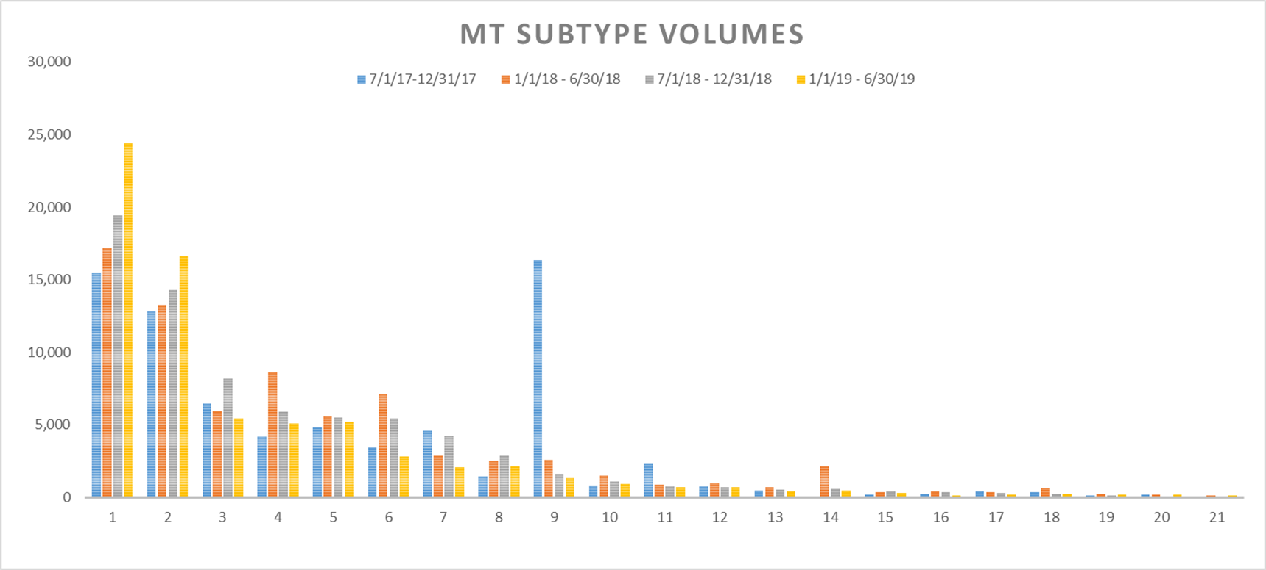
Chart A

Slide 4
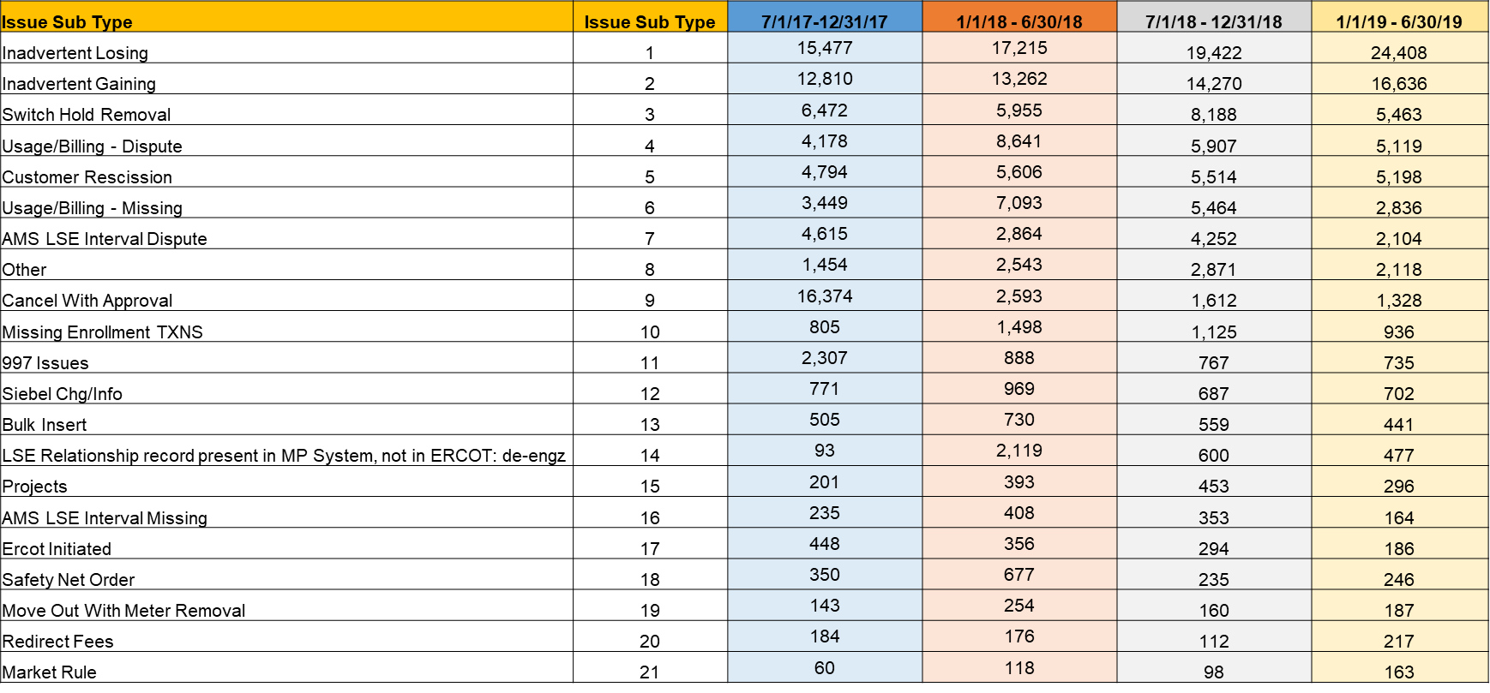
Chart B

Slide 5
TDTMS
August 22th
ERCOT MetCenter
On the Agenda: IAS

