Slide 1
System Protection Working Group (SPWG)
Update to ROS
August 1, 2019
Micheal Davis, Jr, P.E.

Slide 2
SPWG Meeting
Meeting held on July 9, 2019
Next meeting will be held November 13-14, 2019
Some topics discussed:
  Relay loadability definition/application
  Relay loadability data requirements for submittals to ERCOT
  Feedback to DWG and PGDTF on protection-related questions

Slide 3
Transmission Operator Protection System Misoperations 2019 Q1
ERCOT Protection System Misoperations Data – 138kV and 345kV Combined
Gradual increase in rolling average misoperation rate in the last year, 6.2% to 8.3%

Slide 5
Protection System Misoperations – 2019 Q1
 |  | Q1 | 2019 YTD
# of Misoperations | Total | 37
 | 345 kV | 5
 | 138 kV | 31
 | < 100 kV | 1
By Category | Failure to Trip | 0
 | Slow Trip | 0
 | Unnecessary Trip during Fault | 24
 | Unnecessary Trip – Non Fault | 13
 | SPS | 0
By Relay System Type | Electromechanical | 4
 | Solid State | 0
 | Microprocessor | 29
 | Other/ N/A | 4
By Equipment Protected | Line | 15
 | Transformer | 7
 | Generator | 1
 | Shunt/Series Capacitor | 2
 | Shunt/Series Reactor | 0
 | Dynamic VAR system | 0
 | Bus | 1
 | Breaker | 10

Slide 6
Protection System Misoperations 2019 Q1

Slide 7
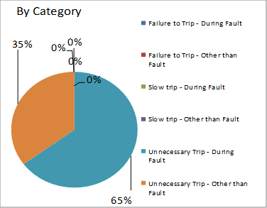
Protection System Misoperations 2019 Q1

Slide 8
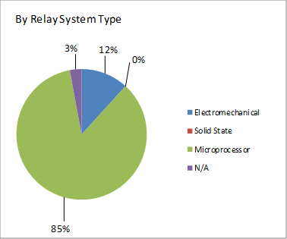
Protection System Misoperations 2019 Q1

Slide 9
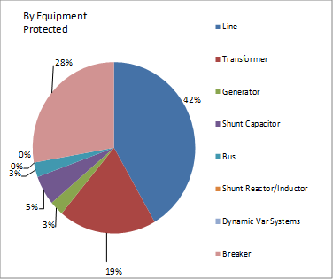
Protection System Misoperations 2019 Q1

Slide 10
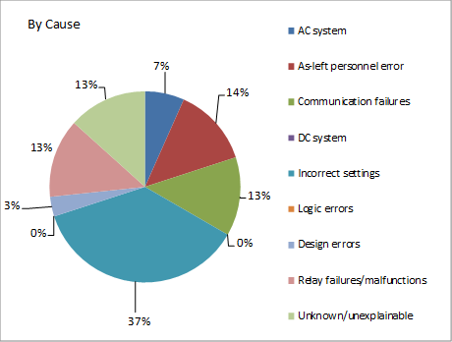
Protection System Misoperations 2019 Q1

Slide 11
Protection System Misoperations 2019 Q1
Summary of Human Performance Issues noted for 2019 Q1:
A 138kV line breaker overtripped for a fault on the bus capacitor bank due to incorrect logic settings in the trip output contacts. The field settings were inadvertently revised during relay maintenance and not checked prior to placing back in service.
A 138kV line breaker overtripped for an external fault. The DCB pilot scheme was inadvertently enabled in error during a construction project.
A 138kV line breaker overtripped for an external fault due to incorrect polarization settings. Negative sequence polarization should have been used due to mutual coupling.
A 138kV capacitor bank inadvertently tripped on overvoltage. Overvoltage time delay was inadvertently set to 0 by mistake.
A 138kV bus differential tripped during an external line fault. An incorrect CT ratio was left in place during a construction project.
A 138kV line breaker overtripped for an external fault due to incorrect logic settings.
Failure to Trip/Slow Trip Misoperations in 2019 Q1:
None

Slide 12
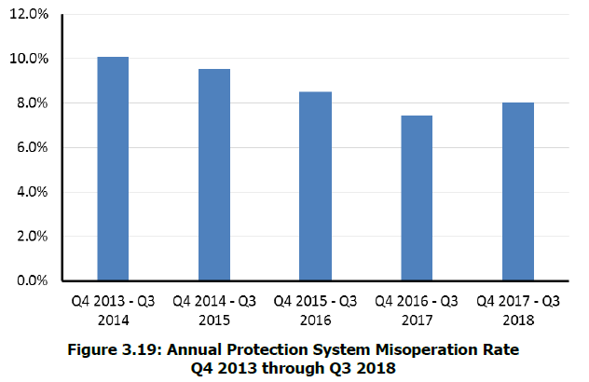
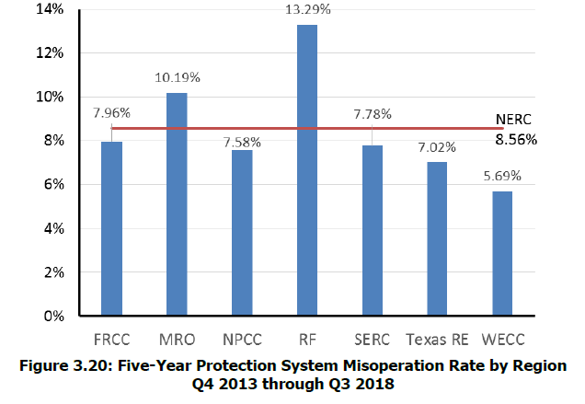
NERC State of Reliability Report
Key Takeaways
The overall NERC 2018 protection system misoperation rate is slightly higher than 2017, though a statistically significant downward and improving trend continues to be observed. The regional misoperations rate ranges from 5.7% to 13.3%.

Slide 13
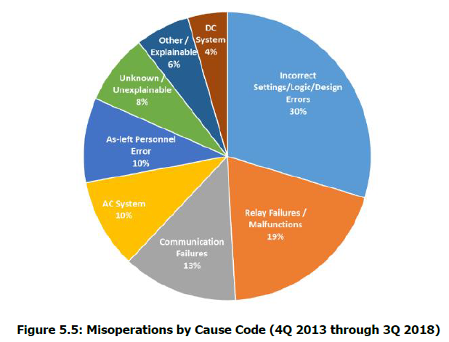
NERC State of Reliability Report
Key Takeaways
The top three causes of misoperations are Incorrect Settings/Logic/Design Errors, Relay Failures/Malfunctions, and Communication Failures over the past five years. These cause codes have consistently accounted for more than 60% of all misoperations since data collection started in 2011.

Slide 14
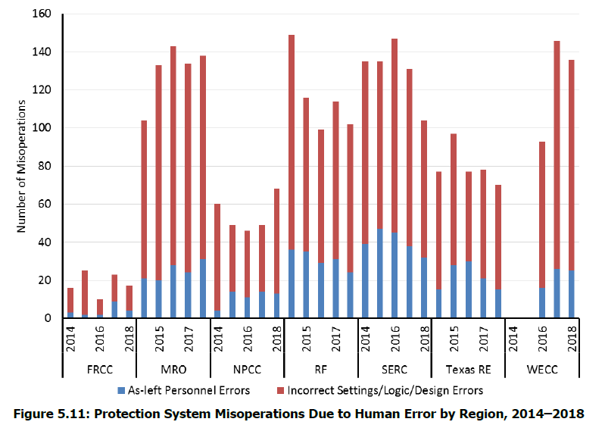
NERC State of Reliability Report
Key Takeaways
Misoperations due to the two different types of Human Error categorized by NERC: As-left personnel errors and Incorrect Settings/Logic/Design Errors account for roughly 40% of misoperations over the last five years.

Slide 15
Questions ?

