Slide 1
PDCWG Report to ROS
Chair: Chad Mulholland, NRG
Vice Chair: Jimmy Jackson, CPS
ROS
August 8th, 2019

Slide 2
Report Overview & Notes
Report Overview
Meeting Minutes
BAL-001-TRE-1 FMEs & IMFR
No FMEs in the month of June
Frequency Control Report

Slide 3
Meeting Minutes
PDCWG Meeting 7/18/19
NPRR 919 / NOGRR 184 - Exemption from Governor PFR Control for Certain Resources in PUNs
most PDC members not in favor
Battery Storage Operational Requirements
PDC agrees that batteries should, as a general rule, have the same operational requirements whether charging or discharging
Establishing generator bid/offer limits for RRS under NPRR 863 – Updated outline from ERCOT
There was a lot of PDC feedback following the June discussion on this topic; changes were incorporated and reviewed at July PDC
ERCOT Analysis of Inertia & Frequency Response
Evaluated frequency event recovery time as a function of inertia, RoCoF, load dampening, and interconnection frequency response broken down by generator fuel types
Regulation & Frequency Control Reports

Slide 4
Frequency Measurable Events Performance

Slide 5
Frequency Measurable Events
There were no FMEs in June

Slide 6
Interconnection Minimum Frequency Response (IMFR) Performance
IMFR Performance currently 949.35 MW/0.1Hz
Frequency Response Obligation (FRO): 381 MW/0.1 Hz

Slide 7
Frequency Control Report
June 2019

Slide 8
CPS1 Performance

Slide 9
RMS1 Performance of ERCOT Frequency

Slide 10
Frequency Profile Analysis

Slide 11
Time Error Corrections

Slide 12
ERCOT Total Energy

Slide 13
ERCOT Total Energy from Wind Generation

Slide 14
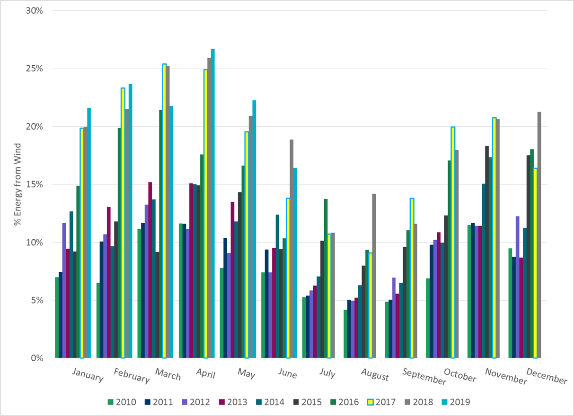
ERCOT % Energy from Wind Generation

Slide 15
Questions?

