Slide 1
Distributed Generation Capacity Forecasting for the CDR
July 31, 2019
Notes:
Welcome to

Slide 2
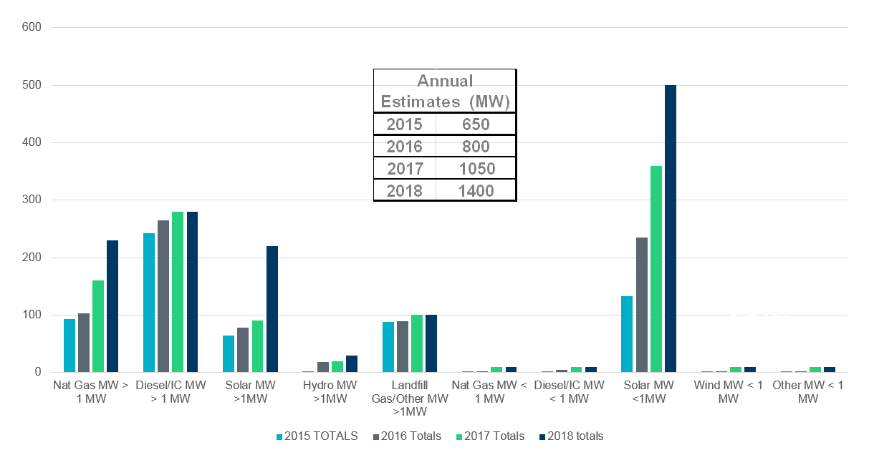
ERCOT Estimated Total DER Growth 2015-2018 (MW)
181%
26%
31%
Note: This estimate includes informal data reporting by many NOIEs and excludes generation data informally reported by investor-owned utilities for generation that would typically be considered backup or emergency generation.

Slide 3
Distributed Energy Resources Trends
Solar PV → Significant growth
Utility Scale (> 1 MW)
Residential/Commercial (< 1 MW)
Internal Combustion Engines
Diesel → limited growth
Nat Gas → Significant growth
Energy Storage → limited growth
Utility Scale Batteries (> 1 MW)
Residential/commercial (< 1 MW)
-- Wind Turbines → very limited growth
Utility Scale
Residential(< 20 kW)
Landfill Gas/Biogas → very limited growth

Slide 4
Residential Solar Growth Projection
April 12, 2019 SAWG DG Solar Forecast Tool
http://www.ercot.com/content/wcm/key_documents_lists/172703/DGSolar_Forecasting_Tool.xlsm
Estimates Long-term Growth using S-curve
Total capacity based on AWS Truepower analysis
Summer Peak Capacity Factor at 36% based on AWS Truepower analysis.

Slide 5
Utility Scale Solar Growth Projections
No Forecast tool developed yet
Comprised of two primary groups of installations
NOIE Community Solar (750-998 kW)
Competitive Choice (typically 5-10 MW)
Proposed methodology would be similar to Rooftop Solar
Estimate Long-term Growth using S-curve
Total Capacity estimates
Suggest hosting solar developer roundtable to help develop/refine?
Summer Peak Capacity Factor similar to Transmission Connected?

Slide 6
Natural Gas Growth Projections
Installations started along Gulf Coast for hurricane resiliency
Starting to spread to other areas of ERCOT
Proposed methodology
No Forecast tool developed
Suggest informal Poll of DSP’s to determine short/medium term growth?
Summer/winter Peak Capacity Factor?
Self Dispatched
Price Responsive
Non-price Responsive

Slide 7
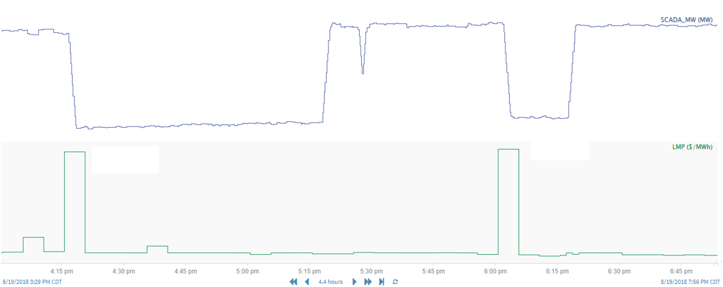
Price Responsive –Diesel and Nat Gas
2019 - SODGs are mapped to their corresponding Loads in the ERCOT Network model.
Using the Telemetry of those mapped Loads, ERCOT can measure SODG response

Slide 8
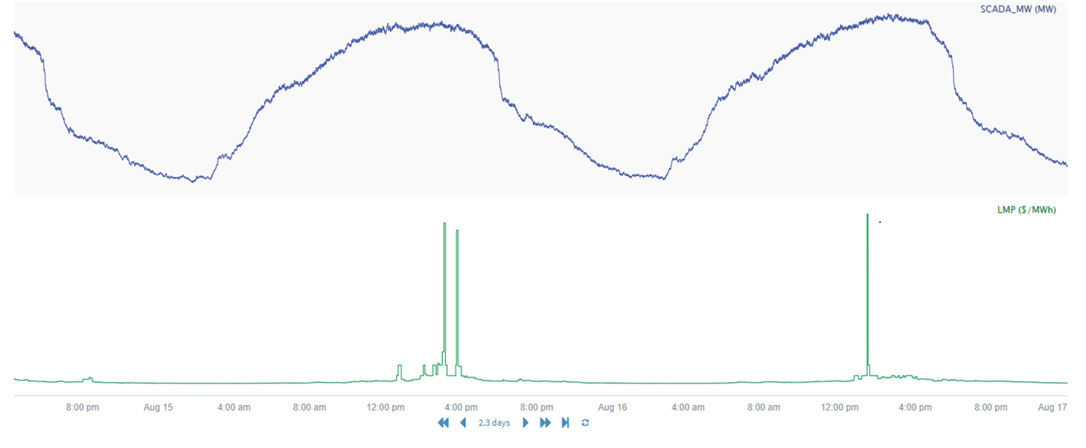
Non-Price Responsive—Diesel and Nat Gas
Multiple price spikes and no change in SCADA MW

