Slide 1
RIOO-RS Update
July 30, 2019

Slide 2
Information/Data issues
What’s been found, what may need to be updated:
  Connectivity
  Data that does not match the updated validation rules; special characters (#, $, *)
ERCOT will provide an updated RARF, Delta Report, and Audit Report to the RE.
If the RE agrees with the updated RARF, the RE should submit the RARF to ERCOT.
If the RE does not agree with the changes, the RE should schedule a call with your Client Services Account Manager.
Audit Report may show errors if GIC data has not been submitted or validation rules have been updated.
Model may show that the RE owns equipment, an “ADD” was created, please verify ownership.

Slide 3
Most frequent changes – top 10
Seasonal Limits
Operational Parameters
Capacitor and Reactor Data
Reactive Capability
General and Site Info (Contact information)
Ownership
Breakers / Switches
Transformer Tap Settings
Lines
Gen Load Sprint - ESIID

Slide 4
Wireframe Review

Slide 5
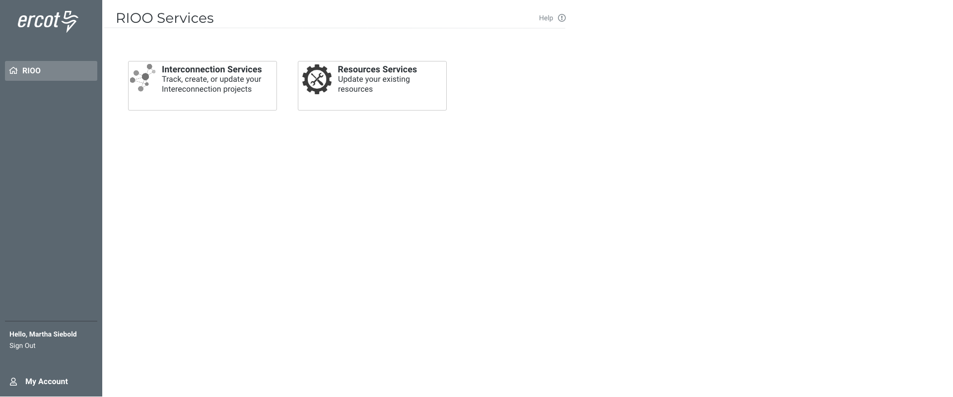

Slide 6
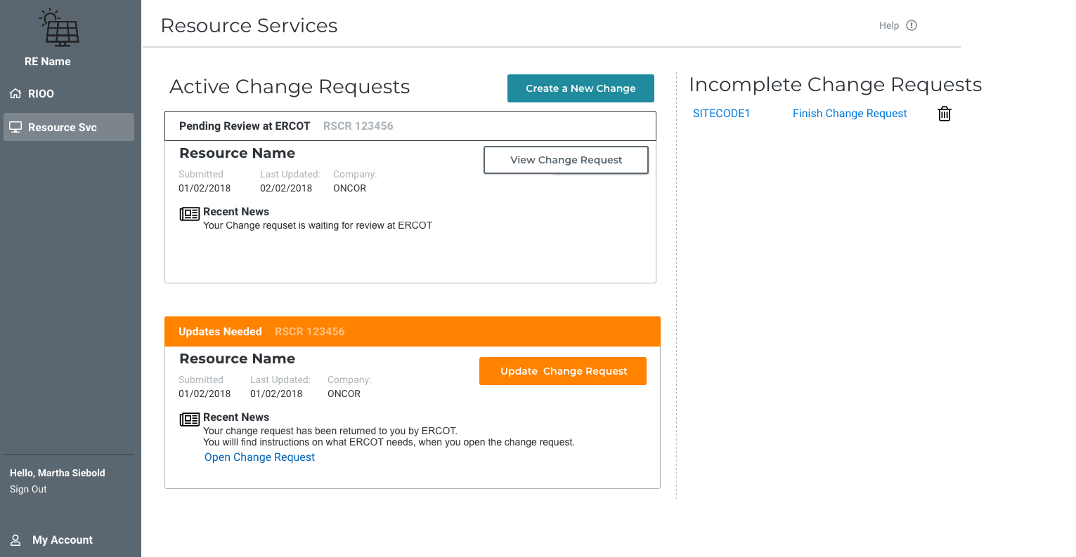

Slide 7
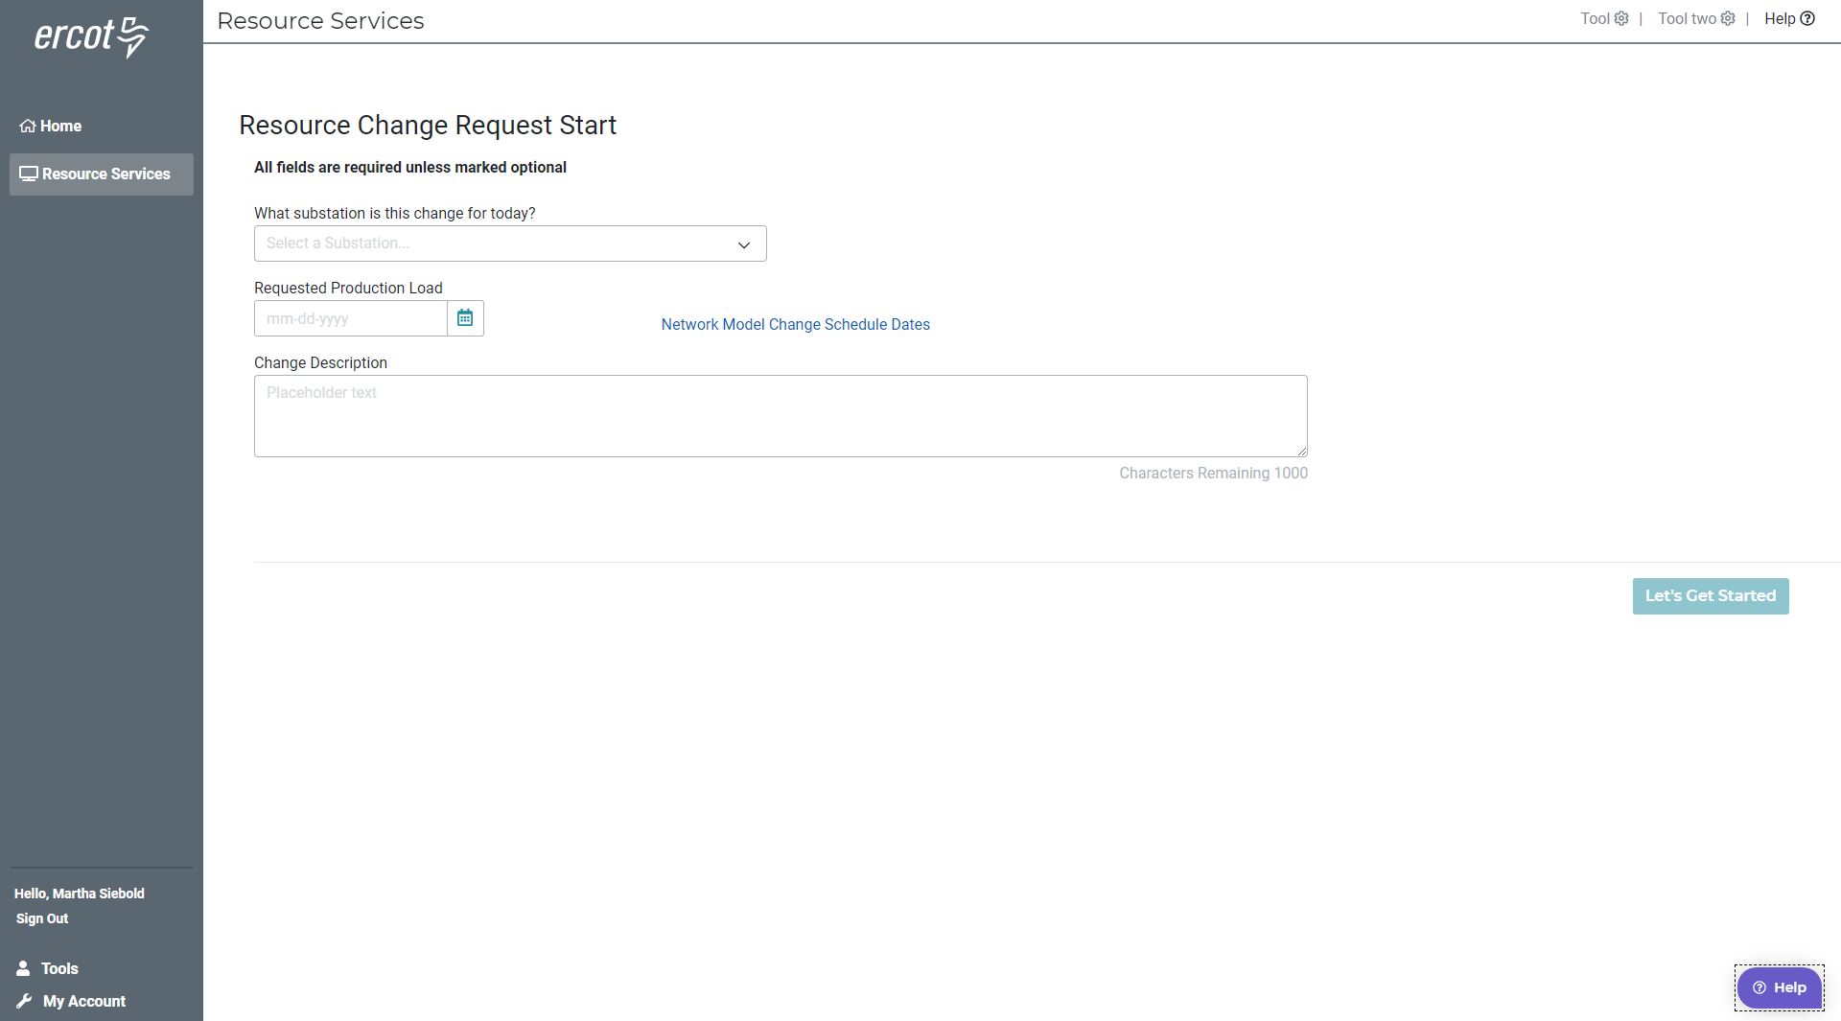

Slide 8
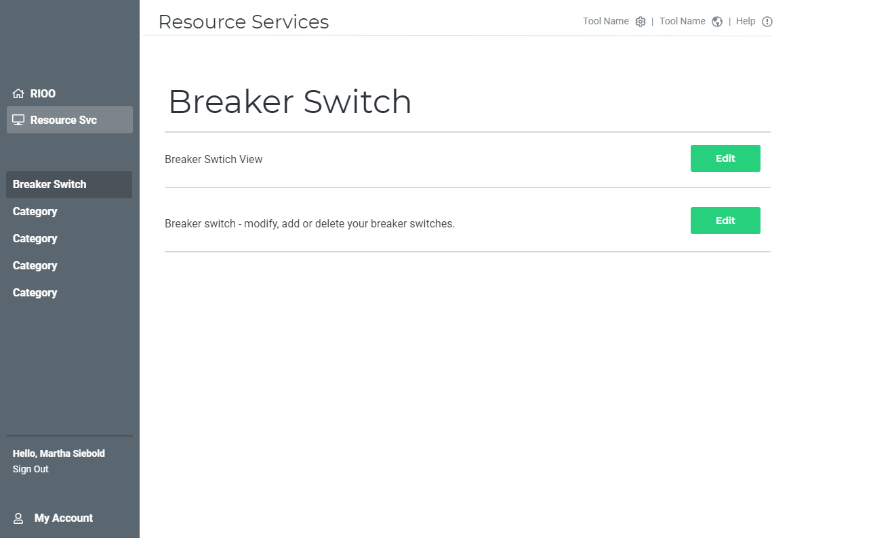

Slide 9
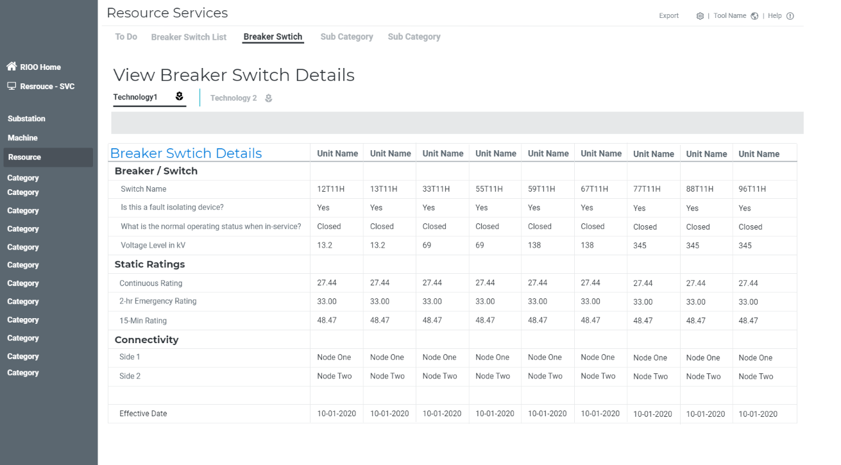

Slide 10
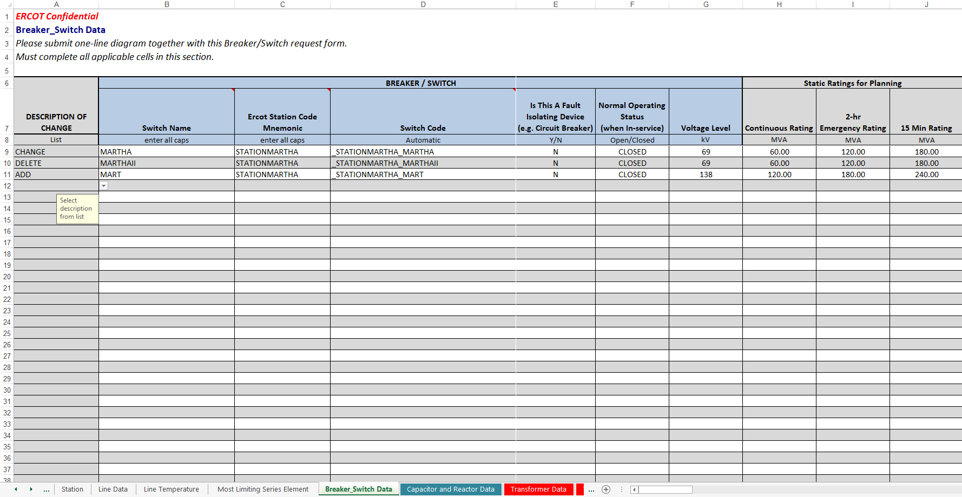
Transmission.xls: Breaker_Switch Data

Slide 11
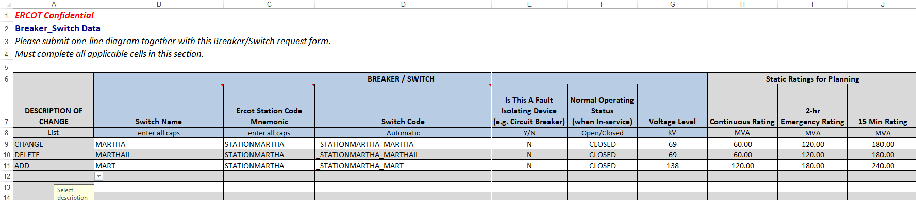
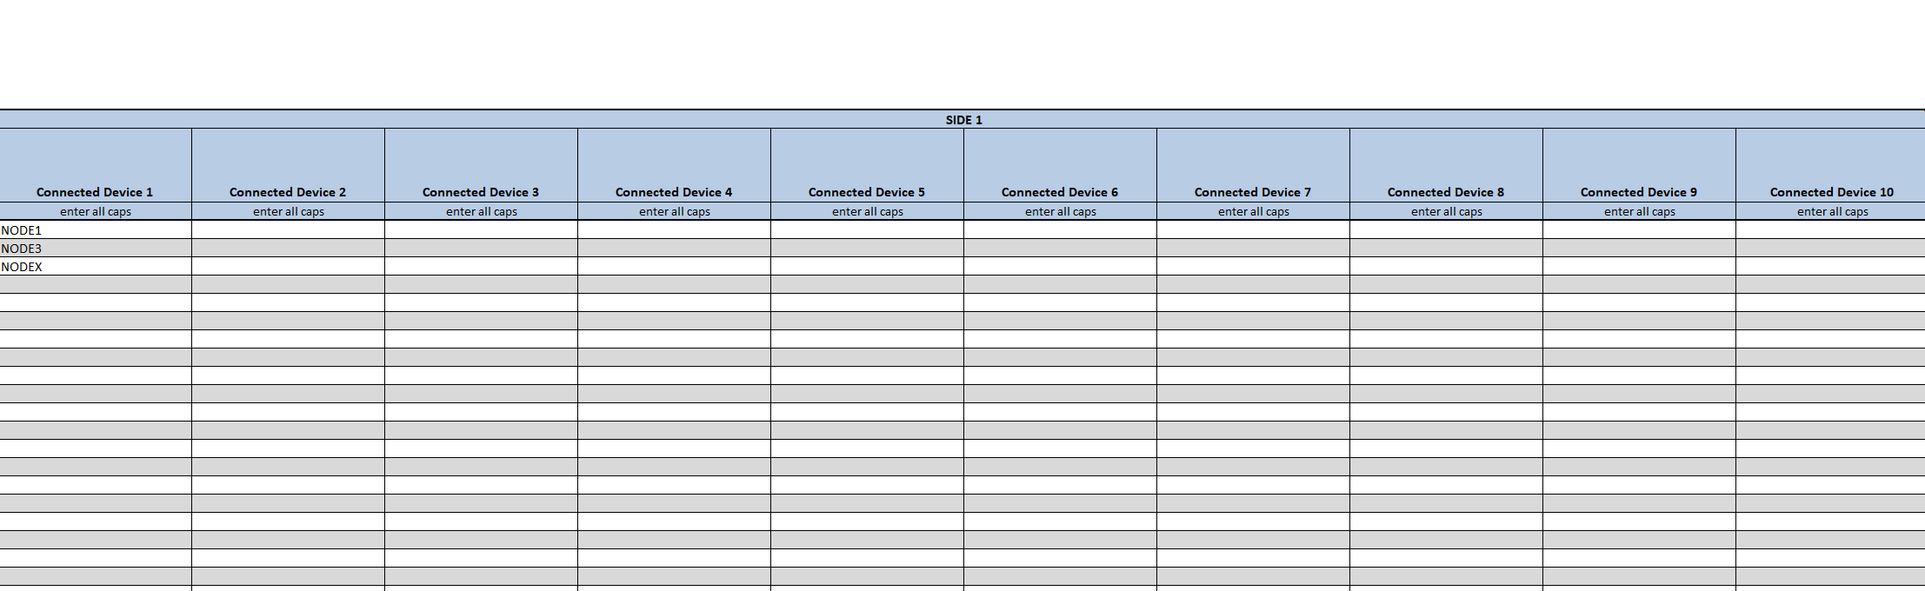
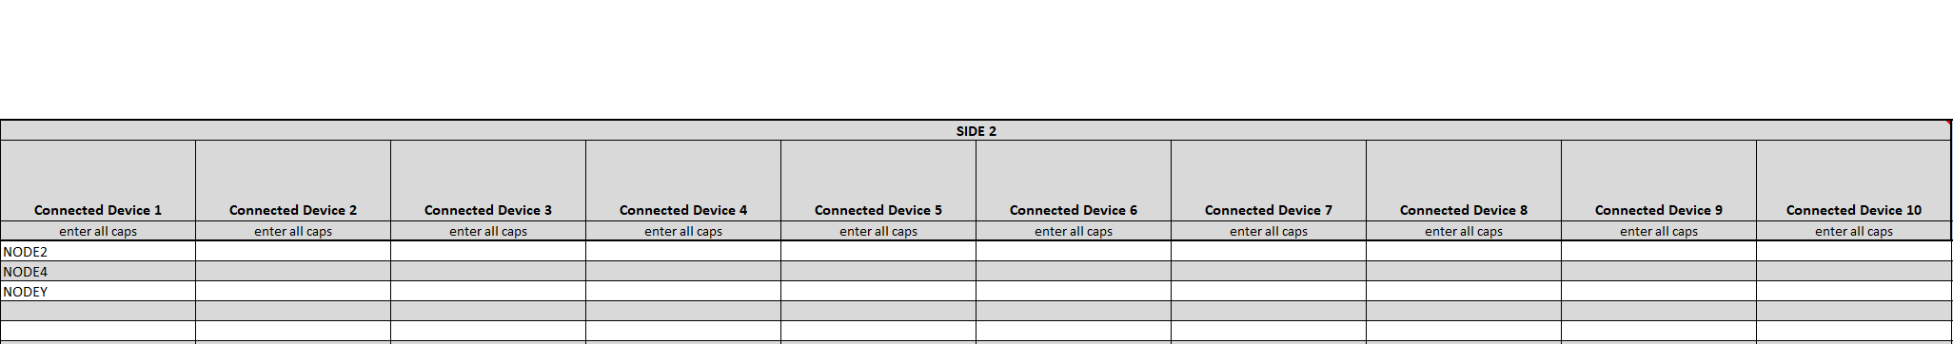
Sample Data: Breaker_Switch Data

Slide 12
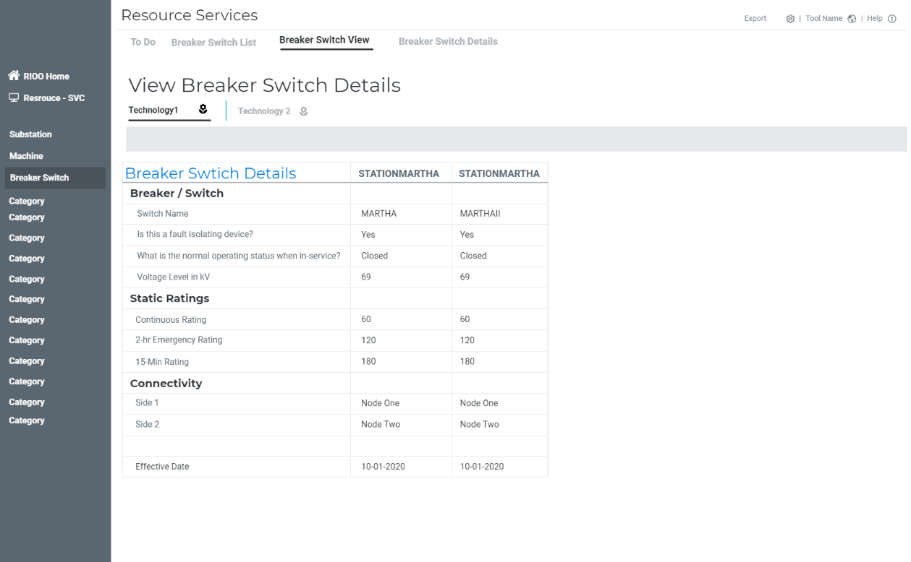

Slide 13
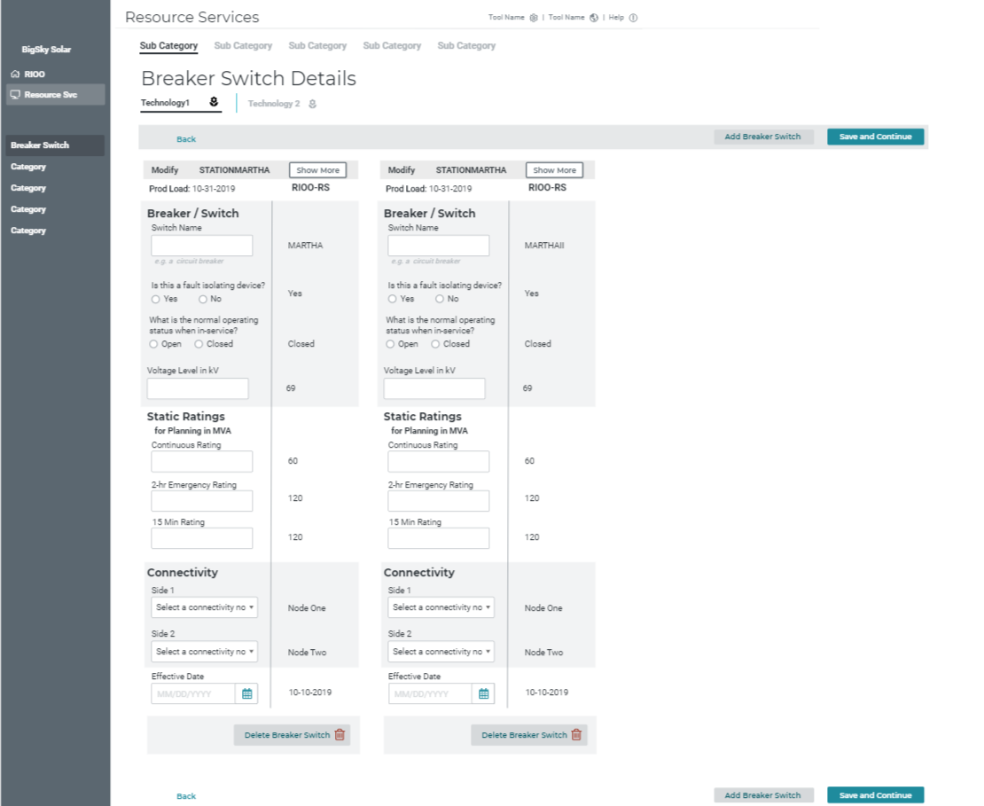

Slide 14
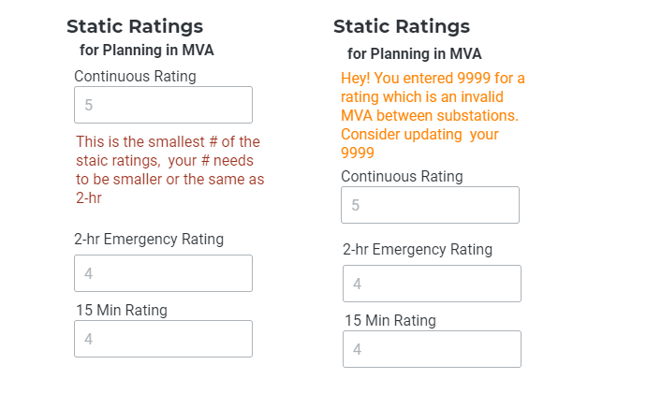
Messaging samples

Slide 15
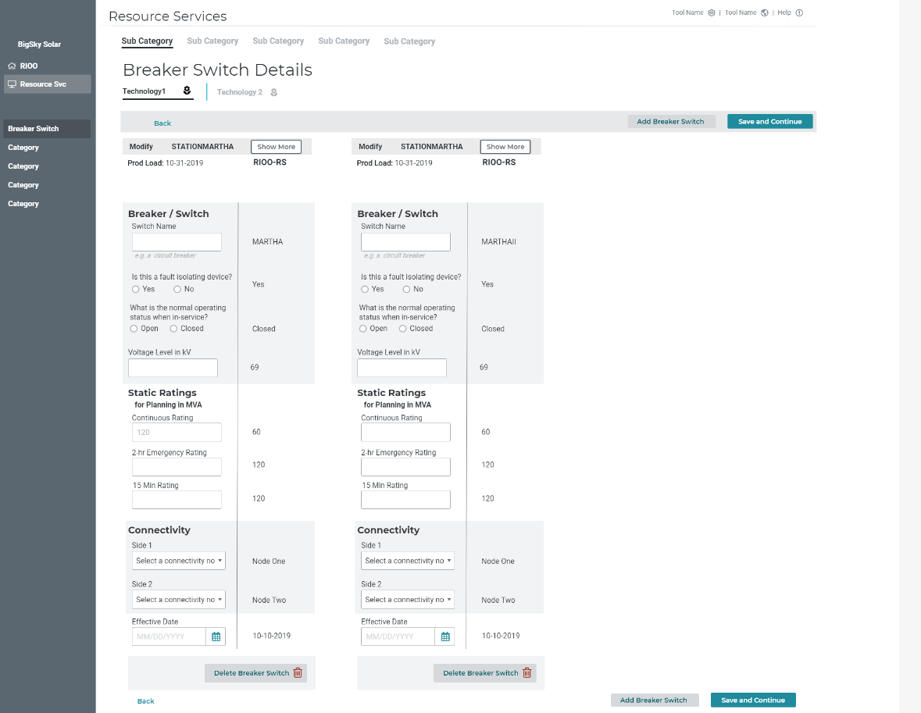

Slide 16
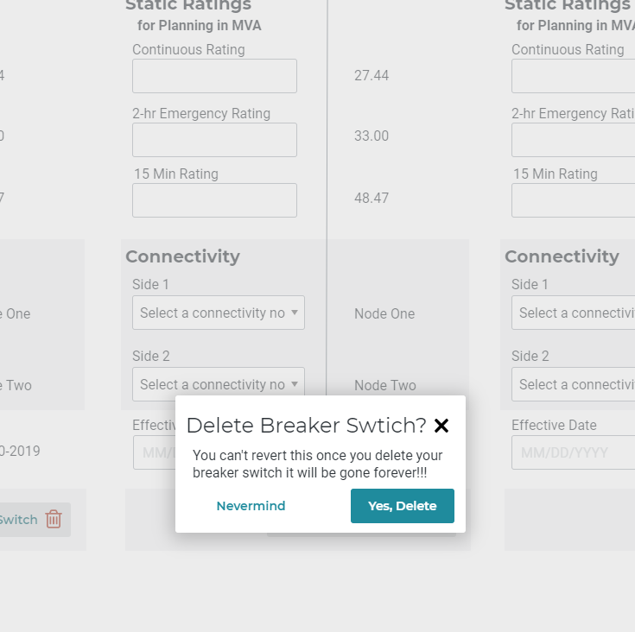

Slide 17
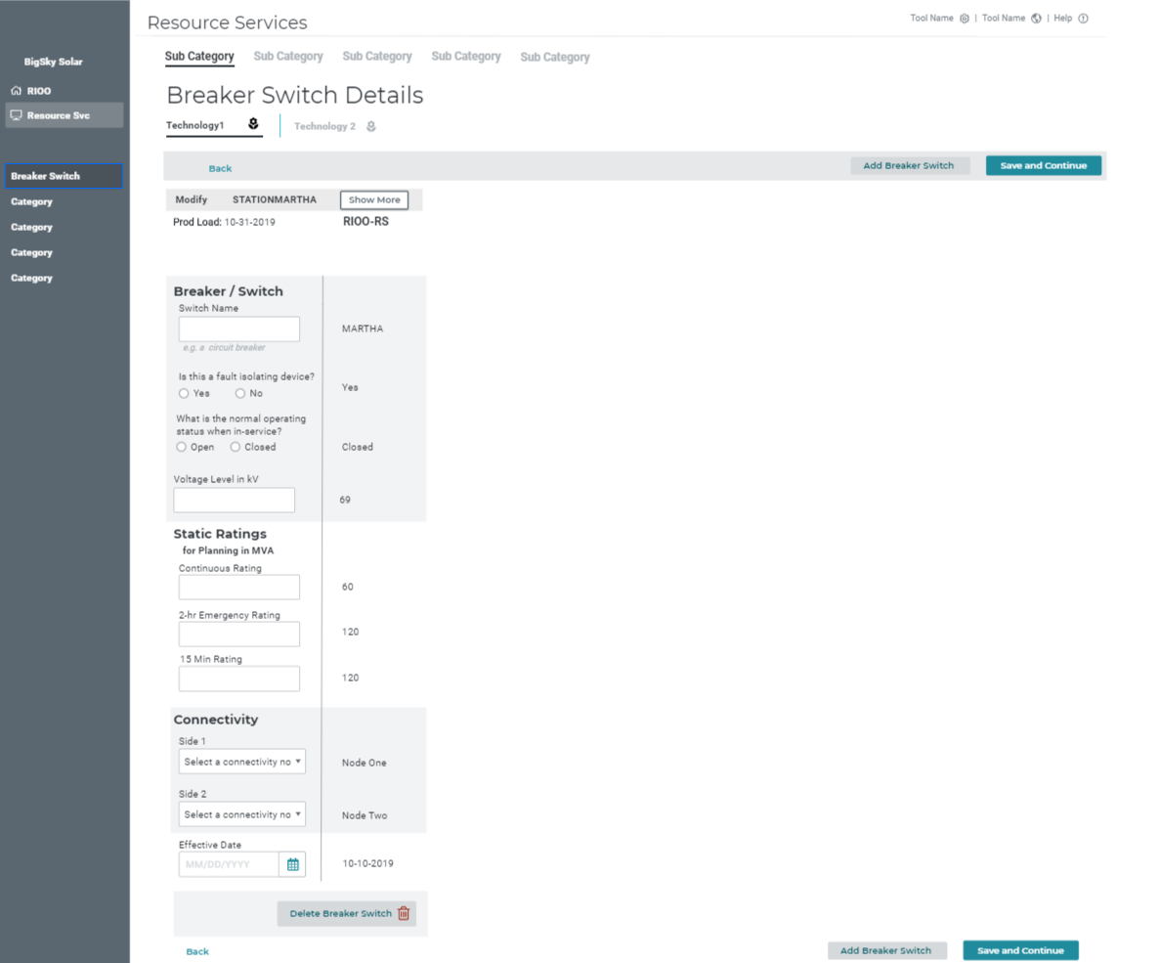
120

Slide 18
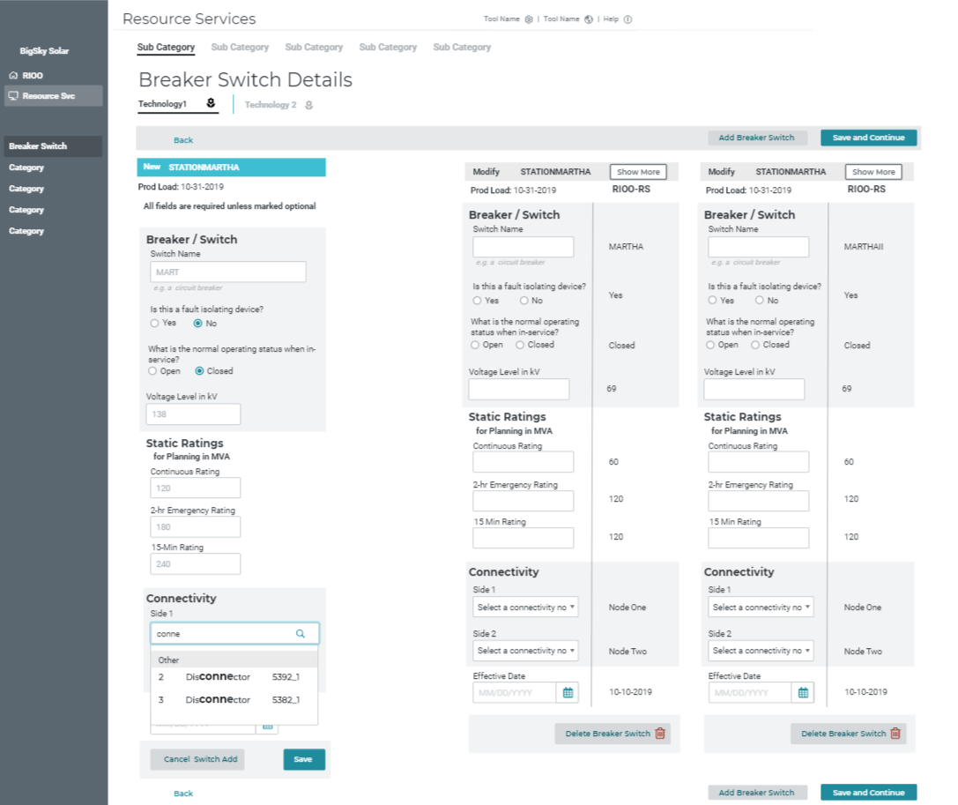

Slide 19
Connectivity for Breaker Switch Old

Slide 21
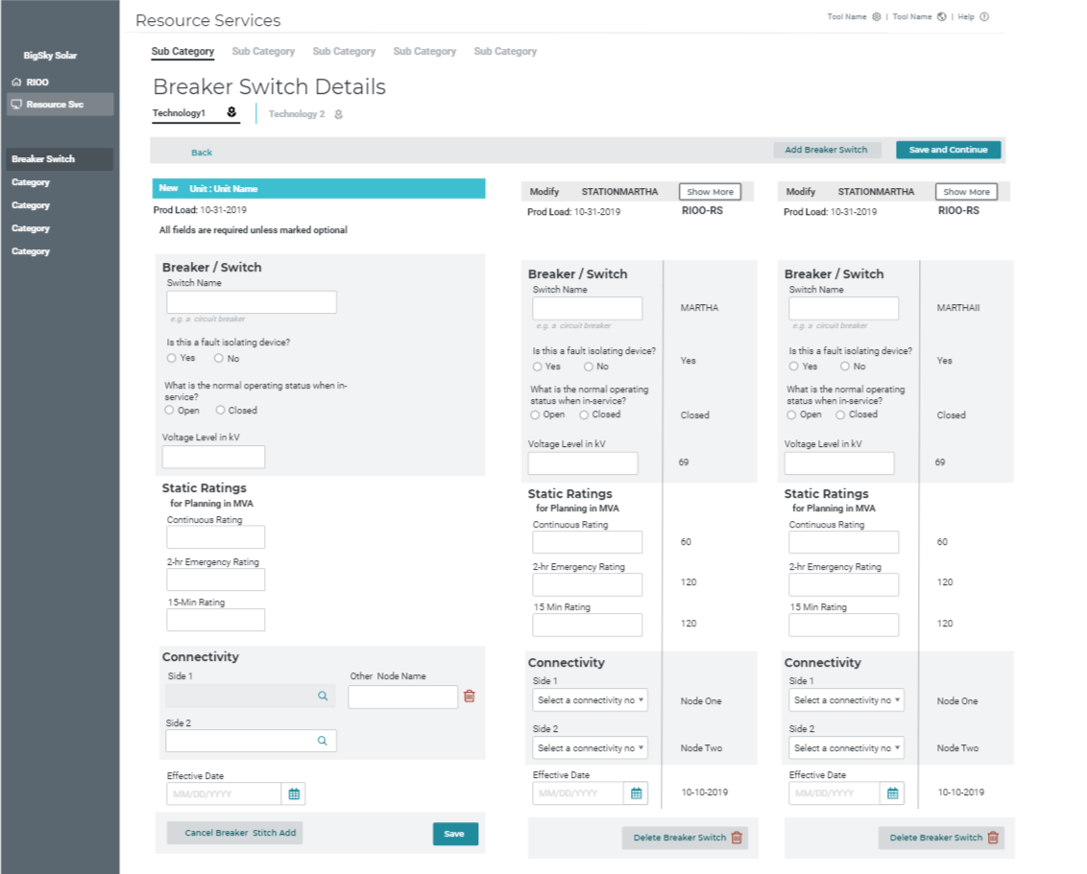

Slide 22
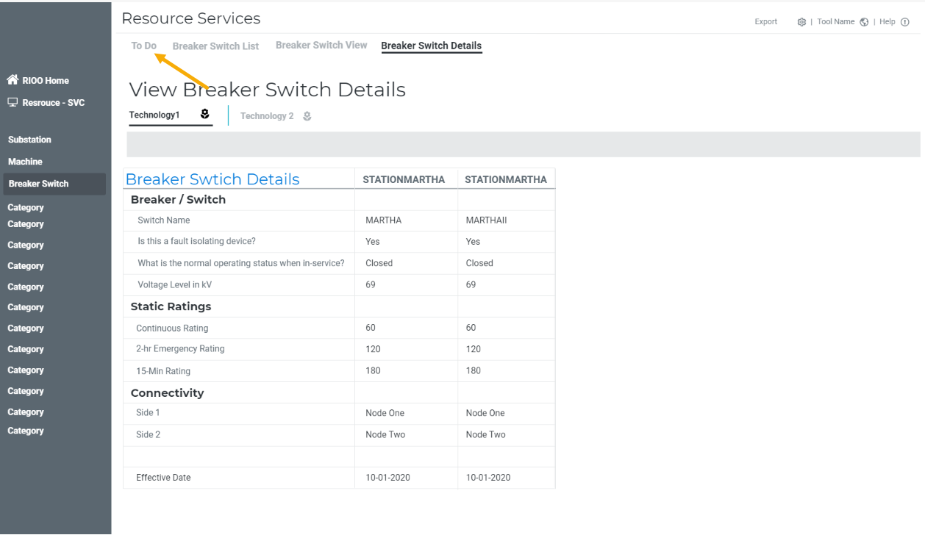

Slide 23
