Slide 1
TEAMS –
Texas Electric Advanced Market Solution
Update to Retail Market Subcommittee (RMS)
August 6, 2019

Slide 2
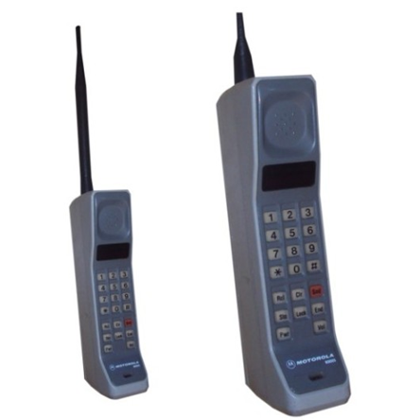

TEAMS Project objectives
Consolidate the applications portfolio by migrating all existing mainframe applications, data and processes to long term supportable platforms
  Primarily SAP and Oracle platforms
Modernize and enhance business and technical capabilities for improved performance, operations and change management
FROM TO
Notes:
CIS has been around for a long time. So now we are modernizing

Slide 3

Now we will take a dive into the market facing changes

Slide 4
Market Facing Changes – Key Points
Process Improvements
  Billing
  Meter Removal
Rate Description
  – All listed will align with the Tariff language
Unmetered EDI data field change
  Guardlight - Multiple Unmetered Light Types
Quantity Segments

Slide 5
Process Improvements
Billing
  Current:
    Monday: Take reading(s)
    Monday night: Store reading(s) during batch process
    Tuesday night: Prepare to Bill with reading(s) obtained on Monday
    Wednesday: Monday’s 810 and 867 Transactions are sent around 2:00am
  Future:
  Billing will be performed one day earlier on the night that the reads were obtained thus eliminating the one day lag in 810s and 867s after the scheduled read date, for example:
    Monday: Take reading(s)
    Monday night: Prepare to Bill with reading(s) obtained on Monday
    Tuesday: Monday’s 810 and 867 Transactions would be sent out

Slide 6
Process Improvements
  Meter Removal
  Meter removal on active account (energized) - the 814_20 will show the value “NONE” for the meter number
Notes:
For meter removal on activi account – energized - we are going to utilize a item already in the guide - utilize NONE for the meter number – rather than using a virtual/ dummy meter

Slide 7
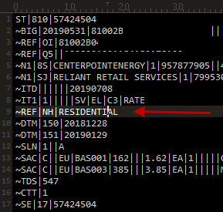
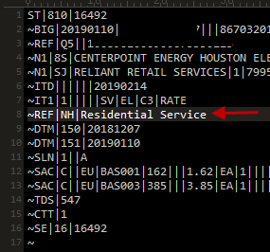
Rate description
Mass Market – Residential:
    810_02:
~REF*NH*RESIDENTIAL (Current)
~REF*NH*Residential Service (Future)
Current Future

Slide 8
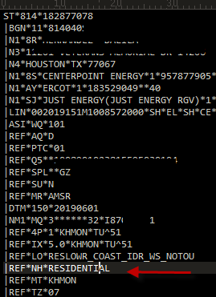
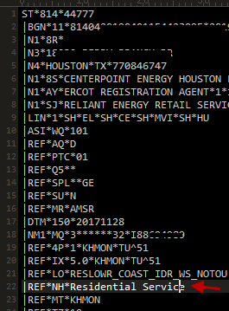
Rate description - Cont.
Mass Market – Residential:
    814_04:
~REF*NH*RESIDENTIAL (Current)
~REF*NH*Residential Service (Future)
Current Future

Slide 9
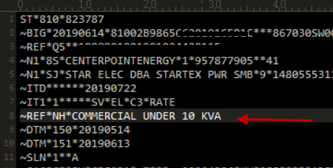
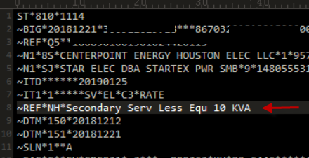
Rate description - Cont.
Mass Market – Small Commercial:
    810_02:
~REF*NH*Commercial Under 10 KVA (Current)
~REF*NH* Secondary Service Less Equ 10 KVA (Future)
  Current Future

Slide 10
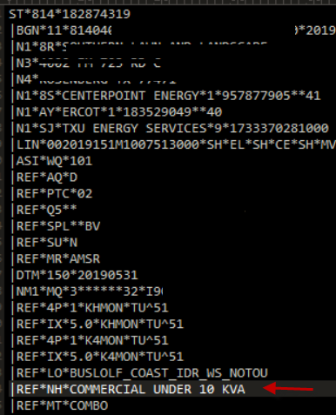
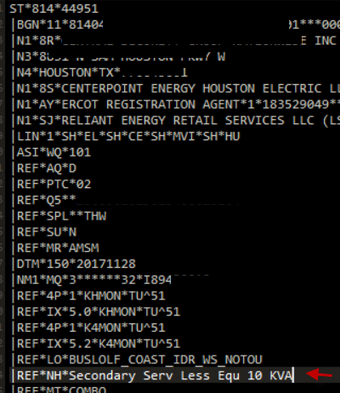
Rate description - Cont.
Mass Market – Small Commercial:
      814_04:
~REF*NH*Commercial Under 10 KVA (Current)
~REF*NH* Secondary Serv Less Equ 10 KVA (Future)
Current Future
Notes:
Keep in mind – will refer back to this in a later slide

Slide 11
Rate description - Cont.
Letter of Authorization (LOA) Processes:
    Changes will be made to the “Rate Class/Code” field on the usage history spreadsheet files sent in response to usage requests
  This change will impact usage history spreadsheets sent in response to:
      requests from the paper LOA process,
      the online CRIP-LOA system and
      the Demand and Energy Information System (DEIS) used by Customers
Notes:
Applications are not changing-
One other item - meter number field length is changing - so that you will get the complete meter number that is in SAP

Slide 12
Unmetered EDI Data Field Change
Guardlight - Multiple Light Types:
  Will be consolidated into one SLN (Subline Item Detail) loop in the 810_02 TDSP Invoice transaction for the T&D Charge(s) where multiple lights exist
  Will utilize the DTM Date/Time Reference (Unmetered Service Date Range) looping in the 810_02 TDSP Invoice transaction for proration when lights are added or removed in the middle of a monthly billing period.
Notes:
Highlight Unmetered
When we have T&D charges for multiple lights, we will consolidate this into 1 sln loop

Slide 13
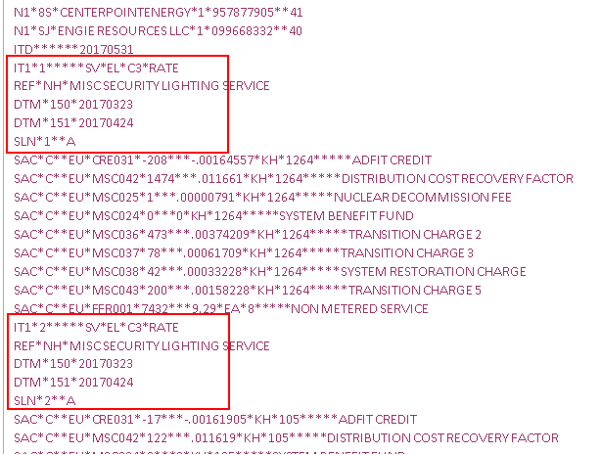
Unmetered EDI Data Field Change
Current:

Slide 14
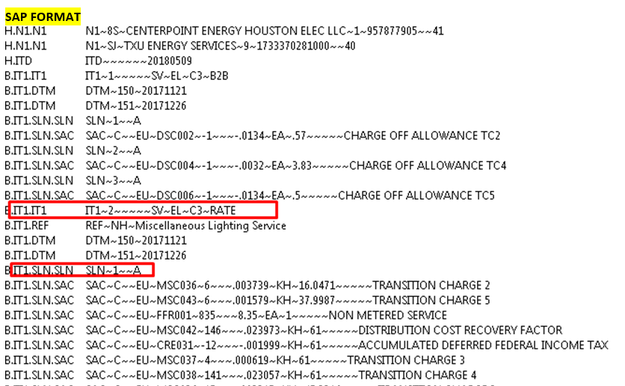
Unmetered EDI Data Field Change
Future:
Notes:
Was presented to the market sometime back by Kathy Scott - tested with our trading partners - produced the invoice to end customer

Slide 15
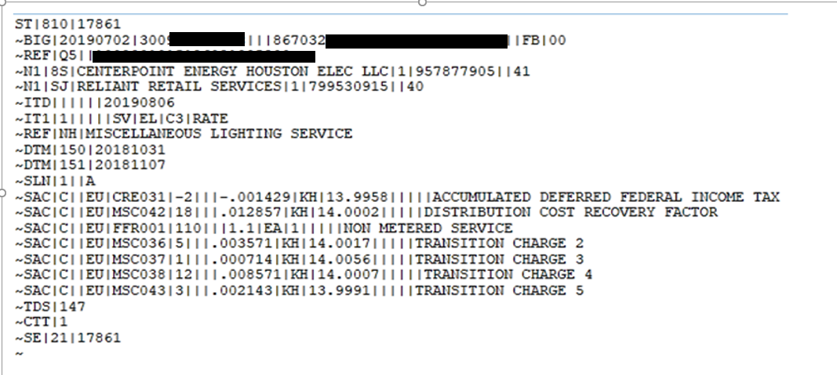
Quantity segments
All quantity segments will be carried out to 4 places to the right of decimal for unmetered
      .

Slide 16
Teams business release strategy
Technical Go Live & Planned Releases
Market Downtime
  – Usage Requests - CRIP, CRIP LOA, DEIS, & UHIT
  Business Release 1 and 2
Dual Mode
Process changes During Migration Timeframes
Market Testing
Market Communication Plan

Slide 17
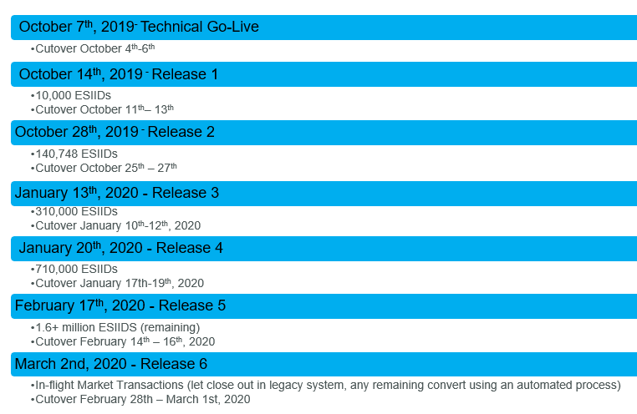
Planned TEAMS - Business Release Strategy
TECHNICAL GO LIVE & PLANNED RELEASES
Notes:
Technical – is only moving code to production. No impact to mass market accounts

Slide 18
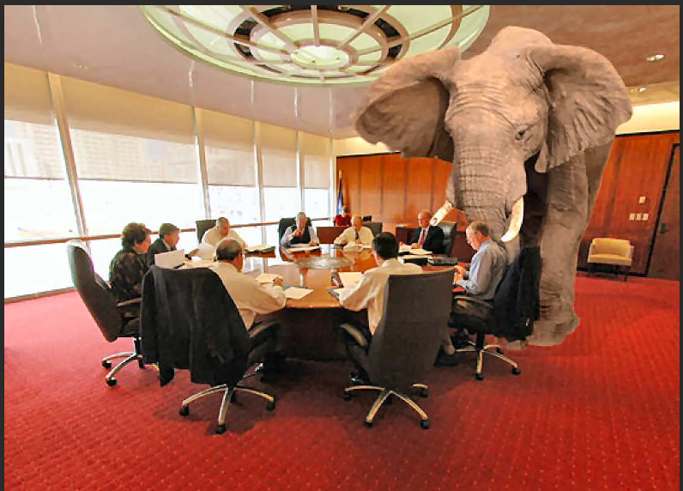
The Big Elephant in the Room -
What is the downtime for the Market?

Slide 19
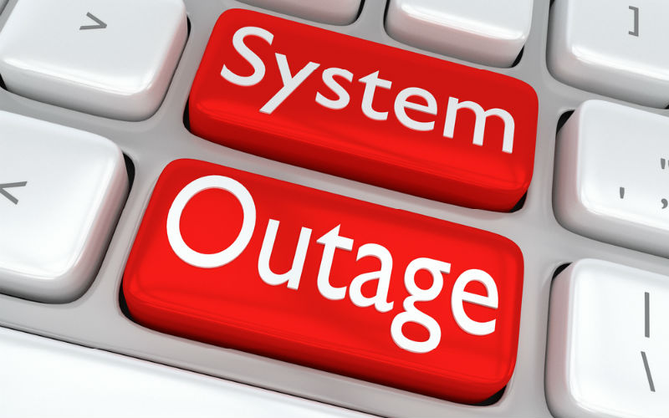
Market downtime - technical go live

Slide 20
Market downtime - Technical go live
  Downtime for Technical Go Live
      Downtime: Friday, October 4th at 10:30 pm
      Go Live: Monday, October 7th at 7:00 am
Technical Go Live - Transactions will not be accepted
Safety Nets MVI’s will not be accepted
Usage Requests - CRIP, CRIP LOA, DEIS, & UHIT
  Message on Home Page
      Unavailable
      Thank you for visiting the CenterPoint Energy web site. The page you requested is not available at this time because we are upgrading our systems in order to serve you better. The page you requested will be available soon. We apologize for any inconvenience this might cause
Notes:
No mvi, emergency - contact call center

Slide 21


Market downtime - Releases 1 and 2

Slide 22
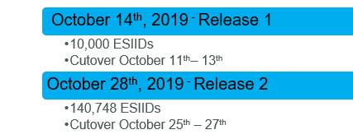
Market Downtime – releases 1 and 2
For Releases 1 and 2:
    Expected downtime to be limited to the weekends only
For Releases 3 – 6, downtime will be provided at a later date

Slide 23
Dual Mode
We will be migrating using a phased approach over multiple months due to multiple releases.
Until we have fully migrated all ESI IDs and CIS processes to SAP we will continue to utilize both the current CIS and new SAP platforms to process market transactions.
Transactions for migrated ESIIDs will contain the SAP changes as previously discussed in prior slides (e.g. rate description, decimal places, reduced billing window)
A list of ESIIDs that are scheduled to be migrated will be provided to each Rep of Record via email. Timelines for that email notification is included later into this presentation.
Notes:
You will see transactions a day earlier for billing ,
Format will be different cis vs sap

Slide 24
Process changes During Migration Timeframes – all releases
  Our transaction processing system will be down during each migration
  We will accept Safety Nets for Move Ins during the migration timeframe on AMS Operational Days for AMS-R premises and on Business Days for AMS-M, Non Standard Metered Services and Unmetered Premises
  NAESB will be up during migration timeframe
  We do not anticipate any delays in the delivery of LSE files (daily AMS data) to Smart Meter Texas (SMT)

Slide 25
Process changes During Migration Timeframes all releases CONT.
  All EDI transactions will be held and processed after the migration is complete
    Switches will work in our systems for the requested date received in the 814_03
  MVIs will work via regular Safety Net process
  All 867_04s will be delayed until Sunday night and 867_03 and 810_02s will generate during Monday night billing.
  However; we will not work other transaction types (MVOs and 650s)
    These should not be sent during the migration timeframe

Slide 26
Market testing
  Test end-to-end transaction processes with ERCOT, CRs, and EDI service providers mid August
  We will closely coordinate our schedule(s) with ERCOT Flight Testing and any other Market activities
Notes:
Already reached and identified the CR’s that will be participating in the Market Test

Slide 27
  MARKET COMMUNICATION PLAN
Regulatory and Business Management will or have visited with PUCT Staff and ERCOT leadership prior to Market testing
Stakeholders will be kept informed throughout the cutover and initial stabilization with Market notices, Market calls, and individual engagement as necessary
Preliminary list of ESIIDs scheduled to be converted to SAP will be provided to Rep of Record(s) a week prior to each migration via email. Please remember that this list will be a snap-shot in time.
Final or a more current list of ESIIDs scheduled to be converted to SAP will be provided to Rep of Record(s) on the day of migration via email
Notes:
If an esiid has a switch pending for 2 weeks, out, will not be in the final converted list, it remain in current system and work complete.

Slide 28
MARKET COMMUNICATION PLAN Cont.
Market Notices
  Market Call(s) information, Schedules and Status of migration
Market Call for Technical Go Live, Releases 1 and 2
  Will be held on Saturday and again on Monday at 10:00am during migration weekend
Designated Mailbox – Direct questions, issues and/or concerns to:
  CISConversionGroup@CenterpointEnergy.com
Notes:
Response - next business day,

Slide 29

Questions

