Slide 1
ERCOT Monthly Interconnection queue trend analysis using Tableau
SAWG Meeting
July 31st, 2019

Slide 2
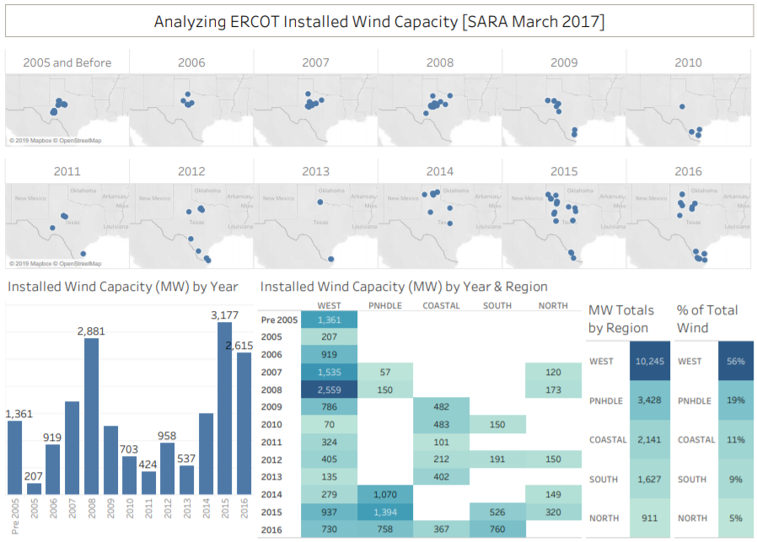
Tableau software
Business intelligence tool focused on data visualization
Ad-hoc analysis (easy to quickly create charts)
Presenting data findings (easy to share analysis through interactive dashboards)
Example of a
Tableau dashboard:
Location of
operational wind
farms and
capacity trends

Slide 3
Interconnection Queue Data Overview
Data is from RIOO-IS (Resource Integration and Ongoing Operations – Interconnection Services)
6 variables from RIOO-IS were used in the analysis
Request Date of Planned Project
Fuel Type
Planned Summer MW Capacity
Application Status
County Location
Projected COD (Commercial Operations Date)

Slide 4
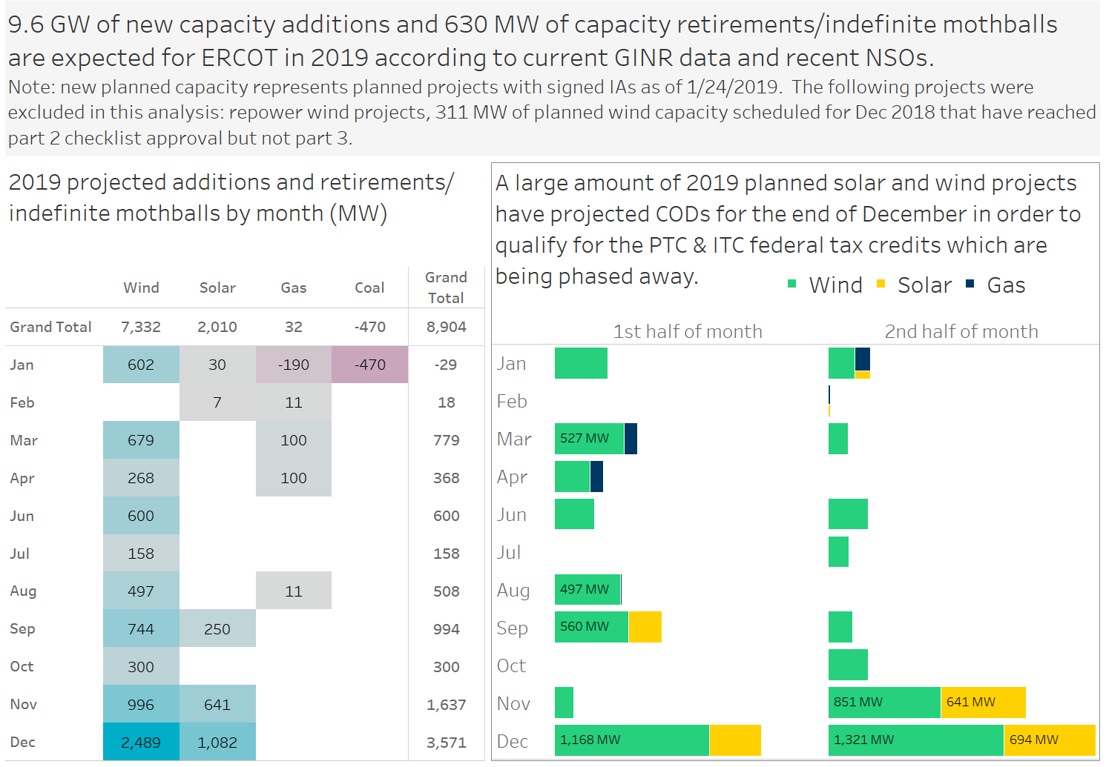
[Analysis 1] 2019 projected additions and retirements

Slide 5
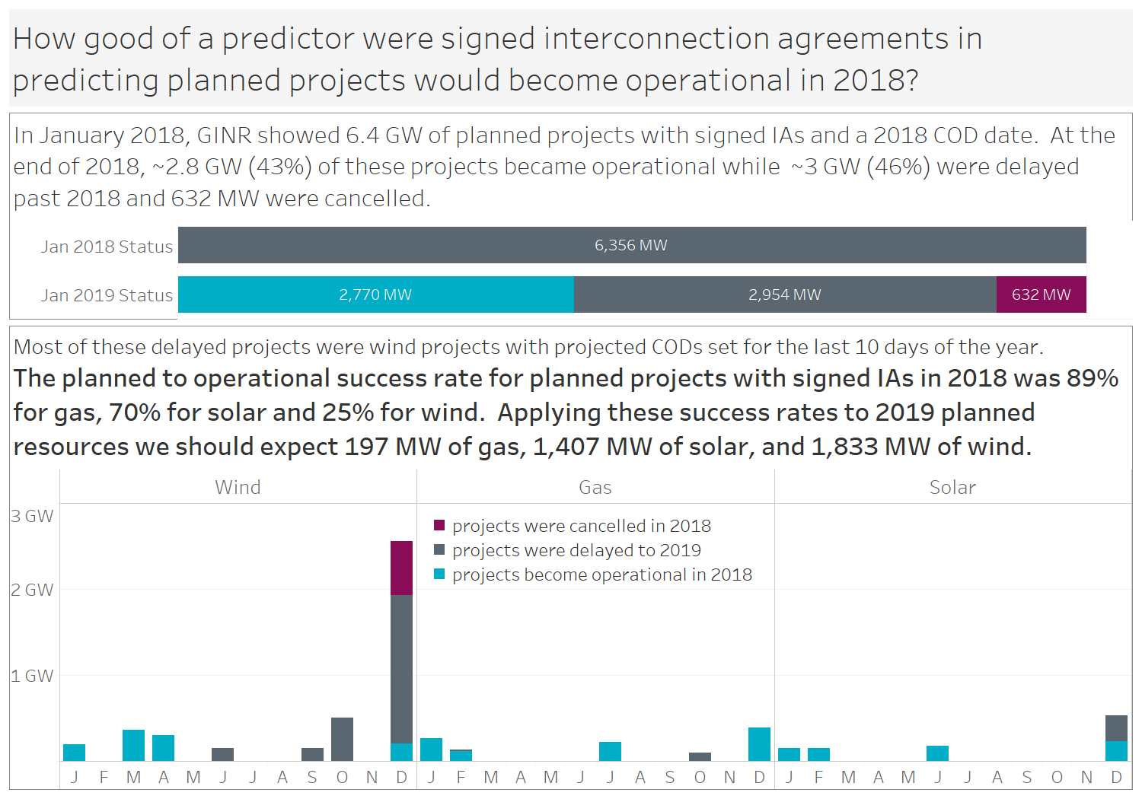
Retrospective analysis of planned projected with 2018 CODs

Slide 6
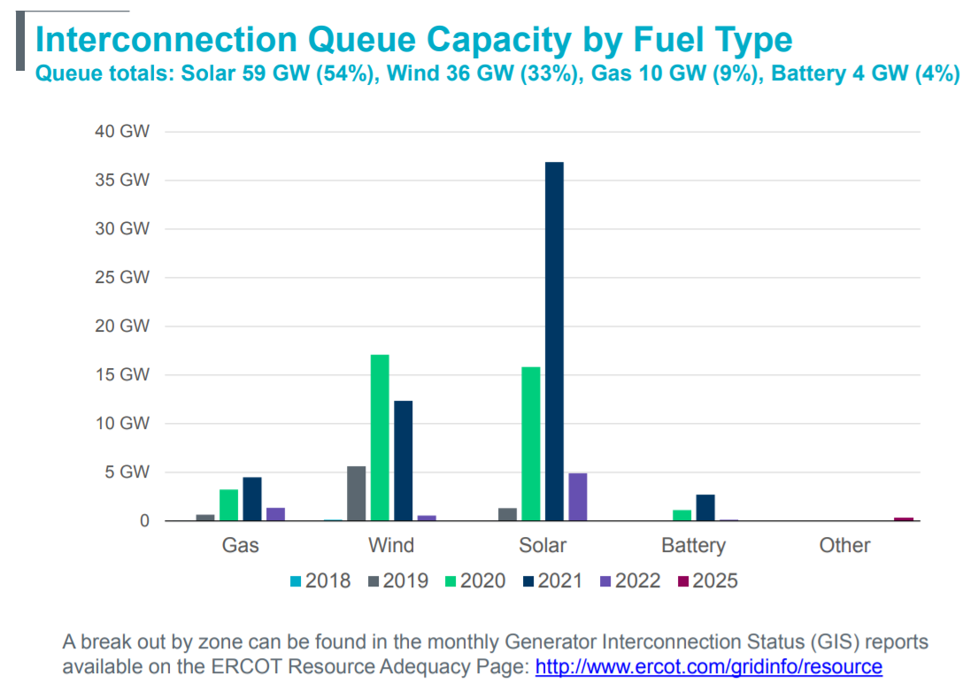
[Analysis 2] Analyzing solar capacity growth in queue
* Chart is from the June 2019 Monthly Operations Report (http://www.ercot.com/committee/board) which used data from the June 2019 GIS report
Notes:
The solar capacity in the queue with a projected COD of 2021 has grown over 35 GW as of the June 2019.

Slide 7
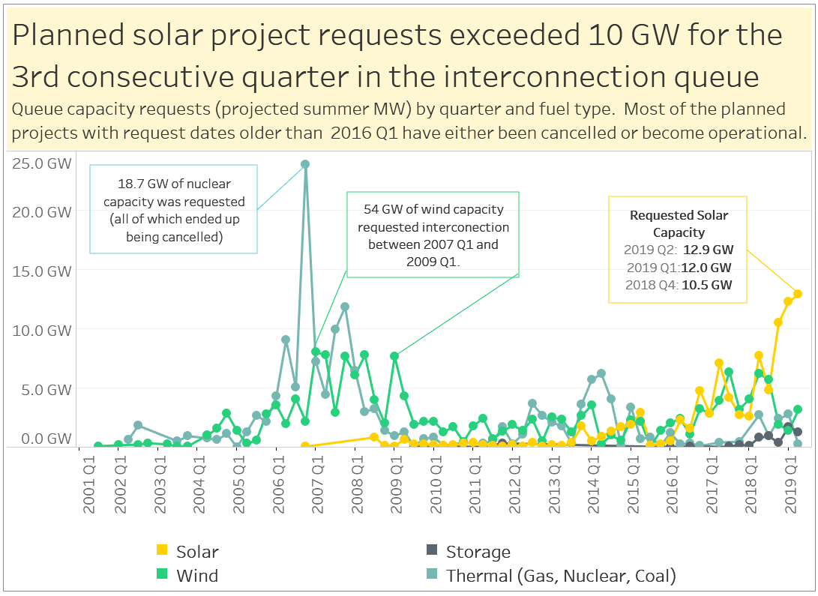

Slide 8
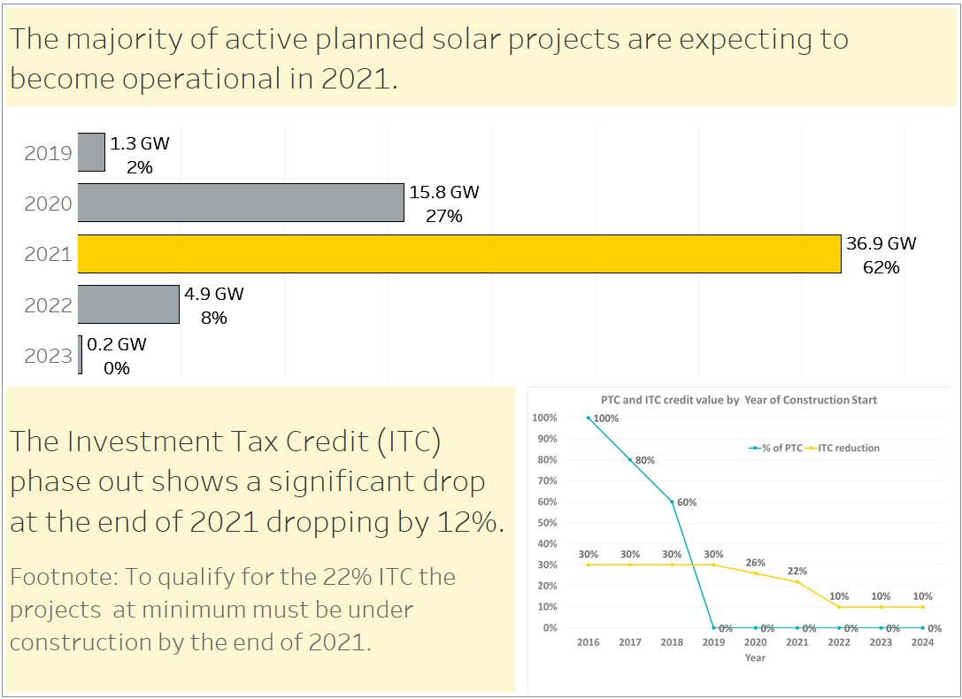

Slide 9
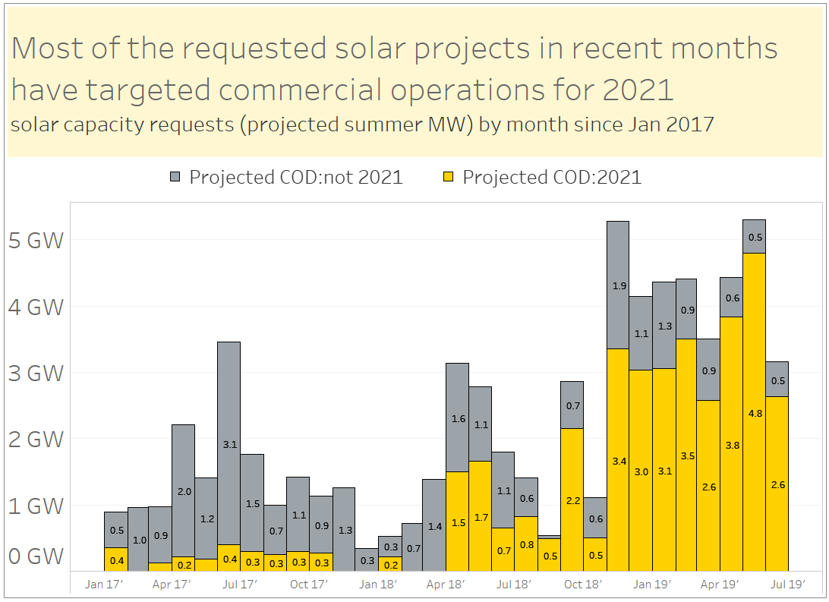

Slide 10
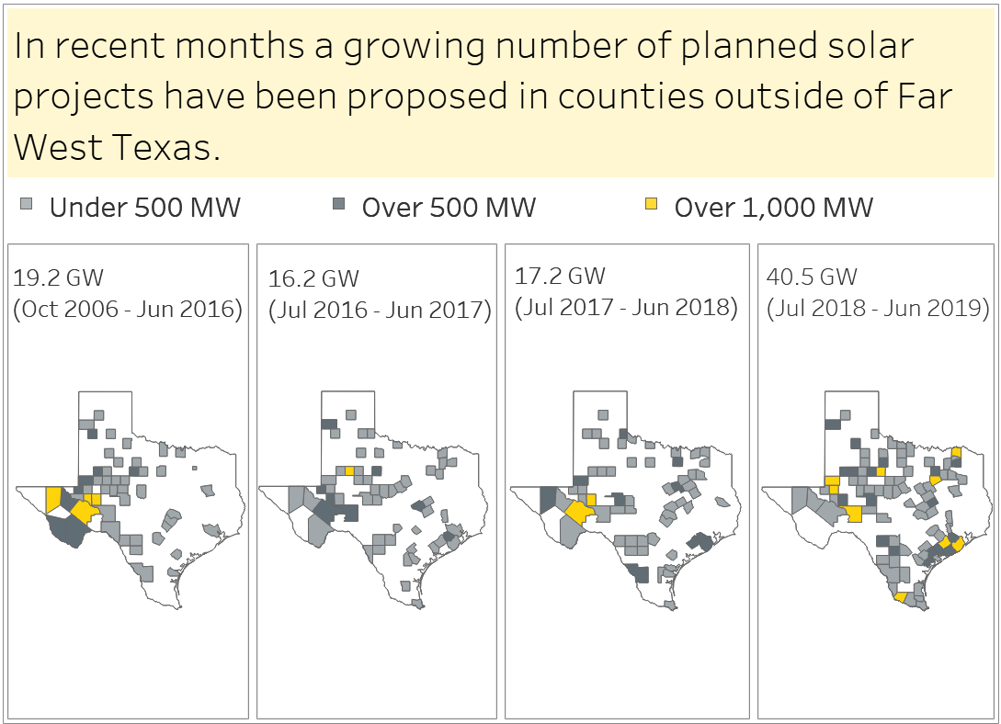

Slide 11
Wrap-up
Brainstorming: Are there other GINR trend analysis topics of interest to explore using Tableau or other data exploration tools?
Send your ideas to Dan Mantena, dan.Mantena@ercot.com

