Slide 1
Credit Exposure Update
Spoorthy Papudesi
Credit Work Group
ERCOT Public
July 25, 2019

Slide 2
Monthly Highlights May 2019- Jun 2019
Market-wide average TPE increased from $324.0 million to $372.7 million
  The increase in TPE is due to higher Forward Adjustment Factors in June
Discretionary Collateral is defined as Secured Collateral in excess of TPE,CRR Locked ACL and DAM Exposure.
  Average Discretionary Collateral increased from $ 870.7 million to $1,164.9 million
  The increase in Discretionary Collateral is largely due to increase in Secured Collateral and decrease in the number of auction lock days in June compared to May
Number of active Counter-Parties increased from 239 to 243
No unusual collateral call activity

Slide 3
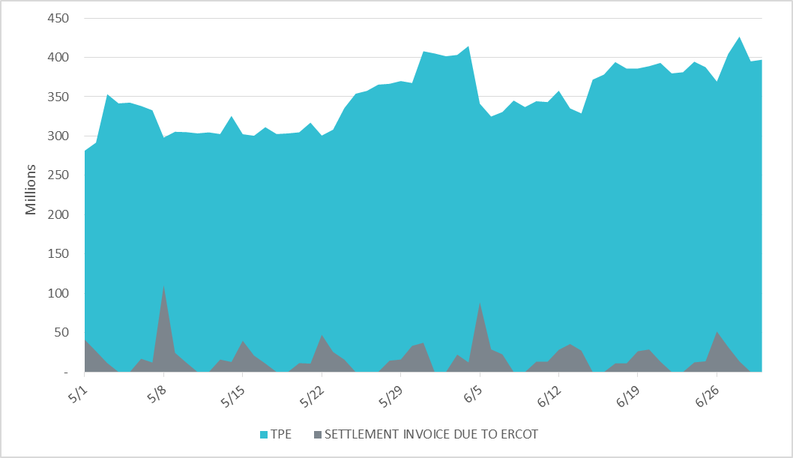
Settlement Invoice Charges/TPE May 2019- Jun 2019

Slide 4
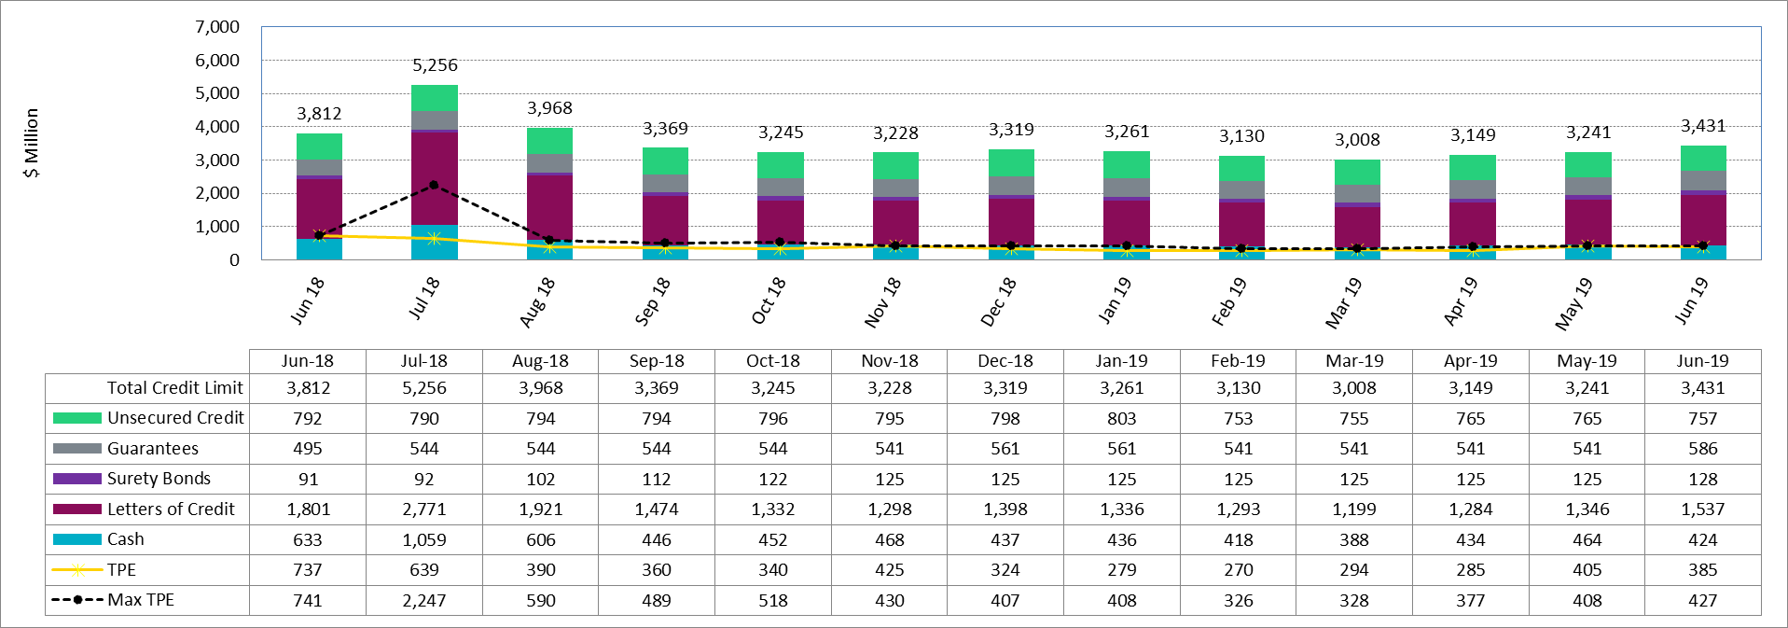
Available Credit by Type Compared to Total Potential Exposure (TPE)
*Numbers are as of month end except for Max TPE

Slide 5
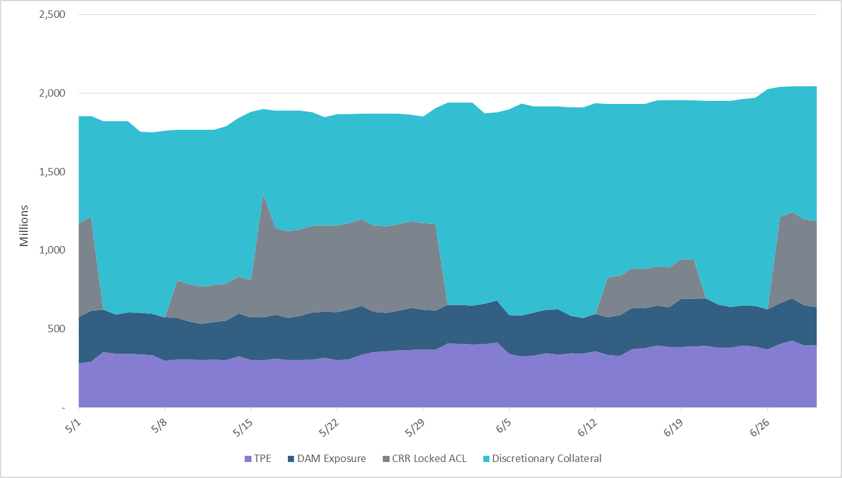
Discretionary Collateral May 2019- Jun 2019
At a Counter-Party level, no unusual changes were noted
Note: Discretionary collateral doesn’t include Unsecured Credit Limit or parent guarantees

Slide 6
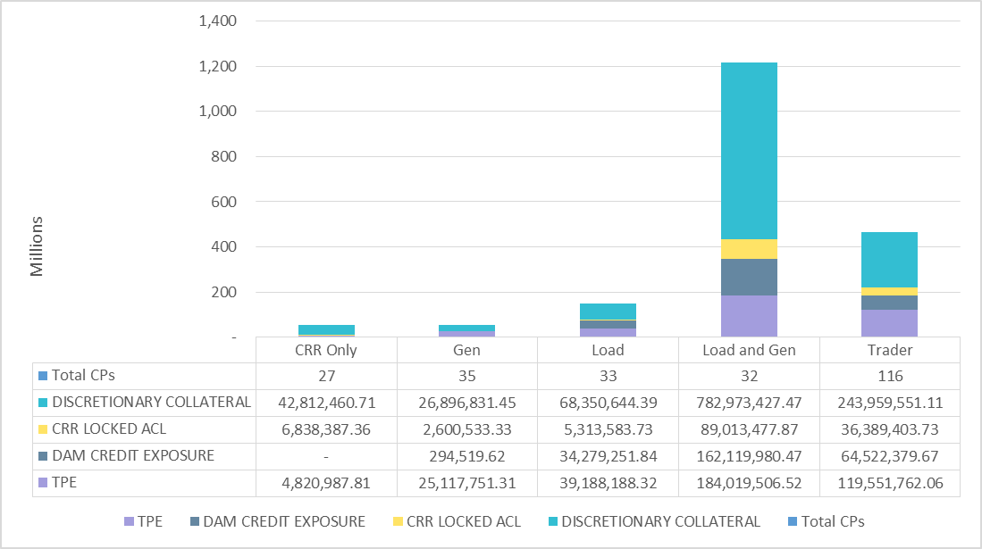
TPE and Discretionary Collateral by Market Segment- Jun 2019
Load and Generation entities accounted for the largest portion of discretionary collateral

Slide 7
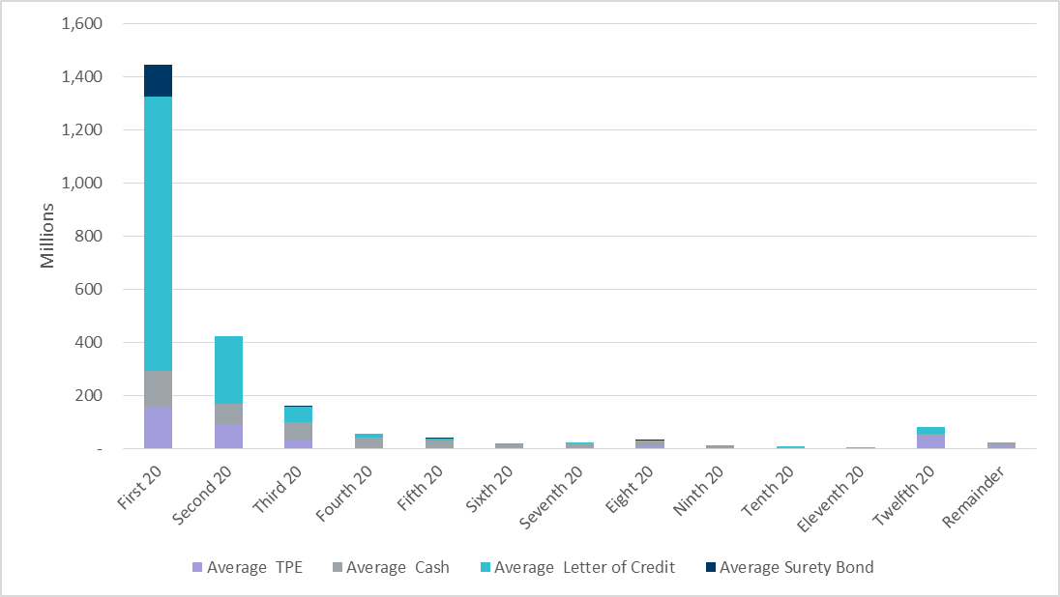
Secured Collateral distribution/ TPE- Jun 2019
Posting of discretionary collateral is relatively concentrated.
Secured Collateral: Letter of Credit, Surety Bond or Cash

Slide 8
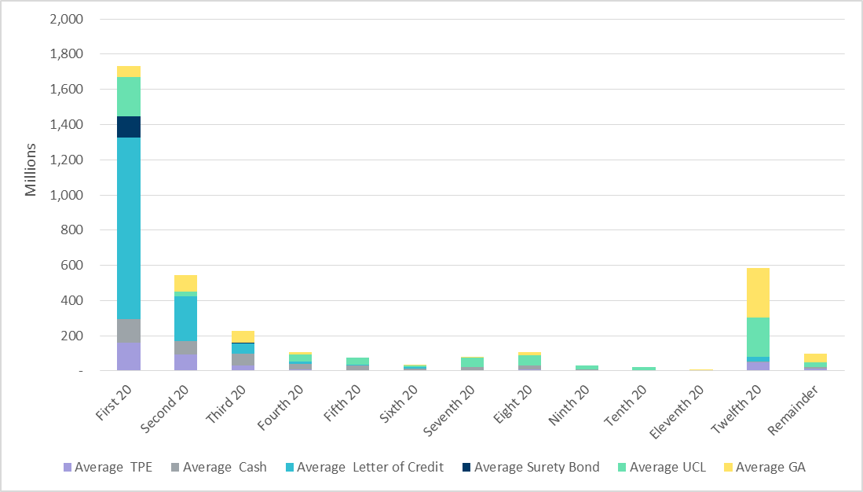
Secured Collateral and Unsecured Credit Limit (UCL) distribution/ TPE- Jun 2019
TPE in the last bucket is mostly covered by Guarantees and UCL

Slide 9
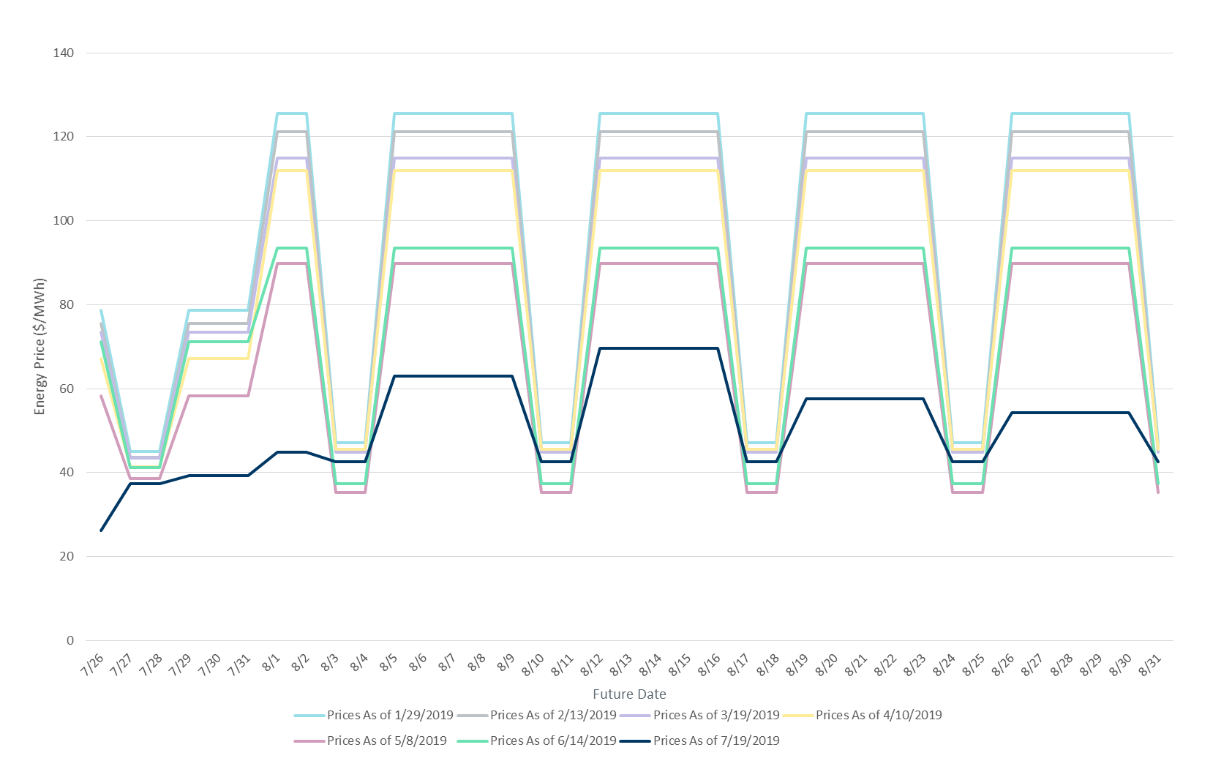
ICE Daily Average Prices April-August 2019
*Daily Average Price = (Peak price*16 +Off-Peak price*8)/24

Slide 10
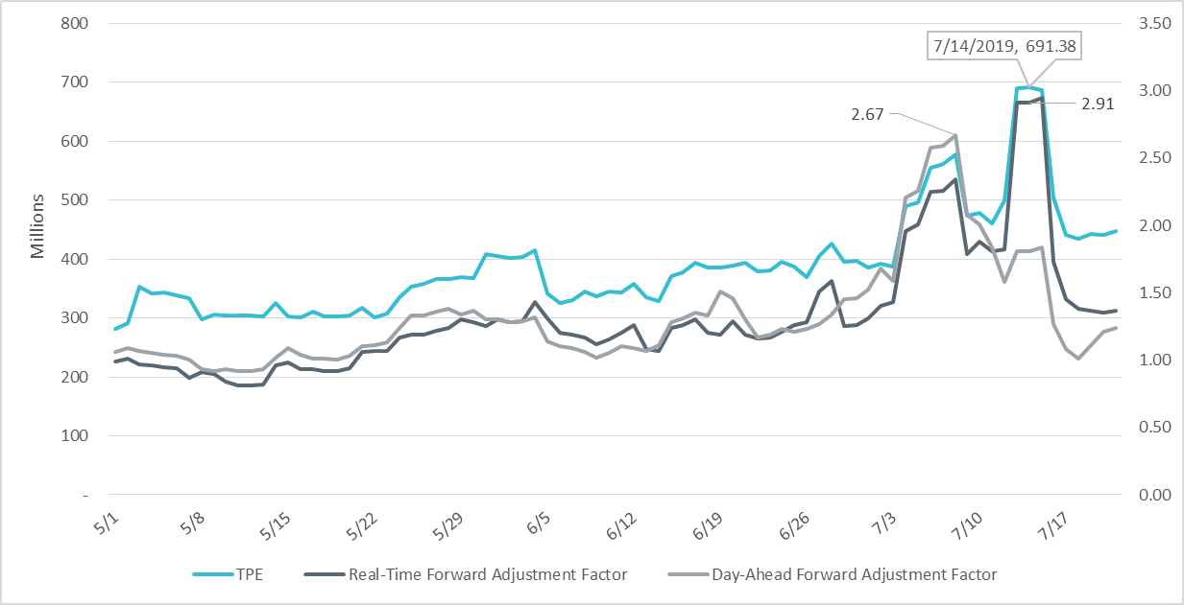
TPE and Forward Adjustment Factors May 2019- Jun 2019
TPE moved in conjunction with forward adjustment factors
The Real-Time (RFAF) and Day-Ahead (DFAF) forward adjustment factors capture the ratio of forward ERCOT North prices to actual prices.

Slide 11
Appendix

Slide 12
Summary of Distribution by Market Segment

Slide 13
Summary of Distribution by Rating Group

Slide 14
Distribution of TPE by Rating and Category

Slide 15
Distribution of Excess Collateral by Rating and Category
Note: Excess collateral doesn’t include Unsecured Credit Limit

Slide 16
Bottom Quintile Distribution of Excess Collateral by Rating and Category

Slide 17
Bottom Quintile Distribution of Average TPE by Rating and Category

Slide 18
Questions

