Slide 1
MSWG
WMS Updates, RTASRESP and FQ, NPRR947 Assignment
July 23, 2019

Slide 2
7/10/2019 WMS meeting takeaways
NPRR 930 – Too many changes for a productive Settlement discussion at this time.
Will we need a determinant for the OSA costs submitted by Dispute Process?
Workshop WebEx 7/25/2019 3-5pm
Battery Energy Storage (still no assignments) but emerging issues, such as limited duration
New NPRR with Settlement Impacts:
NPRR 957 RTF-4 Create Definition and Terms for Energy Storage

Slide 3
RTC Update (7/12/2019 Meeting)
Key Principle 1.6 AS Imbalance Settlement will change
MP Agreement that AS will be awarded in RT and ORDC process removed
Additional principles to be considered concerning:
No new uplift
Unique imbalance calcs by AS service type
15-min, non-zero AS imbalance charged on LRS
(if amount cleared in DAM + trades = RTM Award, then 0*LRS)
Simplified obligation (no portfolio self-arrangement) RTM LRS * RTM AS Awards

Slide 4
RTC Update (7/12/2019 Meeting)
Key Principle 3 RUC w/Awards in RT
Revenues from RTAS Awards will offset RUC Guarantee in RUCMWAMT
Revenues from RTAS Awards will be included in RUCCBAMT
RUCCSAMT will extend to AS capability as well as energy capacity, allocating a portion of RUCMWAMT to QSEs:
Short overall in energy + RTASRESP
RTASRESP > AS Capability
AS capability based on AS Offers vs COP (snapshot)

Slide 5
WMS Assignment: NPRR947, Clarification to Ancillary Service Supply Responsibility Definition and Improvements to Determining and Charging for Ancillary Service Failed Quantities
Foundation work
Understand Ancillary Service definitions as currently written in Protocol
Understand calculation of RTASRESP
Shadowing RTASRESP
Determination of Failed Quantities (FQ)
Use in calculating (FQ)
Shadow calculation of FQ
Use in NSFQAMT, RDFQAMT, RRFQAMT and RUFQAMT
Initial reading of NPRR947

Slide 6
Assignment: NPRR947 Charges Impacted: AS Failure Charges and RTAISIAMT
6.4.9.1.3 (1) . . A QSE is considered to have failed on its Ancillary Services Supply Responsibility when ERCOT determines, in its sole discretion, that some or all of the QSE’s Resource-specific Ancillary Service capacity will not be available in Real-Time.
A prospective determination based on COP, telemetry, Schedule, LASL/HASL or combination? How do we shadow?
Is the same RTASRESP from MMS used in RTAISAMT and in the determination of Failed Qty?
When exactly is failure determined?
How does ERCOT notify the short QSE?
Describe process when ERCOT decides not to conduct a SASM to replace?
6.4.9.2.3 Communication of SASM results provides award info only or does ERCOT also inform QSEs of FQs?
A QSE is considered to have failed on its Ancillary Services Supply Responsibility when ERCOT determines, in its sole discretion, that some or all of the QSE’s Resource-specific Ancillary Service capacity will not be available, or was not available, in Real-Time.
If determined retrospectively, are all the inputs the same?

Slide 7
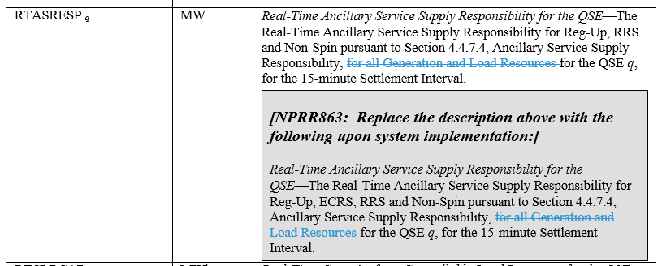
Assignment: NPRR947 Charges Impacted: AS Failure Charges and RTAISIAMT

Slide 8
Assignment: NPRR947 Charges Impacted: AS Failure Charges and RTAISIAMT
Matrix:
RRDFQ | Reconfiguration Reg-Down Failure Quantity per QSE—QSE q’s total capacity associated with reconfiguration reductions on its Ancillary Service Supply Responsibility for Reg-Down, for the hour. | MMS
RRFQ | Responsive Reserve Failure Quantity per QSE—QSE Q’s total capacity associated with failures on its Ancillary Service Supply Responsibility for Responsive Reserve, for the hour. | MMS
Definition:
Ancillary Service Supply Responsibility - The net amount of Ancillary Service capacity that a QSE is obligated to deliver to ERCOT, by hour and service type, from Resources represented by the QSE.
RTARESP is the only Responsibility determinant delivered in extracts. It is a total of all AS Service Types for the QSE. There are no Resource-level or Service Type intermediate determinants to aggregate or to verify with telemetry.

Slide 9
Next MSWG meeting August 26, 2019

